Slide 1
PIE Planning & Resources
Where We Make an Impact – Closing the Loop

Slide 2
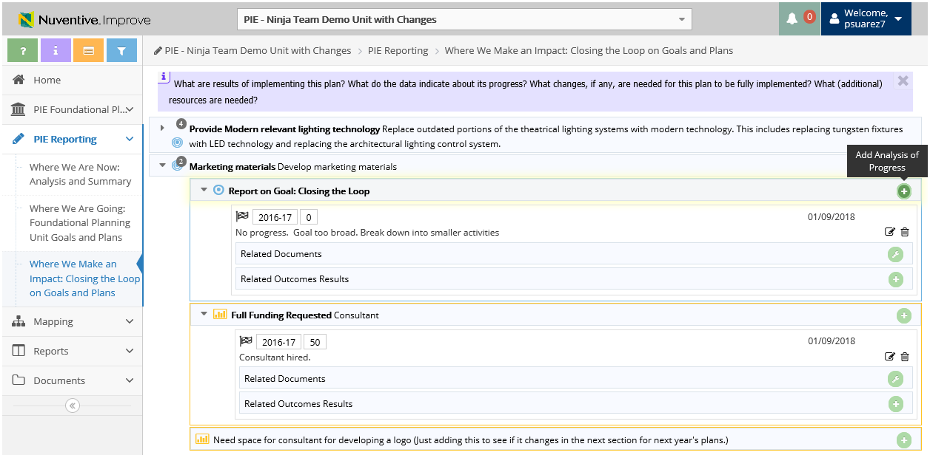
3. Where We Make an Impact – Add Analysis of Progress on Goals
1. Click to View Unit Goals
3. Click to Add Analysis of Progress
2. View Goals (blue) or Resources (orange)

Slide 3
3. Where We Make an Impact – Add Analysis of Progress on Goals and Resources
Analysis of Progress will display for preceding Reporting Years (if applicable)
*Give an update on Goals and Resources from 2017-18 using the Reporting Year 2018-19*

Slide 4
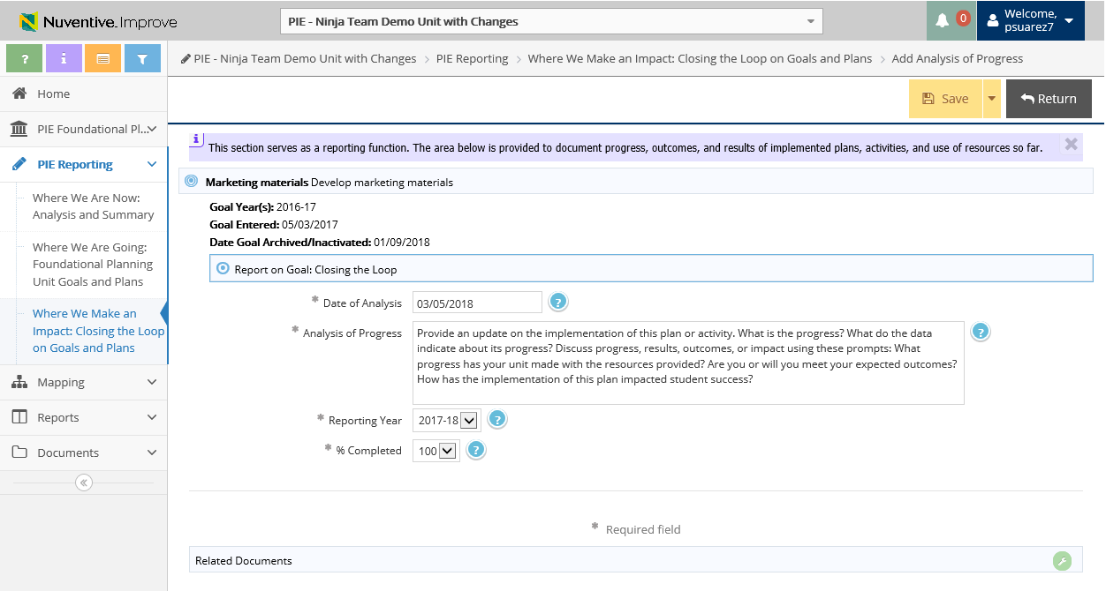
3. Where We Make an Impact – Add Analysis of Progress on Goals
4. Enter Analysis of Progress
7. Make sure to Save and Return
5. Ensure Reporting Year is 2018-19
*Give an update on Goals and Resources from 2017-18 using the Reporting Year 2018-19*
6. Select what % of Goal is completed

Slide 5
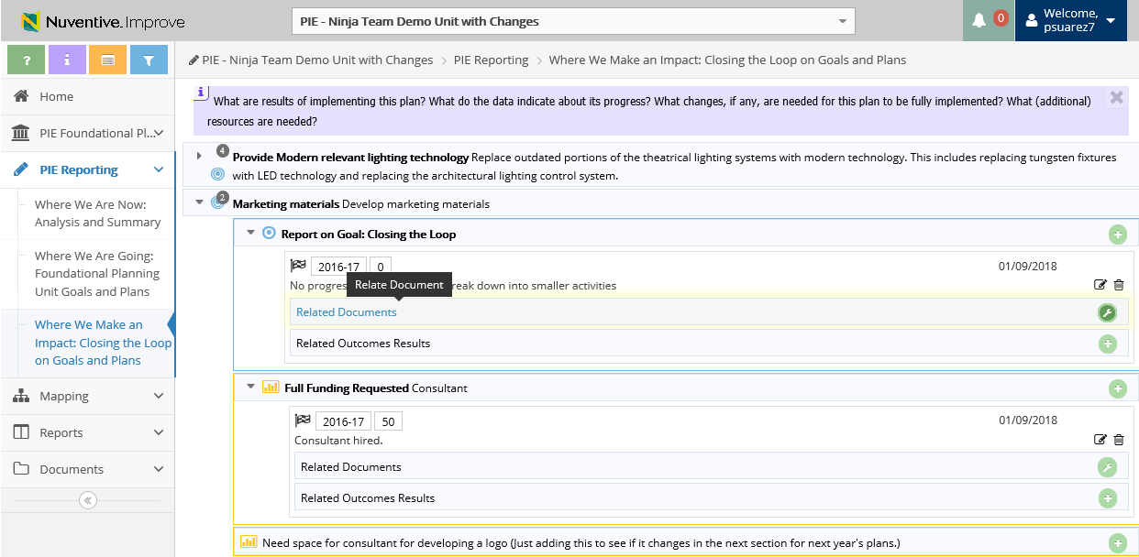
3. Where We Make an Impact – View & Add Related Documents
1. Click to Add Related Documents

Slide 6
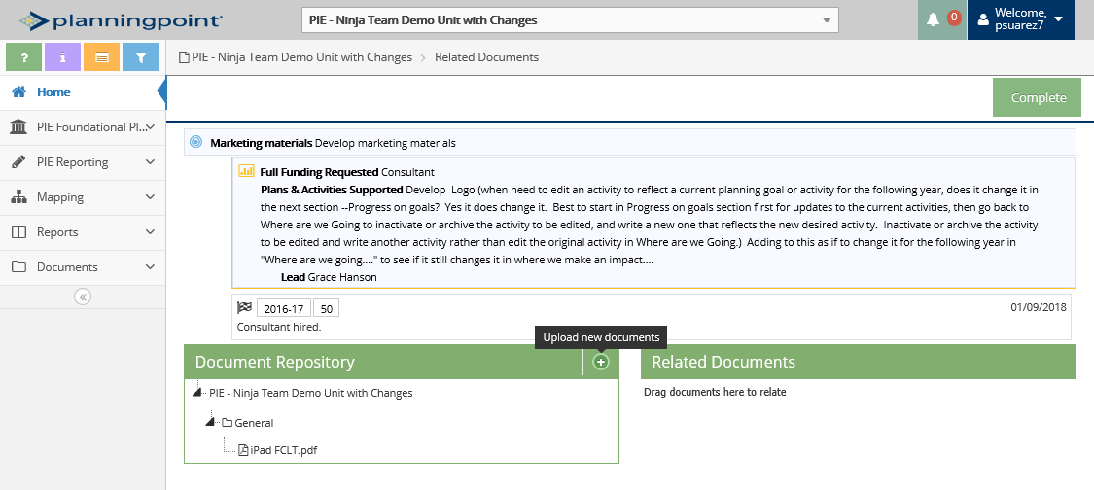
3. Where We Make an Impact – View & Add Related Documents
3. Click to View Document Repository
2. Click to Upload new documents

Slide 7
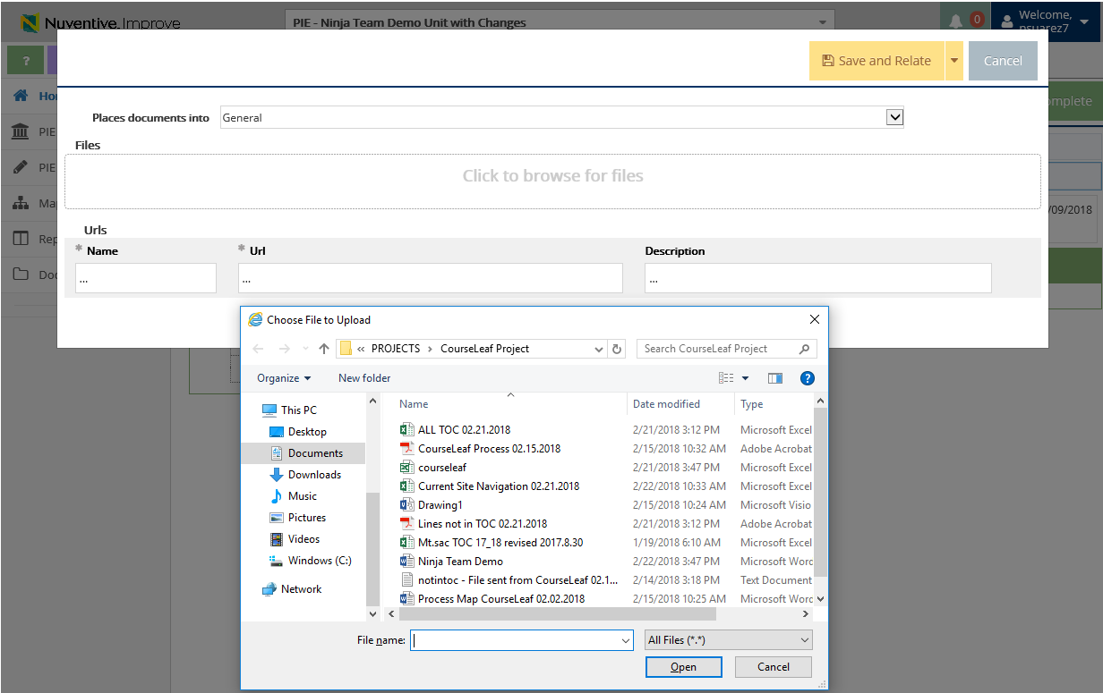
2. Where We Are Going – Uploading Documents to Resources
3. Where We Make an Impact –View & Add Related Documents
Document Retrieval Screen will display
4. Select Location to place uploaded documents to
5. Click to browse and add files on your computer
6. Select File and Select Open

Slide 8
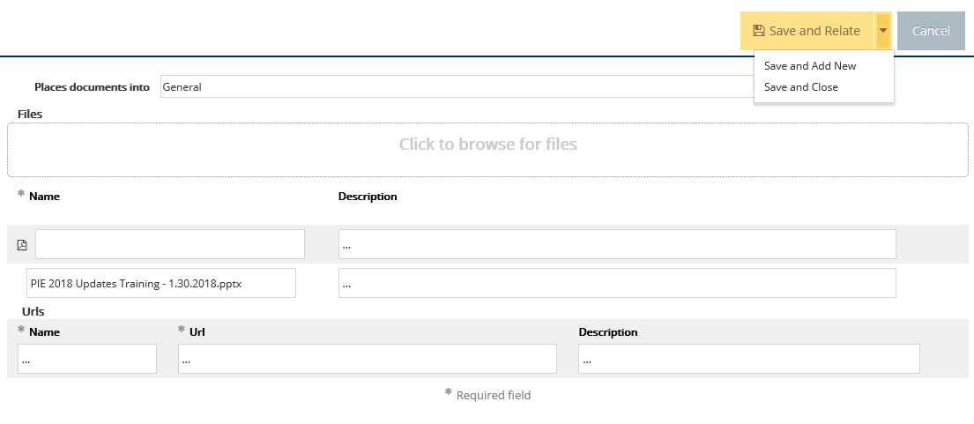
2. Where We Are Going – Uploading Documents to Resources
3. Where We Make an Impact –View & Add Related Documents
7. Select Save and Relate
Save and Add New: saves the document and stays on this screen to keep adding more documents
Save and Close: saves the document and returns to previous screen

Slide 9
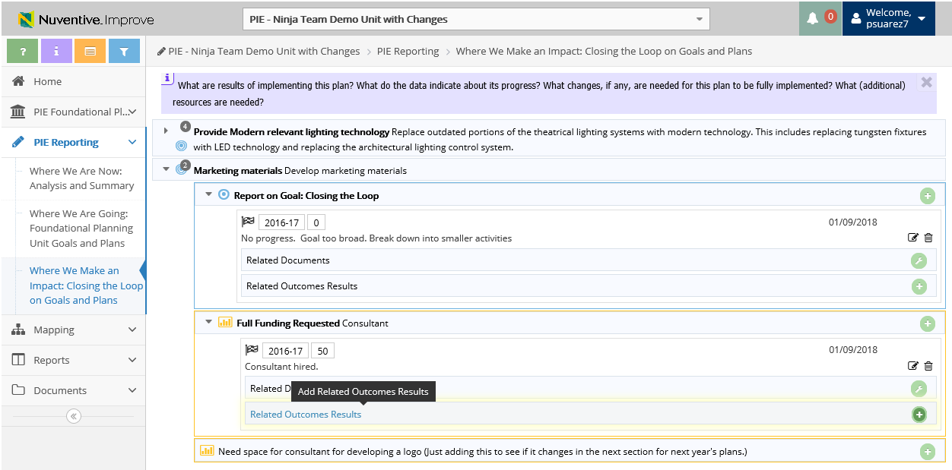
3. Where We Make an Impact – Related Outcomes Results
1. Click to Add Related Outcomes Results

Slide 10
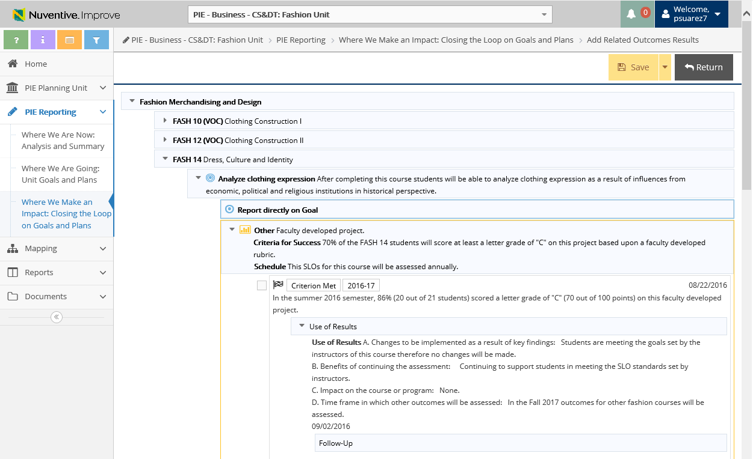
3. Where We Make an Impact – Related Outcomes Results
4. Don’t forget to Save and Return
2. Select drop down arrow to expand and view and report on Goal
3. Place check mark to tie in with SLO (will be added to Goal)

Slide 11
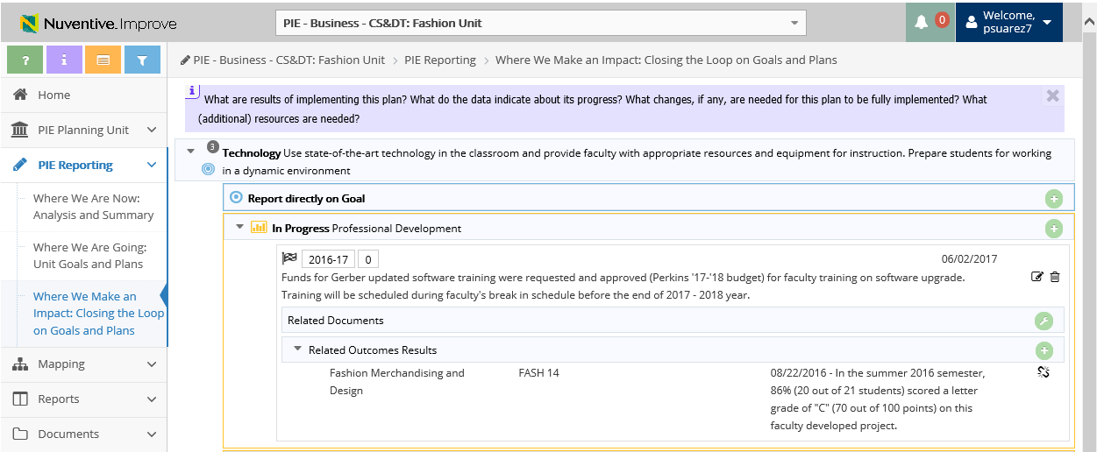
3. Where We Make an Impact – Related Outcomes Results
You are able to un-relate summary of data by selecting this icon
Related Outcome(s) will display

