Slide 1
PIE Planning & Resources
Quality PIE

Slide 2
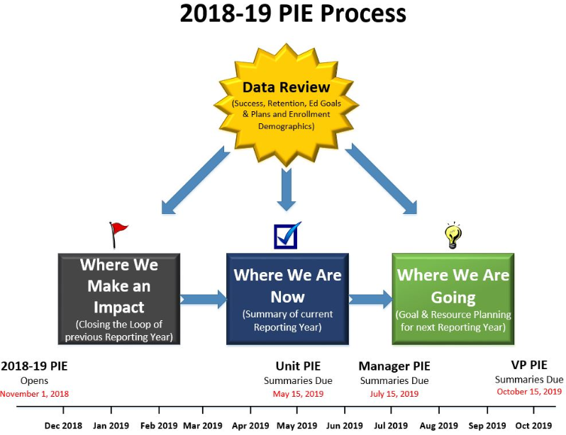
PIE Process – Overview

Slide 3
Accessing PIE – Login
1. www.mtsac.edu/pie
2. Click to access PIE

Slide 4
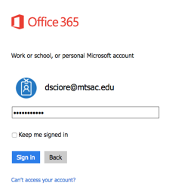
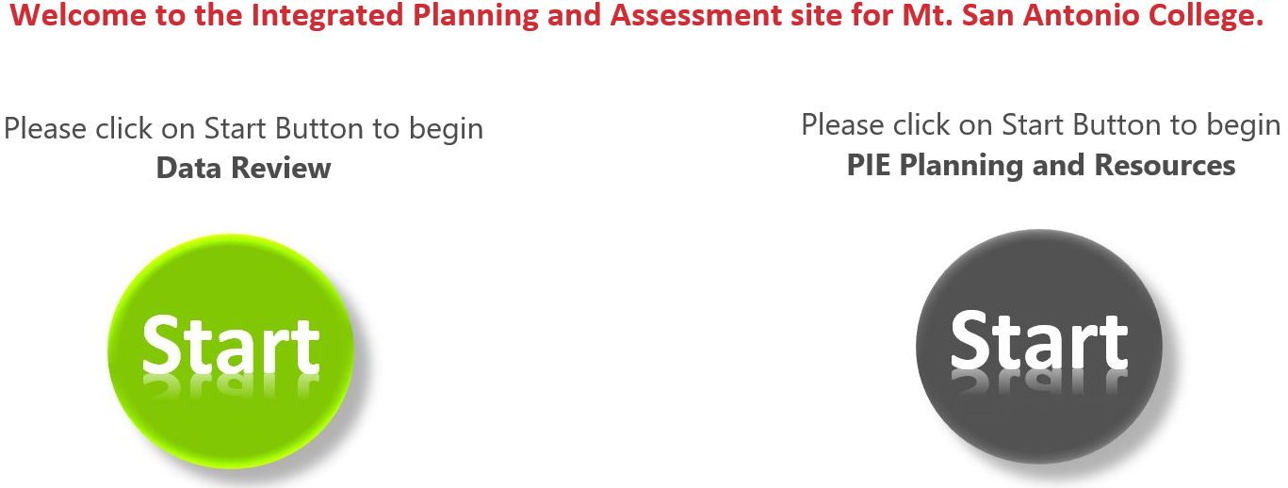
Accessing PIE – Login
After clicking on “Go to PIE” use your Mt. SAC credentials to access the SharePoint interface that houses PIE to begin the process.
3. Use portal user name &
password to login.
4. Click on the gray Start Button to begin PIE Planning and Resources.

Slide 5
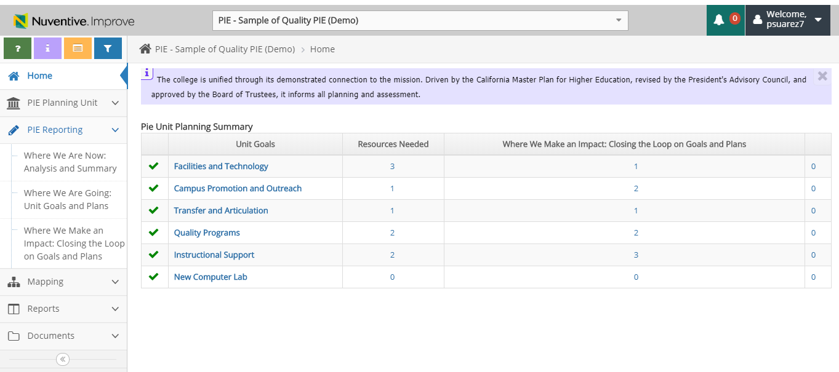
Evaluating Totals – Summary
Home Screen will display a total number of Unit Goals, Resources and Analysis of Progress.

Slide 6
Evaluating Unit Goals – College Goals
Mt. SAC has 5 college goals.
Keep this in mind when writing your over-arching goals in PIE.

Slide 7
PIE Planning & Resources
Closing the Loop

Slide 8
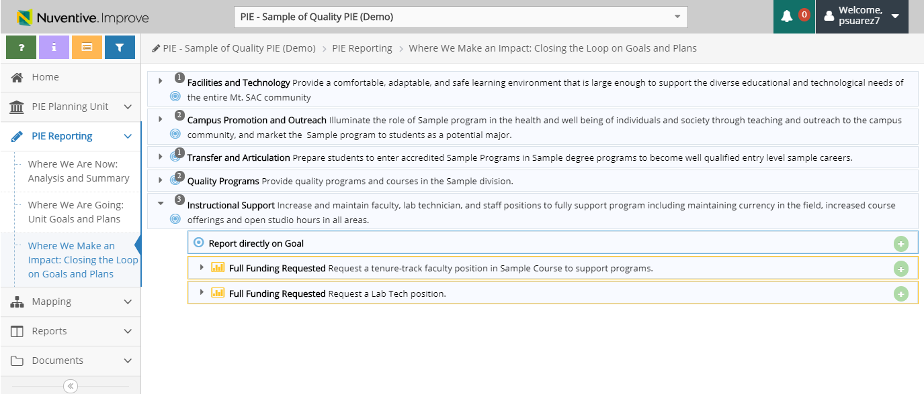
Closing the Loop – Quality Analysis of Progress
Questions to ask:
What are results of implementing this plan?
What does the data indicate about its progress?
What changes, if any, are needed for this plan to be fully implemented?
What (additional) resources are needed?
You can provide an analysis of progress on Unit Goals for a reporting year as well as any Resource Requested.

Slide 9
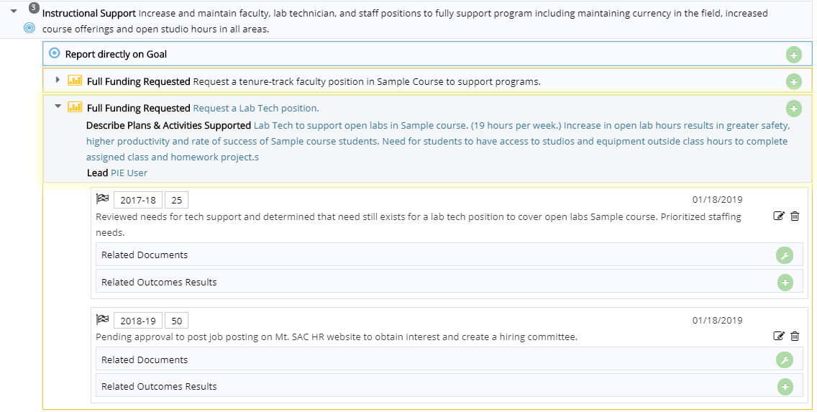
Closing the Loop – Reporting Year
Previous entries will display and show progress of Unit Goals or Resources Requested, similar to a journal entry.
Example:

Slide 10
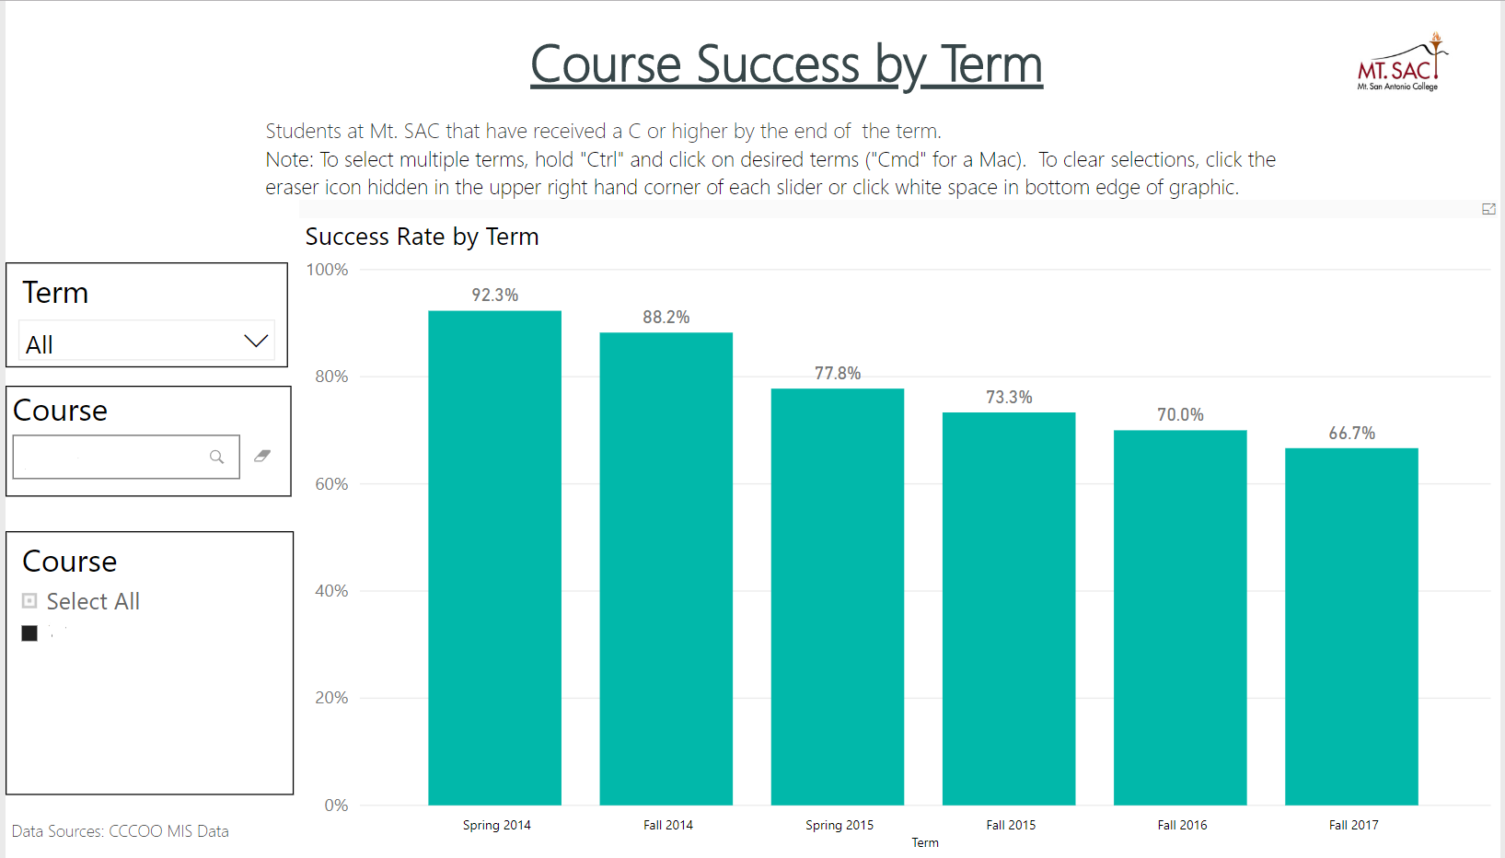
Closing the Loop – Using Data for Unit Goal Planning and Resources
You may be tempted to say, “Oh no! My course’s success rate is dropping! I NEED RESOURCES!”
Power BI dashboards provide you with several data points about your program. As you tell your program's story, what other information is important to consider? Advisory Committee input? State/Federal requirements? Other data sources?

Slide 11
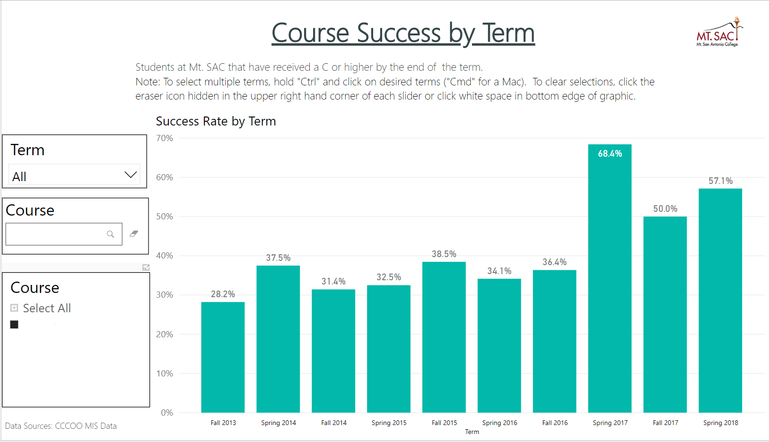
Closing the Loop – Using Data for Unit Goal Planning and Resources
Again, you may be tempted to say, “Alright! My course’s success rate is climbing! I closed my loop!”
PIECE OF THE PIE.
Could the rates be attributed to student count, intervention, or another variable?
Further research is needed to evaluate CAUSAL relationships.

Slide 12
Using Data for Unit Goal Planning and Resources
What are your initial thoughts on the data?
What might be contributing to student success in your program?
What might be detracting student success in your program?
Is this the data we need to make a decision? Why or why not?
What is the most important information?
What is missing?
GOAL
Data-informed requests, decisions, and follow-up (close loop)

Slide 13
Data Review
We appreciate your feedback! Take note of the Credit and Noncredit data menus. More dashboards (flavors of PIE data) to come!

Slide 14
PIE Planning & Resources
Where We Are Now

Slide 15
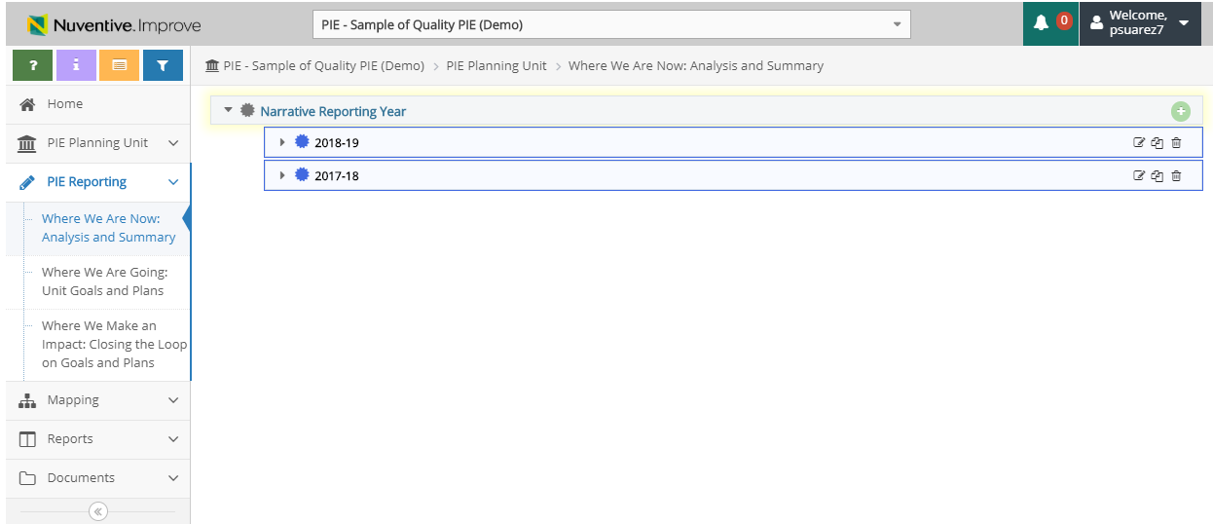
Narrative Reporting Year
Unit PIE authors should enter a new narrative for every reporting year.
The Reporting Years will display as follows with the content provided by the Unit PIE authors.

Slide 16
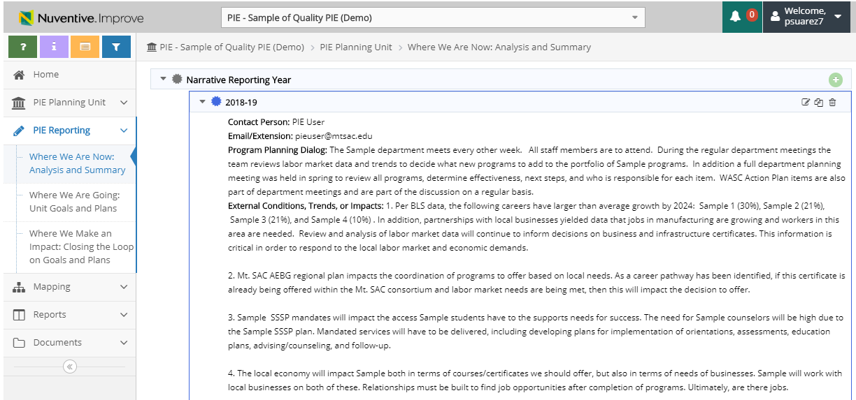
Narrative Reporting Year
A stand-alone section of PIE that allows for documentation of conditions and trends that are informing your planning. Additionally, this is where you can add Internal and External Conditions, Critical Decisions, and Notable Achievements.

Slide 17
PIE Planning & Resources
Where We Are Going – Goals and Resources

Slide 18
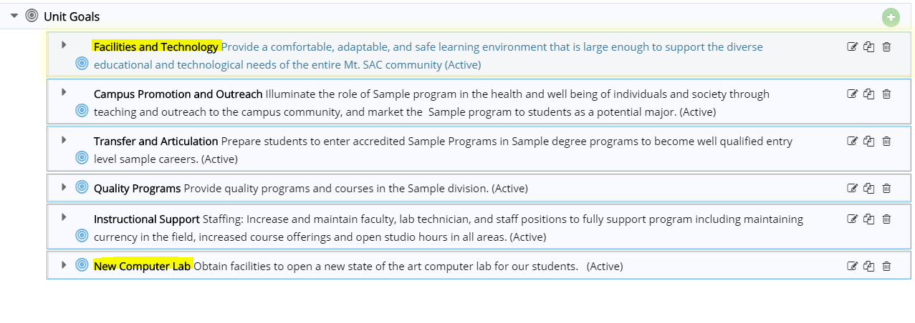
Unit Goals – What are Quality Goals?
Quality Goals can be classified as “over-arching” goals that are not specific plans or activities, but a more general categorization of the drivers of your Unit's work.
Example:
Recommend evaluating all current goals and look for ways to synchronize from various Unit Goals to one.

Slide 19
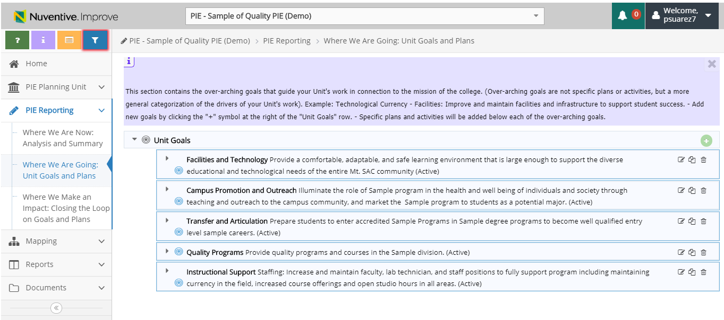
Unit Goals – What are Quality Goals?
Unit Goals should be entered as over-arching goals. If more than 5 goals are entered, re-evaluate all of your goals to see if Unit Goals can be revised and simplified.
*Quality not Quantity*

Slide 20
Unit Goals – What are Quality Goals?
Unit Goal Name: Name of Over-arching Goal
Unit Goal: Description of Over-arching Goal
Goal Year: The current Goal Year must be selected. Multiple Goal Years can be selected as needed.

Slide 21
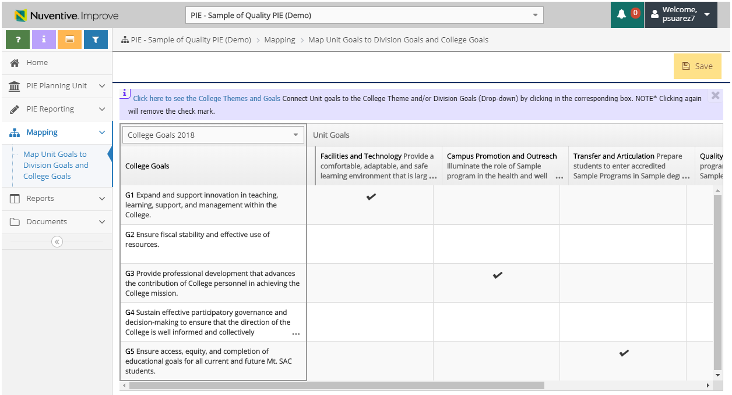
Evaluating Unit Goals – College Goals
You will need to tie your PIE Unit Goals to the College Goals.

Slide 22
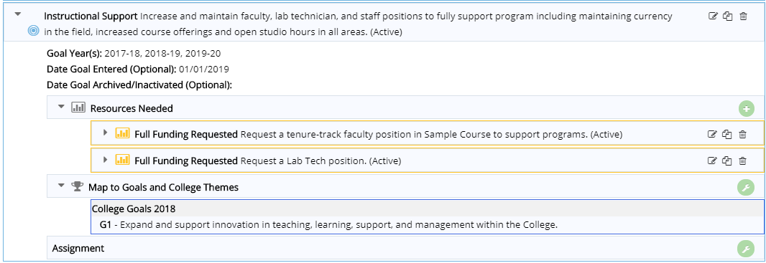
Unit Goals – What are Quality Goals?
Questions to ask:
What is your main objective for the Unit Goal?
Is this a single- or multiple-year Unit Goal?
What Unit Goals are already in progress?
Example:

Slide 23
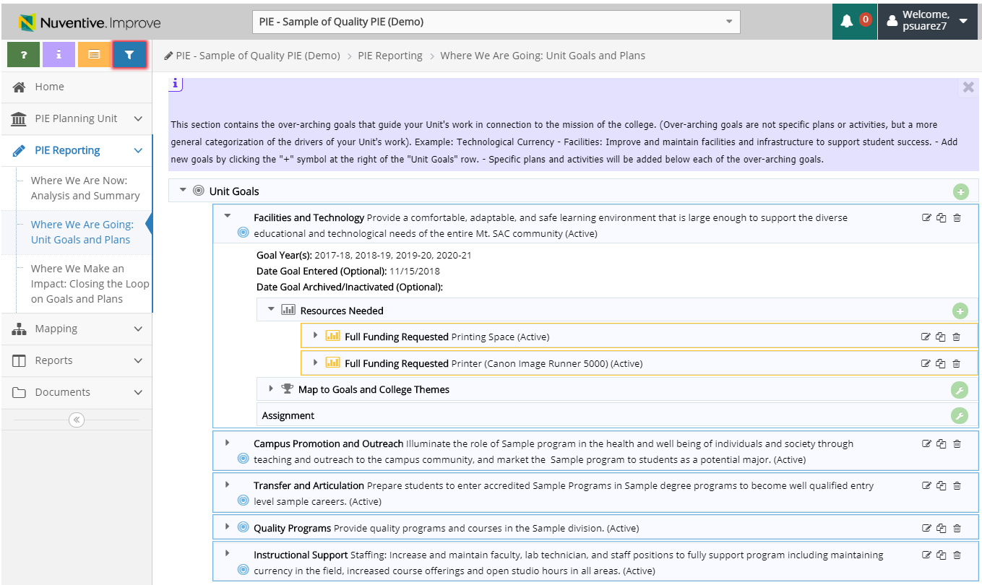
Resources Requested – What are Quality Resources?
Number of Resources Needed
Recommended number of Resources: As many as necessary to achieve your Unit Goal.

Slide 24
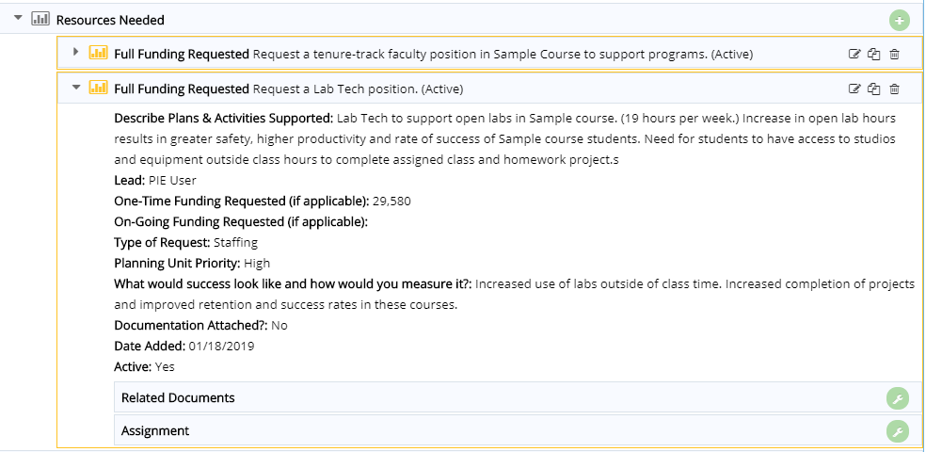
Resources Requested – Plans & Activities Supported
Questions to ask:
What plans and activities will this resource be used for?
Have you used available resources such as the Excel staffing estimate file or consulted with experts on quotes, estimates etc.?
Can Resources to support one goal be combined under 1 Type of Request category?
Example:
Detail specifically how this Requested Resource will support the Unit Goal and contribute to the College Goals.

Slide 25
Resources Requested – Type of Request
Mt. SAC simplified the process of viewing Resources Requested by using a filter option menu.
Example:
Select the correct option to ensure that Resources are categorized appropriately.

Slide 26
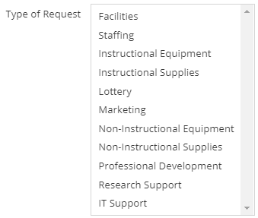
Resources Requested – Type of Request
Facilities – items to be referred to Facilities for assistance
Staffing – new employees/increase to existing employees, hourly, etc.
Instructional Equipment – items more than $500 that qualify for ‘instructional’ pot of $
Instructional Supplies – items less than $500 that qualify for ‘instructional’ pot of $
Lottery – items that meet the definition of State Lottery funding
Marketing – items to be referred to the Marketing office for assistance
Non-instructional equipment – items more than $500 that do NOT qualify for the ‘instructional’ pot of $
Non-instructional supplies – items less than $500 that do NOT qualify for the ‘instructional’ pot of $
Professional Development – items to be referred to POD for assistance
Research Support – items to be referred to Research for assistance
IT support – items to be referred to IT for assistance
Select one Type of Request

Slide 27
Resources Requested – How to Measure Success
How will you identify the level of success for this plan or activity? Criteria for Success should be measurable.
Example:

Slide 28
Access to Sample Quality PIE
Drop down to access
‘PIE – Sample of Quality PIE’

Slide 29
What to do for Quality PIE
Do: Write well articulated content with supporting data, documentation etc.
Do: Utilize data for closing the loop and justification of resources requested.
Do: Collaborate with your department on writing Unit Goals and Resources Requested.
Do: Complete your PIE before May 15, 2019

