Slide 1
Planning for Institutional Effectiveness
Data Review

Slide 2
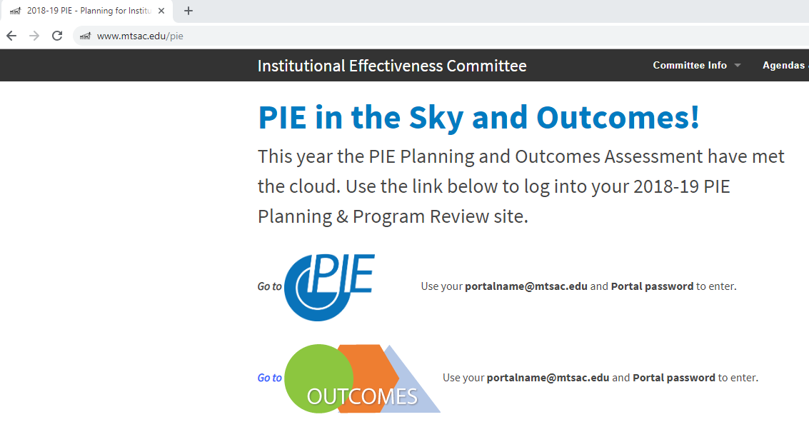
Data Review - Login
1. www.mtsac.edu/pie
2. Click to access PIE

Slide 3
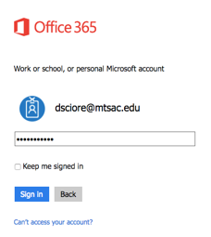
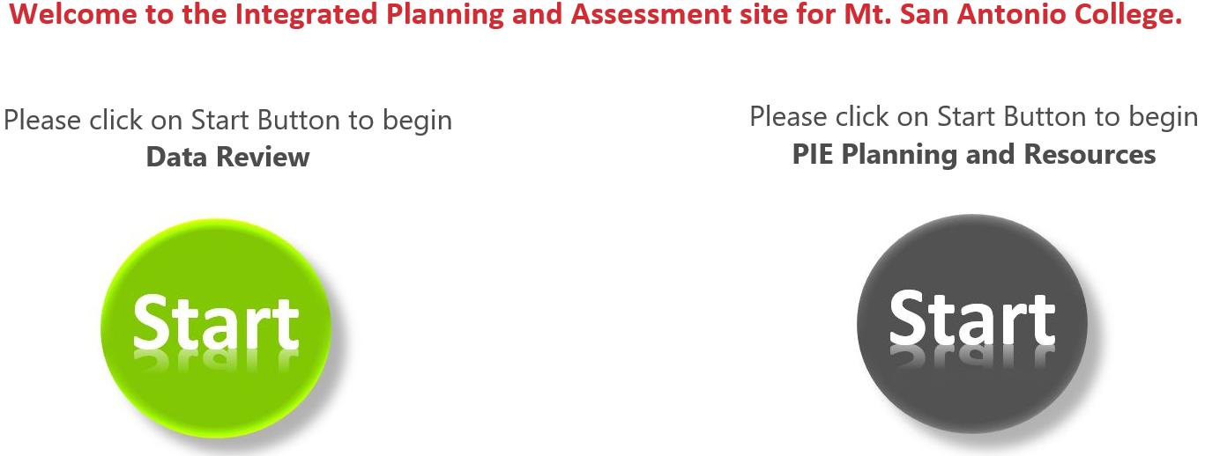
Data Review - Login
After clicking on “Go to PIE” use your Mt. SAC credentials to access the SharePoint interface that houses PowerBI to begin the process
3. Use portal user name &
password to login
4. Click on the green Start Button to begin Data Review
Notes:
Pedro: is this what everyone else that isn’t intimately working on PIE will see? When I log in, I see two different start buttons. Will the user get confused by this??
** we have the same login structure for the regular PIE input, I can put a screenshot of both and tell them to choose the green one etc.

Slide 4
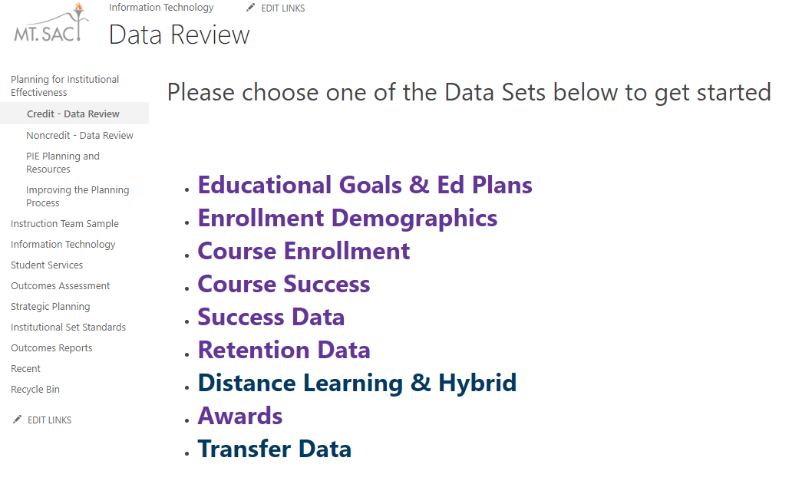
Data Review – Access Data
Click Below
Select any of these categories

Slide 5
Data Review – Data Review Questions
What are your initial thoughts on the data?
What might be contributing to student success in your program?
What might be detracting student success in your program?
Is this the data we need to make a decision? Why or why not?
What is the most important information?
What is missing?

Slide 6
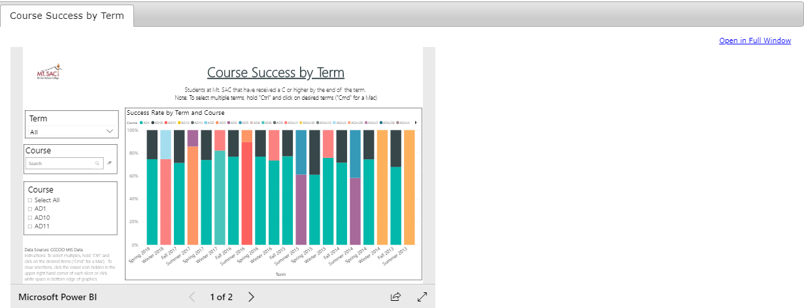

Data Review – COURSE SUCCESS - Selecting Items
2. Enter Course Prefix
1. Select Term
3. Select Course
Notes:
Pedro: Maybe we should rewrite the drop down menu instructions to “In each of the drop down menus (i.e. Division, Unit, Term), you can select multiple terms, units and divisions. Just left click on each drop down menu, press “Ctrl” on your keyboard and click on the desired filter. (‘Cmd’ for Mac users). To minimize the drop down menu, just left click on the menu again.”
“Select for Full Window. Note: this will open up a new tab in your web browser. To close, just close the tab and you will be back to the previous menu”

Slide 7
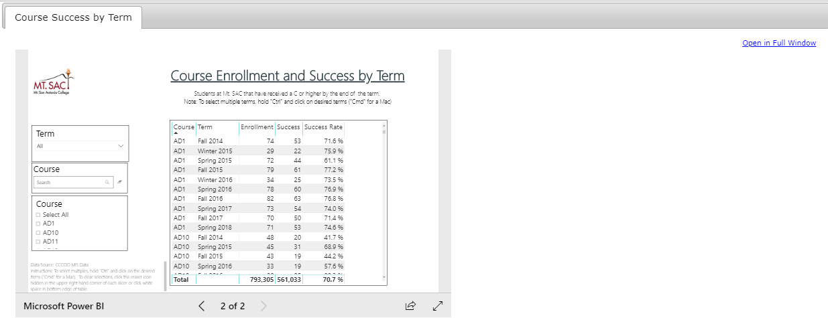
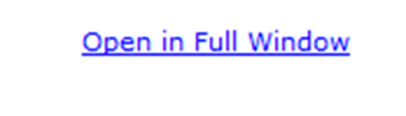
Data Review – COURSE SUCCESS - Selecting Items
2. Enter Course Prefix
1. Select Term
3. Select Course
Notes:
Pedro: Maybe we should rewrite the drop down menu instructions to “In each of the drop down menus (i.e. Division, Unit, Term), you can select multiple terms, units and divisions. Just left click on each drop down menu, press “Ctrl” on your keyboard and click on the desired filter. (‘Cmd’ for Mac users). To minimize the drop down menu, just left click on the menu again.”
“Select for Full Window. Note: this will open up a new tab in your web browser. To close, just close the tab and you will be back to the previous menu”

Slide 8
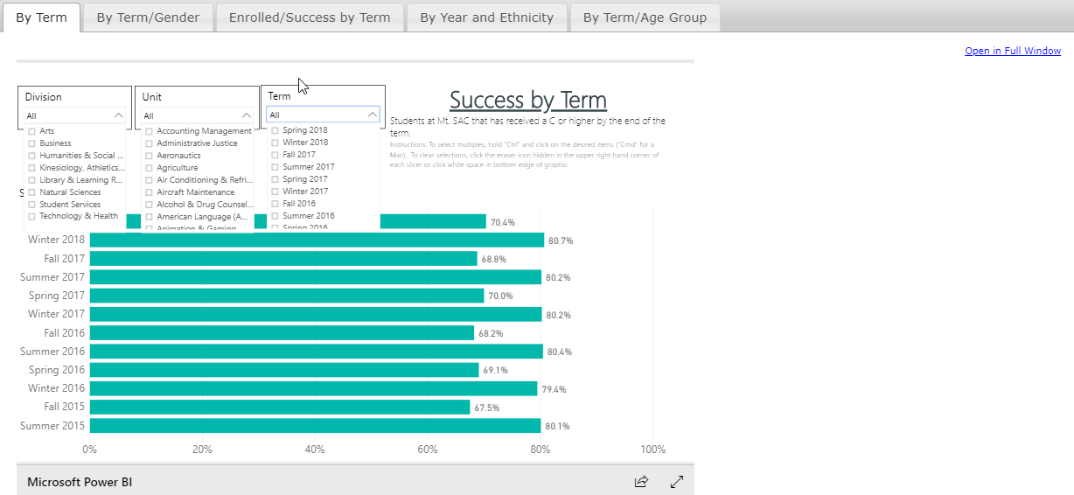
Data Review – SUCCESS - Selecting Items
1. Select Division
2. Select Unit
3. Select Term
Notes:
Pedro: Maybe we should rewrite the drop down menu instructions to “In each of the drop down menus (i.e. Division, Unit, Term), you can select multiple terms, units and divisions. Just left click on each drop down menu, press “Ctrl” on your keyboard and click on the desired filter. (‘Cmd’ for Mac users). To minimize the drop down menu, just left click on the menu again.”
“Select for Full Window. Note: this will open up a new tab in your web browser. To close, just close the tab and you will be back to the previous menu”

Slide 9
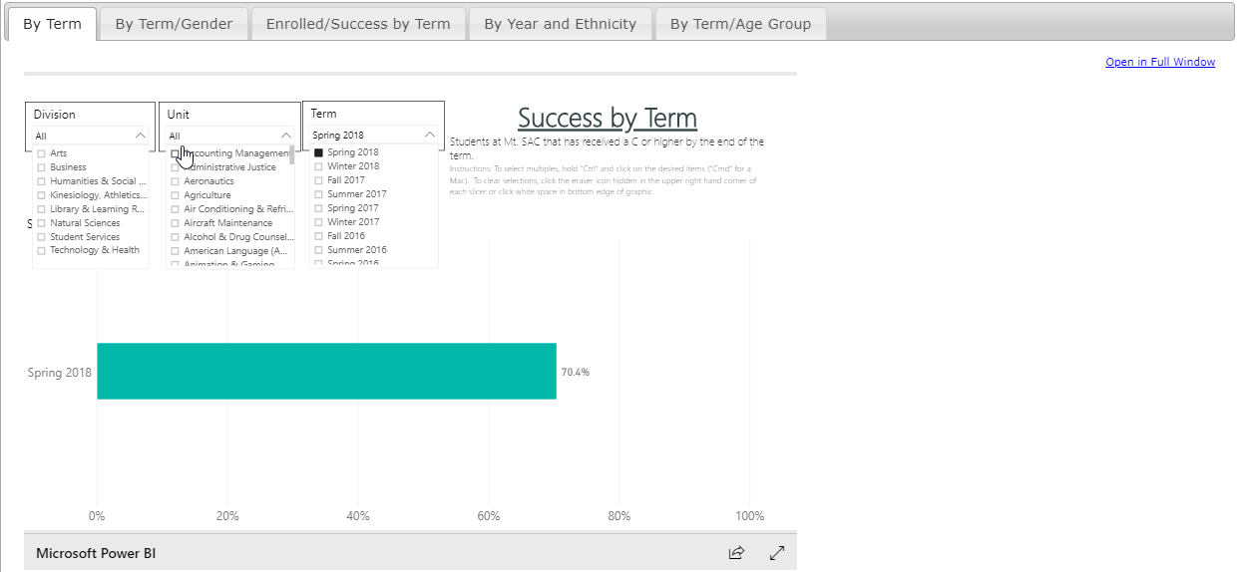
This example shows success for one term (Spring 2018).

Slide 10
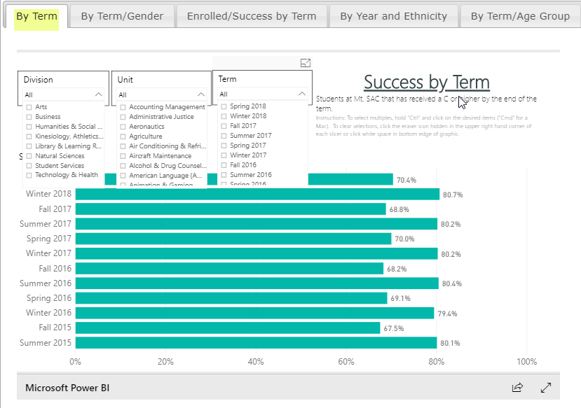
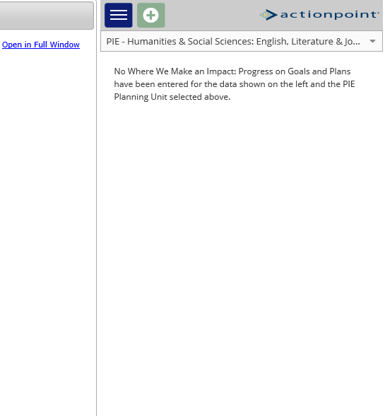
Data Review – SUCCESS - Selecting Items
Select for Full Window
Note: this will open up a new tab in your web browser. To close, just close the tab and you will be back to the previous menu”
* In each of the drop down menus (i.e. Division, Unit, Term), you can select multiple terms, units and divisions. Just left click on each drop down menu, press “Ctrl” on your keyboard and click on the desired filter. (‘Cmd’ for Mac users). To minimize the drop down menu, just left click on the menu again”
Notes:
Pedro: Maybe we should rewrite the drop down menu instructions to “In each of the drop down menus (i.e. Division, Unit, Term), you can select multiple terms, units and divisions. Just left click on each drop down menu, press “Ctrl” on your keyboard and click on the desired filter. (‘Cmd’ for Mac users). To minimize the drop down menu, just left click on the menu again.”
“Select for Full Window. Note: this will open up a new tab in your web browser. To close, just close the tab and you will be back to the previous menu”
11/7/2018 The left screenshot might be too hard for folks (BMS)

Slide 11
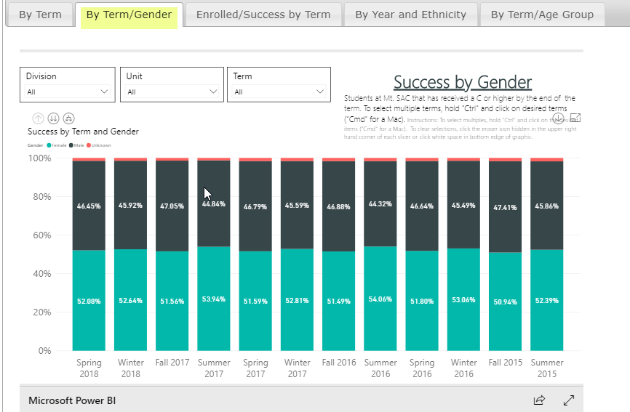
Data Review – SUCCESS – By Term/Gender
The second tab in the Success section displays Term by Gender
A user can hover over a bar and they can get the Title of the bar as well as the Count
(available throughout the interface)

Slide 12
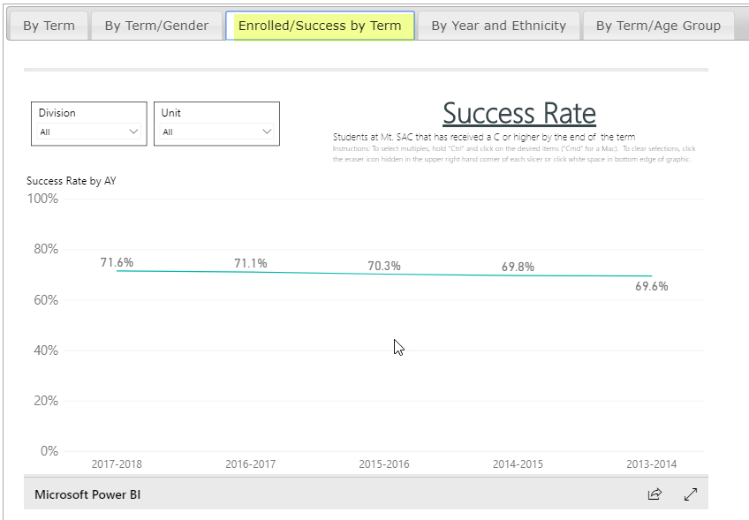
Data Review – SUCCESS – Enrolled/ Success by Term
The third tab displays Enrolled by Success and Term. Student has received a ‘C’ or higher by the end of Term.

Slide 13
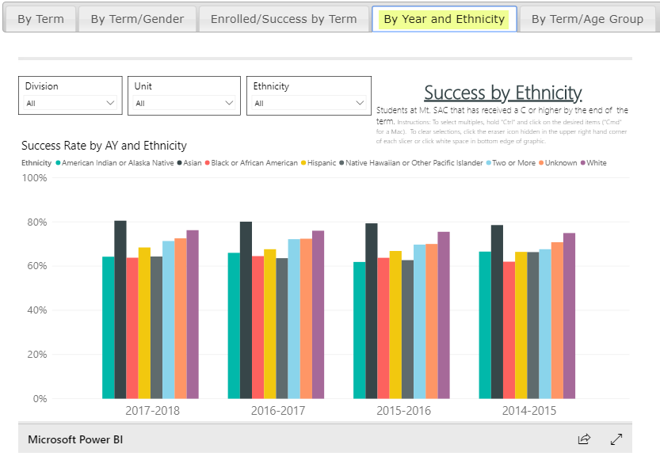
Data Review – SUCCESS – By Year and Ethnicity
The next tab displays Success by Ethnicity. Select Division, Unit, and Ethnicity for a specific ethnic category

Slide 14
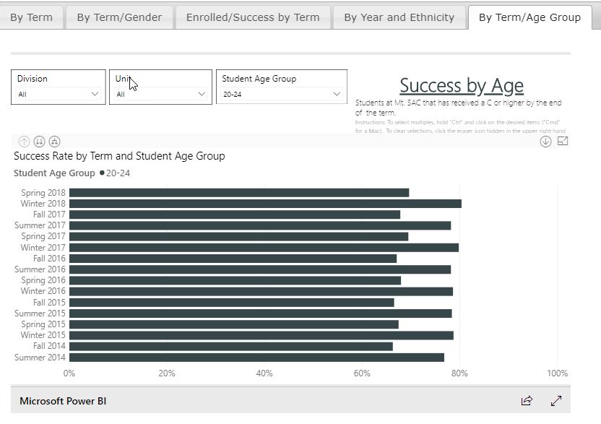
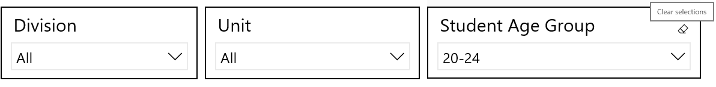
Data Review – SUCCESS – By Term/ Age Group
In the Term by Age Group Tab, students’ success rate by term and student age group is displayed
You can remove filter by using Eraser Button on Filter

Slide 15
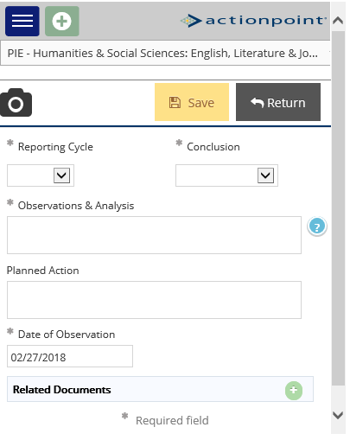
Data Review – SUCCESS – ActionPoint
1. Click on the Plus Button
4. Save and Return
3. There you can add your analysis of progress and how your area will address the data through planning.
2. Select Unit

Slide 16
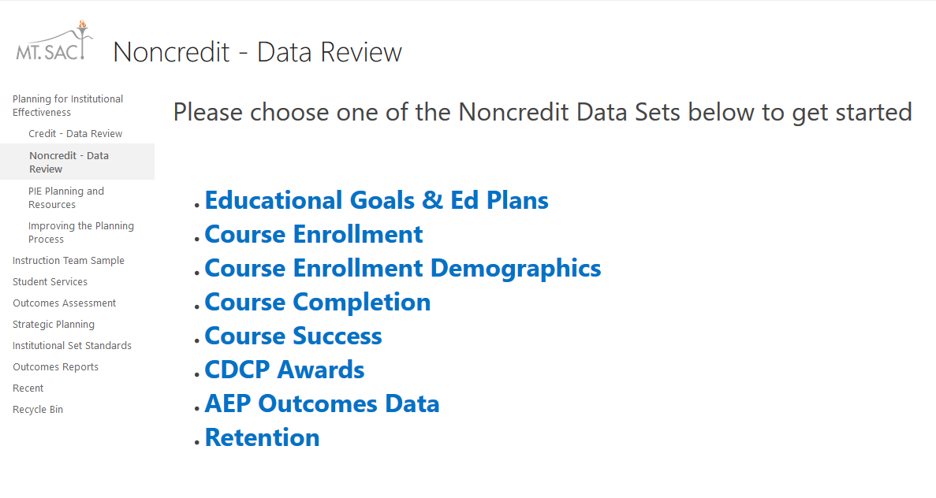
Data Review – Noncredit

Slide 17
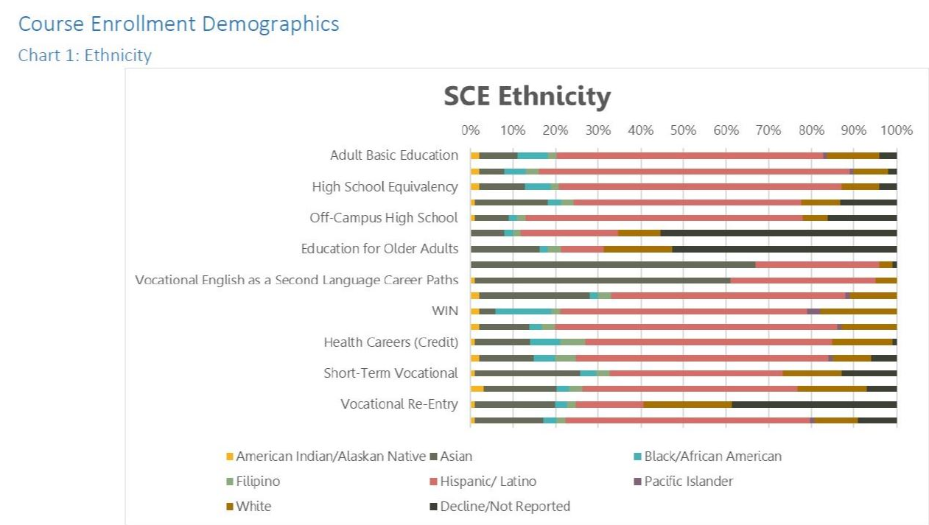
Data Review – Noncredit

Slide 18
Data Review – Helpful PIE Definitions
Educational Goal: The number of students that stated their informed educational goal after participating in the matriculation process.
Ed Plan: The number of students that completed a comprehensive Ed Plan
(Make sure that the fields are describing what we want them to describe).
Enrollment (Demographics) – A student is enrolled in a course if they received an end-of-term notation that is displayed on their official transcript.
Success (Data) – The percentage of students who received a passing/satisfactory grade.

Slide 19
Data Review – Helpful PIE Definitions
Retention – The percentage of students who do not withdraw from class and who receive a valid grade.
Distance Learning – A fully online class with non on-campus meetings.
Hybrid – Is a hybrid class taught partially online with scheduled meetings on-campus.
Awards – The number of degree/certificates given to a student upon the successful completion of a program at Mt. SAC. This includes all Associates, certificates and noncredit awards.
Transfer (Data) – *The number of students enrolling in either the University of California (UC) or the California State University (CSU) system.
* Transfer by program is not available at this time.

Slide 20


Resources
PIE Content Questions
Michelle Sampat: msampat@mtsac.edu
Meghan Chen: mchen@mtsac.edu
Easy as PIE
Research/ Data Review Questions
Barbara McNeice-Stallard:
bmcneice-stallard@mtsac.edu
Annel Medina Tagarao
atagarao@mtsac.edu
Technical Questions:
Pedro Suarez: psuarez7@mtsac.edu
Video Training Resources:
http://www.mtsac.edu/pie

