Slide 1
Planning for Institutional Effectiveness Manager PIE Planning & Resources
2019 User Guide

Slide 2
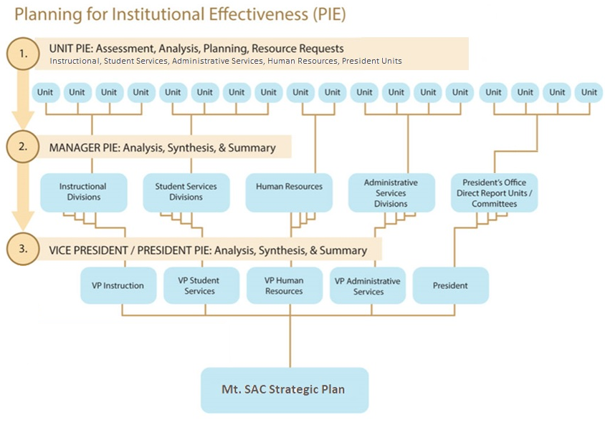
The PIE Process

Slide 3
PIE - Access
1. www.mtsac.edu/pie
2. Click to access PIE

Slide 4
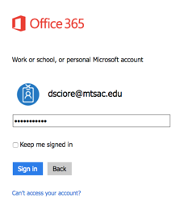
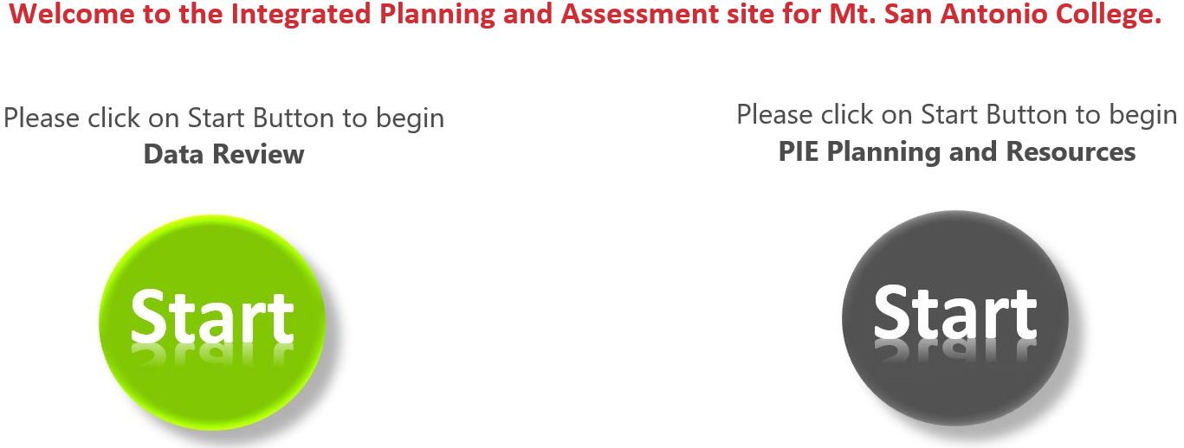
PIE - Home Screen
After clicking on “Go to PIE” use your Mt. SAC credentials to access the SharePoint interface that houses PIE to begin the process
3. Use portal user name &
password to login
4. Click on the gray Start Button to begin PIE Planning and Resources

Slide 5
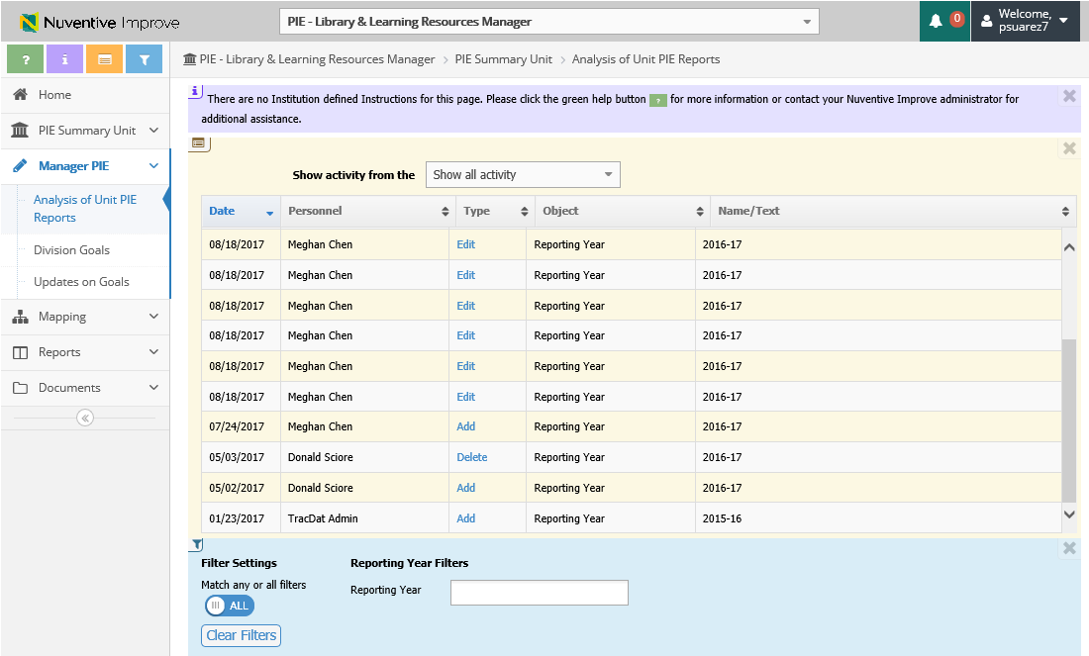
PIE - Unit Planning and Resources – Tool Bar
a. Open Page Help (help content)
b. Open Page Instructions (explanation of requirements)
a
b
c
d
c. Open Page Log (journal of activity)
d. Open Page Filter (narrow down searches)

Slide 6
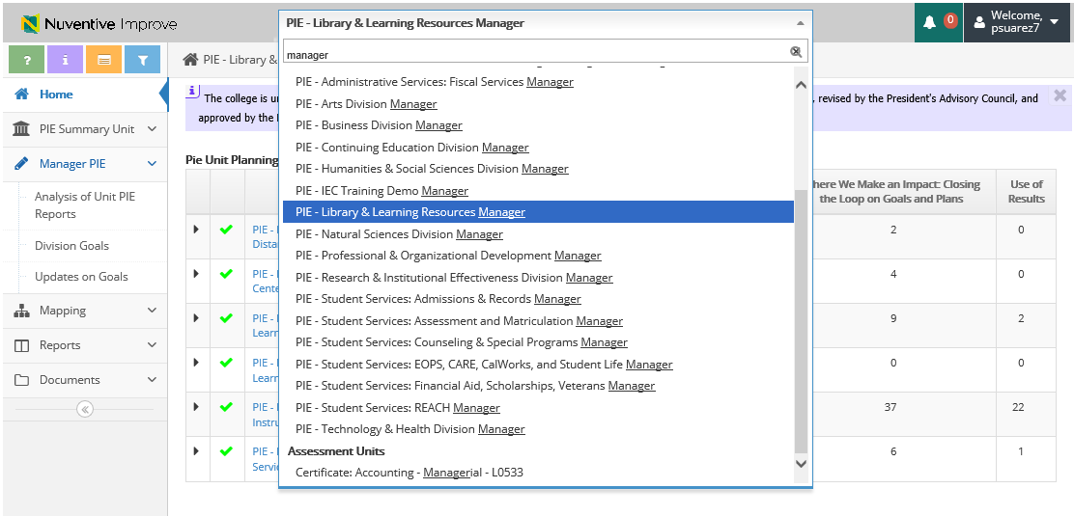
PIE - Unit Planning and Resources
Select the dropdown arrow and select respected department (user has the ability to type in department name)
*Make sure the Dept. starts with “MANAGER”

Slide 7
Planning for Institutional Effectiveness PIE Reports

Slide 8
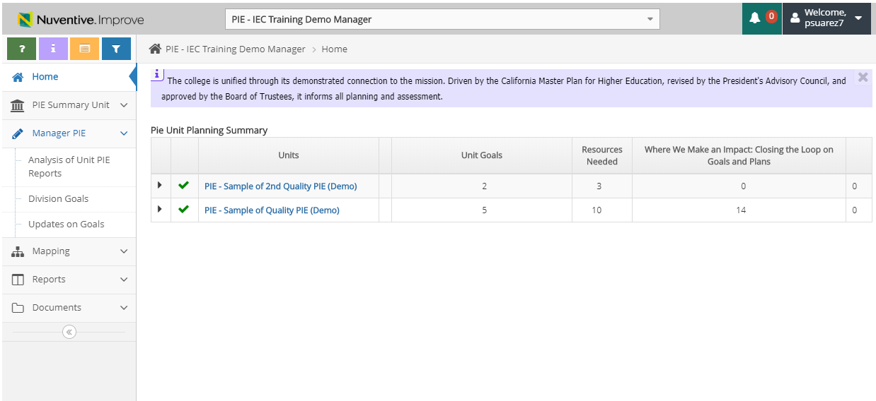
Manager PIE Sections – Recommended Reports for Sections of PIE
Ad-Hoc Report: 1. Notable Achievements – ALL Themes (excel)
Standard Report: Section 2 – Division Goals Summary of Unit PIE’s
Standard Report: Section 3 – Updates on Goals

Slide 9
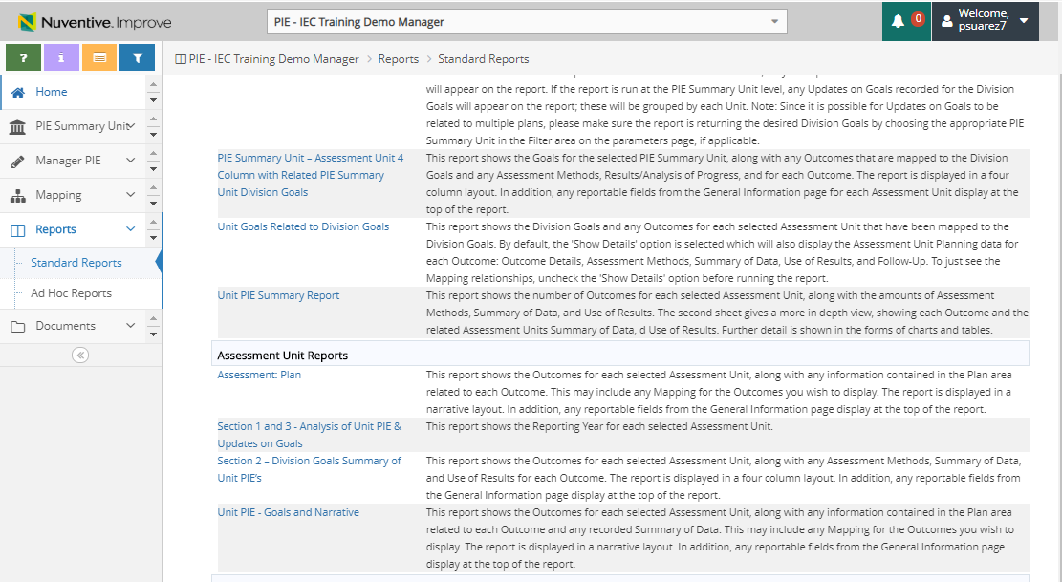
PIE – Location of Standard Reports
Standard Reports
Standard Report: Section 2 – Division Goals Summary of Unit PIE’s
Standard Report: Section 3 – Updates on Goals
1. Select Report

Slide 10
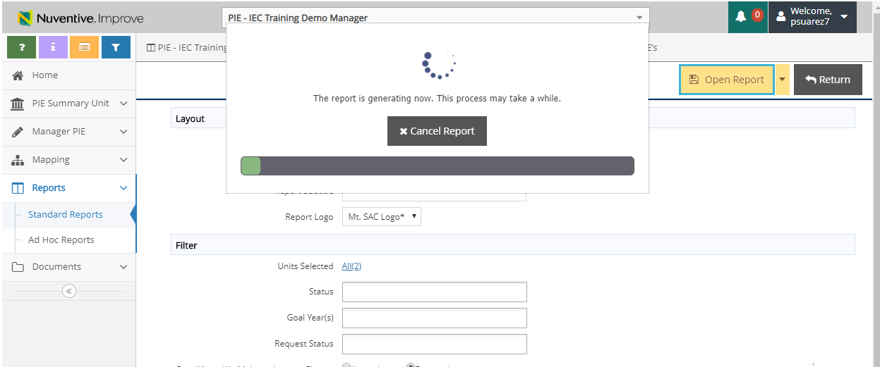
PIE – Location of Standard Reports
2. Select Open Report
3. Report will download. Please ensure you have pop-up blockers enabled.

Slide 11
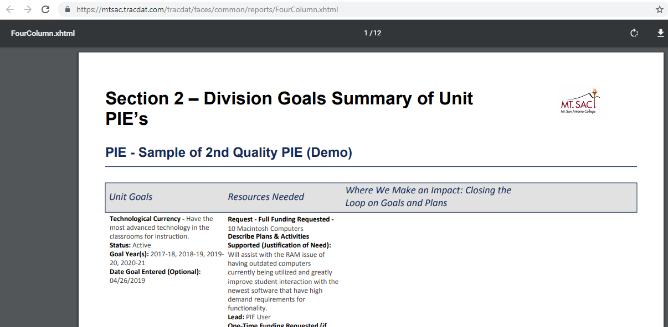
PIE – Location of Standard Reports
4. Report will display

Slide 12
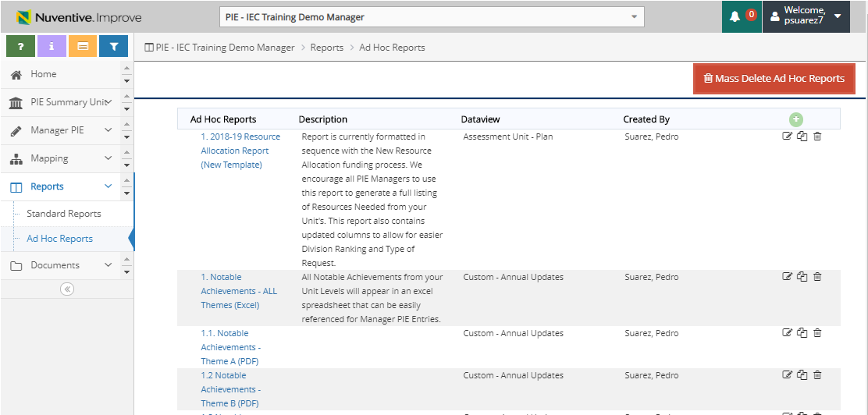
PIE – Location of Ad-Hoc Reports
Ad-Hoc Report: 2018-19 Resource Allocation Report (New Template)
Ad-Hoc Reports
Ad-Hoc Report: 1. Notable Achievements – ALL Themes

Slide 13
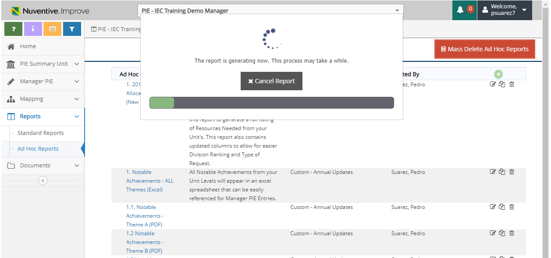
PIE – Notable Achievement Reports
2. Select Report Name and report will download in excel format.

Slide 14
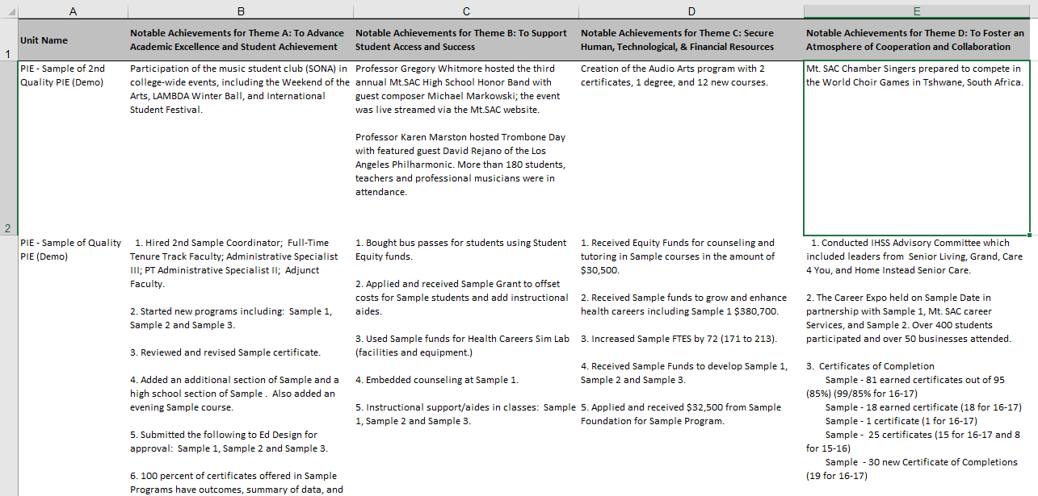
PIE – Notable Achievement Reports
3. Example of report once generated.

Slide 15
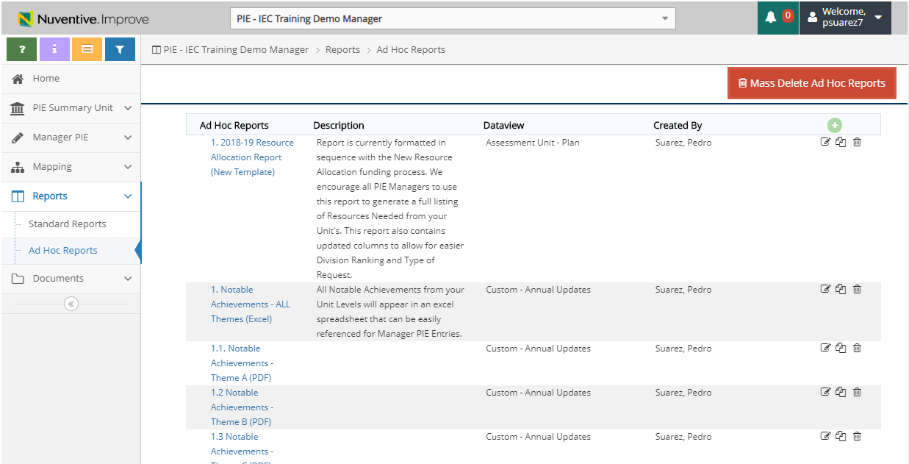
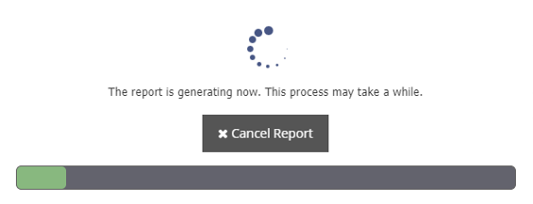
PIE – Resource Allocation Reports
1. Resource Allocation Report
Will display all current resource requests by Unit, Unit Goal and Type of Request. Currently formatted in the resource prioritization template.
2. Select Report Name and report will download in excel format.

Slide 16
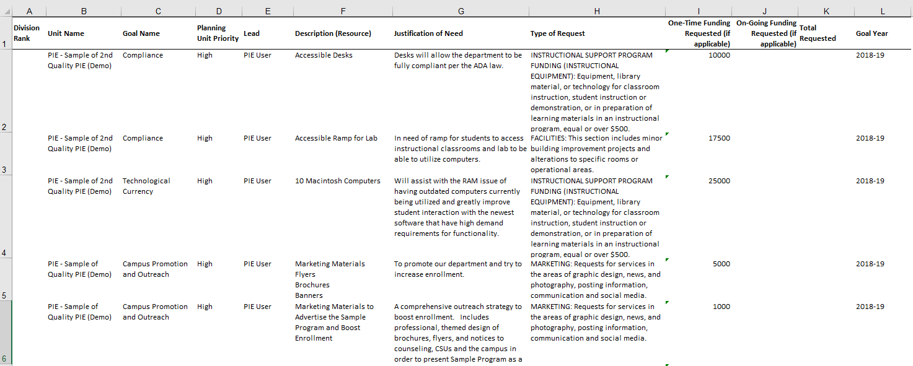
PIE – Resource Allocation Reports
3. Example of report once generated.
16

Slide 17
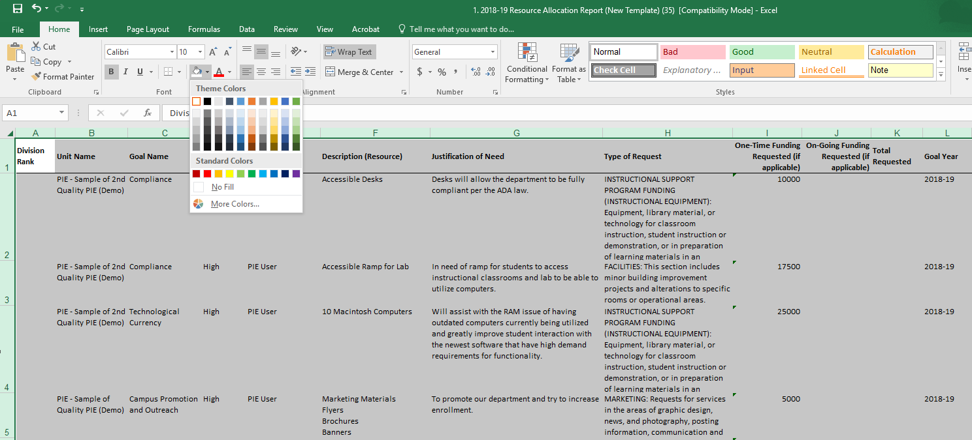
PIE – Resource Allocation Reports – Formatting Options
5. Select Paint Bucket and Select “No Fill”
* This will allow the gridlines to appear.
4. Select to side arrow to remove layer of paint from export file.
17

Slide 18
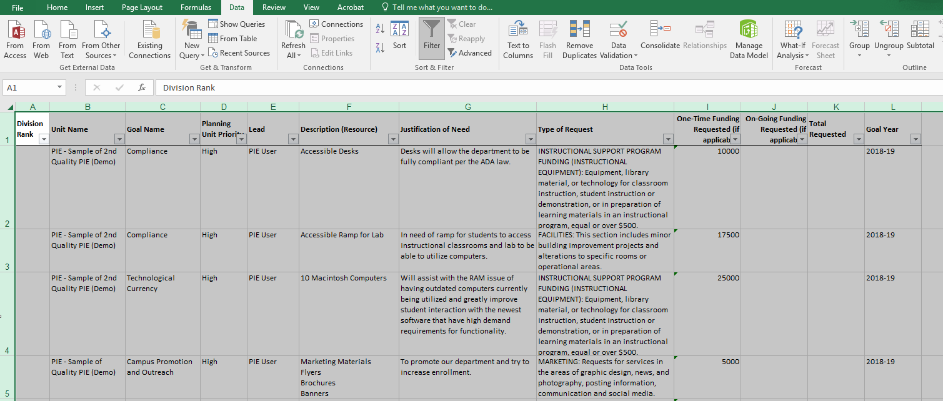
PIE – Resource Allocation Reports – Formatting Options
5. Select Data in the Ribbon menu and Select Filter.
* This will allow Filter options for all of the columns.
18

Slide 19
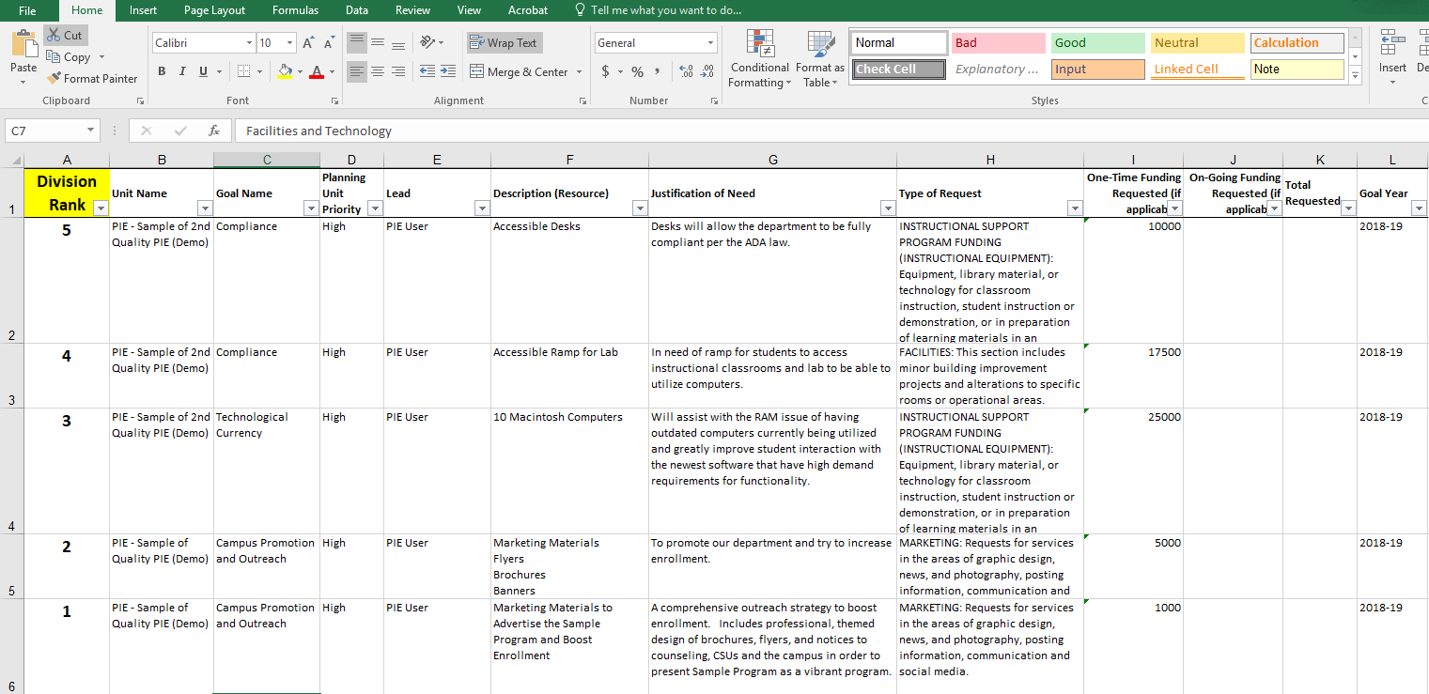
PIE – Resource Allocation Reports – Applying Rank
6. Column 1 will allow you to insert a rank for the resource request.
7. Make sure to save.
19

Slide 20
Manager PIE Planning & Resources
Analysis of Unit PIE Reports, Division Goals & Updates on Goals

Slide 21
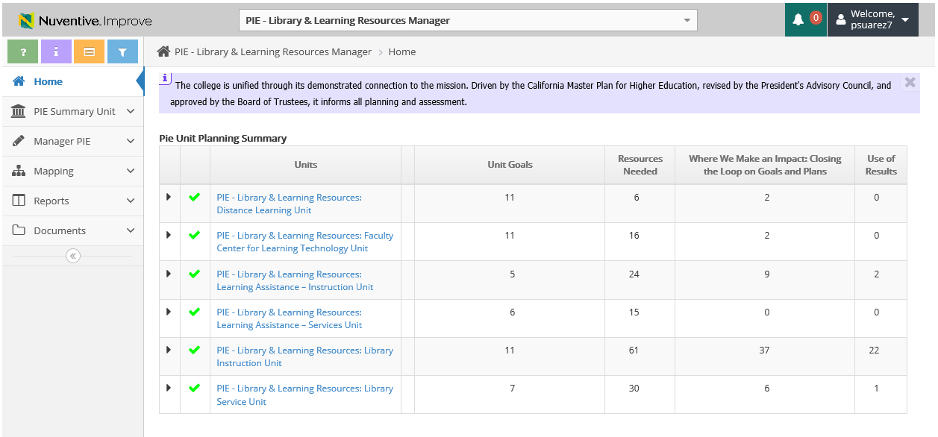
Summary of Units
Summarized data regarding your Units
All Units tied to Manager Department will display

Slide 22
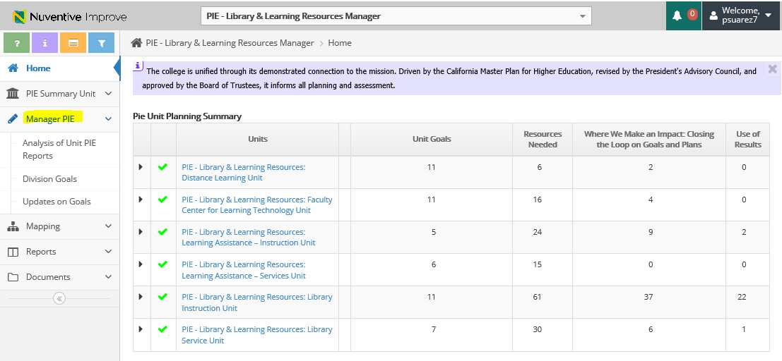
Manager PIE – 3 Planning Sections
Select Manager PIE to view the 3 Planning Sections
Analysis of Unit PIE Reports
Division Goals
Updates on Goals

Slide 23
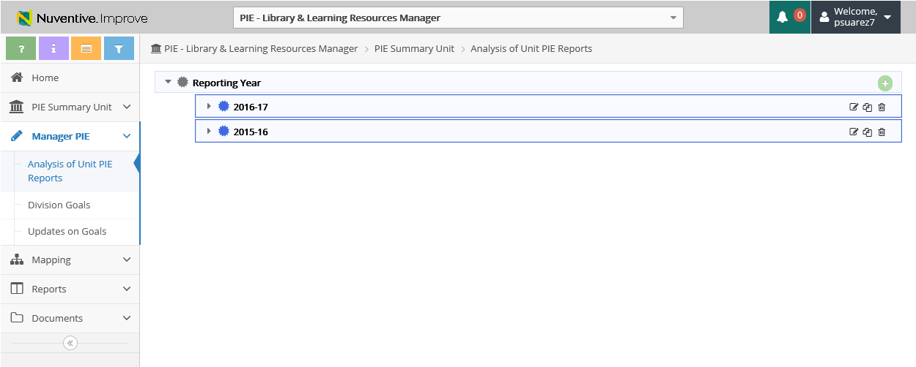
Analysis of PIE Reports – View
Reporting Years will display
1. Select Analysis of PIE Reports
2. Select side arrow to view detail

Slide 24
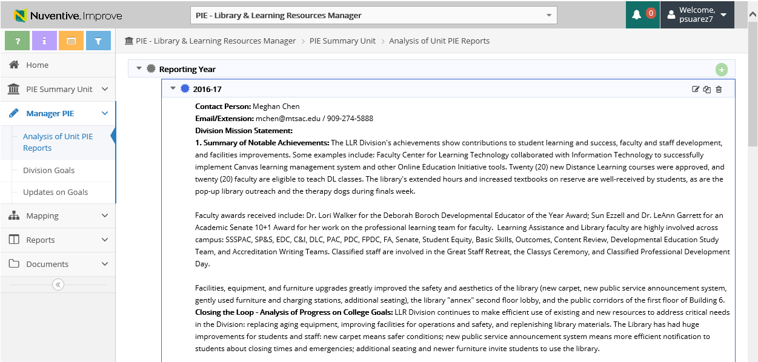
Analysis of PIE Reports – View & Add
3. Add Reporting Year
Edit
Copy
Detail will display

Slide 25
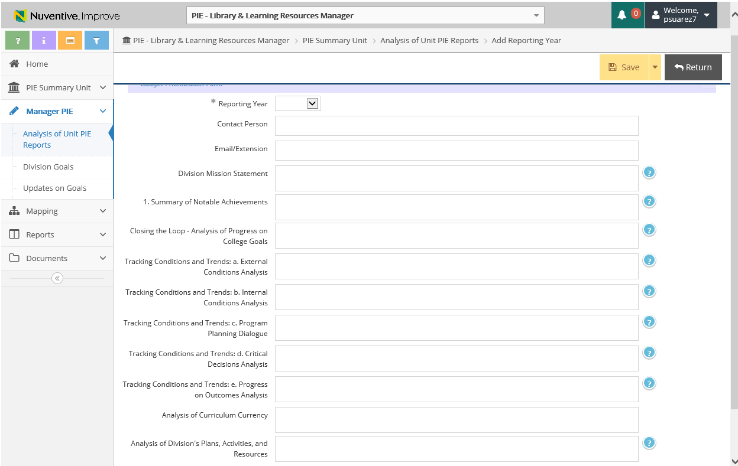
Analysis of PIE Reports - Add Reporting Year
4. Add Reporting Year
6. Save & Return
5. Enter data into the related fields
Help Text

Slide 26
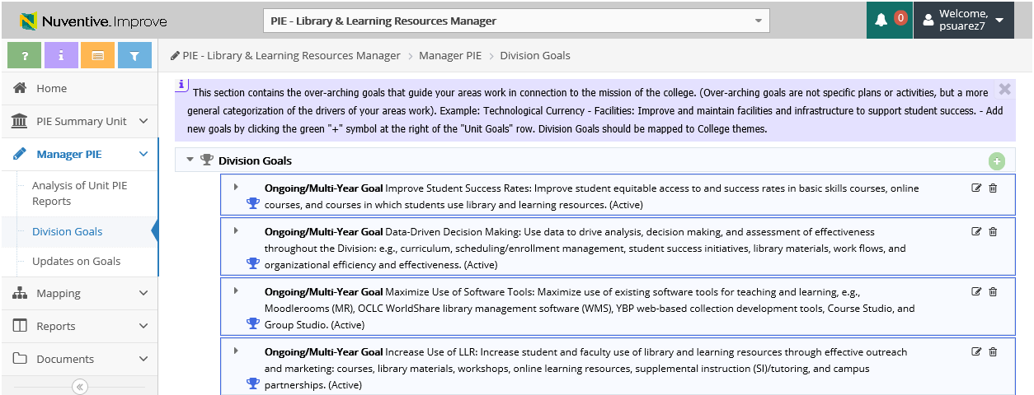
Division Goals – View & Add Division Goal
1. Select Division Goals
2. Add Division Goal
Edit Division Goal
Division Goals will display

Slide 27
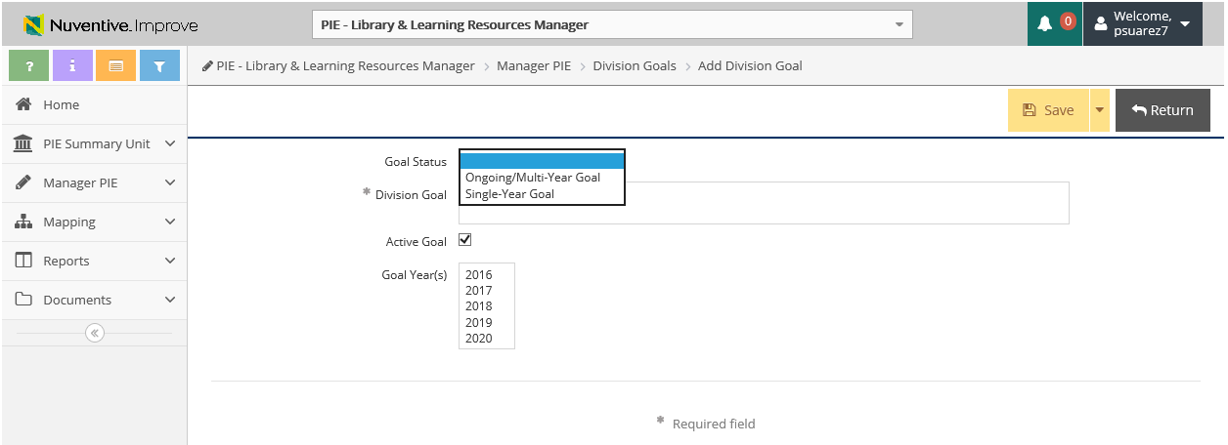
Division Goals – Add/ Edit Division Goal
3. Select Goal Status
4. Enter Division Goal Details
5. Save & Return
** If Editing, update Goal Year(s) and Goal Status

Slide 28
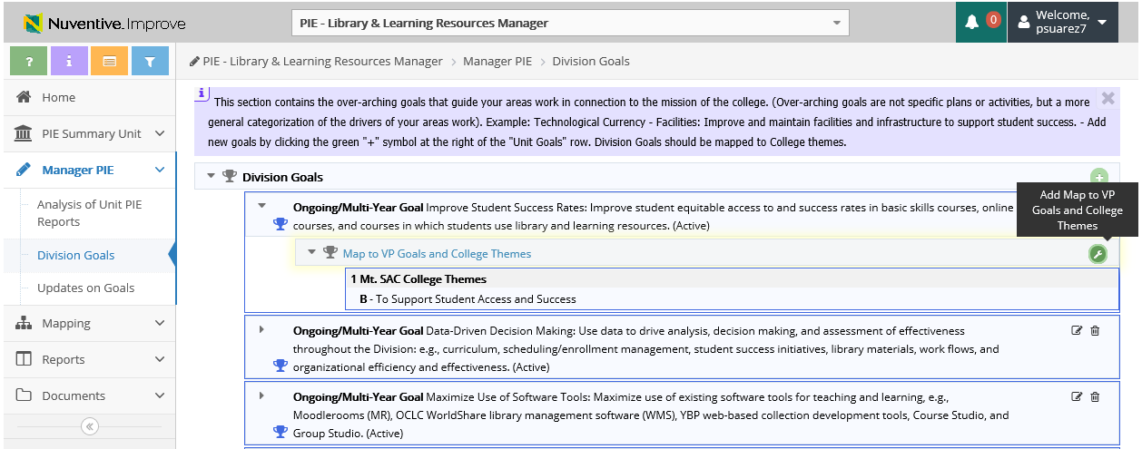
Division Goals – Map to VP Goals and College Themes
1. Select Tool Icon to Add Map to College Goals
**Map to College Goals is also available under ‘Mapping’

Slide 29
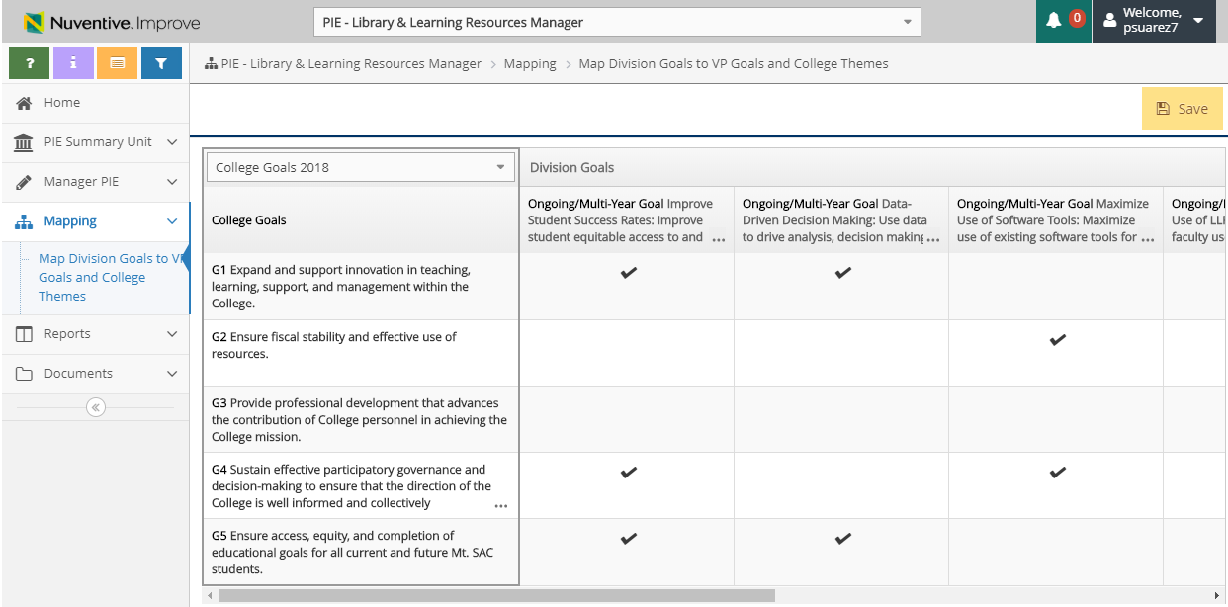
Division Goals – Map to College Goals
2. Select College Goals 2018 on drop down menu
* If any goals related to the Integrated Plan, then this section is where you will do linking

Slide 30
Division Goals – Map to College Goals
4. Select Save & Return
3. Division Goals displayed horizontally and College Goals from vertical. Place a checkmark to link.

Slide 31
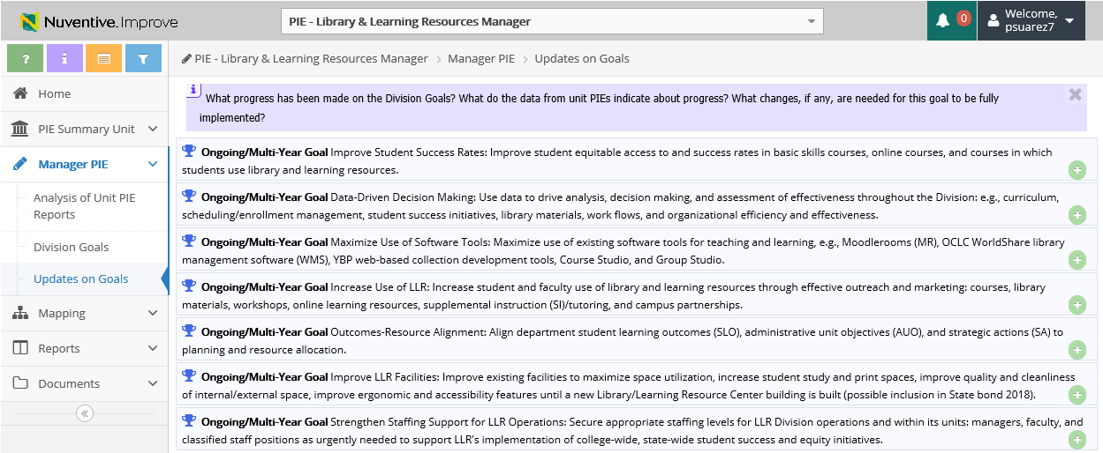
Updates on Goals – View & Add Analysis of Progress
1. Select Updates on Goals
2. Select to Add Analysis of Progress
Goals will display

Slide 32
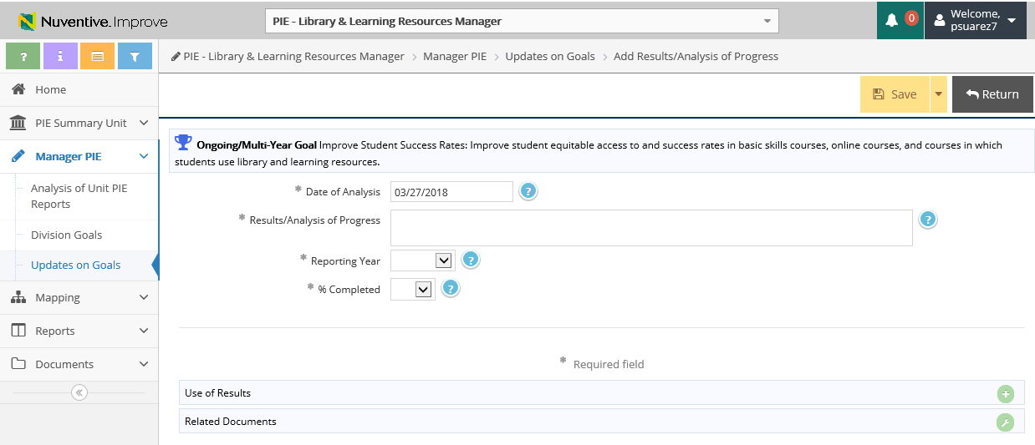
Updates on Goals – Add Use of Results
3. Enter data into the fields for Analysis of Progress

Slide 33
Updates on Goals – Add Related Documents
1. Select to Add Related Documents

Slide 34
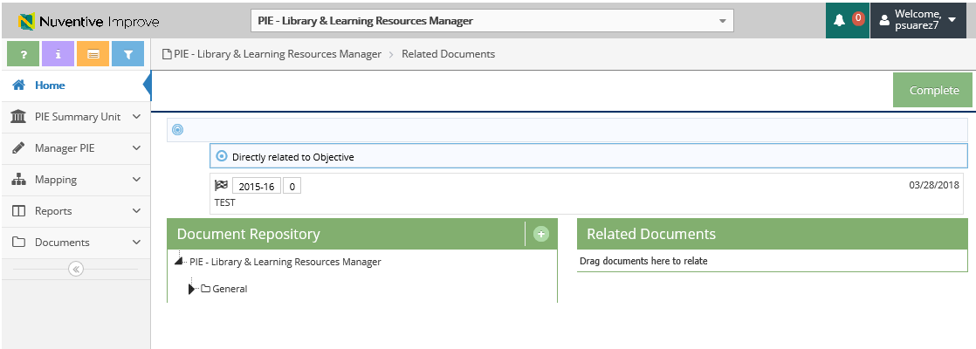
Updates on Goals – Add Related Documents
2. Click to View Document Repository
3. Click to Upload new documents

Slide 35
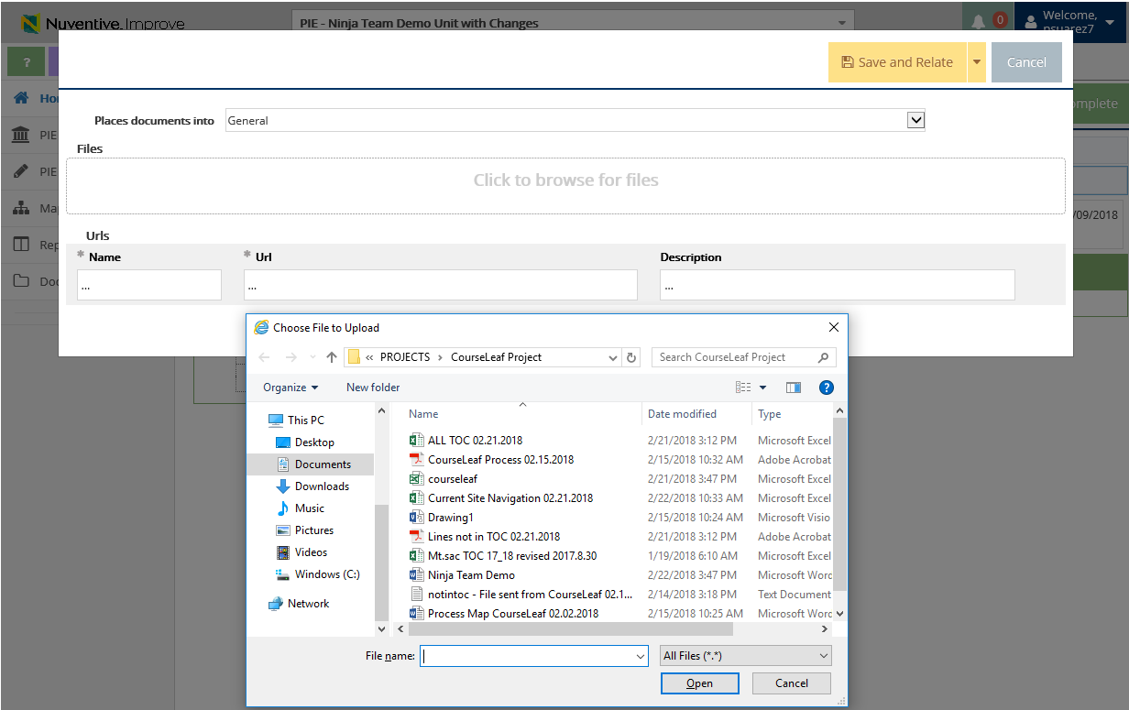
Updates on Goals – Add Related Documents
4. Select Location to place uploaded documents to
Document Retrieval Screen will display
5. Click to browse and add files on your computer
6. Select File and Select Open

Slide 36
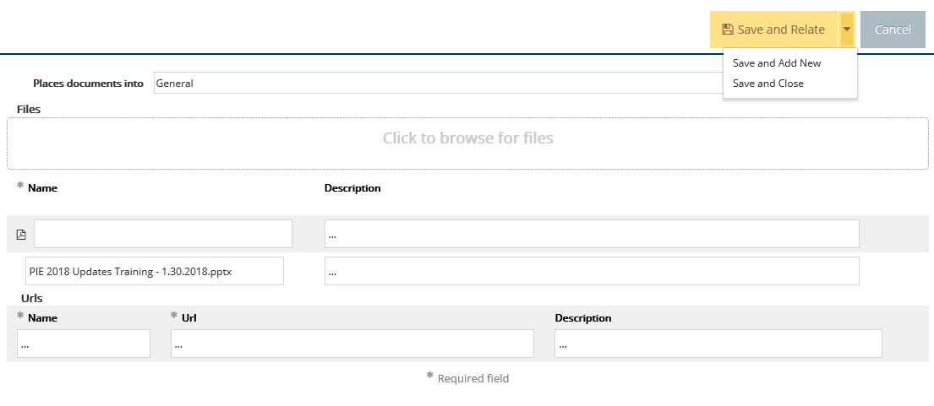
Updates on Goals – Add Related Documents
7. Select Save and Relate
Save and Add New: saves the document and stays on this screen to keep adding more documents
Save and Close: saves the document and returns to previous screen

Slide 37
Resources
PIE Content Questions
Michelle Sampat: msampat@mtsac.edu
Meghan Chen: mchen@mtsac.edu
PIE Summaries are due by July 15th, 2019
Research/ Data Review Questions
Barbara McNeice-Stallard:
bmcneice-stallard@mtsac.edu
Technical Questions:
Pedro Suarez: psuarez7@mtsac.edu
Video Training Resources:
http://www.mtsac.edu/pie

