Slide 1

PIE Planning & Resources
Where We Are Now

Slide 2
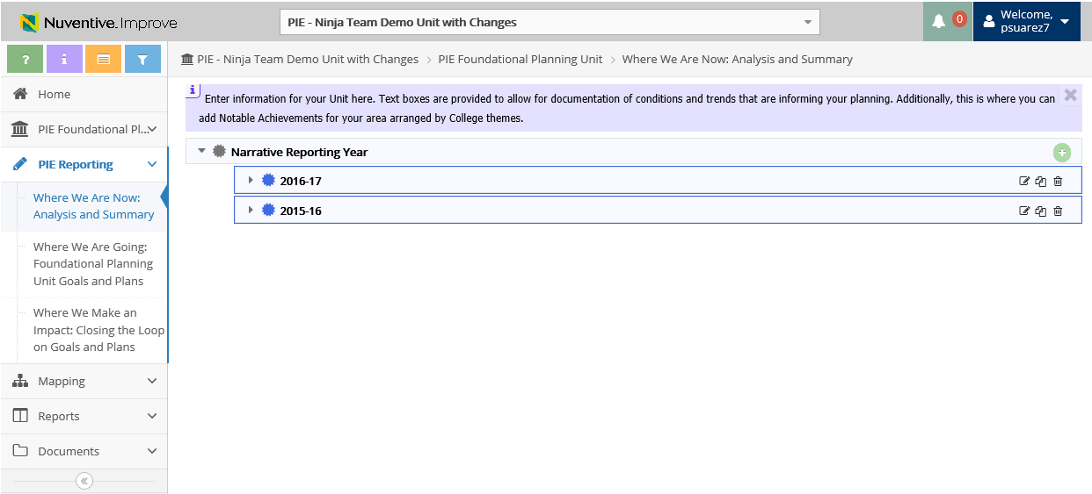
1. Where We Are Now – View & Create Reporting Year
Summary of Previous Years will Display
Create
Edit
Copy
Delete

Slide 3
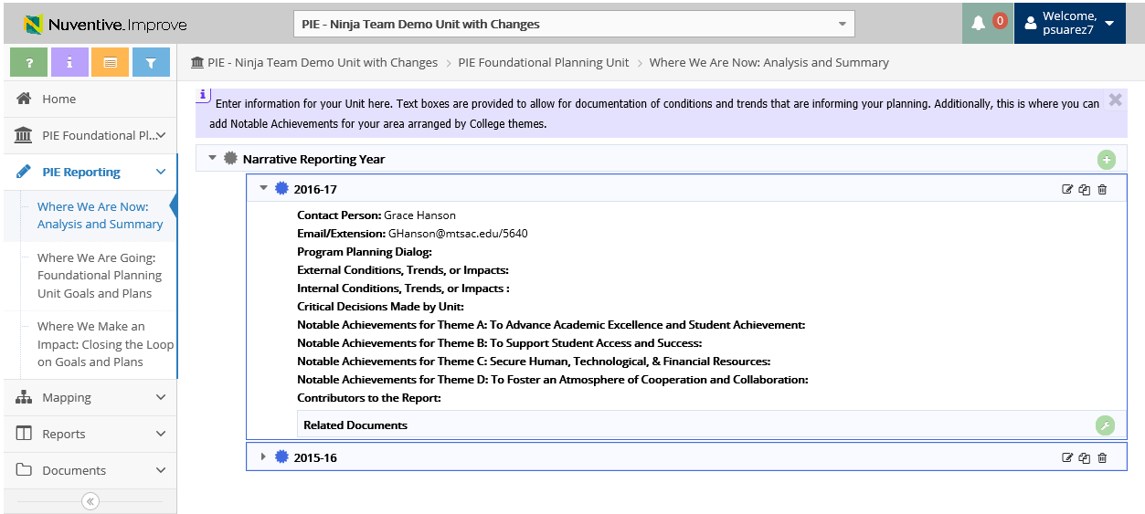
1. Where We Are Now – View & Copy Reporting Year
2. Click to Copy Year
1. Click to View selected Year data

Slide 4
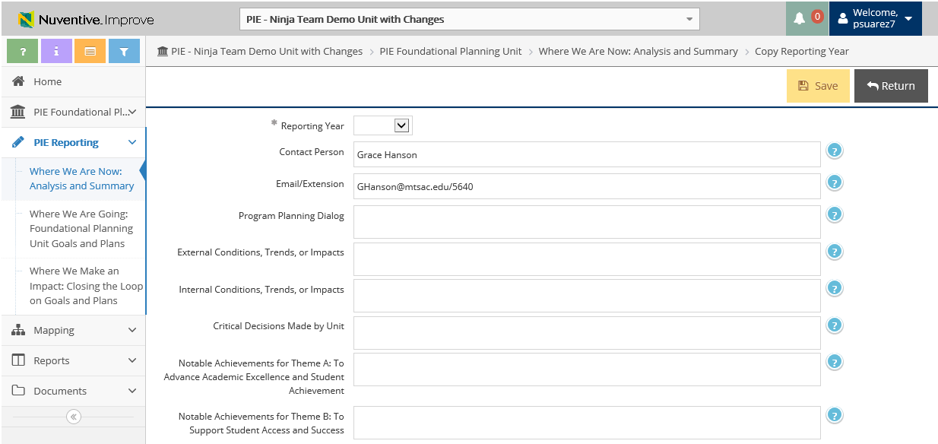

1. Where We Are Now – Copy Year Data
3. Enter New Year
5. Click Save
4. Enter data into the related fields
6. Click Return for previous page

Slide 5
1. Where We Are Now – View & Create Reporting Year
1. Click to Create New Reporting Year
*only create new year to start a new PIE with no previous entries

Slide 6
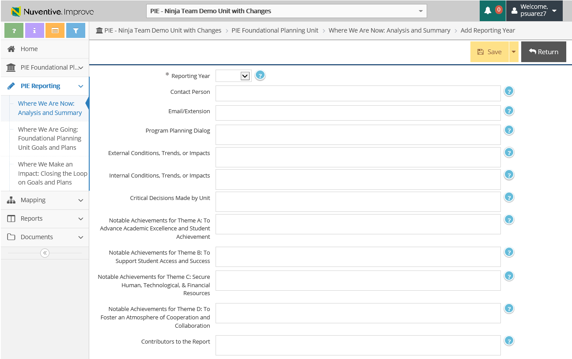
1. Where We Are Now – Create New Reporting Year
3. Click Save
4. Click Return for previous page
2. Enter data into the related fields

Slide 7


Resources
PIE Content Questions
Michelle Sampat: msampat@mtsac.edu
Meghan Chen: mchen@mtsac.edu
Easy as PIE
Research/ Data Review Questions
Barbara McNeice-Stallard:
bmcneice-stallard@mtsac.edu
Technical Questions:
Pedro Suarez: psuarez7@mtsac.edu
Video Training Resources:
http://www.mtsac.edu/pie

