Slide 1
Planning for Institutional Effectiveness
PIE Planning & Resources
2018 User Guide

Slide 2


PIE 2018 vs Prior Years
Ribbon changes ( Main & Left Screen)
Field title changes and removal of redundant fields
Enhanced “Help Text” Fields
Terminology updates

Slide 3
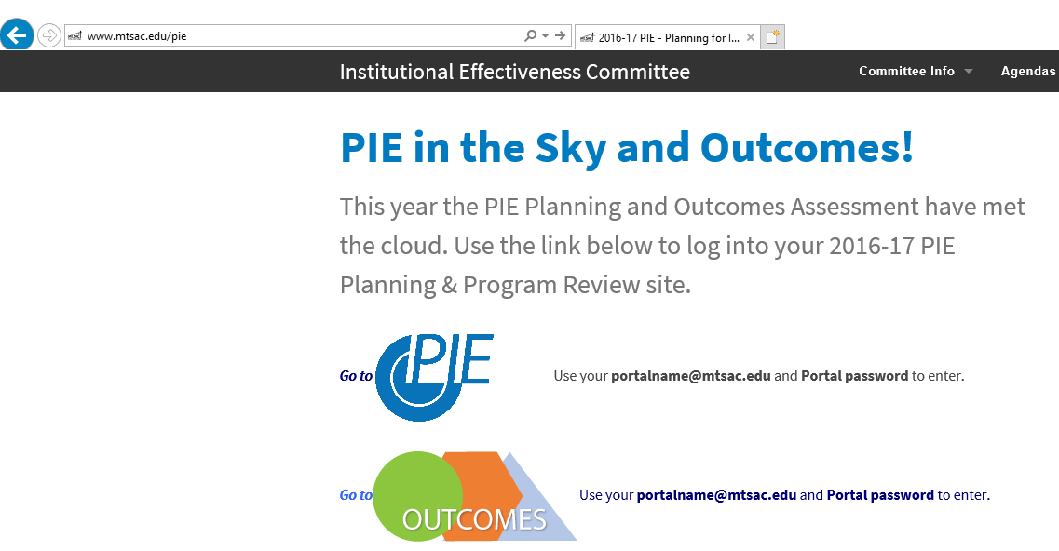
PIE - Access
1. www.mtsac.edu/pie
2. Click to access PIE

Slide 4
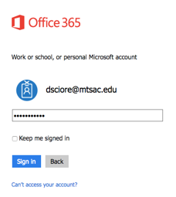
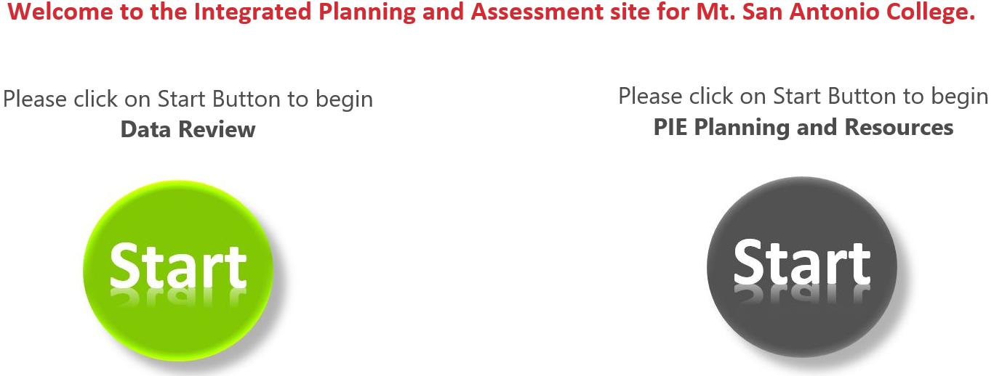
PIE - Home Screen
After clicking on “Go to PIE” use your Mt. SAC credentials to access the SharePoint interface that houses PIE to begin the process
3. Use portal user name &
password to login
4. Click on the gray Start Button to begin PIE Planning and Resources

Slide 5
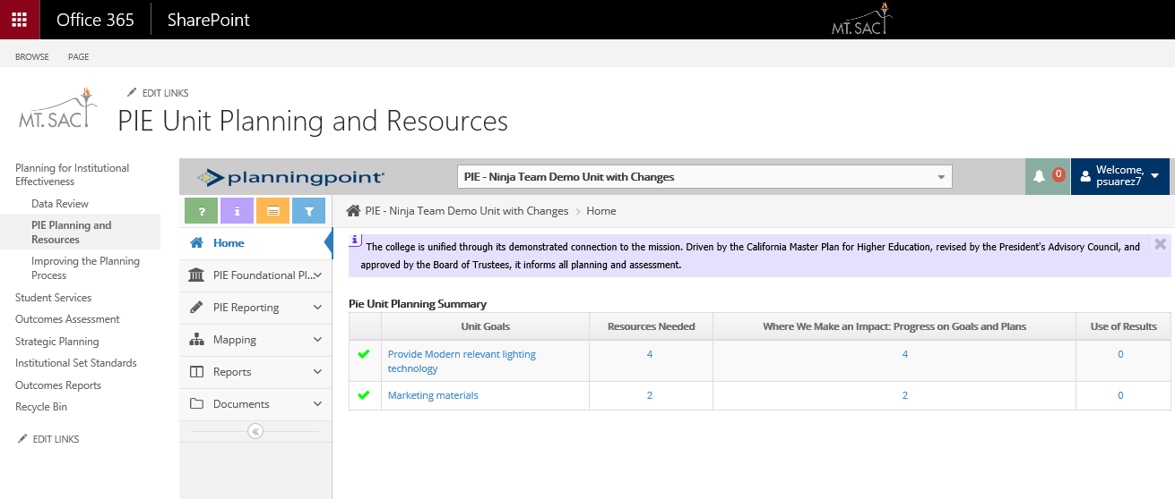
PIE - Unit Planning and Resources
SharePoint displays the PIE Unit Interface to enter data

Slide 6
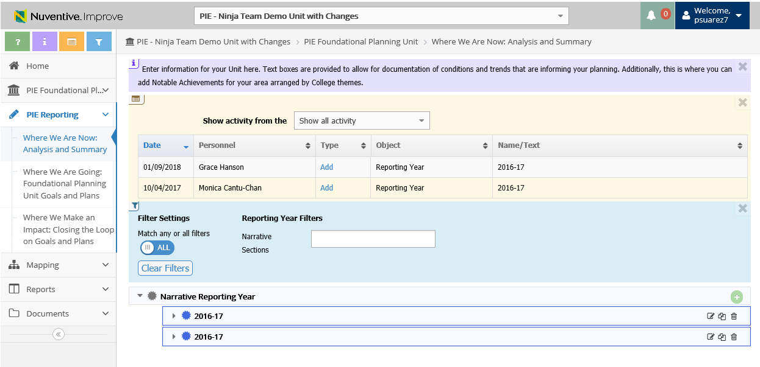
PIE - Unit Planning and Resources – Tool Bar
a. Open Page Help (help content)
b. Open Page Instructions (explanation of requirements)
c. Open Page Log (journal of activity)
d. Open Page Filter (narrow down searches)
b
c
d

Slide 7
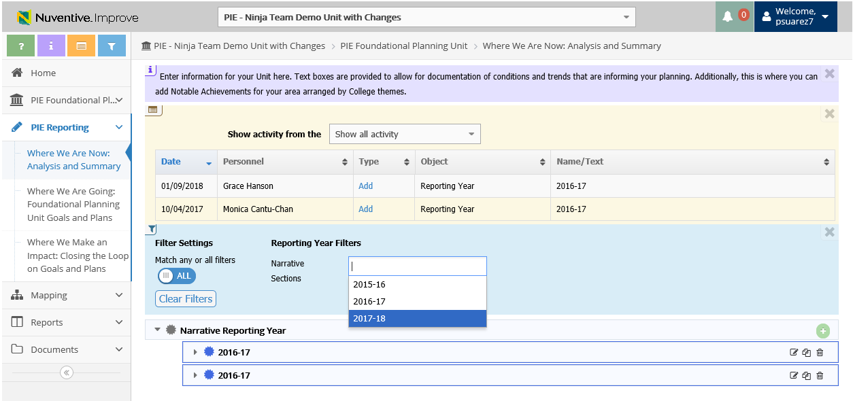
PIE - Unit Planning and Resources – Filter
d. Open Page Filter (narrow down searches)
Filters can be applied and will remain until they are cleared
d.

Slide 8
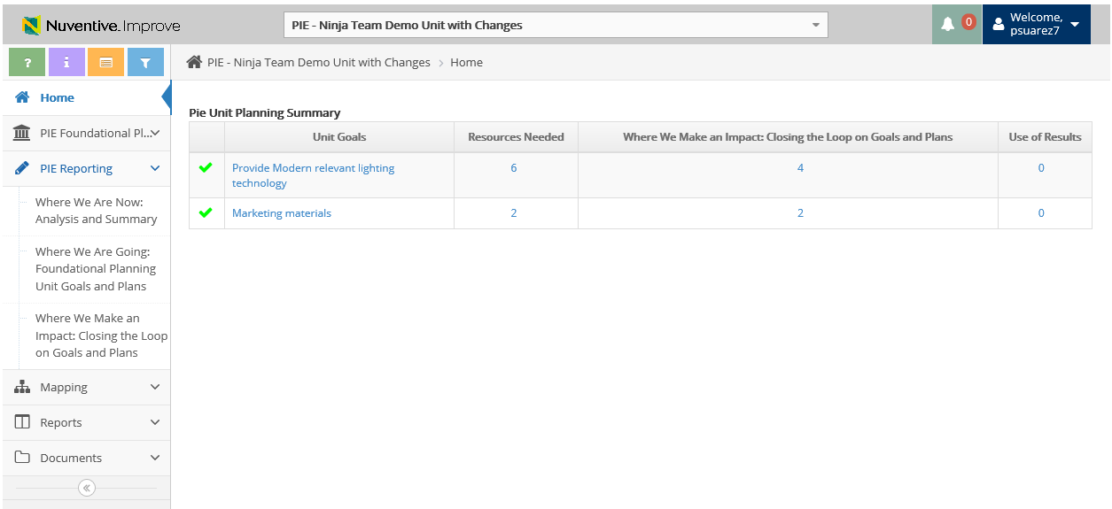
PIE - Unit Planning and Resources
Select PIE Reporting to view the 3 Planning Sections
Where We Are Now: Analysis and Summary
Where We Are Going: Foundational Planning Unit Goals and Plans
Where We Make an Impact: Closing the Loop on Goals and Plans

Slide 9
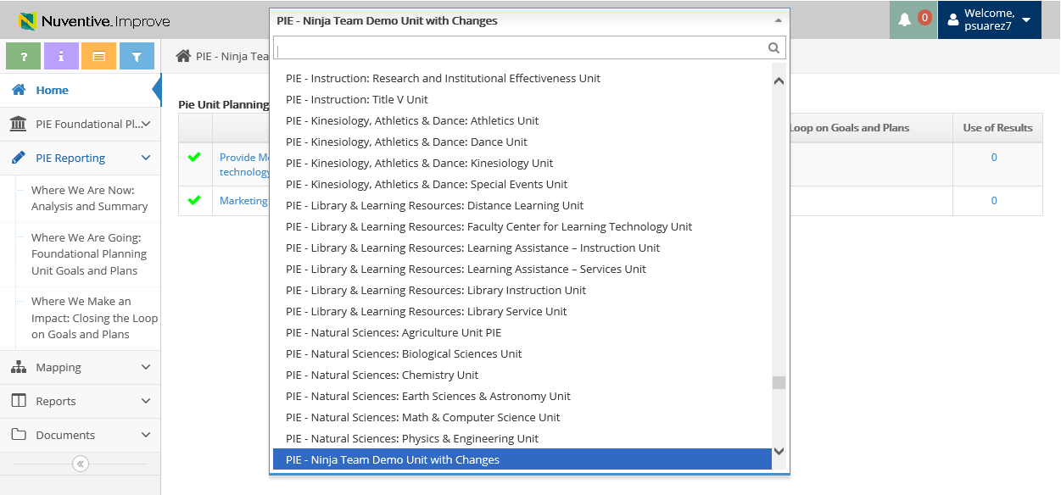
PIE - Unit Planning and Resources
Select the dropdown arrow and select respected department (user has the ability to type in department name)
*Make sure the Unit starts with “PIE”

Slide 10

PIE Planning & Resources
Where We Make an Impact – Closing the Loop

Slide 11
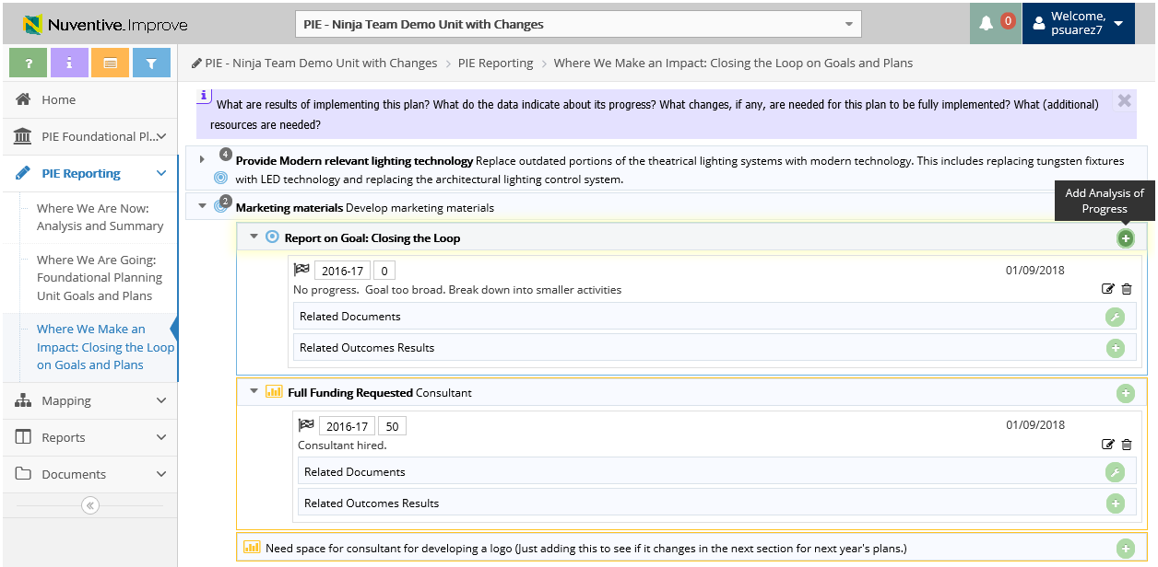
3. Where We Make an Impact – Add Analysis of Progress on Goals
1. Click to View Unit Goals
2. Click to Add Analysis of Progress
Analysis of Progress will display for preceding Reporting Years (if applicable)
**Only Edit Analysis of Progress for minor updates (ex: grammar)

Slide 12
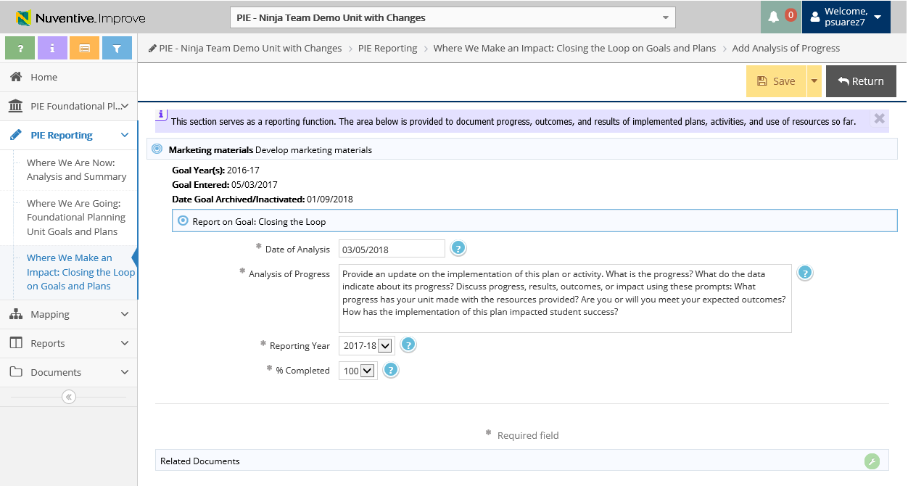
3. Where We Make an Impact – Add Analysis of Progress on Goals
3. Enter Analysis of Progress
6. Make sure to Save and Return
4. Ensure Reporting Year is 2017-18
*Give an update on Unit Goals for Reporting Year 2017-18 for Unit Goals from 2016-17*
5. Select what % of Goal is completed

Slide 13
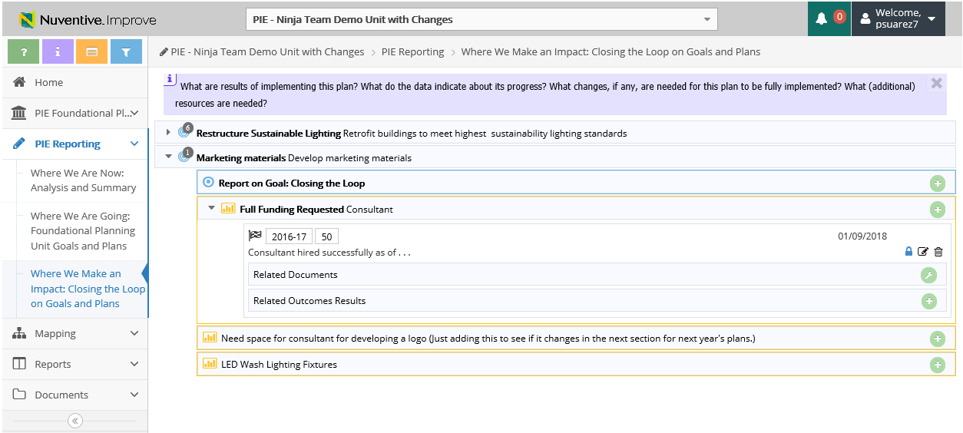
3. Closing the Loop – Add Analysis of Progress on Resources
2. Click to Add Analysis of Progress
1. Click to View Resources
*Each Resource will need Analysis of Progress for Reporting Year*
*Give an update on Resources for Reporting Year 2017-18 for Resources from 2016-17*

Slide 14
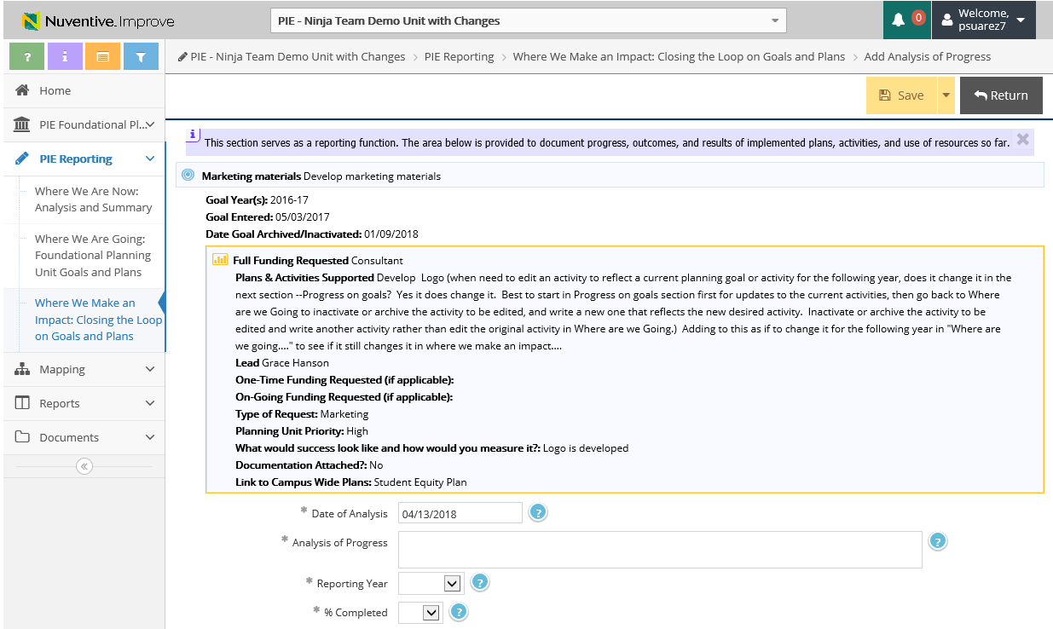
3. Closing the Loop – Add Analysis of Progress on Resources
5. Make sure to Save and Return
3. Enter progress of goals and plans
*Each Resource will need Analysis of Progress for Reporting Year*
4. Ensure Reporting Year is 2017-18

Slide 15
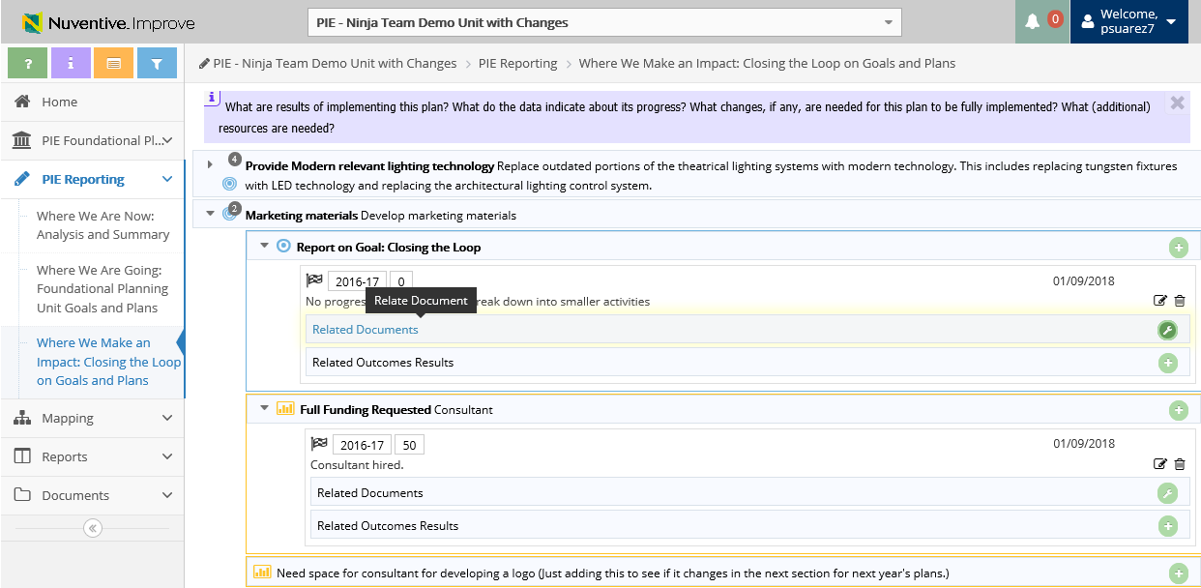
3. Where We Make an Impact – View & Add Related Documents
1. Click to Add Related Documents

Slide 16
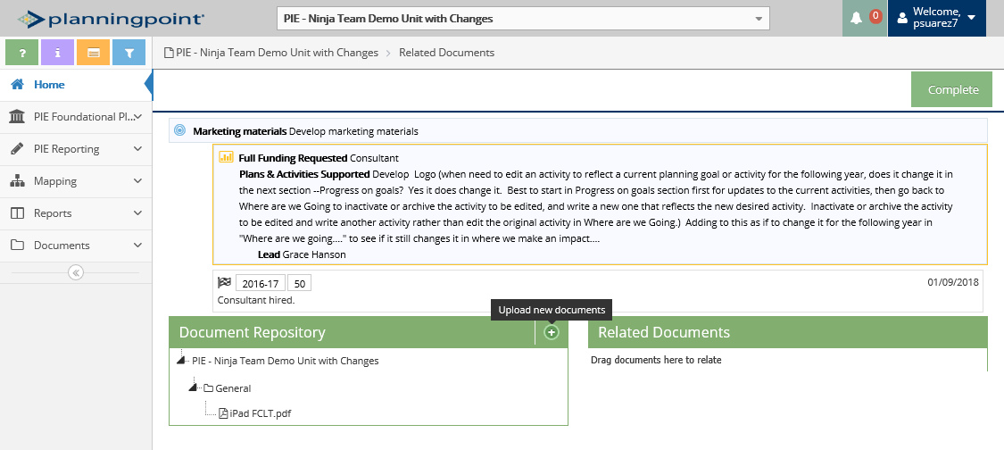
3. Where We Make an Impact – View & Add Related Documents
3. Click to View Document Repository
2. Click to Upload new documents

Slide 17
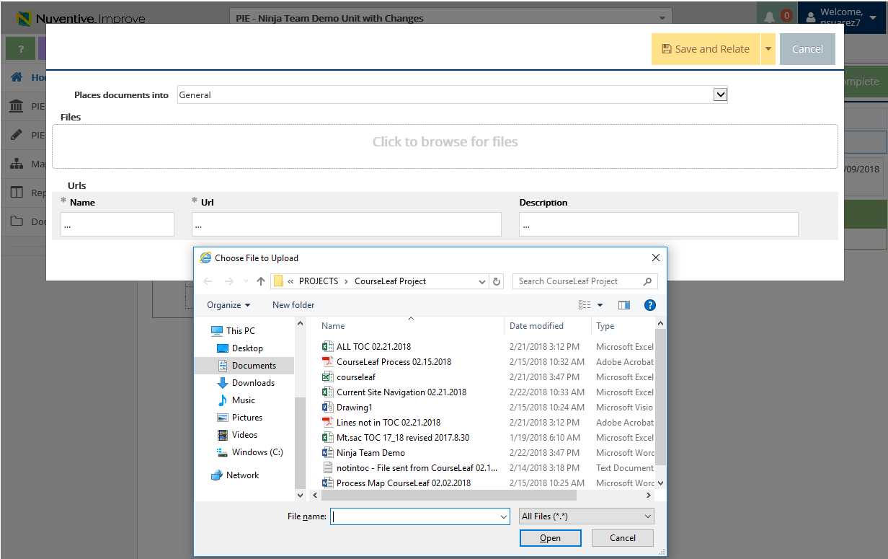
2. Where We Are Going – Uploading Documents to Resources
3. Where We Make an Impact –View & Add Related Documents
Document Retrieval Screen will display
4. Select Location to place uploaded documents to
5. Click to browse and add files on your computer
6. Select File and Select Open

Slide 18
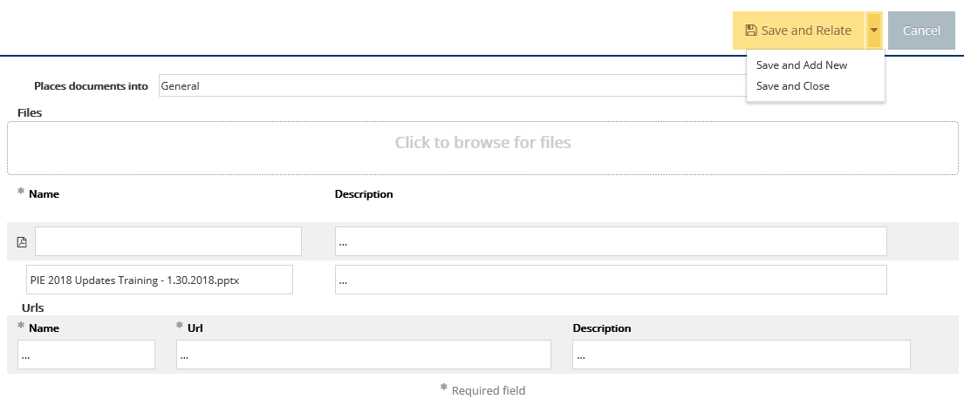
2. Where We Are Going – Uploading Documents to Resources
3. Where We Make an Impact –View & Add Related Documents
7. Select Save and Relate
Save and Add New: saves the document and stays on this screen to keep adding more documents
Save and Close: saves the document and returns to previous screen

Slide 19
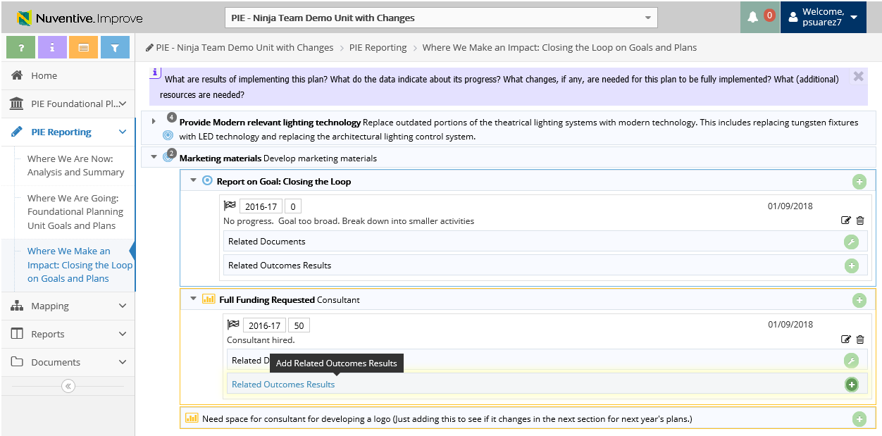
3. Where We Make an Impact – Related Outcomes Results
1. Click to Add Related Outcomes Results

Slide 20
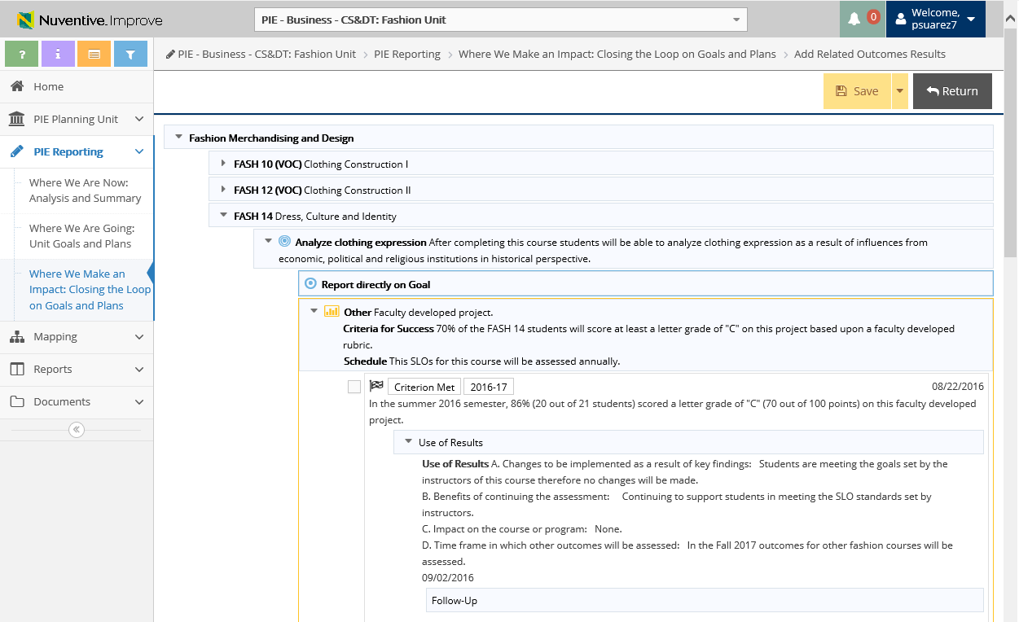
3. Where We Make an Impact – Related Outcomes Results
4. Don’t forget to Save and Return
2. Select drop down arrow to expand and view and report on Goal
3. Place check mark to tie in with SLO (will be added to Goal)

Slide 21
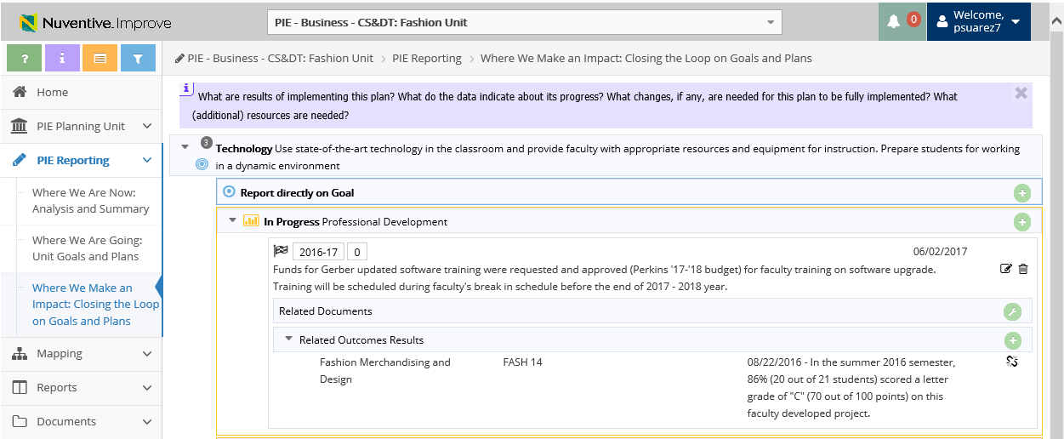
3. Where We Make an Impact – Related Outcomes Results
You are able to un-relate summary of data by selecting this icon
Related Outcome(s) will display

Slide 22
Planning for Institutional Effectiveness
Data Review
2018 User Guide

Slide 23
Data Review - Login
1. www.mtsac.edu/pie
2. Click to access PIE

Slide 24
Data Review - Login
After clicking on “Go to PIE” use your Mt. SAC credentials to access the SharePoint interface that houses PowerBI to begin the process
3. Use portal user name &
password to login
4. Click on the green Start Button to begin Data Review
Notes:
Pedro: is this what everyone else that isn’t intimately working on PIE will see? When I log in, I see two different start buttons. Will the user get confused by this??
** we have the same login structure for the regular PIE input, I can put a screenshot of both and tell them to choose the green one etc.

Slide 25
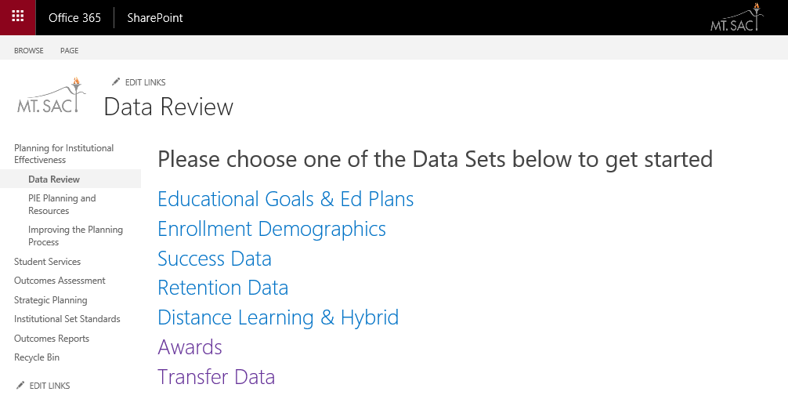
Data Review – Access Data
Click Below
Select any of these categories

Slide 26
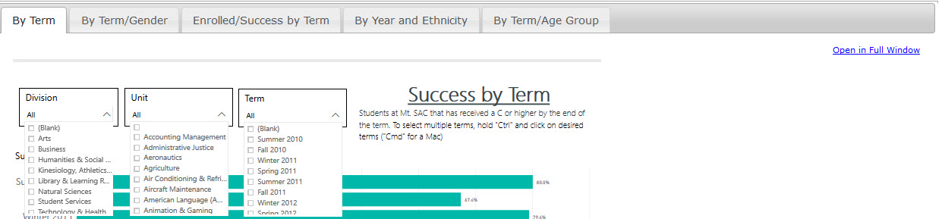
Data Review – SUCCESS - Selecting Items
1. Select Division
2. Select Unit
3. Select Term
Notes:
Pedro: Maybe we should rewrite the drop down menu instructions to “In each of the drop down menus (i.e. Division, Unit, Term), you can select multiple terms, units and divisions. Just left click on each drop down menu, press “Ctrl” on your keyboard and click on the desired filter. (‘Cmd’ for Mac users). To minimize the drop down menu, just left click on the menu again.”
“Select for Full Window. Note: this will open up a new tab in your web browser. To close, just close the tab and you will be back to the previous menu”

Slide 27
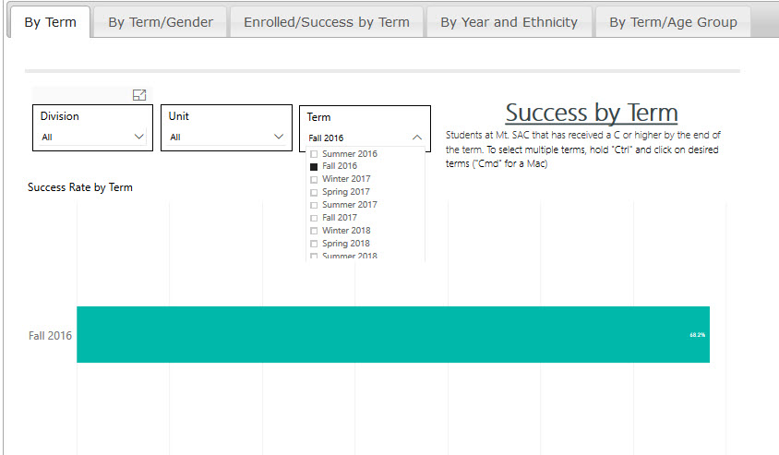
This example shows success for one term (Fall 2016).

Slide 28
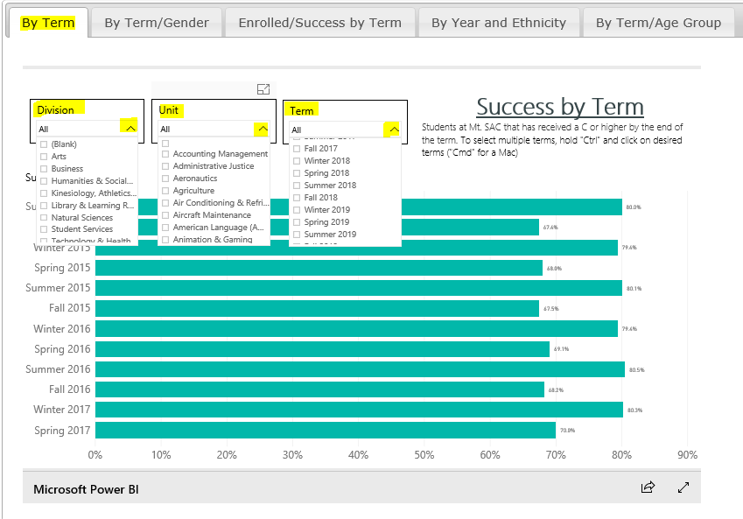
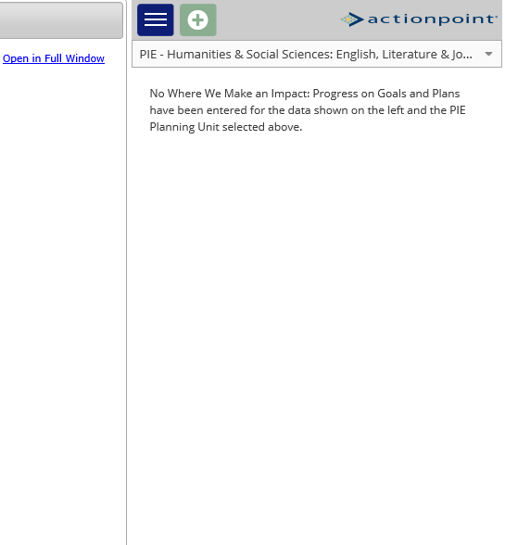
Data Review – SUCCESS - Selecting Items
Select for Full Window
Note: this will open up a new tab in your web browser. To close, just close the tab and you will be back to the previous menu”
* In each of the drop down menus (i.e. Division, Unit, Term), you can select multiple terms, units and divisions. Just left click on each drop down menu, press “Ctrl” on your keyboard and click on the desired filter. (‘Cmd’ for Mac users). To minimize the drop down menu, just left click on the menu again”
Notes:
Pedro: Maybe we should rewrite the drop down menu instructions to “In each of the drop down menus (i.e. Division, Unit, Term), you can select multiple terms, units and divisions. Just left click on each drop down menu, press “Ctrl” on your keyboard and click on the desired filter. (‘Cmd’ for Mac users). To minimize the drop down menu, just left click on the menu again.”
“Select for Full Window. Note: this will open up a new tab in your web browser. To close, just close the tab and you will be back to the previous menu”

Slide 29
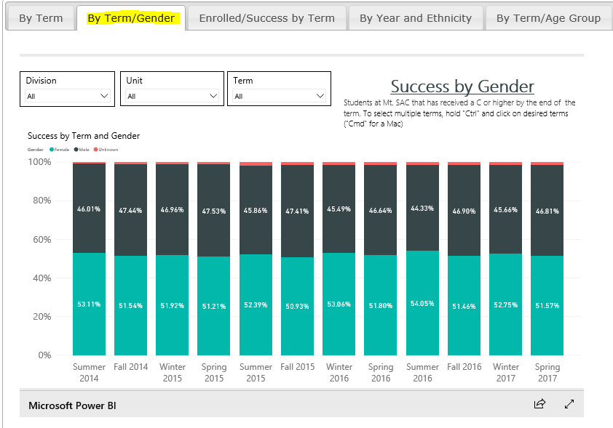
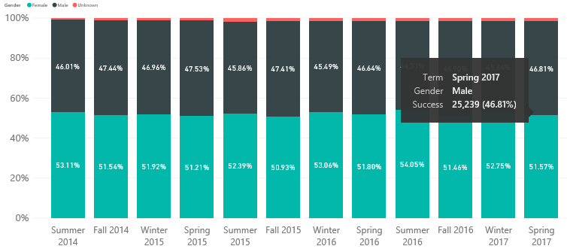
Data Review – SUCCESS – By Term/Gender
The second tab in the Success section displays Term by Gender
A user can hover over a bar and they can get the Title of the bar as well as the Count
(available throughout the interface)

Slide 30
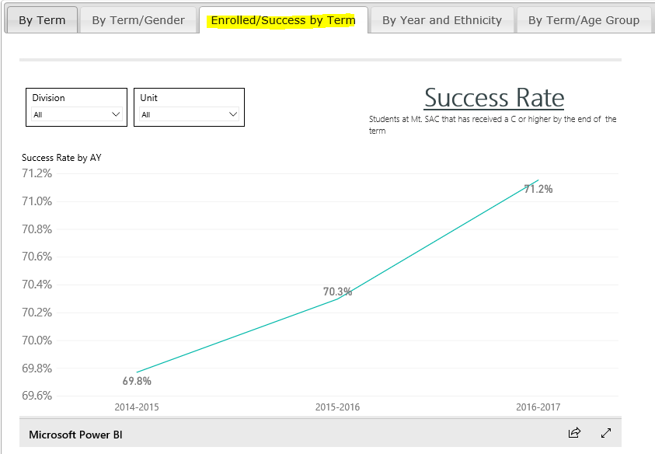
Data Review – SUCCESS – Enrolled/ Success by Term
The third tab displays Enrolled by Success and Term. Student has received a ‘C’ or higher by the end of Term.

Slide 31
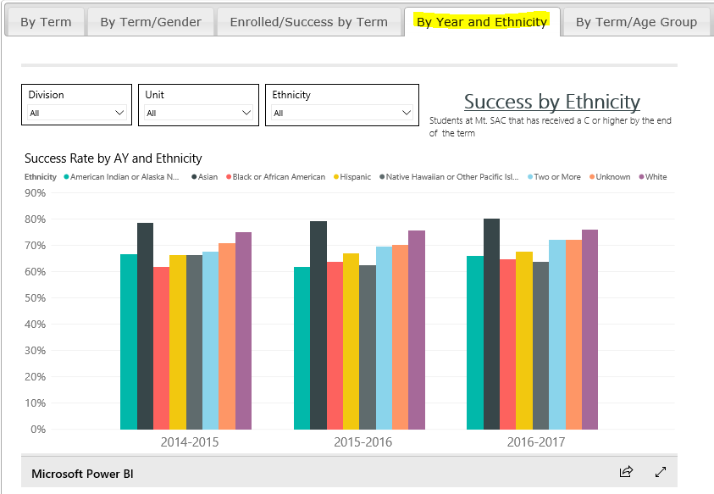
Data Review – SUCCESS – By Year and Ethnicity
The next tab displays Success by Ethnicity. Select Division, Unit, and Ethnicity for a specific ethnic category

Slide 32
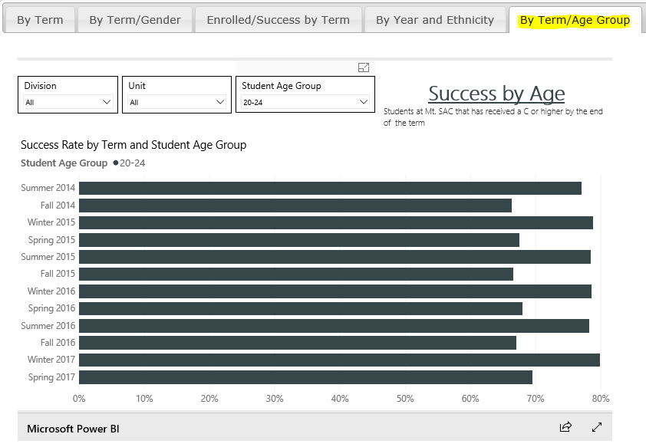
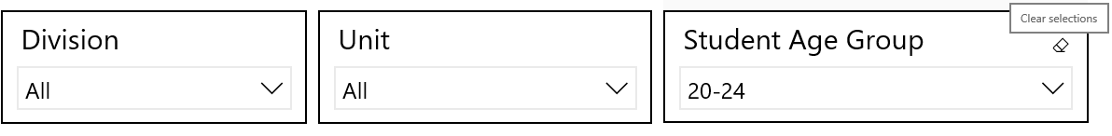
Data Review – SUCCESS – By Term/ Age Group
In the Term by Age Group Tab, students’ success rate by term and student age group is displayed
You can remove filter by using Eraser Button on Filter

Slide 33
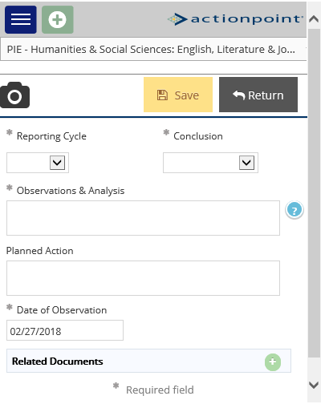
Data Review – SUCCESS – ActionPoint
1. Click on the Plus Button
4. Save and Return
3. There you can add your analysis of progress and how your area will address the data through planning.
2. Select Unit

Slide 34
Data Review – Data Review Questions
What are your initial thoughts on the data?
What might be contributing to student success in your program?
What might be detracting student success in your program?
Is this the data we need to make a decision? Why or why not?
What is the most important information?
What is missing?

Slide 35
Data Review – Helpful PIE Definitions
Educational Goal: The number of students that stated their informed educational goal after participating in the matriculation process.
Ed Plan: The number of students that completed a comprehensive Ed Plan
(Make sure that the fields are describing what we want them to describe).
Enrollment (Demographics) – A student is enrolled in a course if they received an end-of-term notation that is displayed on their official transcript.
Success (Data) – The percentage of students who received a passing/satisfactory grade.

Slide 36
Data Review – Helpful PIE Definitions
Retention – The percentage of students who do not withdraw from class and who receive a valid grade.
Distance Learning – A fully online class with non on-campus meetings.
Hybrid – Is a hybrid class taught partially online with scheduled meetings on-campus.
Awards – The number of degree/certificates given to a student upon the successful completion of a program at Mt. SAC. This includes all Associates, certificates and noncredit awards.
Transfer (Data) – *The number of students enrolling in either the University of California (UC) or the California State University (CSU) system.
* Transfer by program is not available at this time.

Slide 37

PIE Planning & Resources
Where We Are Now

Slide 38
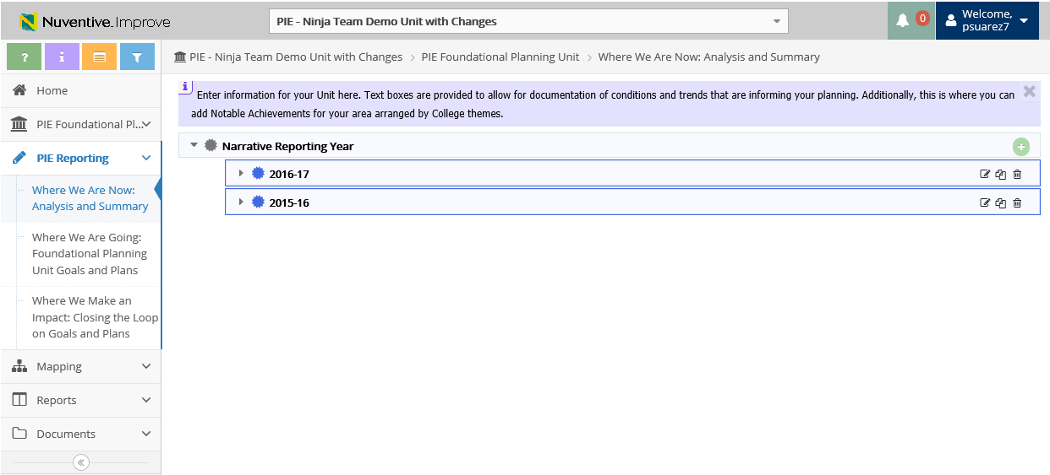
1. Where We Are Now – View & Add Reporting Year
Summary of Previous Years will Display
Add
Edit
Copy
Delete

Slide 39
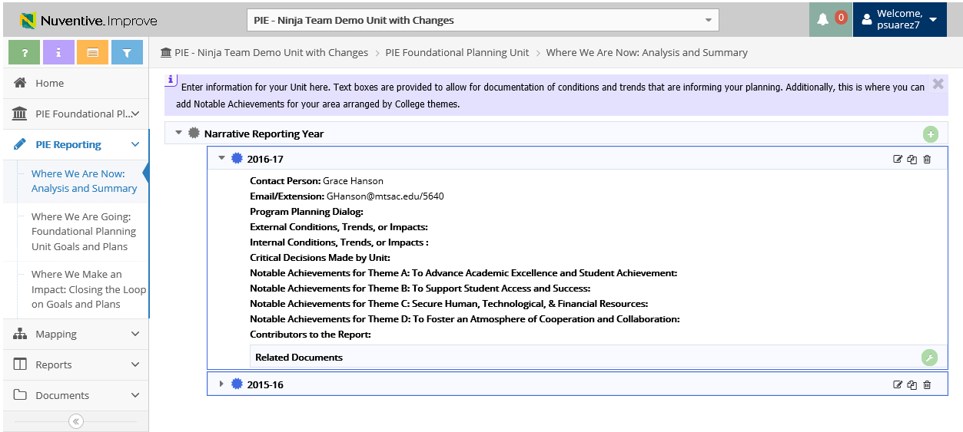
1. Where We Are Now – View & Copy Reporting Year
2. Click to Copy Year
1. Click to View selected Year data

Slide 40
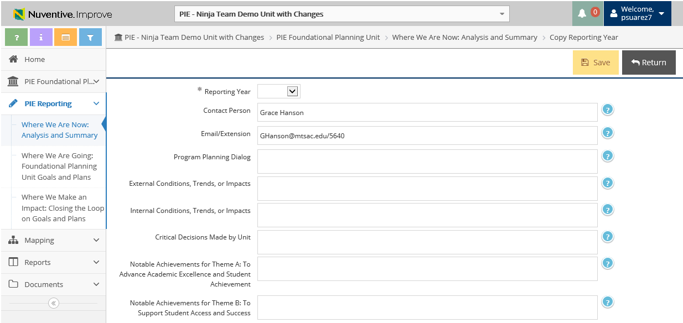

1. Where We Are Now – Copy Year Data
3. Enter New Year
5. Click Save
4. Enter data into the related fields
6. Click Return for previous page

Slide 41
1. Where We Are Now – View & Add Reporting Year
1. Click to Add New Reporting Year
*only Add New Reporting Year to start a new PIE with no previous entries

Slide 42
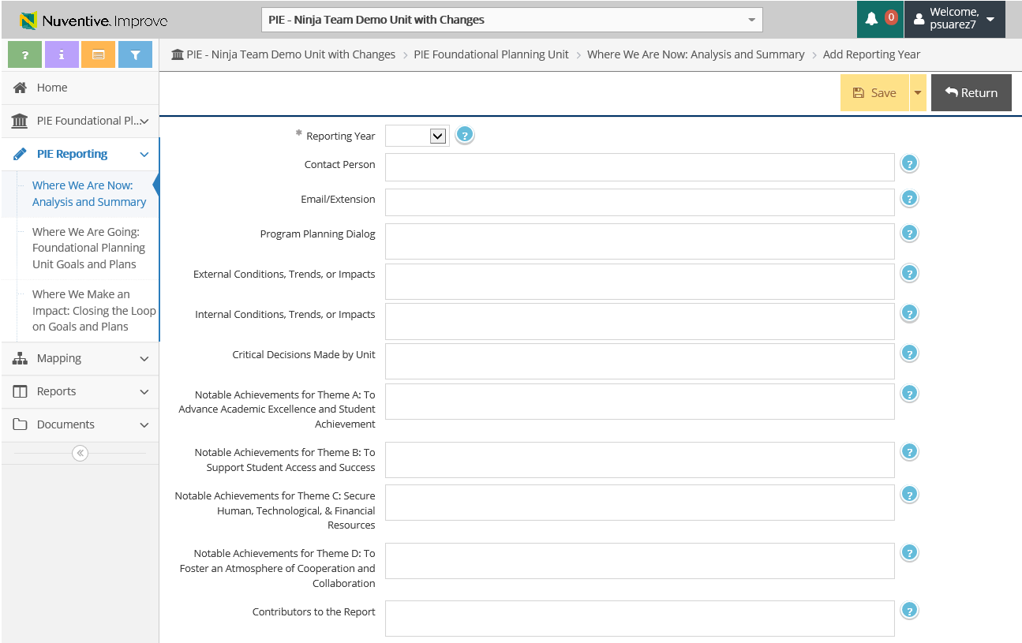
1. Where We Are Now – Add New Reporting Year
3. Click Save
4. Click Return for previous page
2. Enter data into the related fields

Slide 43

PIE Planning & Resources
Where We Are Going

Slide 44
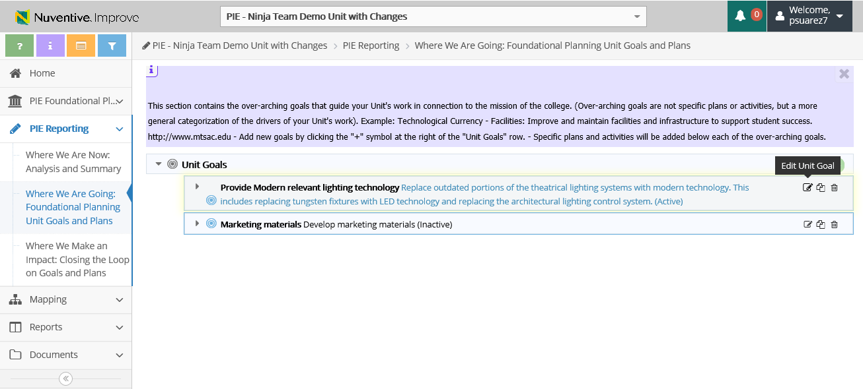
Review and Update Exisiting Goals
2. Where We Are Going – Edit Unit Goals
1. Click to View Unit Goals
2. Click to Edit Unit Goals
*These are existing goals from last year. If substantial changes are being made, a new goal should be added

Slide 45
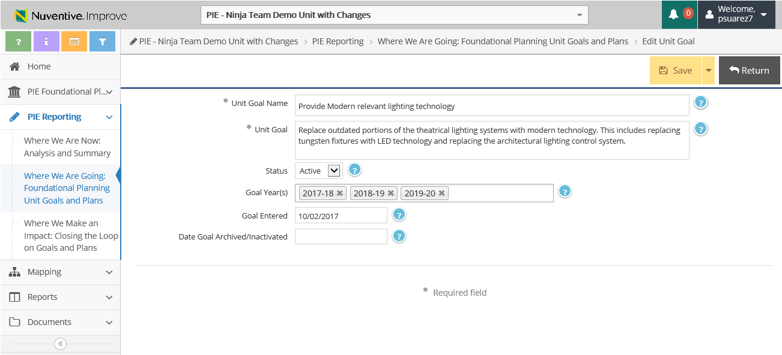
Review and Update Exisiting Goals
2. Where We Are Going – Edit Unit Goals
4. Select Goal Years (Multiple years may be selected)
3. Enter information into the following fields
5. Make sure to Save & Return
*Substantive edits should not be made to Unit Name or Unit Goal

Slide 46
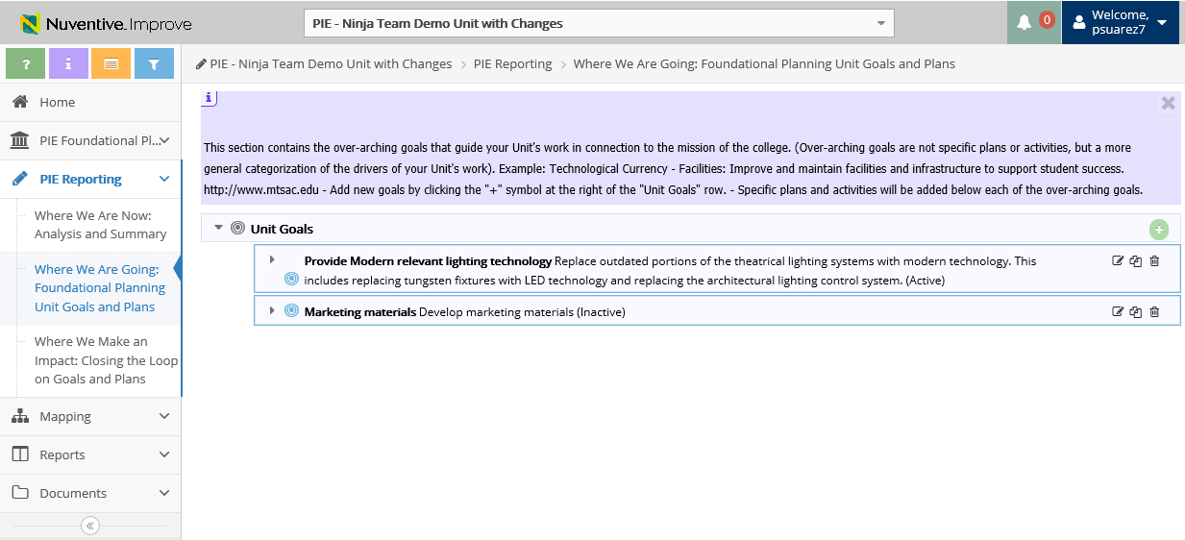
2. Where We Are Going – Add Unit Goals
1. Click to Add Unit Goals

Slide 47
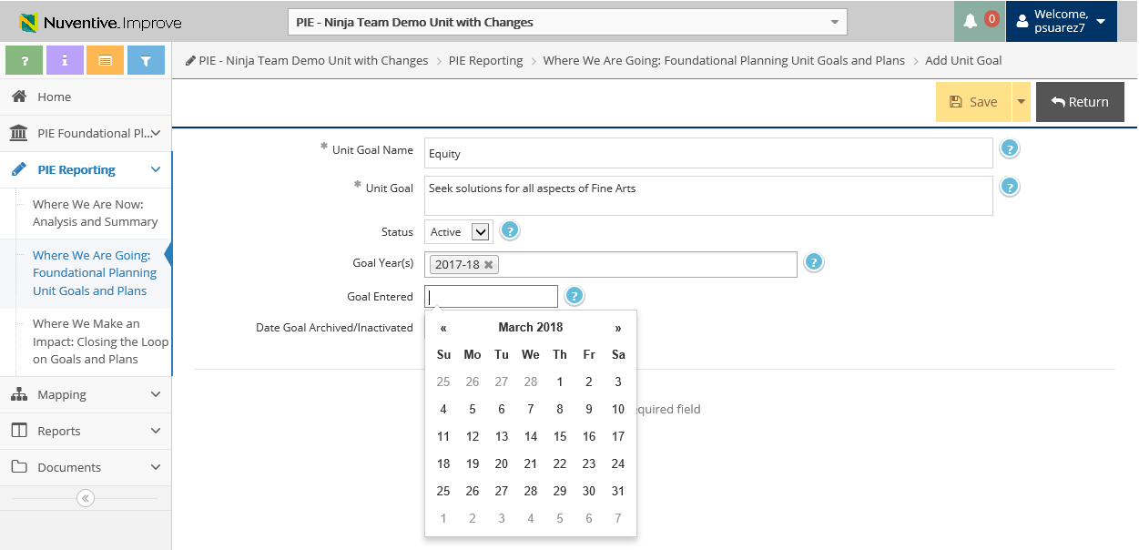
2. Where We Are Going – Add Unit Goals
4. Make sure to Save & Return
2. Enter information into the following fields
3. Select Goal Years (Multiple years may be selected)

Slide 48
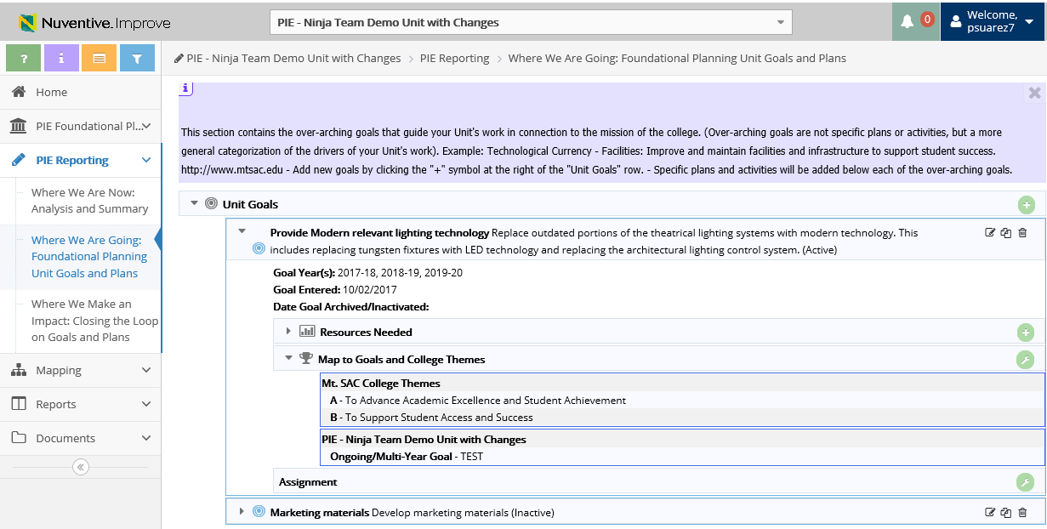
2. Where We Are Going – View Resources
Resources Needed
Click to View Unit Goal Details

Slide 49
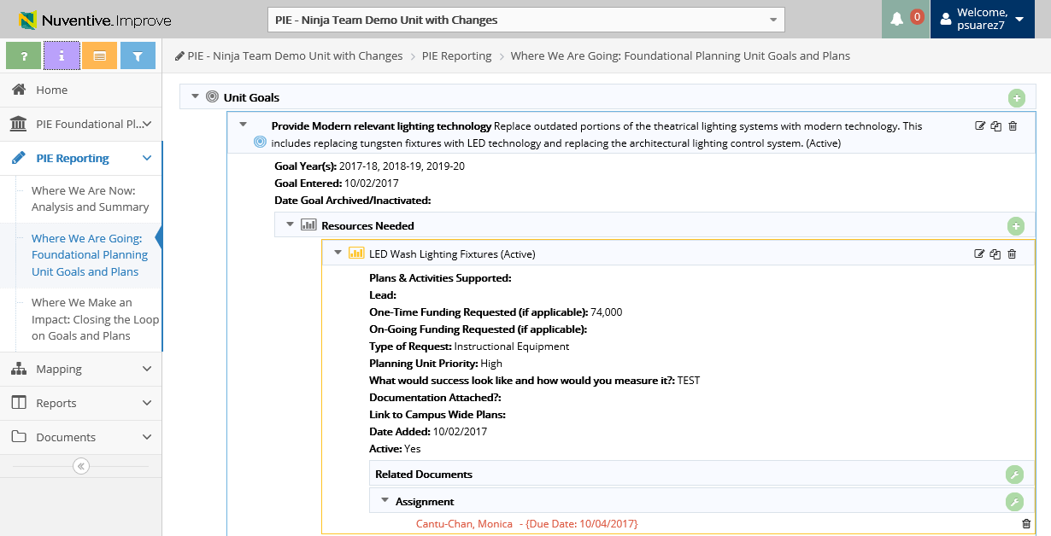
2. Where We Are Going – View Resources
Click to Copy or
Edit Resource
Click to View Resource

Slide 50
2. Where We Are Going – Add Resources Needed
2. Click to Add Resource Needed
1. Select Unit Goal to expand

Slide 51
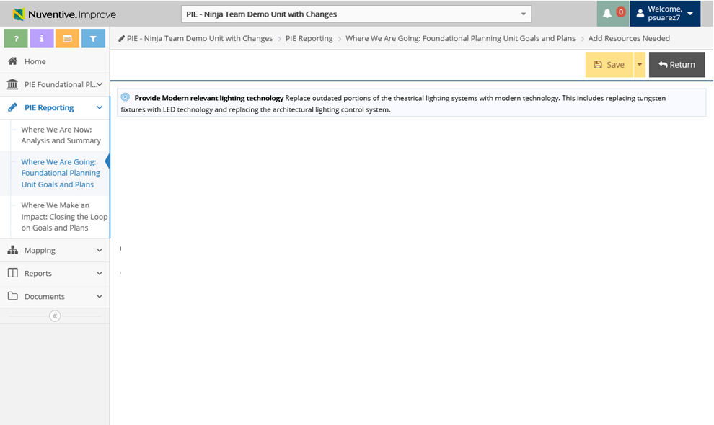
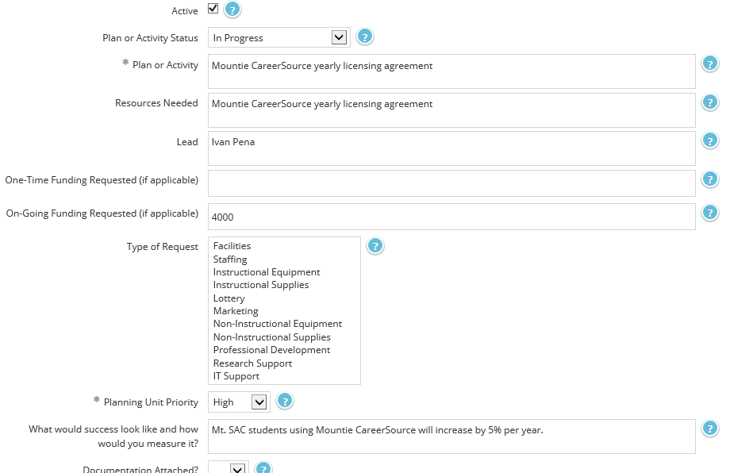
2. Where We Are Going – Add Resources Needed
3. Check On or Off the Active Box
6. Make sure to Save & Return
4. When Adding Resources, enter information into the following fields
5. Select Type of Request

Slide 52
Review and Update Exisiting Goals
2. Where We Are Going – Copy & Moving Resources
2. Click to Copy Unit Goals
1. Click to View Resources Needed

Slide 53
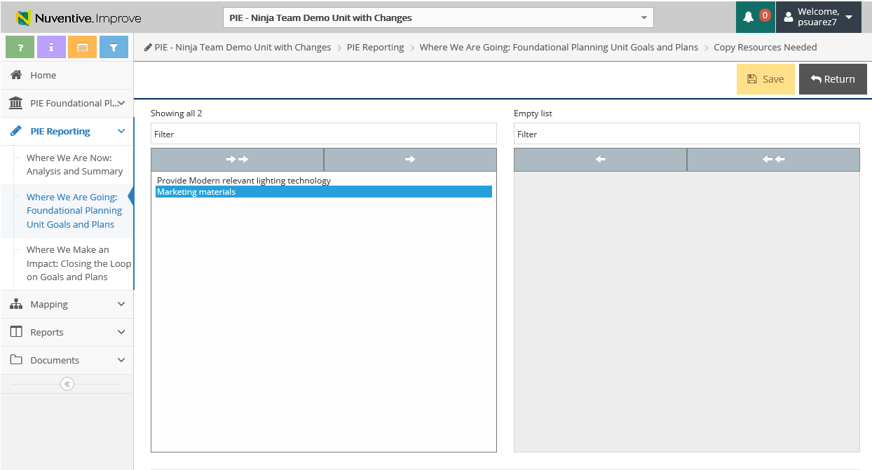
Review and Update Exisiting Goals
2. Where We Are Going – Copy & Moving Resources
3. Select Unit Goal you wish to Copy Resource to
6. Save & Return
You will see all of your Unit Goals displayed
4. Select the Right Arrow to “Move Selected” Unit to the right bucket
5. Unit Goal will appear

Slide 54
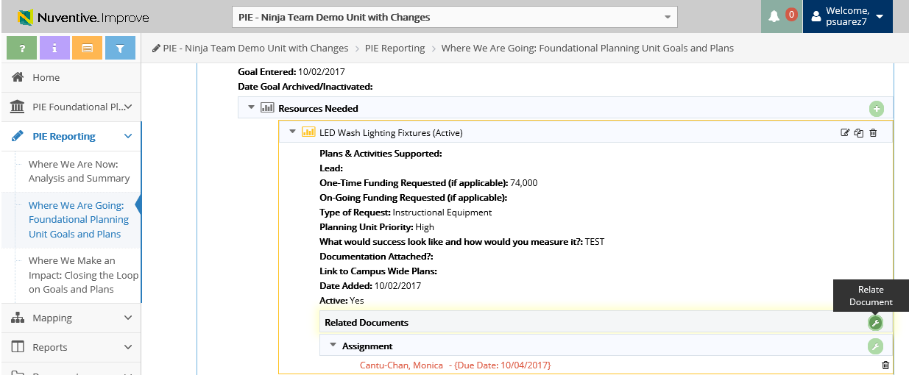
2. Where We Are Going – View & Upload Related Documents
1. Click to Add Related Documents to the Resource

Slide 55
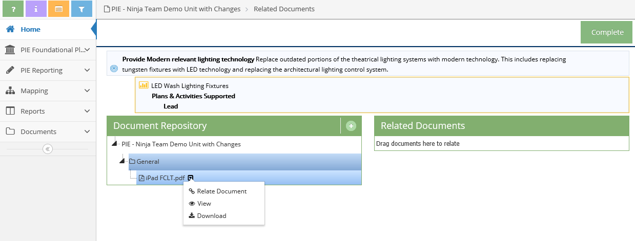
2. Where We Are Going – Uploading Documents to Resources
2. Click to be able to upload documents
3. Documents Repository (Where files are stored via TracDat that were uploaded

Slide 56
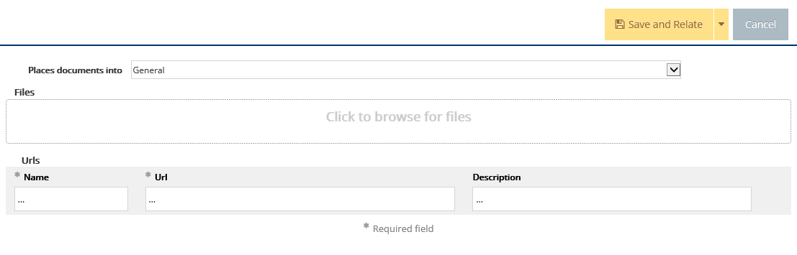
2. Where We Are Going – Uploading Documents to Resources
Document Retrieval Screen will display
4. Select Location to place uploaded documents to

Slide 57
2. Where We Are Going – Uploading Documents to Resources
5. Click to browse and add files on your computer
6. Select File and Select Open

Slide 58
2. Where We Are Going – Uploading Documents to Resources
7. Select Save and Relate
Save and Add New: saves the document and stays on this screen to keep adding more documents
Save and Close: saves the document and returns to previous screen

Slide 59
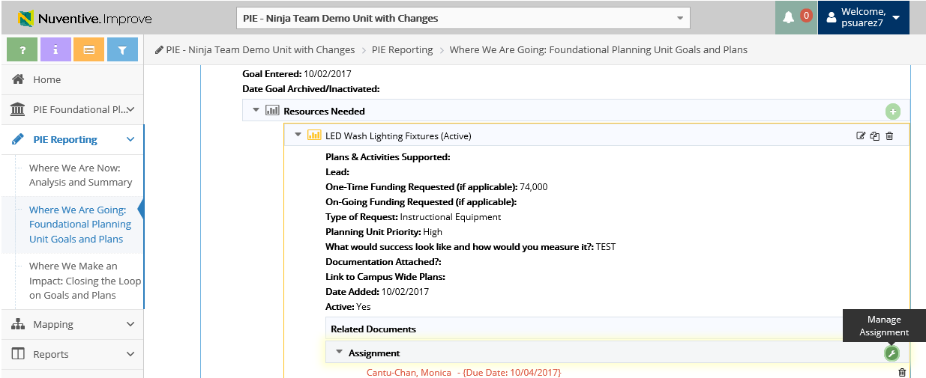
2. Where We Are Going – Manage Assignment
1. Click tool icon to Manage Assignment

Slide 60
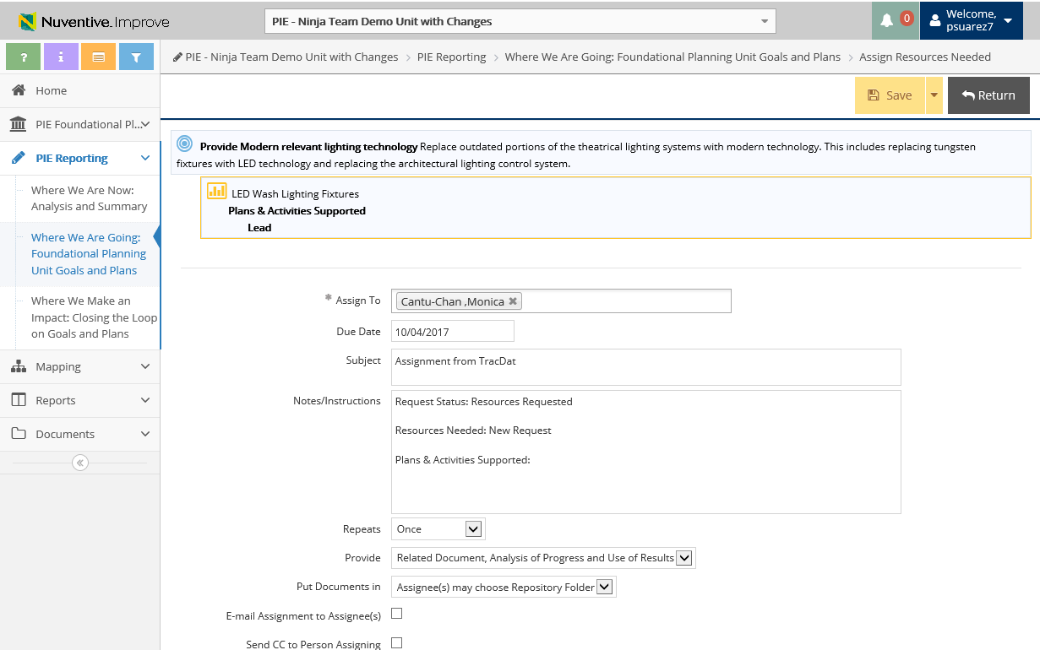
2. Where We Are Going – Manage Assignment
3. Select Save and Return
2. Enter information into the following fields

Slide 61
PIE Planning & Resources
Mapping

Slide 62
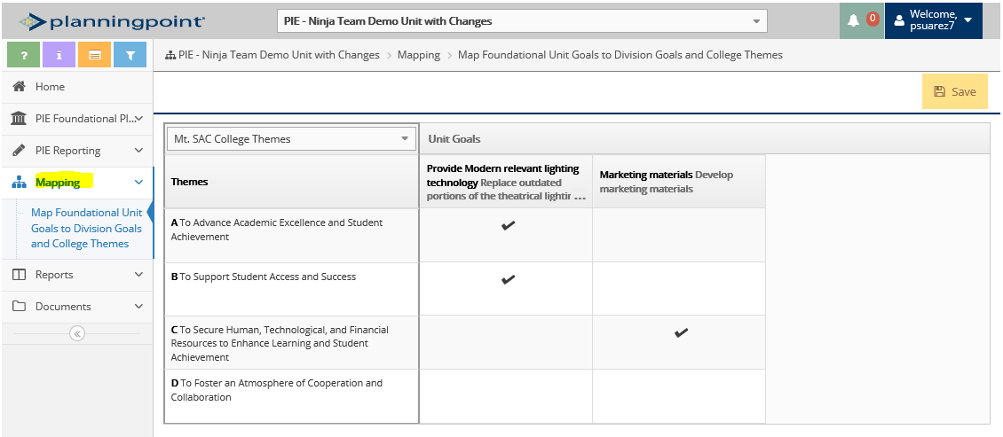
3. Mapping – Select Map Foundational Goals
1. Select Mapping Drop Down Menu
2. Select Map Foundational Unit Goals to Division Goals and College Themes

Slide 63

3. Mapping – Select Mt. SAC College Themes
3. Select Goal Mapping on drop down menu
Users have the ability to Select various Subject Matter Plan Goals
* If any goals related to the Integrated Plan, then this section is where you will do linking

Slide 64

3. Mapping – Select Mt. SAC College Themes
5. Select Save
4. Unit Goals are broken out by theme and a check mark can be place in respect to the applicable Subject Matter Plan Goals

Slide 65
PIE Planning & Resources
Reports

Slide 66

3. Reports – View & Generate Reports
1. Select Standard Reports
3. Select Report
(recommended reports: 1 and 2)
2. Description of Reports will display

Slide 67

3. Reports - Generating Reports
4. Select Format
(PDF, HTML and Word)
5. Insert Report Title
7. Click on Open Report
6. Enter Filters *(if applicable)
*Reports have default settings, only use if specifying certain data

Slide 68

3. Reports – Display of Reports
8. Report will Display

Slide 69

Resources
PIE Content Questions
Michelle Sampat: msampat@mtsac.edu
Meghan Chen: mchen@mtsac.edu
PIE Summaries are due by May 1st, 2018
Research/ Data Review Questions
Barbara McNeice-Stallard:
bmcneice-stallard@mtsac.edu
Technical Questions:
Pedro Suarez: psuarez7@mtsac.edu
Video Training Resources:
http://www.mtsac.edu/pie

