Slide 1
Planning for Institutional Effectiveness
PIE Planning & Resources
2018 User Guide

Slide 2
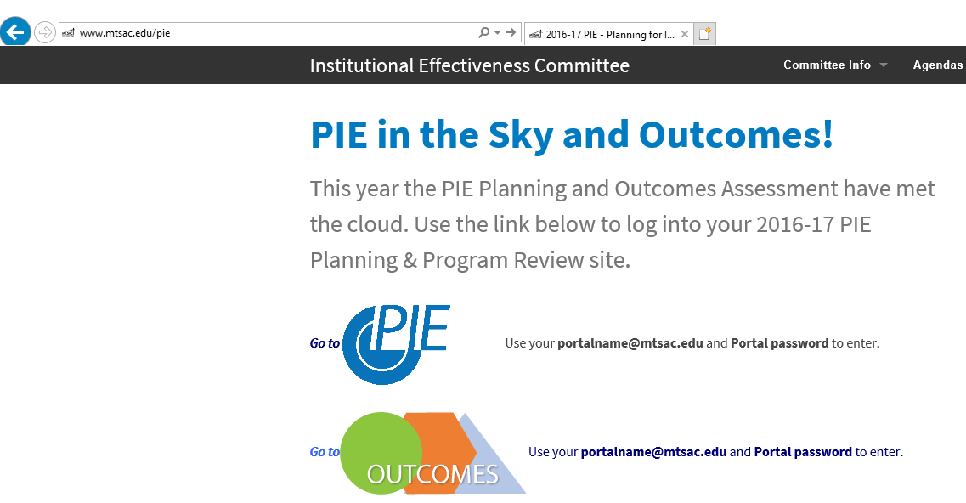
PIE - Access
1. . www.mtsac.edu/pie
2. Click to access PIE

Slide 3
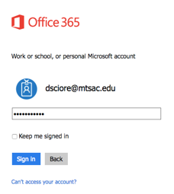
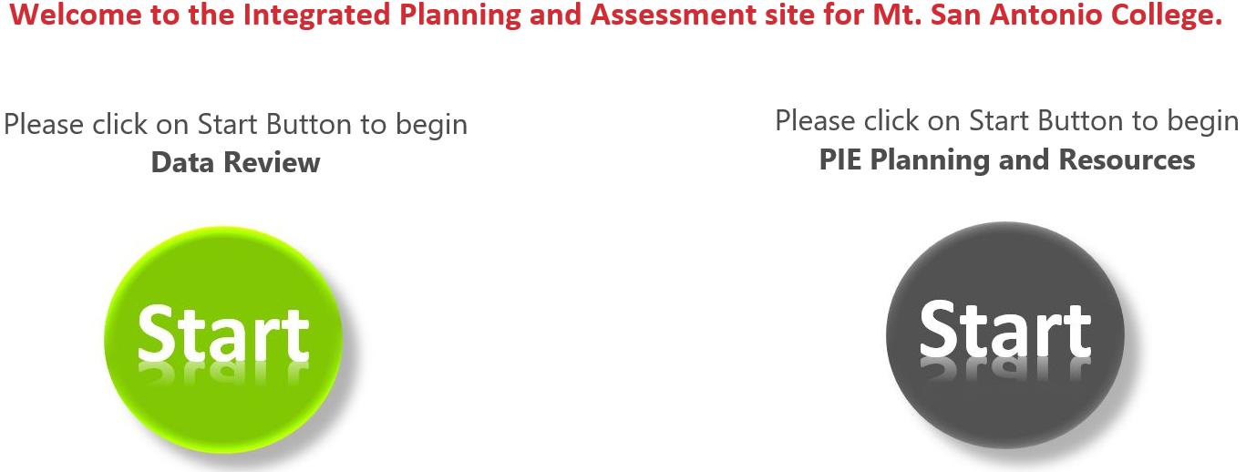
PIE - Home Screen
After clicking on “Go to PIE” use your Mt. SAC credentials to access the SharePoint interface that houses PIE to begin the process
3. Use portal user name &
password to login
4. Click on the gray Start Button to begin PIE Planning and Resources

Slide 4
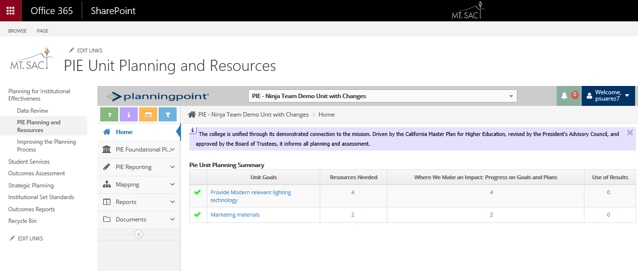
PIE - Unit Planning and Resources
SharePoint displays the PIE Unit interface to enter data

Slide 5
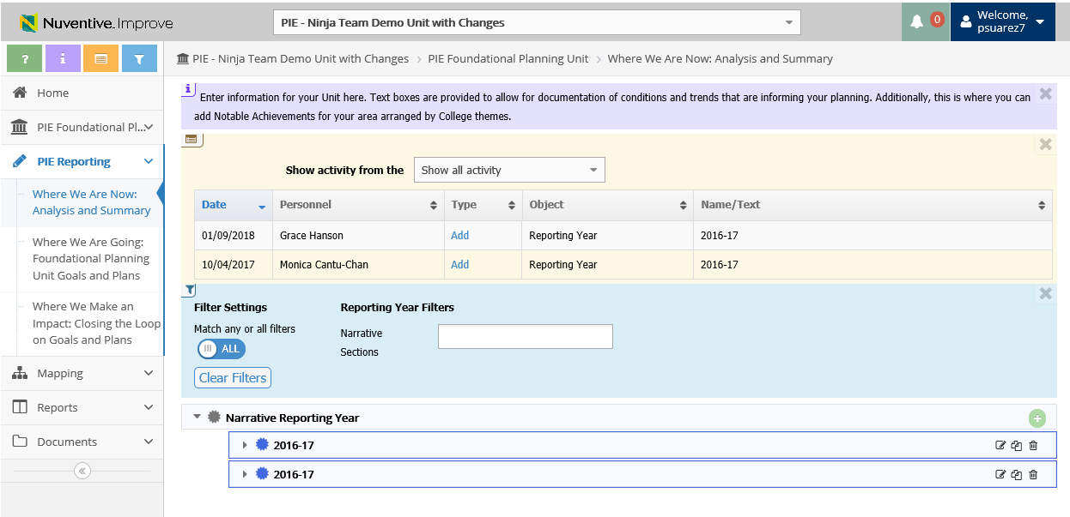
PIE - Unit Planning and Resources – Tool Bar
a. Open Page Help (help content)
b. Open Page Instructions (explanation of requirements)
c. Open Page Log (journal of activity)
d. Open Page Filter (narrow down searches)
b
c
d

Slide 6
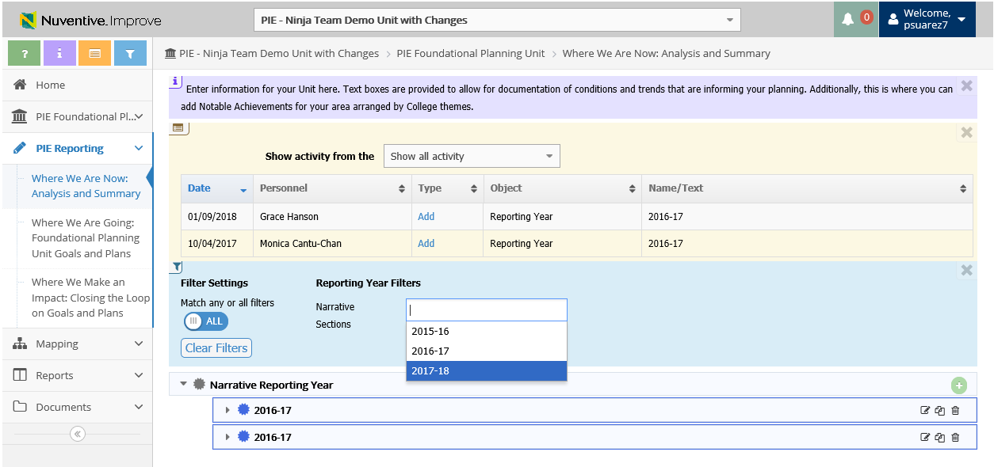
PIE - Unit Planning and Resources – Filter
d. Open Page Filter (narrow down searches)
Filters can be applied and will remain until they are cleared
d.

Slide 7
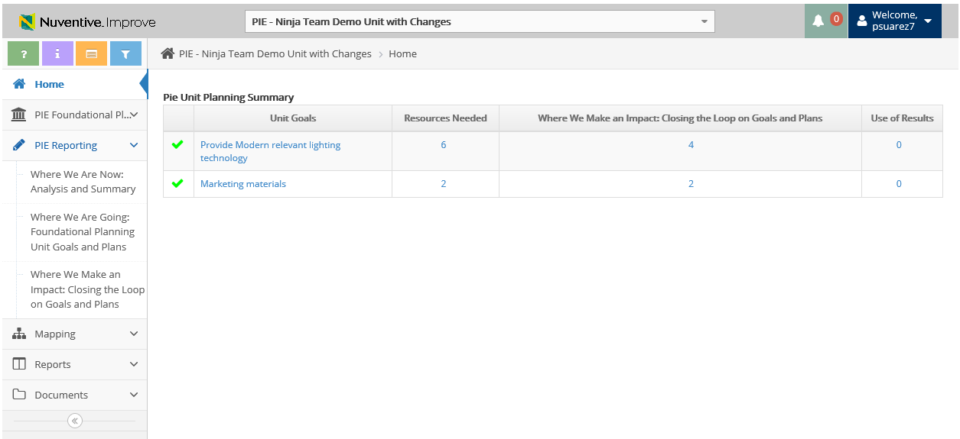
PIE - Unit Planning and Resources
Select PIE Reporting to view the 3 Planning Sections
Where We Are Now: Analysis and Summary
Where We Are Going: Foundational Planning
Where We Make an Impact: Closing the Loop on Goals and Plans

Slide 8
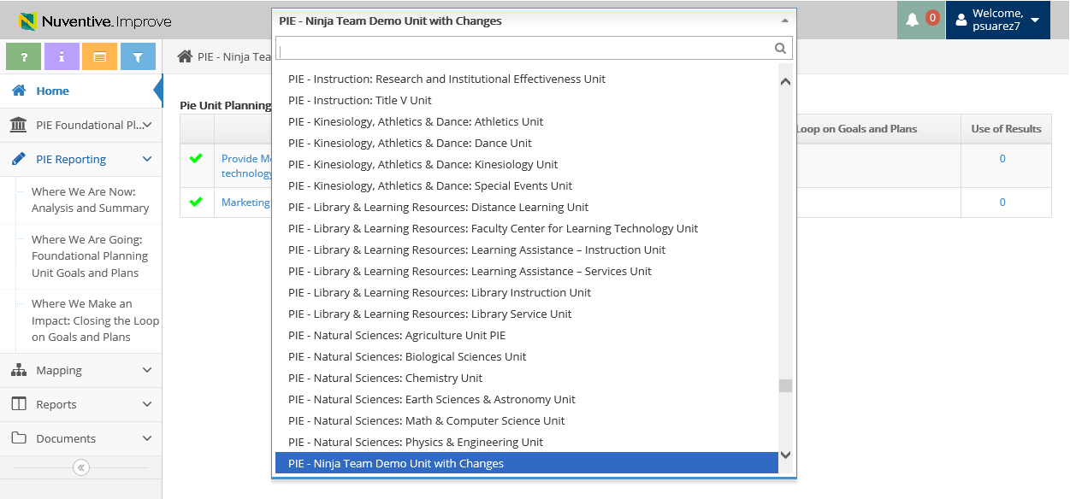
PIE - Unit Planning and Resources
Select the dropdown arrow and select respected department (user has the ability to type in department name)
*Make sure the Unit starts with “PIE”

Slide 9
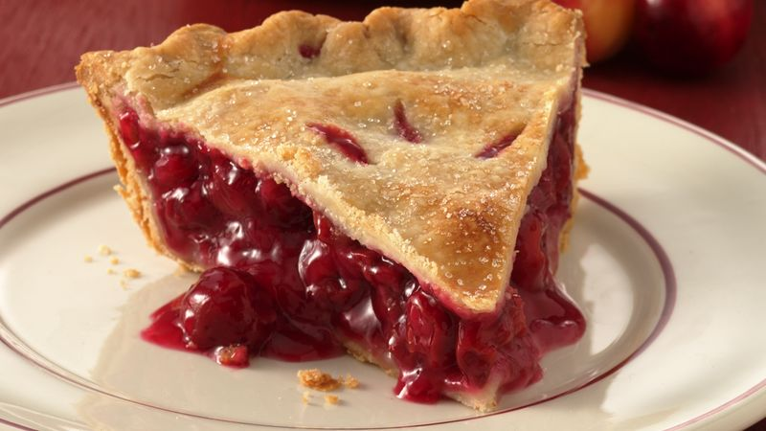

Resources
PIE Content Questions
Michelle Sampat: msampat@mtsac.edu
Meghan Chen: mchen@mtsac.edu
Easy as PIE
Research/ Data Review Questions
Barbara McNeice-Stallard:
bmcneice-stallard@mtsac.edu
Technical Questions:
Pedro Suarez: psuarez7@mtsac.edu
Video Training Resources:
http://www.mtsac.edu/pie

