Slide 1

PIE Planning & Resources
Where We Are Going

Slide 2
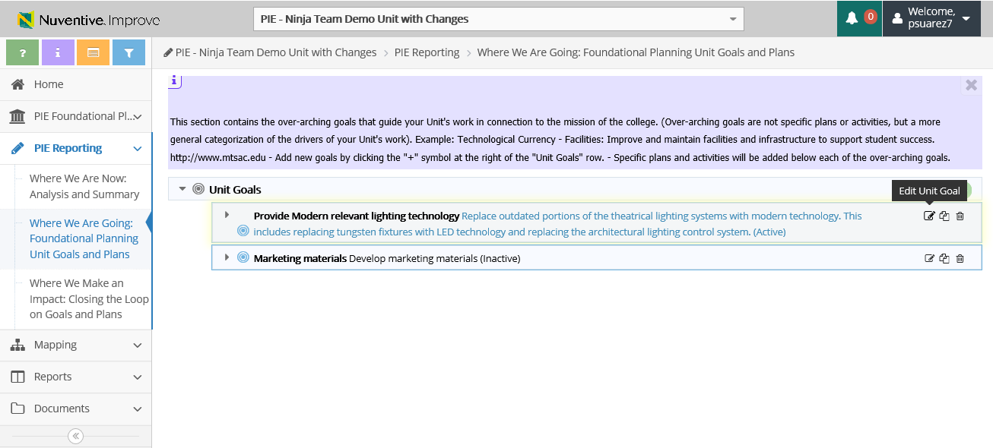
Review and Update Exisiting Goals
2. Where We Are Going – Edit Unit Goals
1. Click to View Unit Goals
2. Click to Edit Unit Goals
*These are existing goals from last year. If substantial changes are being made, a new goal should be added

Slide 3
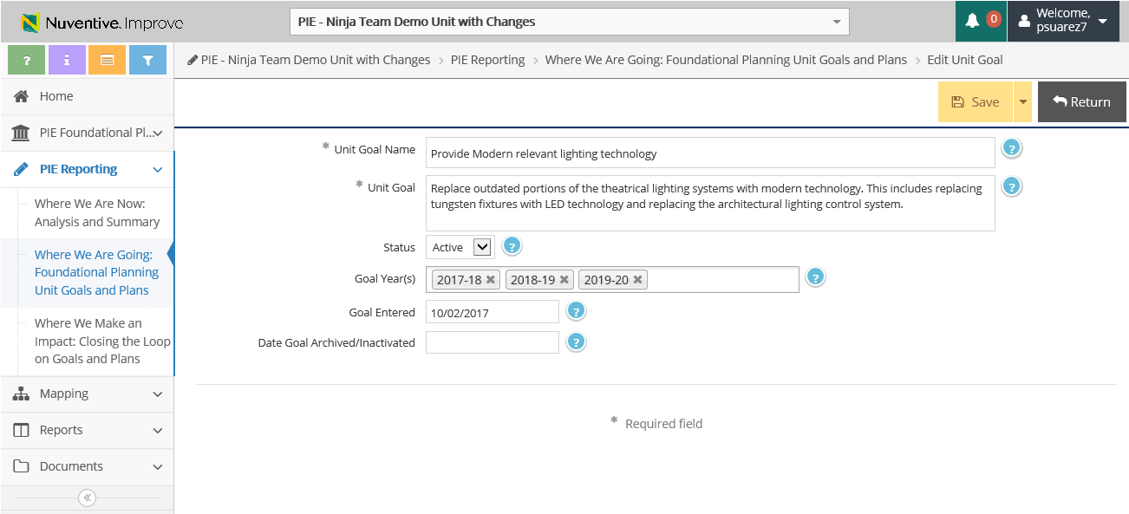
Review and Update Exisiting Goals
2. Where We Are Going – Edit Unit Goals
4. Select Goal Years (Multiple years may be selected)
3. Enter information into the following fields
5. Make sure to Save & Return
*Substantive edits should not be made to Unit Name or Unit Goal

Slide 4
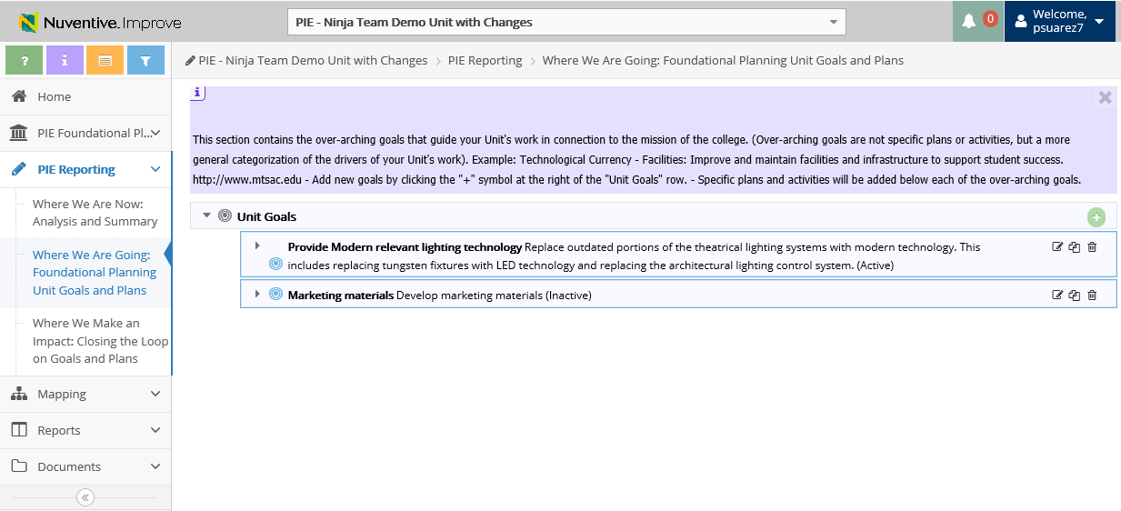
2. Where We Are Going – Add Unit Goals
1. Click to Add Unit Goals

Slide 5
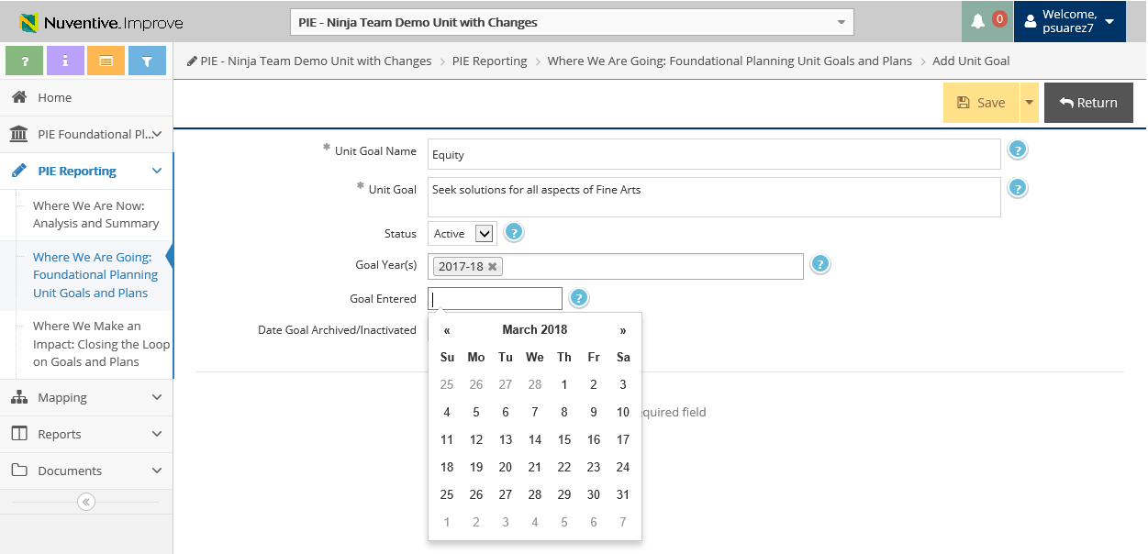
2. Where We Are Going – Add Unit Goals
4. Make sure to Save & Return
2. Enter information into the following fields
3. Select Goal Years (Multiple years may be selected)

Slide 6
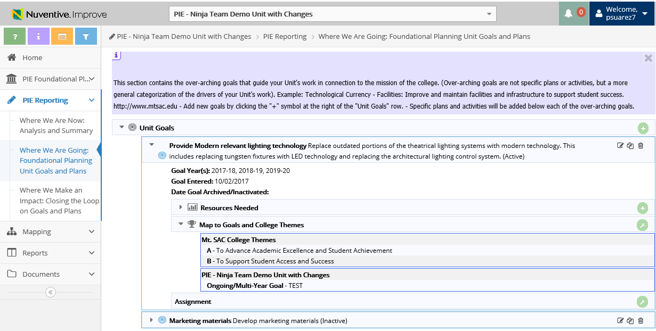
2. Where We Are Going – View Resources
Resources Needed
Click to View Unit Goal Details

Slide 7
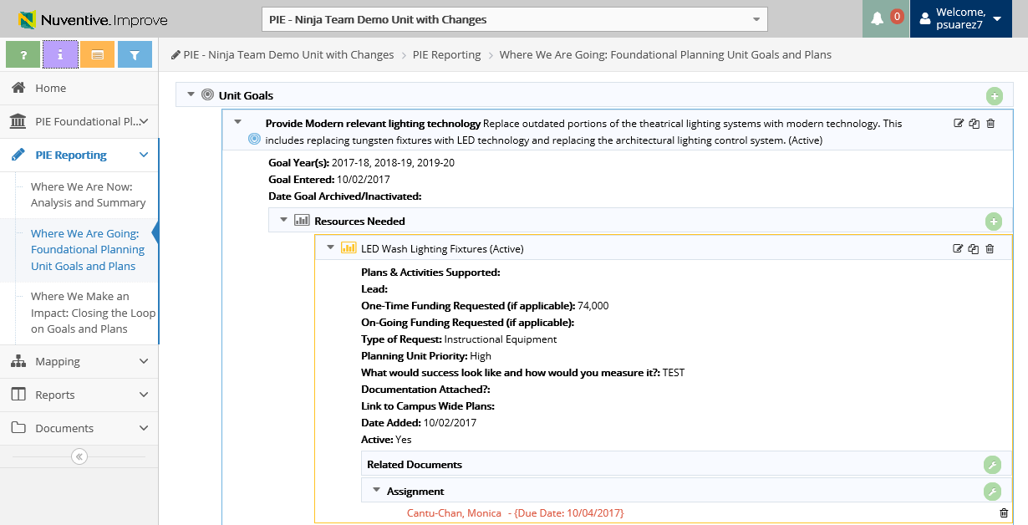
2. Where We Are Going – View Resources
Click to Copy or
Edit Resource
Click to View Resource

Slide 8
2. Where We Are Going – Add Resources Needed
2. Click to Add Resource Needed
1. Select Unit Goal to expand

Slide 9
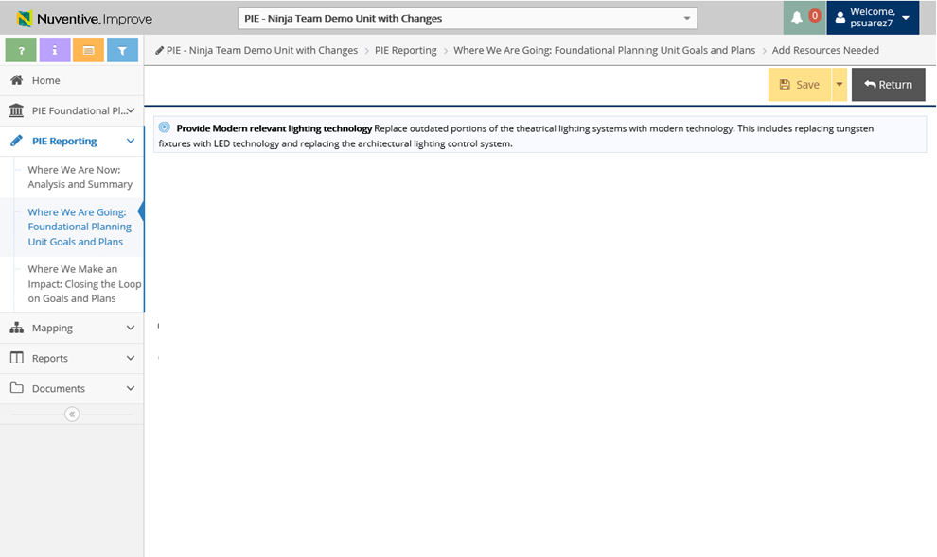
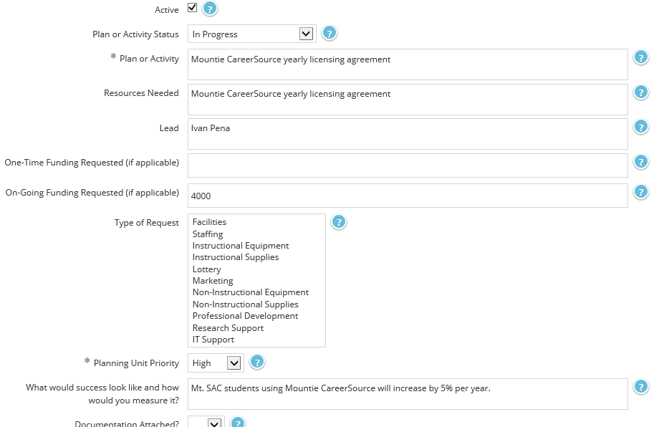
2. Where We Are Going – Add Resources Needed
3. Check On or Off the Active Box
6. Make sure to Save & Return
4. When Adding Resources, enter information into the following fields
5. Select Type of Request

Slide 10
Review and Update Exisiting Goals
2. Where We Are Going – Copy & Moving Resources
2. Click to Copy Unit Goals
1. Click to View Resources Needed

Slide 11
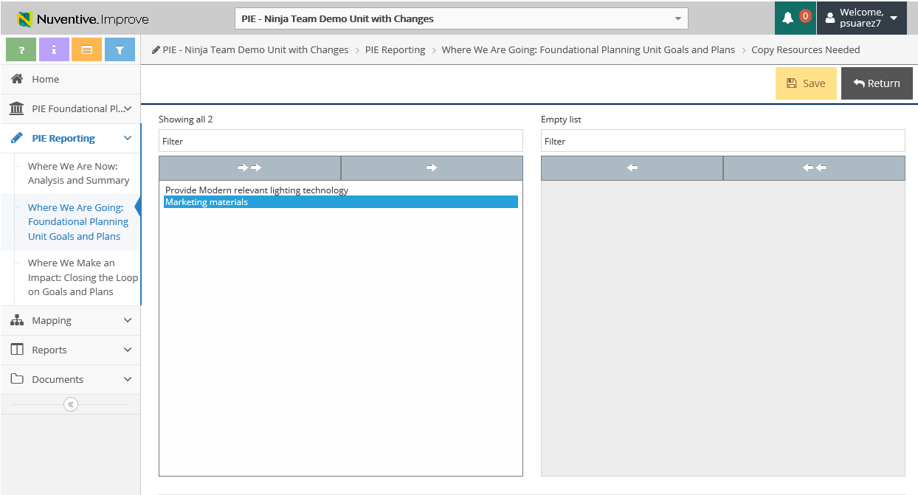
Review and Update Exisiting Goals
2. Where We Are Going – Copy & Moving Resources
3. Select Unit Goal you wish to Copy Resource to
6. Save & Return
You will see all of your Unit Goals displayed
4. Select the Right Arrow to “Move Selected” Unit to the right bucket
5. Unit Goal will appear

Slide 12
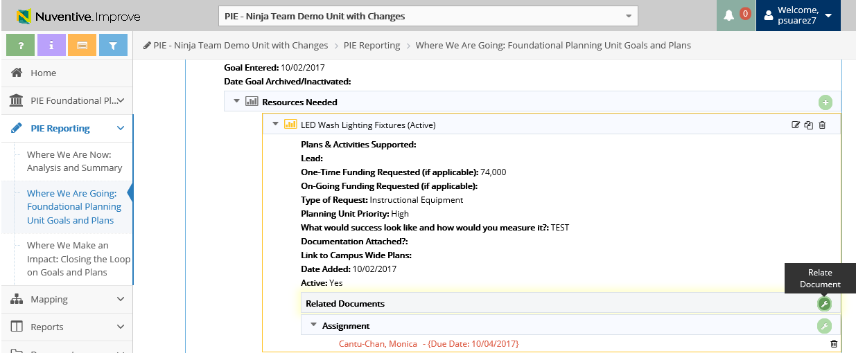
2. Where We Are Going – View & Upload Related Documents
1. Click to Add Related Documents to the Resource

Slide 13
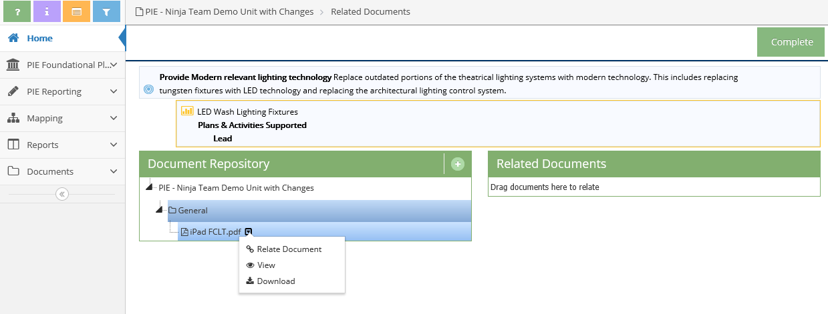
2. Where We Are Going – Uploading Documents to Resources
2. Click to be able to upload documents
3. Documents Repository (Where files are stored via TracDat that were uploaded

Slide 14
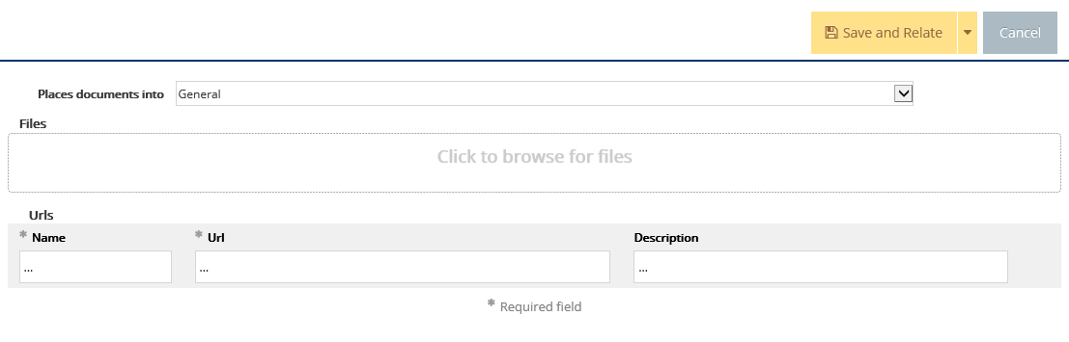
2. Where We Are Going – Uploading Documents to Resources
Document Retrieval Screen will display
4. Select Location to place uploaded documents to

Slide 15
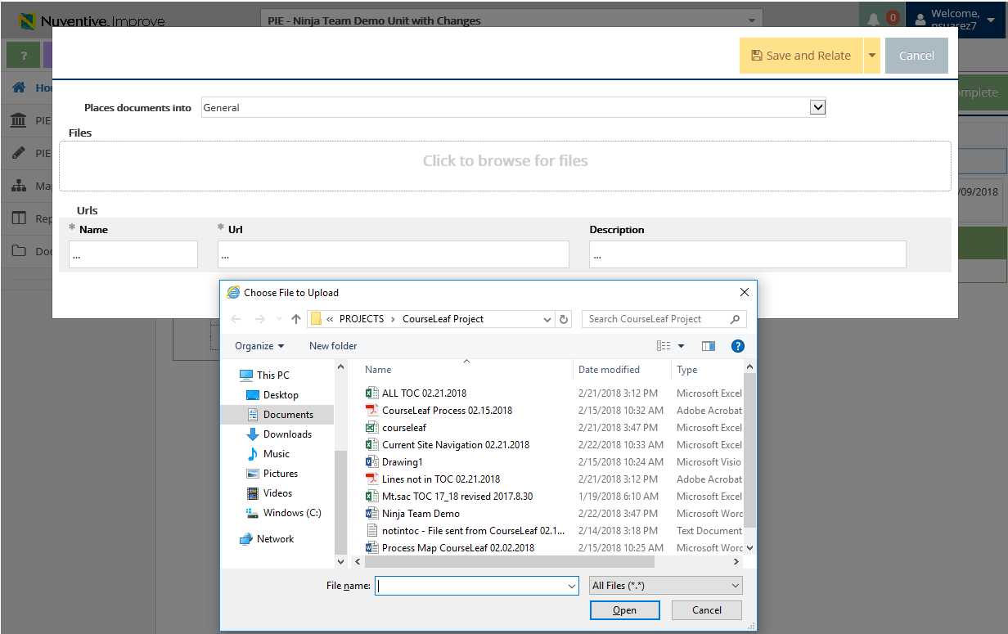
2. Where We Are Going – Uploading Documents to Resources
5. Click to browse and add files on your computer
6. Select File and Select Open

Slide 16
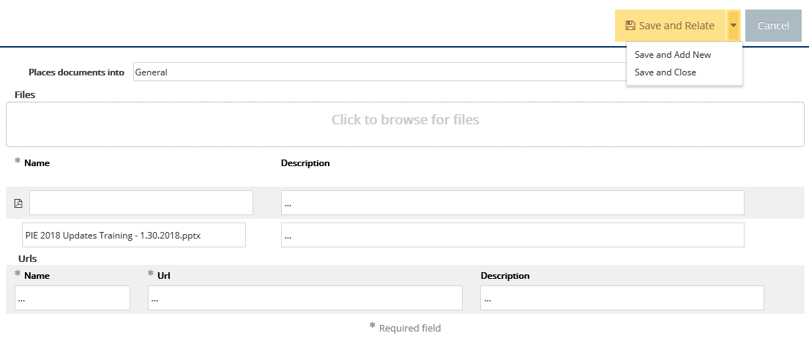
2. Where We Are Going – Uploading Documents to Resources
7. Select Save and Relate
Save and Add New: saves the document and stays on this screen to keep adding more documents
Save and Close: saves the document and returns to previous screen

Slide 17
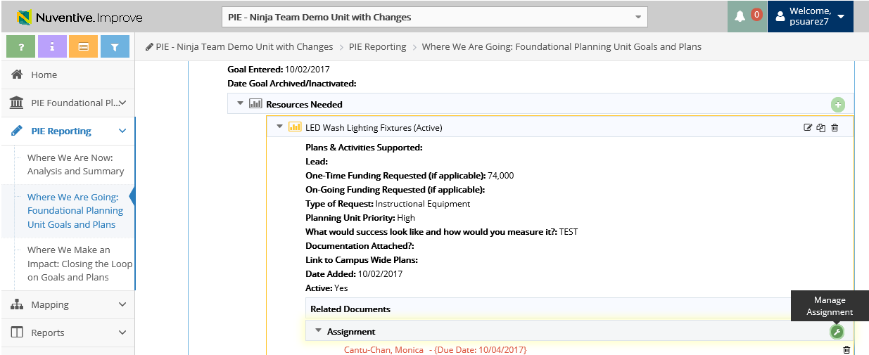
2. Where We Are Going – Manage Assignment
1. Click tool icon to Manage Assignment

Slide 18
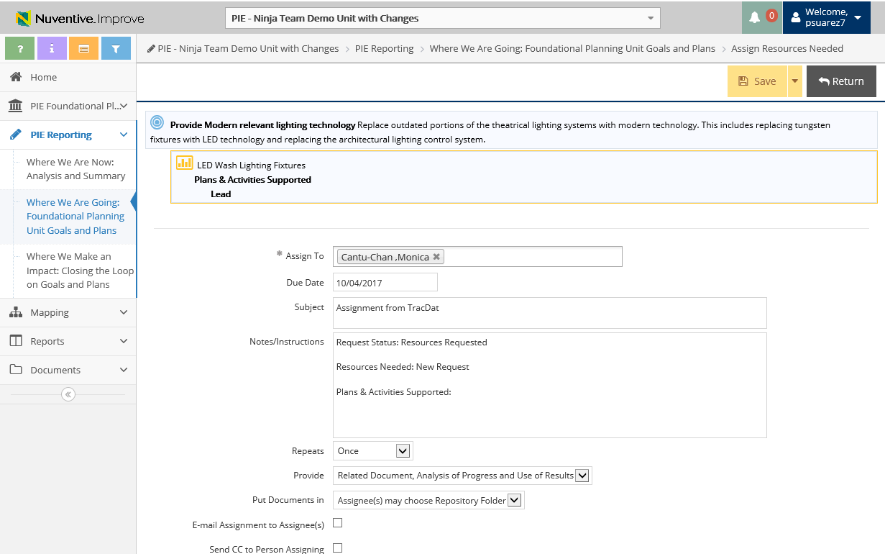
2. Where We Are Going – Manage Assignment
3. Select Save and Return
2. Enter information into the following fields

Slide 19


Resources
PIE Content Questions
Michelle Sampat: msampat@mtsac.edu
Meghan Chen: mchen@mtsac.edu
PIE Summaries are due by May 1st, 2018
Research/ Data Review Questions
Barbara McNeice-Stallard:
bmcneice-stallard@mtsac.edu
Technical Questions:
Pedro Suarez: psuarez7@mtsac.edu
Video Training Resources:
http://www.mtsac.edu/pie

