Slide 1

PIE Planning & Resources
Where We Make an Impact – Closing the Loop

Slide 2
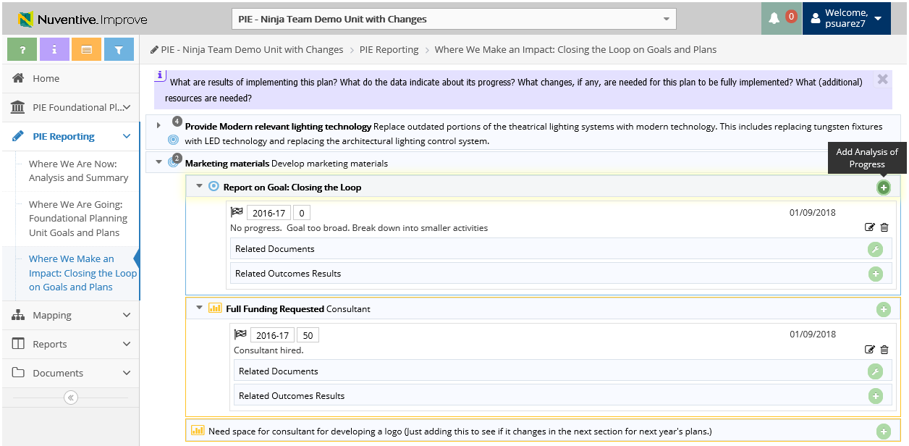
3. Where We Make an Impact – Add Analysis of Progress on Goals
1. Click to View Unit Goals
2. Click to Add Analysis of Progress
Analysis of Progress will display for preceding Reporting Years (if applicable)
**Only Edit Analysis of Progress for minor updates (ex: grammar)

Slide 3
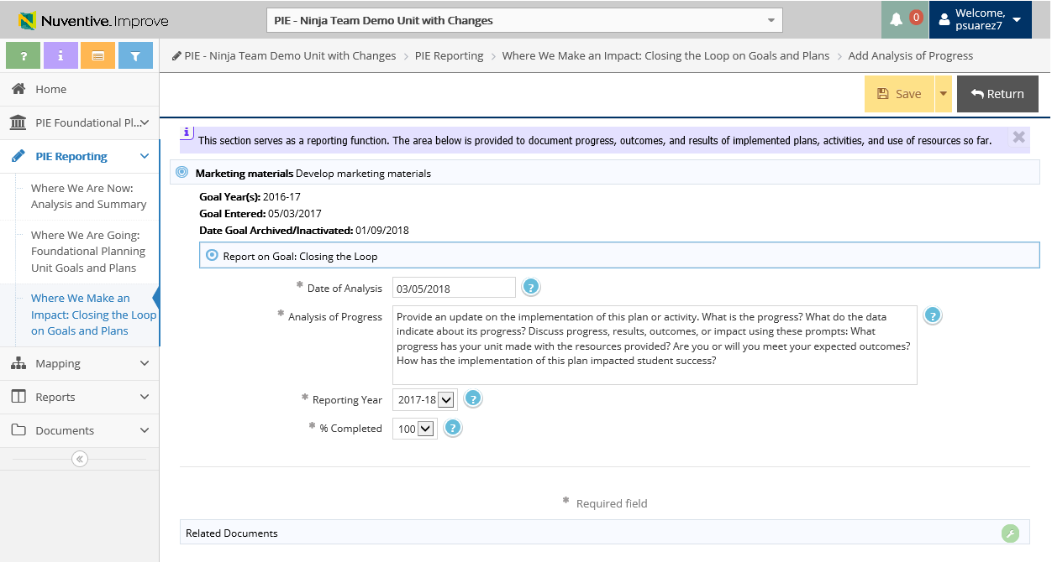
3. Where We Make an Impact – Add Analysis of Progress on Goals
3. Enter Analysis of Progress
6. Make sure to Save and Return
4. Ensure Reporting Year is 2017-18
*Give an update on Unit Goals for Reporting Year 2017-18 for Unit Goals from 2016-17*
5. Select what % of Goal is completed

Slide 4
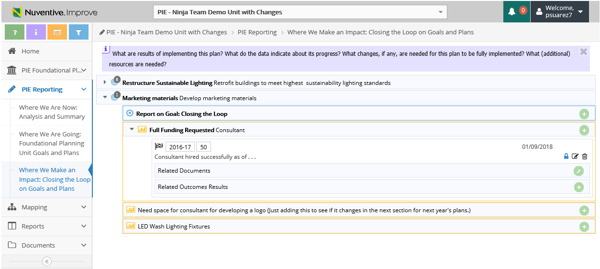
3. Closing the Loop – Add Analysis of Progress on Resources
2. Click to Add Analysis of Progress
1. Click to View Resources
*Each Resource will need Analysis of Progress for Reporting Year*
*Give an update on Resources for Reporting Year 2017-18 for Resources from 2016-17*

Slide 5
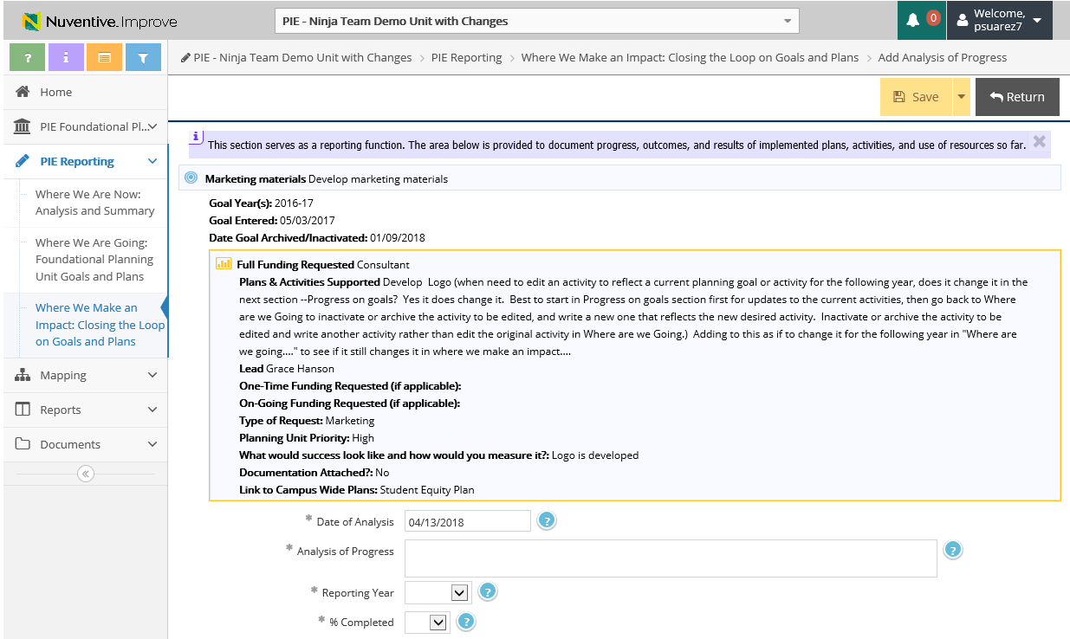
3. Closing the Loop – Add Analysis of Progress on Resources
5. Make sure to Save and Return
3. Enter progress of goals and plans
*Each Resource will need Analysis of Progress for Reporting Year*
4. Ensure Reporting Year is 2017-18

Slide 6
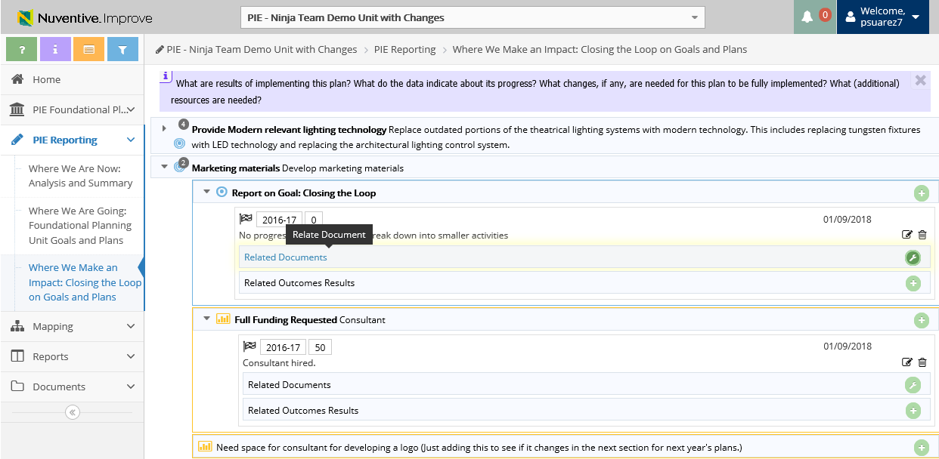
3. Where We Make an Impact – View & Add Related Documents
1. Click to Add Related Documents

Slide 7
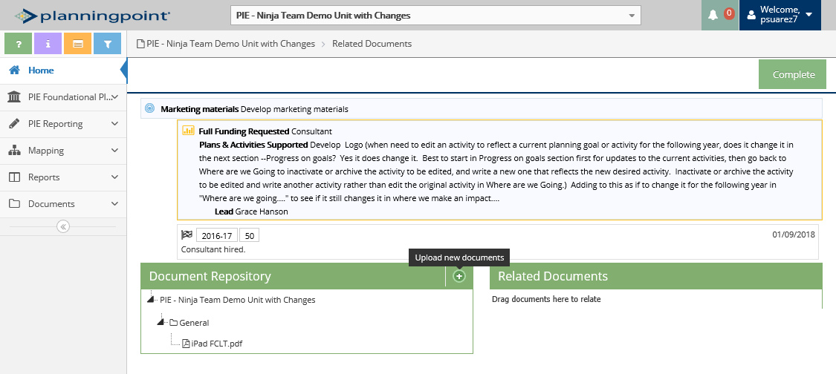
3. Where We Make an Impact – View & Add Related Documents
3. Click to View Document Repository
2. Click to Upload new documents

Slide 8
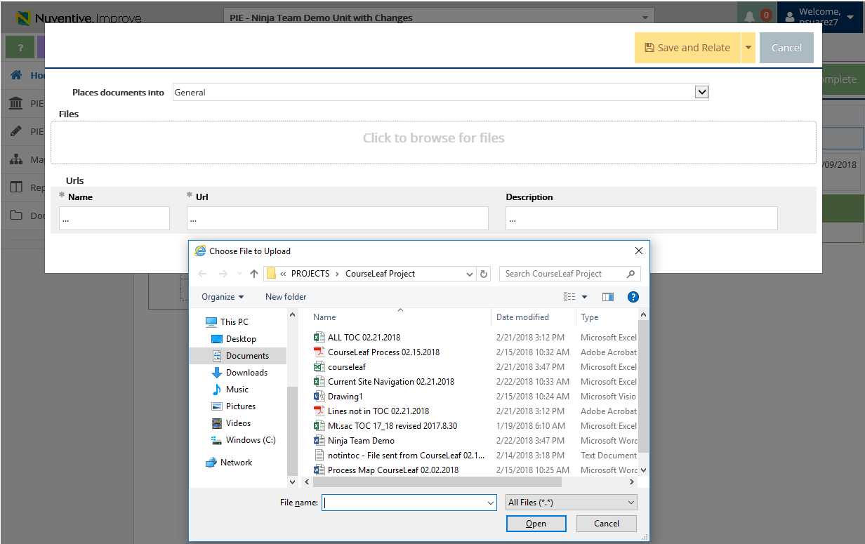
2. Where We Are Going – Uploading Documents to Resources
3. Where We Make an Impact –View & Add Related Documents
Document Retrieval Screen will display
4. Select Location to place uploaded documents to
5. Click to browse and add files on your computer
6. Select File and Select Open

Slide 9
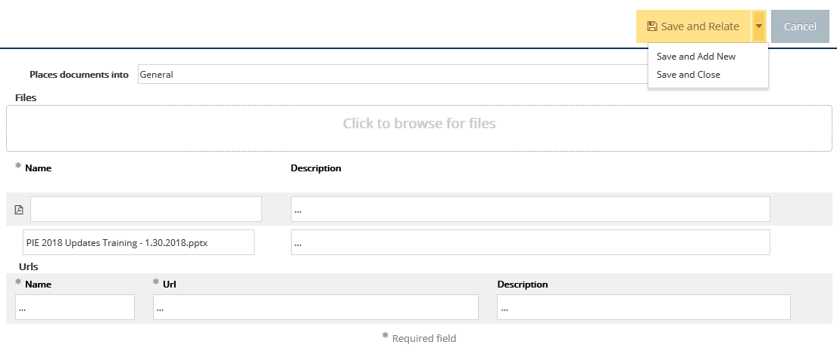
2. Where We Are Going – Uploading Documents to Resources
3. Where We Make an Impact –View & Add Related Documents
7. Select Save and Relate
Save and Add New: saves the document and stays on this screen to keep adding more documents
Save and Close: saves the document and returns to previous screen

Slide 10
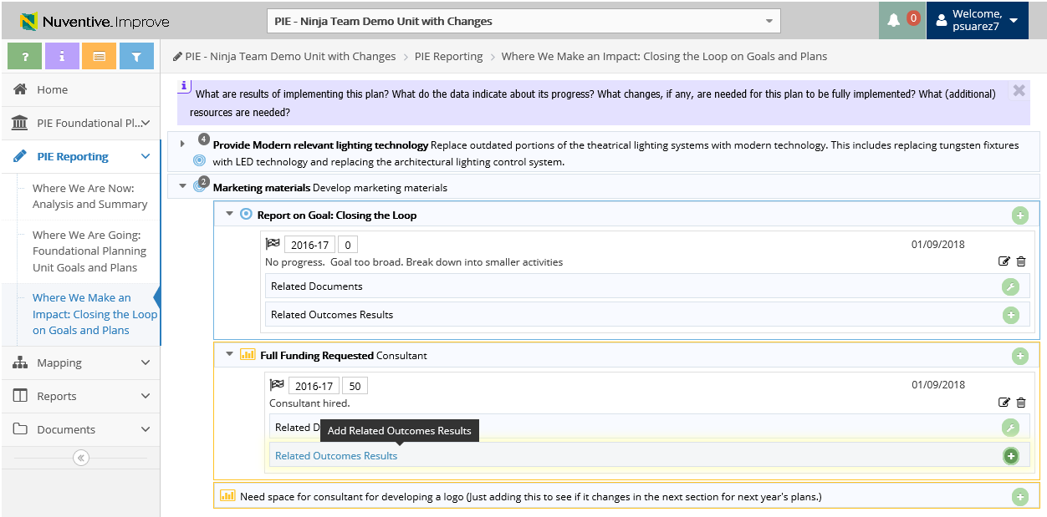
3. Where We Make an Impact – Related Outcomes Results
1. Click to Add Related Outcomes Results

Slide 11
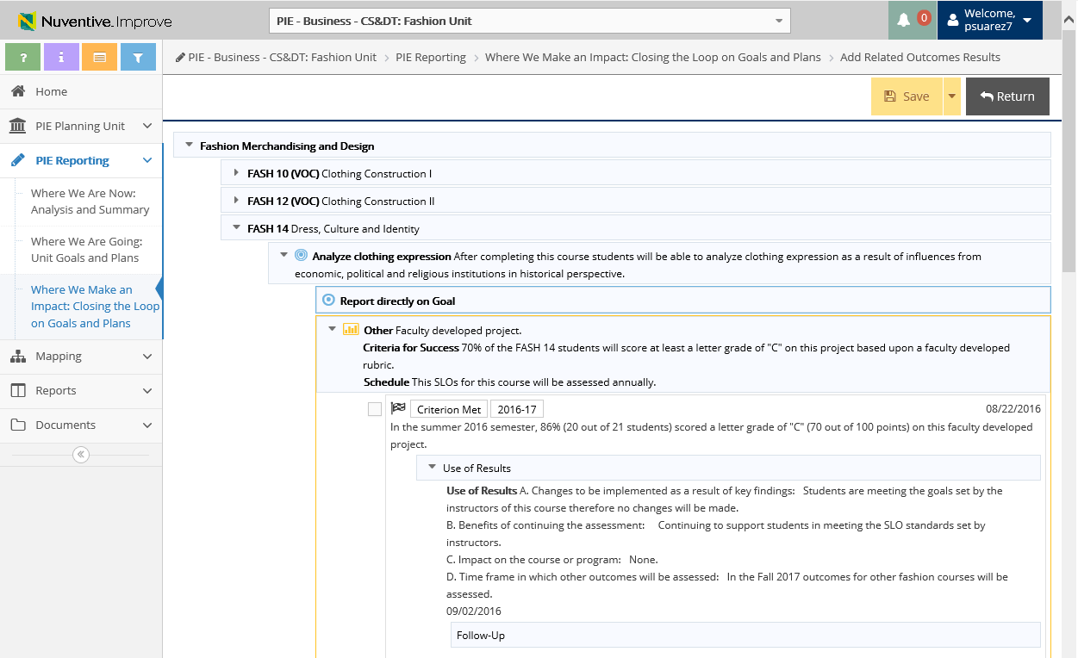
3. Where We Make an Impact – Related Outcomes Results
4. Don’t forget to Save and Return
2. Select drop down arrow to expand and view and report on Goal
3. Place check mark to tie in with SLO (will be added to Goal)

Slide 12
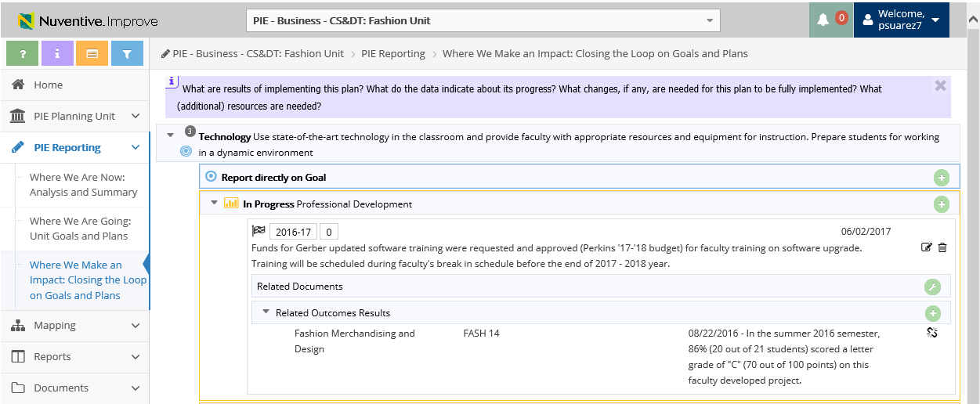
3. Where We Make an Impact – Related Outcomes Results
You are able to un-relate summary of data by selecting this icon
Related Outcome(s) will display

Slide 13


Resources
PIE Content Questions
Michelle Sampat: msampat@mtsac.edu
Meghan Chen: mchen@mtsac.edu
PIE Summaries are due by May 1st, 2018
Research/ Data Review Questions
Barbara McNeice-Stallard:
bmcneice-stallard@mtsac.edu
Technical Questions:
Pedro Suarez: psuarez7@mtsac.edu
Video Training Resources:
http://www.mtsac.edu/pie

