Slide 1
VP PIE Planning & Resources
User Guide 2018

Slide 2
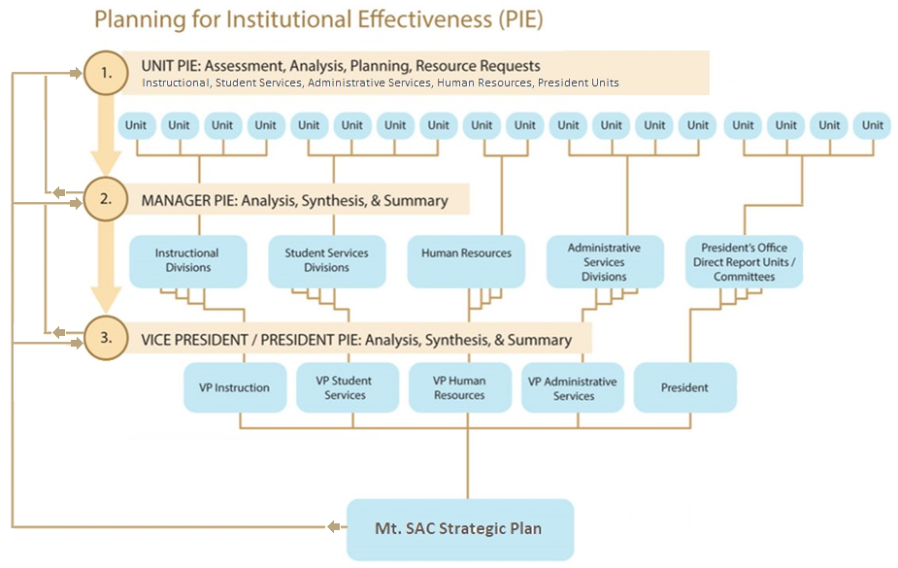
PIE Process: Where does my unit PIE go?
2018 Due Dates:
May 15th – Instructional Unit PIE
June 30th – Prioritization of Instruction Unit Resource Request
July 15th –
Division Manager PIE
Closing Loop
Feedback
Data

Slide 3
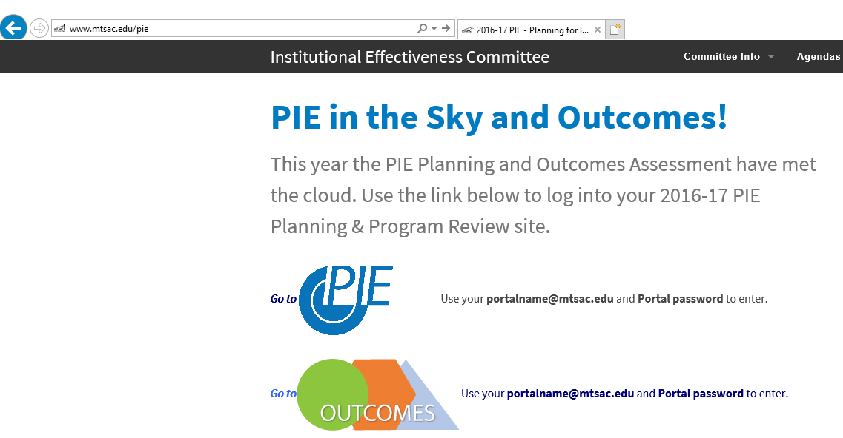
PIE - Access
1. www.mtsac.edu/pie
2. Click to access PIE

Slide 4
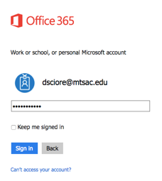
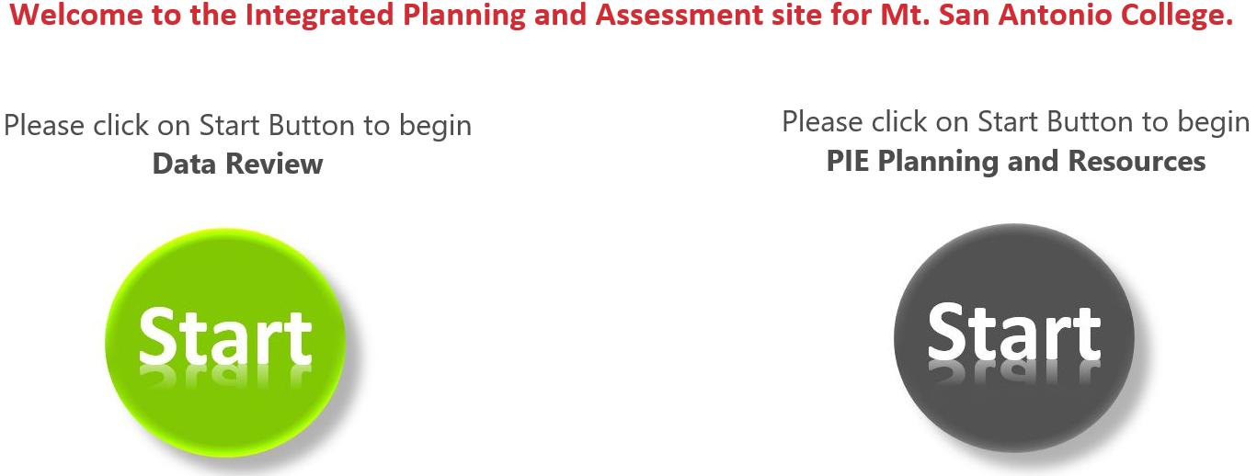
PIE - Home Screen
After clicking on “Go to PIE” use your Mt. SAC credentials to access the SharePoint interface that houses PIE to begin the process
3. Use portal user name &
password to login
4. Click on the gray Start Button to begin PIE Planning and Resources

Slide 5
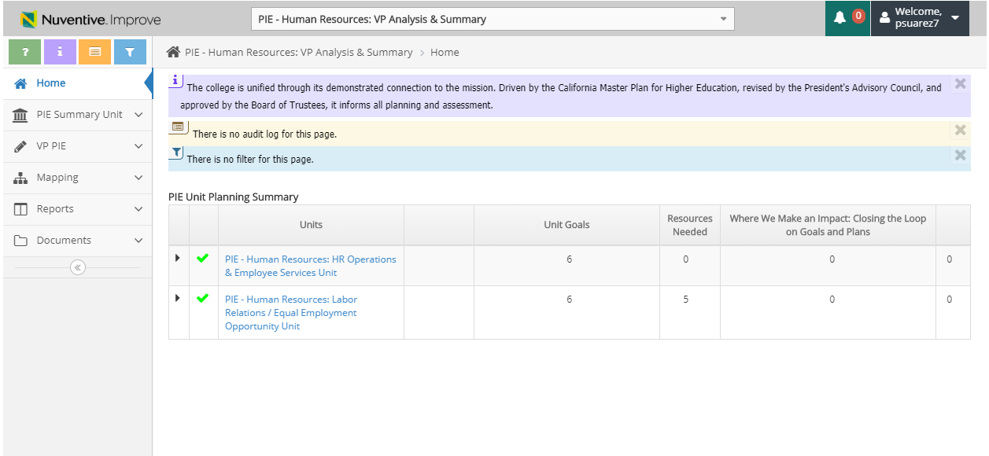
PIE - Unit Planning and Resources – Tool Bar
a. Open Page Help (help content)
b. Open Page Instructions (explanation of requirements)
a
b
c
d
c. Open Page Log (journal of activity)
d. Open Page Filter (narrow down searches)

Slide 6
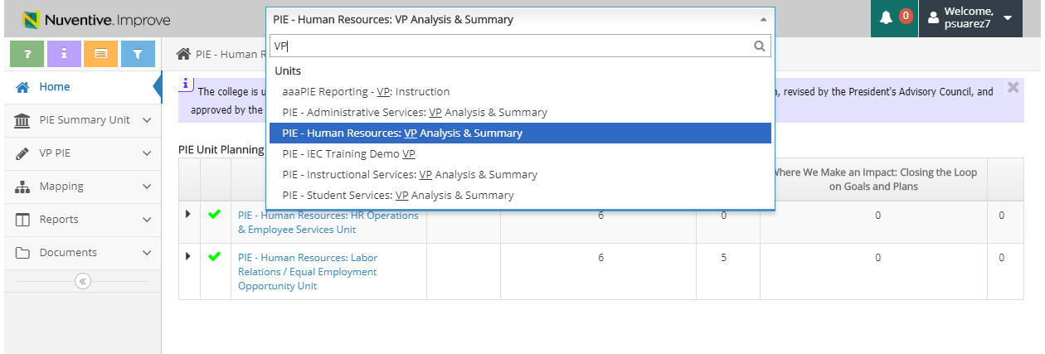
PIE - Unit Planning and Resources
Select the dropdown arrow and select respected department (user has the ability to type in department name)
*Make sure the title contains “VP Analysis & Summary”

Slide 7
VP PIE Planning & Resources
Reports

Slide 8
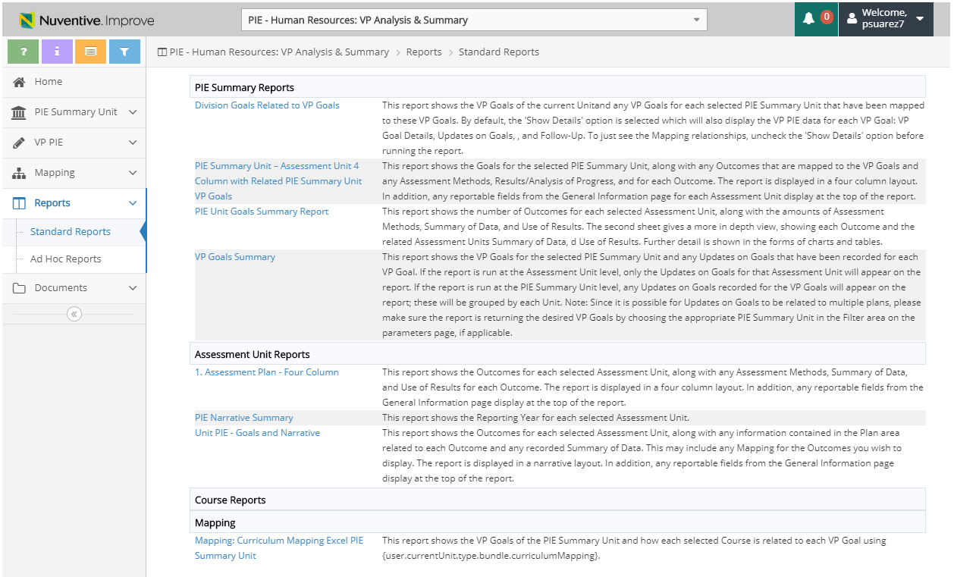
3. Reports – View & Generate Reports
Description of report will display
1. Select Standard Reports

Slide 9
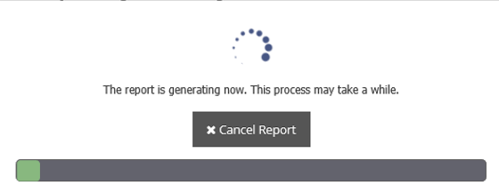
3. Reports – View & Generate Reports
2. Select Report to Open
3. Report will display by selecting ‘Open’ or ‘Save As’

Slide 10
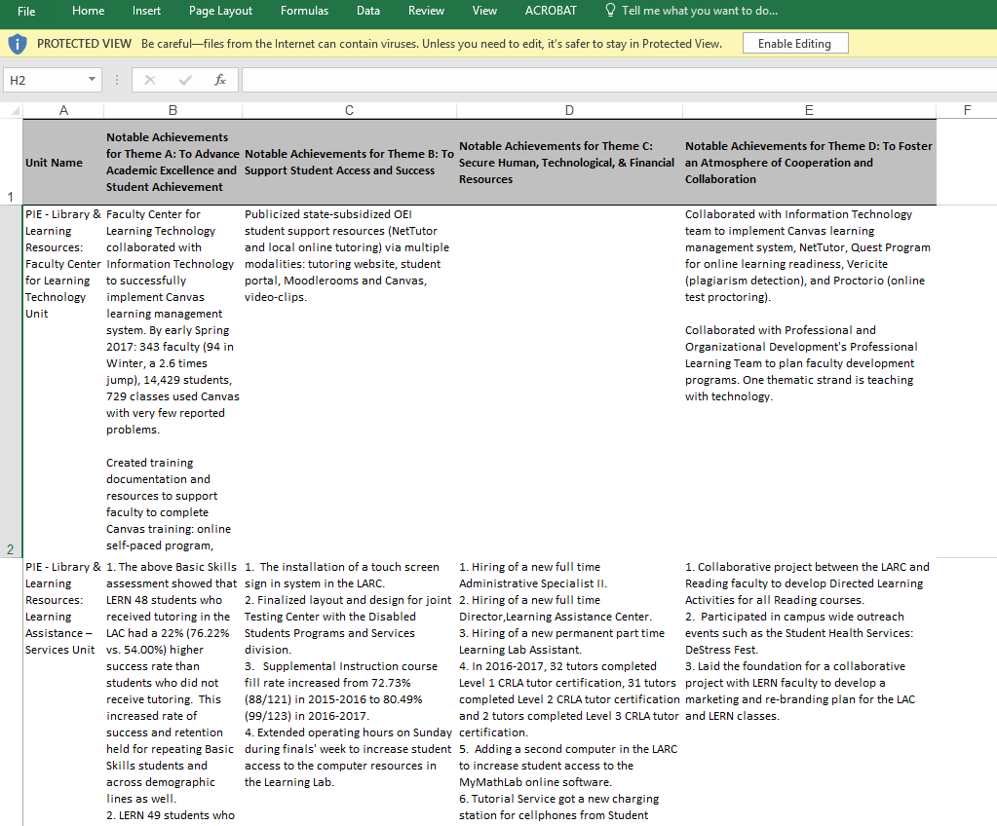
3. Reports – Display of Reports
4. Report will Display in Format Excel or PDF

Slide 11
VP PIE Planning & Resources
Analysis of Manager PIE Reports, VP Goals & Updates on Goals

Slide 12
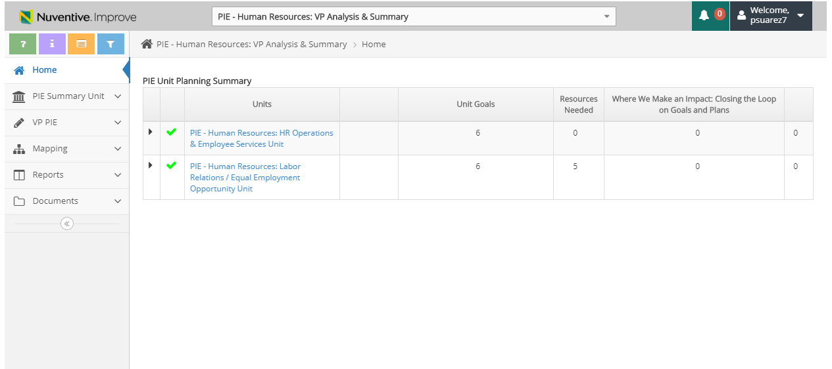
Summary of Units
Summarized data regarding your Units
All Units tied to VP & Manager PIE will display

Slide 13
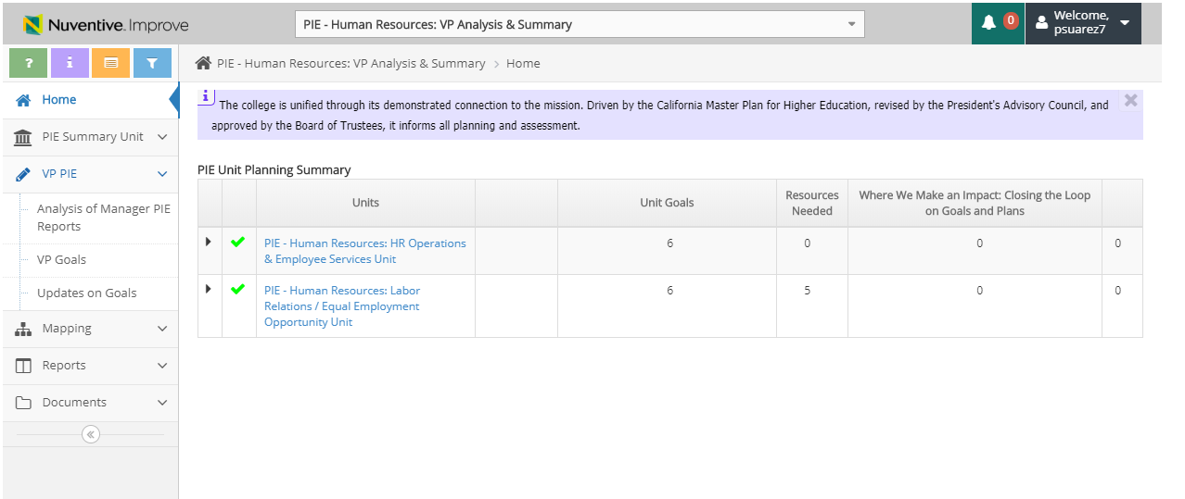
VP PIE – 3 Planning Sections
Select VP PIE to view the 3 Planning Sections
Analysis of Manager PIE Reports
VP Goals
Updates on Goals

Slide 14
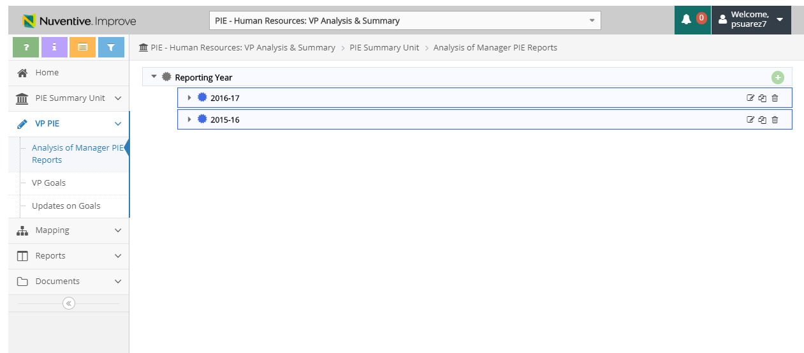
Analysis of Manager PIE Reports – View
1. Select Analysis of Manager PIE Reports
Reporting Years will display
2. Select side arrow to view detail

Slide 15
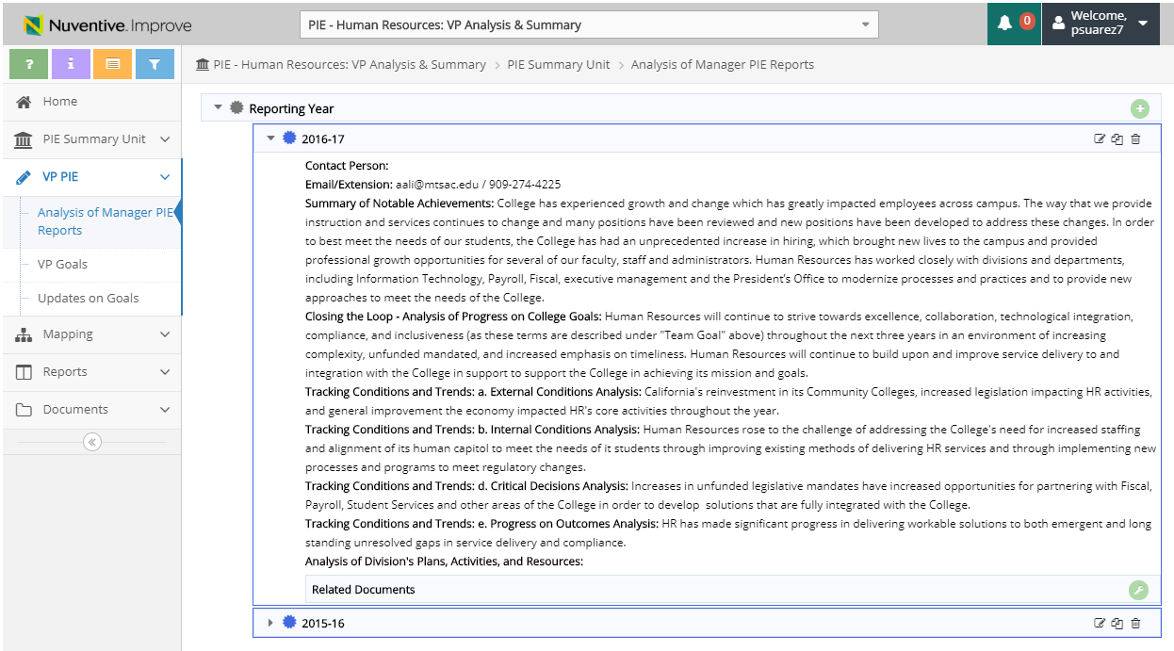
Analysis of Manager PIE Reports – View & Add
3. Add Reporting Year
Edit
Copy
Detail will display
*Note, if no previous reporting year displays, no data was entered and a new reporting year will have to be entered*

Slide 16
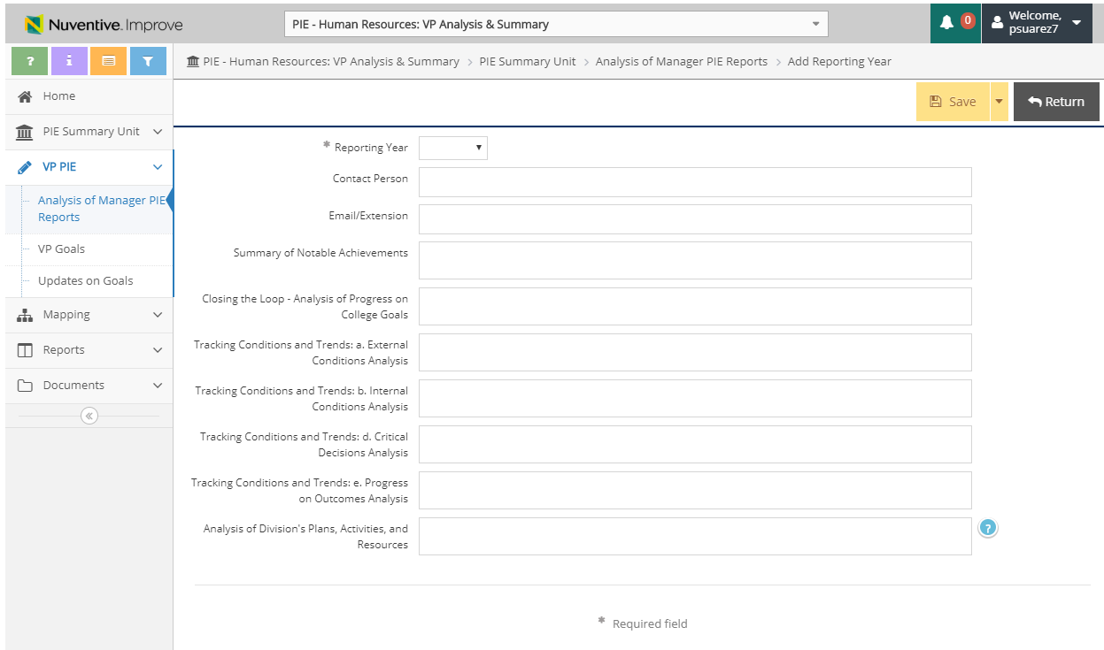
Analysis of Manager PIE Reports - Add Reporting Year
4. Add Reporting Year
6. Save & Return
5. Enter data into the related fields
Help Text

Slide 17
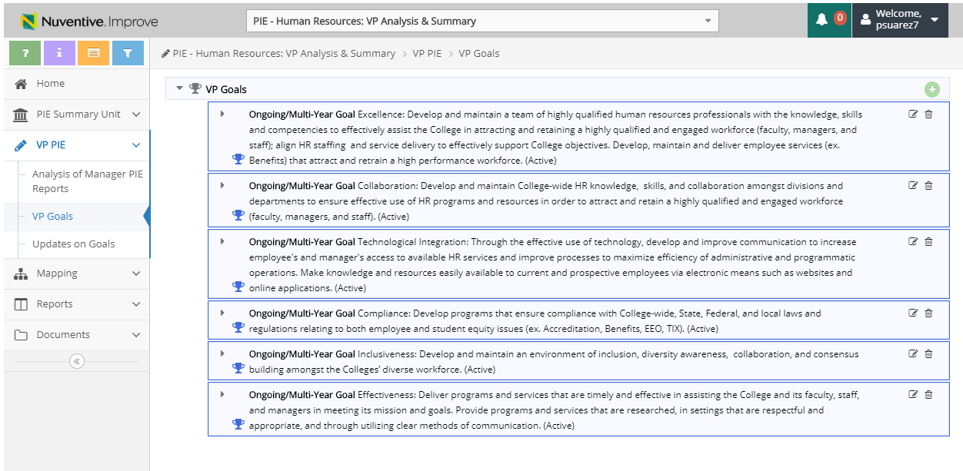
VP Goals – View & Add VP Goal
2. Add VP Goal
1. Select VP Goals
Edit VP Goal
Division Goals will display

Slide 18
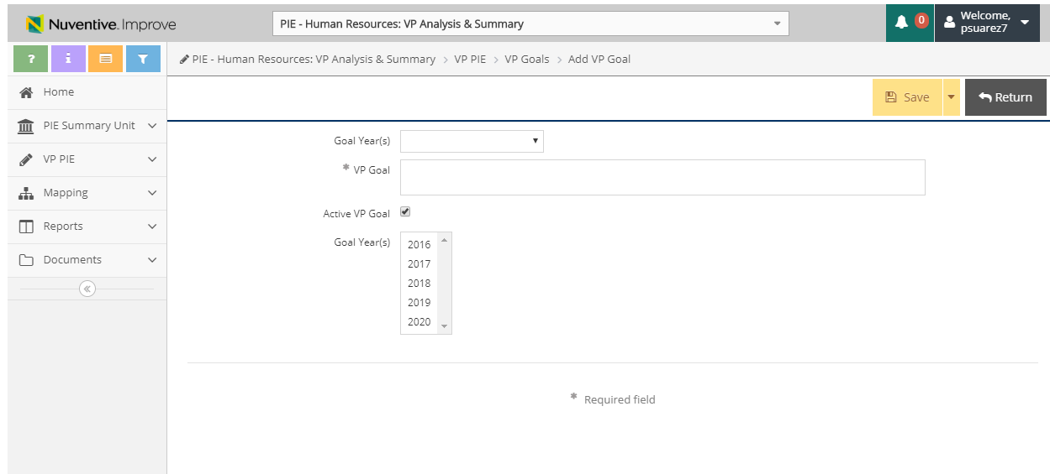
VP Goals – Add/ Edit VP Goal
3. Select Goal Year
4. Enter VP Goal Details
5. Check box if Goal is still Active, if Inactive, remove.
6. Save & Return

Slide 19
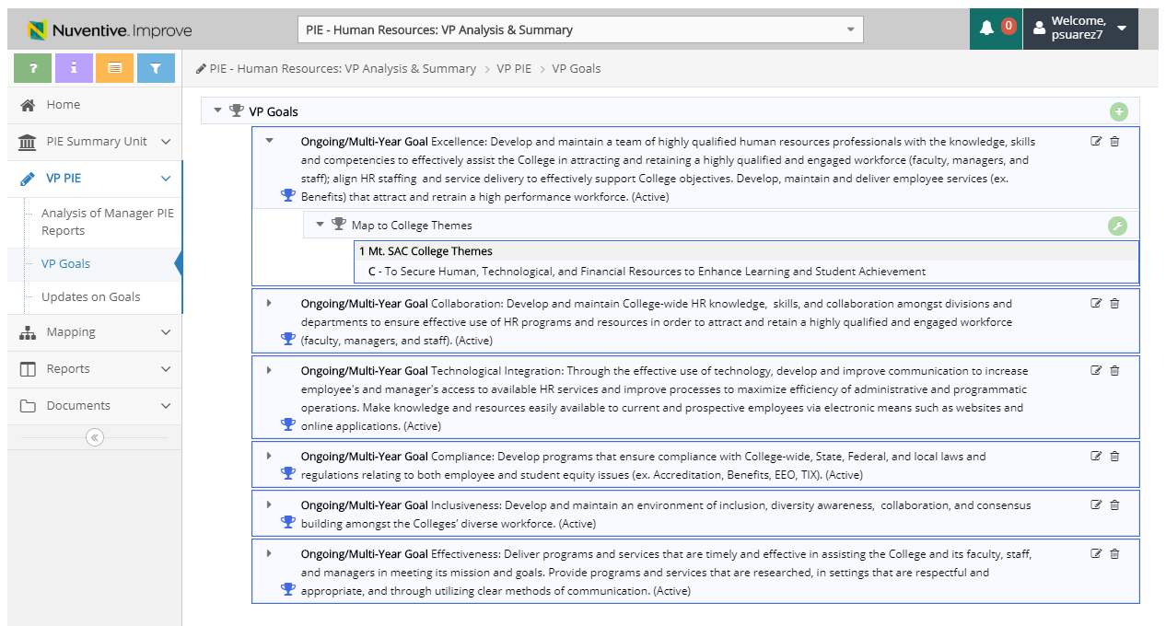
VP Goals – Map to VP Goals and College Themes
1. Select Tool Icon to Add Map to VP Goals and College Themes
**Map to VP Goals and College Themes also available under ‘Mapping’

Slide 20
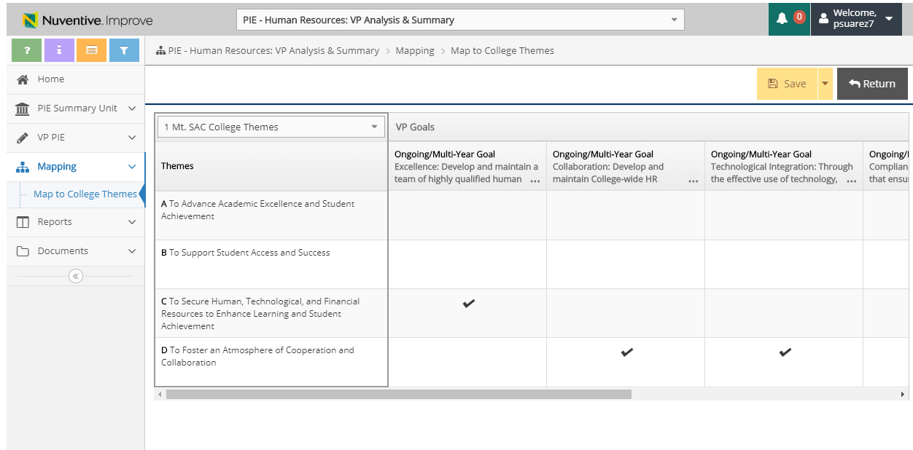
VP Goals – Map to VP Goals and College Themes
2. Select Mt. SAC College Themes on drop down menu
* If any goals related to the Integrated Plan, then this section is where you will do linking

Slide 21
VP Goals – Map to VP Goals and College Themes
4. Select Save & Return
3. Unit Goals are broken out by theme and a checkmark can be place in respect to the applicable Subject Matter Plan Goals

Slide 22
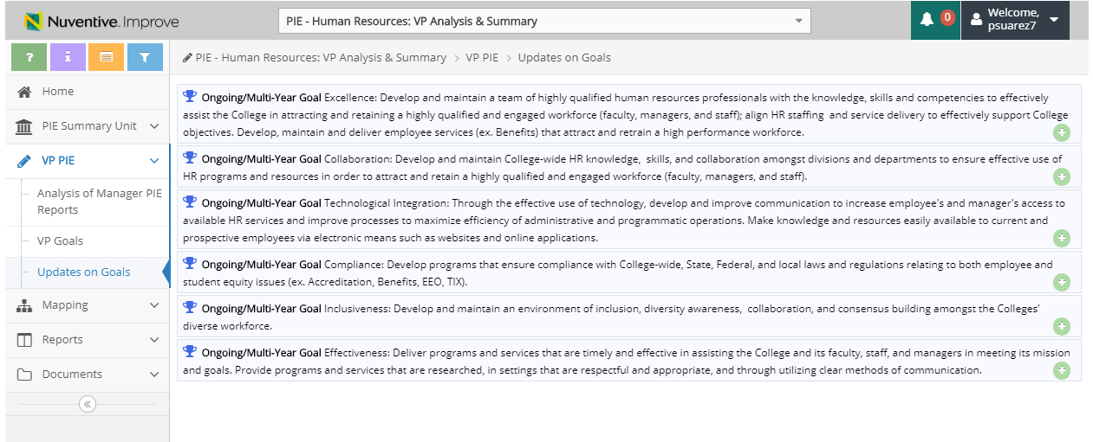
Updates on Goals – View & Add Analysis of Progress
1. Select Updates on Goals
2. Select to Add Analysis of Progress
Goals will display

Slide 23
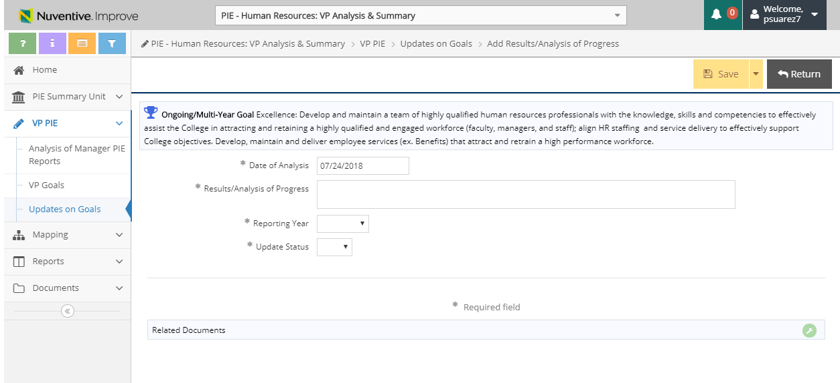
Updates on Goals – Add Use of Results
3. Enter data into the fields for Analysis of Progress

Slide 24
Updates on Goals – Add Related Documents
1. Select to Add Related Documents

Slide 25
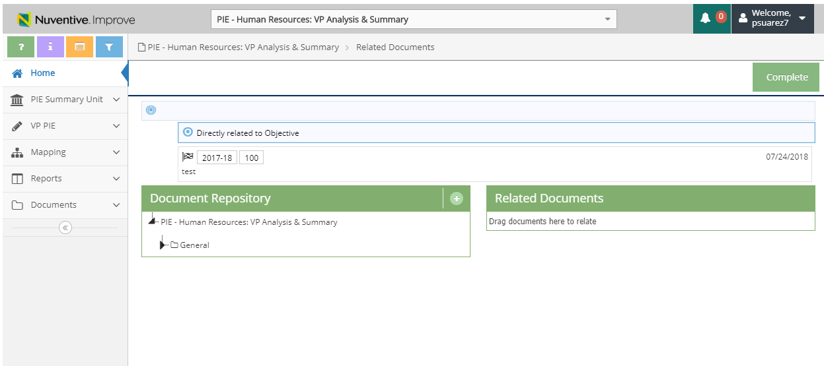
Updates on Goals – Add Related Documents
2. Click to View Document Repository
3. Click to Upload new documents

Slide 26
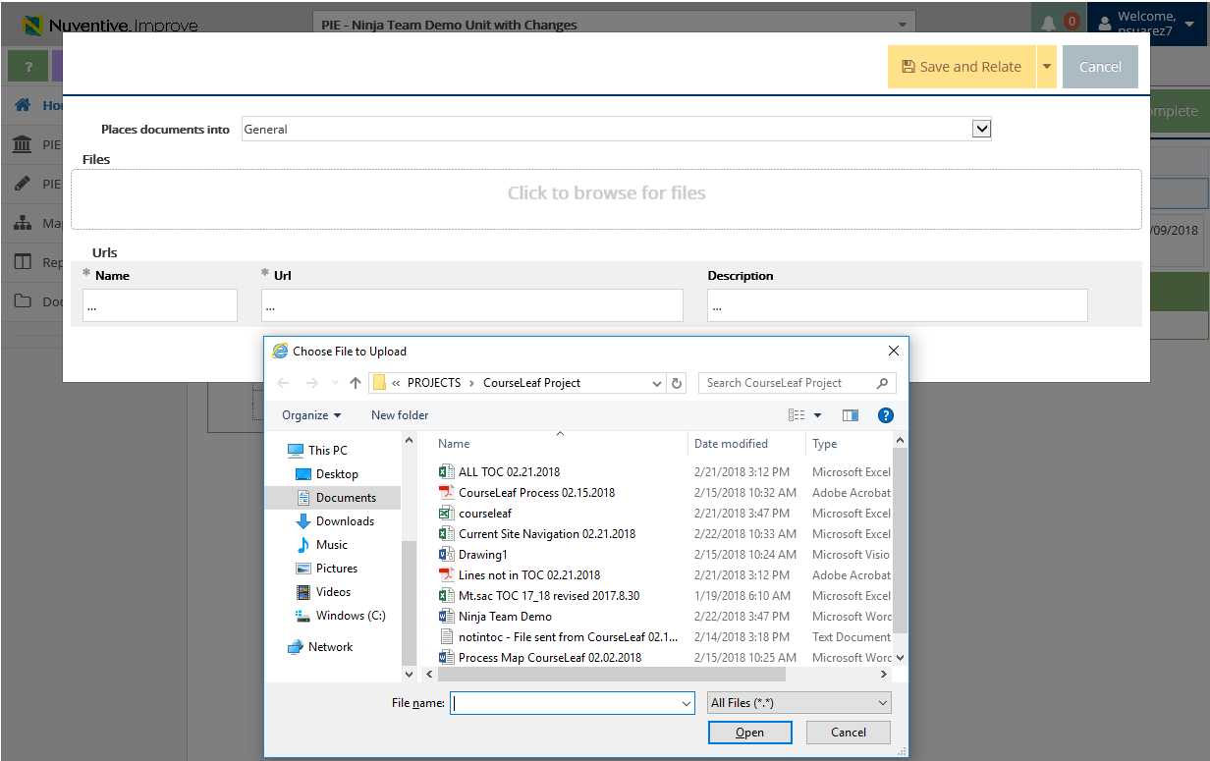
Updates on Goals – Add Related Documents
4. Select Location to place uploaded documents to
Document Retrieval Screen will display
5. Click to browse and add files on your computer
6. Select File and Select Open

Slide 27
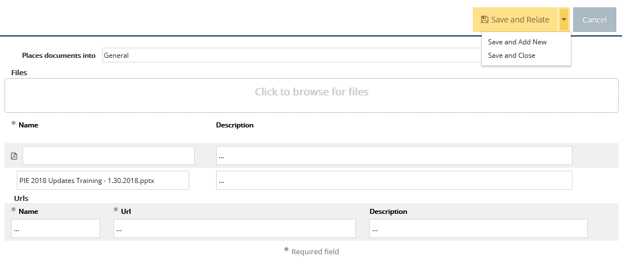
Updates on Goals – Add Related Documents
7. Select Save and Relate
Save and Add New: saves the document and stays on this screen to keep adding more documents
Save and Close: saves the document and returns to previous screen

Slide 28


Resources
PIE Content Questions
Michelle Sampat: msampat@mtsac.edu
Meghan Chen: mchen@mtsac.edu
VP Summaries are due by September 2018
Research/ Data Review Questions
Barbara McNeice-Stallard:
bmcneice-stallard@mtsac.edu
Technical Questions:
Pedro Suarez: psuarez7@mtsac.edu
Video Training Resources:
http://www.mtsac.edu/pie

