Slide 1
President’s Welcome
Dr. Bill Scroggins

Slide 2

Welcome to the ACCJC and Mt. SAC
Institutional Self Evaluation Launch and Training!
Quick tips for engaging during the session:
  Ask questions by unmuting and asking question or type question in chat.
  Keep yourself muted when not asking question.
  The ppt will be shared with your college Accreditation Liaison Officer. The session is not recorded.
Mt. San Antonio
October 22, 2021
Notes:
Kelly & Dr. Scroggins ALO starts

Slide 3

Topics for Today
Part One: Accreditation Context
  Accreditation Purposes & Processes
  ACCJC Expectations & Current Practice
Part Two: Nuts/Bolts Developing ISER
  Interpreting the Standards for Self-Evaluation
  Developing the ISER: Tips & Resources
  After the ISER: What to Expect
Notes:
Kelly, ALO

Slide 4
Learning Outcomes
Understand the ISER in context of the accreditation process
Engage in the self-evaluation process as an opportunity to document and establish goals for continuous improvement
Interpret Standards and apply them to your College/District policies and practices
Write a concise, clear, and evidence-based ISER
Notes:
ALO – then introduces me

Slide 5
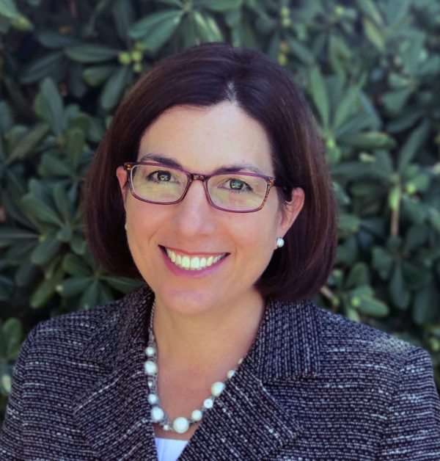
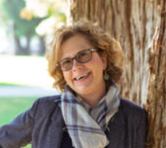
Co-Facilitators
Gohar Momjian
Vice President &
Your ACCJC Staff Liaison
Kelly Fowler
Vice President of Instruction
Barbara Mezaki
Faculty Accreditation Co-Lead
Alli Frickert
Faculty Accreditation Assistant
Notes:
Say hello. Explain my role as staff liaison – partnering with institution in support of their mission and quality
-Becomes immersed in your institution’s mission, culture, and student populations.
-Primary point of contact for accreditation activities.
-Provides trainings and resources
-ISER development
-Board of Trustees, and other groups as needed
-Answers questions about review process, standards, policies, etc.
-Provides information and resources for other reports (AR, AFR, Substantive Change applications)
-Serves as a resource for comprehensive peer review teams to ensure clarity and consistency.
-Provides institutional context to the Commission.
Explain ALO role –
-Critical point of contact with the Commission
-Keeps current with Commission policies and practices
-Maintains institutional records of accreditation activities
-Advocates for the accreditation process
-Ensures that your president is appropriately informed
-Your local accreditation resource on campus!
Emphasize this work provides opportunity to engage entire college
Want this to be a discussion. An opportunity for you to ask questions. There’s a lot of you, so we’ll do our best to accommodate your questions. I have multiple screens so if you have a question raise your hand or put your question in the chat. Your ALO will be monitoring the chat and helping me with questions.
We plan to present a few slides, ask you to participate in some activities, and each of us will learn something new from eachother in the process.

Slide 6
Training: Part One
Context for Accreditation
Notes:
Gohar

Slide 7
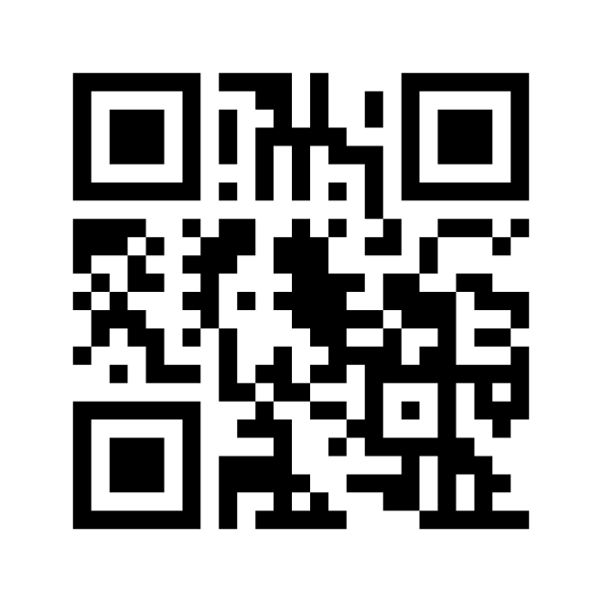
What is Accreditation?
In 1 to 3 words describe accreditation:
Accreditation is….:
?
?
?
https://www.menti.com/dkifm3jupa
Notes:
Gohar
Copy and paste link into chat

Slide 8
Your Thoughts:
Insert word cloud
Notes:
Gohar |

Slide 9

What is Accreditation
Accreditation is a practice of academic quality control
  Promotes institutional excellence through application of standards
  Advances meaningful and effective student learning and achievement
  Provides assurance to students, general public, & others of quality of educational offerings
In the United States we are fortunate that this is a peer review driven process. In many other countries, colleges and universities are recognized by a government education agency, such as the Ministry of Education.
Notes:
Barbara Mezaki

Slide 10
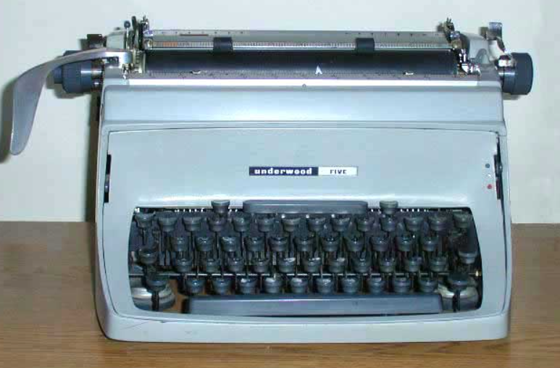
Why Does Your College Seek Accreditation?
In 1 to 3 words describe why accreditation is important:
Type Your Response in Chat
Top Three Reasons:
?
?
?
Notes:
Gohar ask to Type in chat

Slide 11
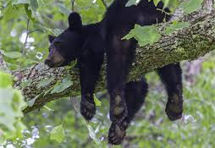
Why Bother?
Access to Title IV (Federal Student Aid)
Credibility to degrees and credentials (transfer & employment)
Assure quality to the public and students
Stimulates institutional innovation and improvement
Provides quality assurance to students, the public, and other institutions that you are achieving your mission
Notes:
Allie Frickert
-institutional effort over 2 yr period, reaffirm reasons they mentioned
Benefits of this practice:
-Gives credibility to degrees and credentials awarded to students (transfer and employment)
-Stimulates institutional innovation and improvement
-Enables access to Title IV (Federal Student Aid)
-Provides quality assurance to students, the public, and other institutions that your Colleges are achieving their missions

Slide 12


Who ACCJC Accredits
Public and private colleges with primary mission of granting associate degrees (may also award certificates and other credentials, including bachelor’s degrees) in:
  California
  Hawaii
  U.S. territories of Guam and American Samoa
  The Republic of Palau
  The Federated States of Micronesia
  The Commonwealth of the Northern Marianas
  The Republic of the Marshall Islands
Notes:
Chisa, Lance, & Kelly
-135 institutions in our region, 114 CA community colleges, private, non-profit/for profit, Islands, more than 2.1 million students,

Slide 13
ACCJC Mission in Action
Outcomes
Innovation
Improvement
The ACCJC supports its member institutions to advance educational quality and student learning and achievement. This collaboration fosters institutional excellence and continuous improvement through innovation, self-analysis, peer review, and application of standards.
Student Learning & Achievement
Peer Review
Collegiality
Standards
Review
Quality Assurance
Institutional Improvement
Notes:
Gohar
Like our member colleges, we have a mission here at ACCJC which is what you see here on the screen.
We also have a strategic plan and core values which guide the work we do and how we engage with our members.

Slide 14
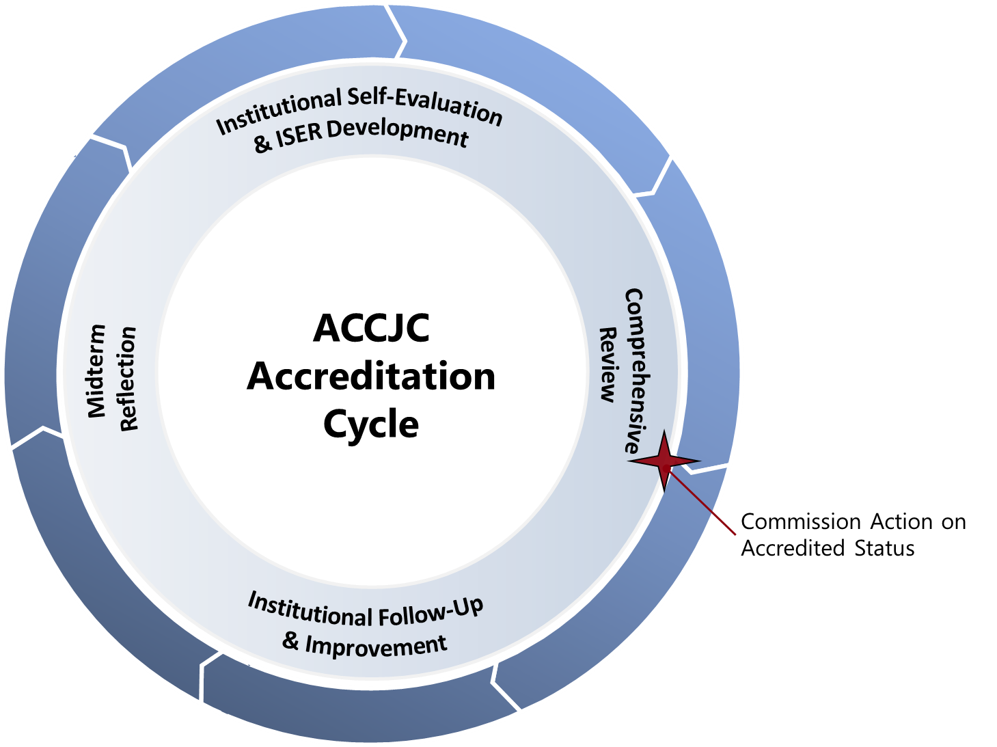
Accreditation Cycle and Reports
At a Glance
Self Evaluation & Comprehensive Review (every 7 years)
Follow Up Reports (if required)
Midterm Reporting (4th year after comp review)
Ongoing Reporting
  Annual Report
  Annual Fiscal Report
  Substantive Change
Notes:
Gohar
-accreditation based on 7 year cycle
-institutions conducts its own self evaluation and then validated by peers
-process designed to help institutions improve and focus on effective institutional processes and improving student outcomes
-throughout 7 years, monitoring activities
touchpoint mid-cycle
-review of the college is in context of its mission
Monitor certain aspects of institutional quality per federal regulations
Fiscal Health
Headcount growth or decline
Substantive Changes

Slide 15
Overview: The Accreditation Evaluation Process
Self-Reflection
(ISER)
Peer Review
(Team ISER Review & Focused Site Visit)
Affirmation
(ACCJC Action)
Ongoing Commitment to Improvement & Educational Excellence
Notes:
Gohar
-beginning of process not end test,
-Institutional Self Evaluation Report (ISER) – clean slate, prior history of reports not considered
-Peer Review Team/Formative and Summative Components: concluding in Team Report with Recommendations (for improvement or for compliance); Commendations;
-Commission action – accreditation status

Slide 16

Intended Outcomes
To develop an ISER that the college and ACCJC can use as a meaningful and effective framework for fostering institutional excellence and student success.
To demonstrate how you exemplify academic quality and continue to improve.
The goal is quality not quantity!
Notes:
Kristina Allende

Slide 17
Good Practices for the Self-Evaluation
Suggested process outlined in Guide to Institutional Self-Evaluation
Plan backward, and build in “slip time”
Keep the mission in mind
Discuss the Standard, gather the evidence, then write
Use the ISER template on accjc website
Address gaps and areas for improvement as you find them
Include as many people as possible in some aspect of the reflection
Communicate, communicate, communicate…and communicate again
Notes:
Morris, Sokha, & Audrey

Slide 18

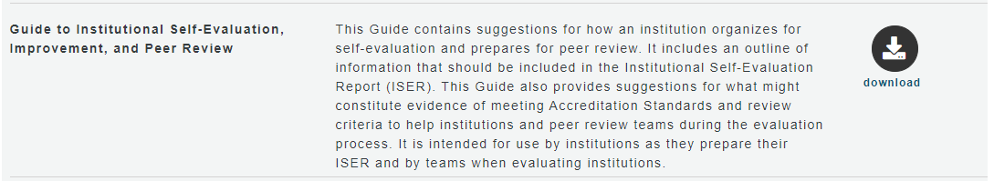
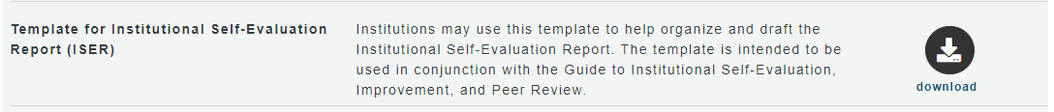
Institutional Self Evaluation Report (ISER)
ISER Training – 2 ½ years prior to comprehensive review
Advanced ISER training – approx. one year prior to visit
Liaison – available as needed
https://accjc.org/guides-and-manuals/
Notes:
Gohar

Slide 19
Four Interconnected Standards of Institutional Practice
Standard I
Standard II
Standard III
Standard IV
Mission
Instructional Programs
Human Resources
Decision-Making Roles & Processes
Physical Resources
Chief Executive Officer
Assuring Academic Quality & Institutional Effectiveness
Library & Learning Support Services
Technology Resources
Governing Board
Institutional Integrity
Student Support Services
Financial Resources
Multi-College Districts
Notes:
Emily Woolery
3 min.
emphasize standards are descriptions of good practice; to provide guidance on what makes a quality institution, emphasize developed and revised through peer process, together improving what quality means
what you should know about them:
-commission, volunteers from member institutions serving on ad hoc committees, vetted by many representatives developed standards
-2-year process of conversations and decision-making
emphasize standards are descriptions of good practice; to provide guidance on what makes a quality institution, emphasize developed and revised through peer process, together improving what quality means
-all parts of institution – institutional review (not micro program level)
-126 statements
Who—the commission, volunteers from member institutions serving on ad hoc committees, vetted by many representatives
How—2-year process of conversations and decision-making
Purpose—define Standards of Good Practice; to provide guidance on what makes a quality institution
Broadly written for application to diverse institutions: all institutions should be able to see themselves in those standards.
Application varies by college.
But they aren’t the easiest statements to understand sometimes.

Slide 20
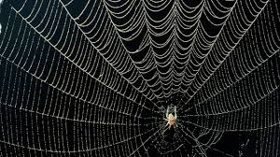
Key Concepts Woven in the Standards
Institutional mission
Integrity and honesty - institutional policies and actions
Student outcomes
Metrics and evidence to assess quality
Ongoing internal quality assurance practices
Continuous improvement for high performance
Notes:
Kristina Allende
3 min.
-Broadly written for application to diverse institutions: all institutions should be able to see themselves in those standards.
-Application varies by college.
-squishy terms
And they aren’t the easiest statements to understand sometimes.
Lead into exercise

Slide 21


Developing the ISER
Collaborative Partnership – multiple groups and perspectives working together!
Notes:
Robert Stubbe
College stakeholder working together reflecting on institution strengths and areas of improvement in application of accreditation standards. Something about two sides of same coin….peer teams will do same

Slide 22
Developing the ISER
What criteria do you think will make a good ISER?
What values/skills do you believe are important for your college’s process?
Place your response in chat
Notes:
Gohar
Typing in chat as activity -- Or jamboard – ask how did it

Slide 23

Mindset for ISER Development
Celebrate and appreciate what works well
Look for alignment with standards
Focus on outcomes
Evidence based analysis
Open-minded to improve
Valuing internal accountability
Holistic thinking across institutional systems
Mindful of mission accomplishment and values
Notes:
Lianne Greenlee

Slide 24
Formative/Summative Comprehensive Review
ISER IS DUE AUGUST 1, 2023
Benefit for Colleges:
Reduce fear / eliminate surprise
Time to consider team’s feedback for planning and improvement
Cost benefit
Benefit for Membership:
Promote collegiality
Increase transparency and trust
Emphasize institutional improvement
Formative
Component
Fall 2023
Summative
Component
Spring 2024
Notes:
Gohar

Slide 25
Expectations of Peer Reviewers
Seek to understand
Seeking to understand starts with the ISER
Practice appreciative inquiry on site
Alignment with Standards rather than hunting for deficiencies
Validation and affirmation
Goal: educational quality and institutional improvement
Outcome: the team report. . . reflection of your team and ACCJC
Excerpted from Team Training materials, Spring 2021
Notes:
Patty Quinones

Slide 26

Discussion
What concerns or questions do you have about the accreditation, ISER Development, the review process?
Notes:
Gohar & Kelly

Slide 27


Helpful Resources and Publications
Available on ACCJC’s website (accjc.org);
  Eligibility Requirements
  Standards of Accreditation
  Commission Policies
  Guides and Manuals
  Educational Series
  Webinars, conferences and symposiums
  Ongoing trainings
  News and Communications
    Announcements
    ACCJC Connect subscribe to or visit: https://accjc.org/accjc-connect/
    Recent Commission Actions
Notes:
Gohar & Kelly

Slide 28
Training: Part Two
Nuts and Bolts of ISER Development

Slide 29

Overview: The Accreditation Evaluation Process
Self-Reflection
(ISER)
Peer Review
(Team ISER Review & Focused Site Visit)
Affirmation
(ACCJC Action)
Ongoing Commitment to Improvement & Educational Excellence
Notes:
-beginning of process not end test,
-Institutional Self Evaluation Report (ISER) – clean slate, prior history of reports not considered
-Peer Review Team/Formative and Summative Components: concluding in Team Report with Recommendations (for improvement or for compliance); Commendations;
-Commission action – accreditation status
focus on ongoing process – #accreditation365 - accreditation is part of everyday work

Slide 30
Major Steps: Institutional Self Evaluation Process
Possible Steps of the Process:
Determine leaders.
Plan backward.
Invite others.
Discuss Standards
Assign teams.
Gather evidence. Make changes.
Draft sections.
Compile the report.
Share with constituencies.
Review and revise the report.
Share again?
Edit and finalize the report.
Get Board approval.
Submit.
Prepare for the Visit.
Notes:
Process layed out in Guide, seems simple but complex, ALO and steering committee will need to map out process and timeline
-real life perspective -- encourage to create a calendar with details and goals that allow many people to be involved. share perspectives such as how to be inclusive in process, how to keep people motivated, importance of communication – based on culture

Slide 31
Four Interconnected Standards of Institutional Practice
Standard I
Standard II
Standard III
Standard IV
Mission
Instructional Programs
Human Resources
Decision-Making Roles & Processes
Physical Resources
Chief Executive Officer
Assuring Academic Quality & Institutional Effectiveness
Library & Learning Support Services
Technology Resources
Governing Board
Institutional Integrity
Student Support Services
Financial Resources
Multi-College Districts
Notes:
3 min.
emphasize standards are descriptions of good practice; to provide guidance on what makes a quality institution, emphasize developed and revised through peer process, together improving what quality means
Focus on achieving institutional mission
Integrity and honesty in institutional policies and actions
Focus on student outcomes (e.g., completion of meaningful educational goals, attainment of demonstrable knowledge and skills)
Metrics and evidence used to assess institutional quality
Ongoing internal quality assurance practices
Continuous improvement for high performance
-Broadly written for application to diverse institutions: all institutions should be able to see themselves in those standards.
-Application varies by college.
-squishy terms
And they aren’t the easiest statements to understand sometimes.
Lead into exercise

Slide 32
Key Concepts Woven in the Standards
Notes:
Type in chat – as reminder
Institutional mission
Integrity and honesty - institutional policies and actions
Student outcomes
Metrics and evidence to assess quality
Ongoing internal quality assurance practices
Continuous improvement for high performance
3 min.
-Broadly written for application to diverse institutions: all institutions should be able to see themselves in those standards.
-Application varies by college.
-squishy terms
And they aren’t the easiest statements to understand sometimes.
Lead into exercise

Slide 33
Interpreting Individual Standards
Step 1: Use highest-level Standard area as your lens
For Example: Standard II.A.1
  Standard II = Student Learning Programs and Services
  Standard II.A = Instructional Programs

Slide 34
Interpreting Individual Standards
Step 2: Isolate the basic components of each sentence
(i.e., subject, verb, direct object)
Standard II.A.1:
All instructional programs, regardless of location or means of delivery, including distance education and correspondence education, are offered in fields of study consistent with the institution’s mission, are appropriate to higher education, and culminate in student attainment of identified student learning outcomes, and achievement of degrees, certificates, employment, or transfer to other higher education programs.

Slide 35
UPCOMING ACTIVITY PURPOSE
  To provide opportunity to discuss varying perspectives on the standard
  To identify differences among standards which are related
  To identify 1-2 pieces of evidence at your college which would demonstrate alignment
  To provide opportunity to norm college’s interpretation and expectation to demonstrate alignment
Notes:
3 min
explain purpose and lead first step is to learn how to interpret standard

Slide 36

Group Activity - Interpreting the Standards
  Break into groups.
  Read assigned example standard in the handout.
  Discuss the Standards interpretation and accompanying questions.
  Determine sources of evidence.
  Be prepared to discuss with the full group.
Notes:
9:30 – 10:00 (slides 17 -18) BREAKOUT Activity 30 Minutes --
BREAK – 10am – 10:15 am
Return – 10:15am
Goals:
Provide an opportunity to discuss varying perspectives on standards
Identify differences among standards that may seem overly similar
Identify 1-2 pieces of evidence that could demonstrate college’s alignment
Begin to norm college’s interpretations and expectations
5 min –explain assignment, provide handouts, have guide excerpts available to help
Note they will need to distinguish among similar sounding standards, how distinguish, how not redundant?
-lens of main standard
-detail or level of system under review
-policy or procedure

Slide 37
Activity Let’s Discuss
  I.A.2 (Mission): The institution uses data to determine how effectively it is accomplishing its mission, and whether the mission directs institutional priorities in meeting the educational needs of students.
  I.B.4 (Assuring Academic Quality and Institutional Effectiveness/Academic Quality): The institution uses assessment data and organizes its institutional processes to support student learning and student achievement.
  I.B.5 (Assuring Academic Quality and Institutional Effectiveness/Institutional Effectiveness): The institution assesses accomplishment of its mission through program review and evaluation of goals and objectives, student learning outcomes, and student achievement. Quantitative and qualitative data are disaggregated for analysis by program type and mode of delivery.
Notes:
BREAK – 10am – 10:15 am
Return – 10:15am
Start report out 10:15 – 10:40am (~5 min. per group + reflection) – slides 19-23

Slide 38
Activity Let’s Discuss
  I.B.2 (Assuring Academic Quality and Institutional Effectiveness/Academic Quality): The institution defines and assesses student learning outcomes for all instructional programs and student and learning support services.
  II.A.3 (Instructional Programs): The institution identifies and regularly assesses learning outcomes for courses, programs, certificates and degrees using established institutional procedures. The institution has officially approved and current course outlines that include student learning outcomes. In every class section students receive a course syllabus that includes learning outcomes from the institution’s officially approved course outline.
  II.C.2 (Student Support Services): The institution identifies and assesses learning support outcomes for its student population and provides appropriate student support services and programs to achieve those outcomes. The institution uses assessment data to continuously improve student support programs and services

Slide 39
Activity Let’s Discuss
  I.C.8 (Institutional Integrity): The institution establishes and publishes clear policies and procedures that promote honesty, responsibility and academic integrity. These policies apply to all constituencies and include specifics relative to each, including student behavior, academic honesty and the consequences for dishonesty.
  III.A.13 (Human Resources): The institution upholds a written code of professional ethics for all of its personnel, including consequences for violation.
  IV.C.11 (Governing Board): The governing board upholds a code of ethics and conflict of interest policy, and individual board members adhere to the code. The board has a clearly defined policy for dealing with behavior that violates its code and implements it when necessary. A majority of the board members have no employment, family, ownership, or other personal financial interest in the institution. Board member interests are disclosed and do not interfere with the impartiality of governing body members or outweigh the greater duty to secure and ensure the academic and fiscal integrity of the institution.

Slide 40
Activity Let’s Discuss
  I.C.5 (Institutional Integrity): The institution regularly reviews institutional policies, procedures, and publications to assure integrity in all representations of its mission, programs, and services.
  IV.C.7 (Governing Board): The governing board acts in a manner consistent with its policies and bylaws. The board regularly assesses its policies and bylaws for their effectiveness in fulfilling the college/district/system mission and revises them as necessary.

Slide 41
Activity Reflection
  What are your key takeaways from the activity?
  What did you find particularly helpful?
  How can this approach inform your ISER process?
  What challenges do you anticipate as you get started?

Slide 42

Structure of the Report
Title page
Certification page/signatures
Table of Contents
Introduction
Student achievement data and institution-set standards
Organization of the self-evaluation process
Organizational information
Compliance with ERs 1-5
Compliance with Commission policies
Analysis of Standards
  Evidence of Meeting the Standard
  Analysis and Evaluation
  Conclusion
Quality Focus Essay
Notes:
follow template, in the guide, remember technical report not dissertation, start with understanding the standard and looking to your evidence first, then analyze, discuss, and write – analysis is heart of report

Slide 43
Structure of the Report
Evidence of Meeting the Standard
  Indicates WHAT specific evidence demonstrates alignment with the Standard
  Briefly describes the evidence in context of the standard to explain WHY it is relevant
  This document demonstrates that the College…..
Analysis and Evaluation
  Indicates HOW the evidence demonstrates alignment with the Standard
  Evaluates the effectiveness of the policy, procedure, or practice in meeting the Standard
Conclusion at end of main sections
  Provide a brief summary at a high, holistic level on the effectiveness of the College’s efforts towards the Standard
  If the College determines improvements are needed, improvement plans should follow
Notes:
– tips and perspectives both as ALO and peer reviewer

Slide 44
Improvement Plans and the QFE
Self-Identified Improvement plans (a.k.a. planning agenda)
  Purpose: Plans to strengthen college’s alignment to specific standards
Quality Focus Essay (QFE)
  Purpose: Long term plans to improve student learning and achievement
  Should identify outcomes, which are measurable and achievable
  Should identify responsible parties/groups
  Should have a timeline
Teams will provide feedback

Slide 45
Good Practices for Approaching the Report
Discuss the Standard, gather the evidence, then write
Use the ISER template (available on ACCJC website)
Keep the narrative clear, direct, and focused – use active voice
Use introductory sections to set the context and tone
Assign ERs 1-5 & Commission Policies with related Standards
“Freeze” evidence from websites in a PDF or screenshot

Slide 46
Good Practices for Evidence
Gather your evidence before you begin writing
More evidence is not necessarily better
Provide representative samples showing results of institutional processes
Use evidence to demonstrate how processes/cycles are institutionalized
Call out relevant sections of large documents (highlights, excerpts, etc.)
Compare your evidence with Guide to Institutional Self-Evaluation
Notes:
Not historical novel, focus on most current and reasonable available

Slide 47
Heads Up – Distance Education
In September 2020, the U.S. Department of Education (ED) issued a final rule related to Distance Education and Innovation under the Higher Education Act (HEA).
Modified definitions for distance ed and correspondence ed
Defined regular and substantive interaction
ACCJC Policy revisions adopted June 2021

Slide 48

What Happens Next?
Fall 2021: ISER Training/Development
AUG 1, 2023: ISER Due to ACCJC
Fall 2023: Team ISER Review (peer review)
Spring 2024: Focused Site Visit (peer review)
June 2024: Commission decision
Throughout the process: ACCJC training & support
Notes:
11:00 – 11:20am – slides 31 - 33
ISER production per your timelines
Analyze Standard
Gather evidence first
Identify Gaps
Make changes
Write report
Reviews process
Dec. 2022/Jan 2023 (60 days in advance of Team ISER Review) Report due to ACCJC

Slide 49
Remaining Questions and Comments
&
THANK YOU!

