Slide 1
Virtual Resource Fair
Helping students connect with the Mt. SAC campus community.

Slide 2
ACCESS
Accessibility Resource Centers for Students

Slide 3
ACCESS
Accessibility Resource Centers for Students
Accessible Technology
Disability Management
ASL Interpreters
Counseling & Advising
Steps
Submit a ACCESS application
Provide documentation of disability
Meet with a ACCESS counselor to establish accommodations
Services
Puzzle Project
Tram
Are based on
educational
barriers
Strategies Classes
Learning Disabilities Assessments
The Center (DHH)
Equipment Loans
Speech & Language Assessments
Accessible Technology Center
Alternate Media
Eligibility
Student Tips
Presentations
Documented Disability
Educational Limitation
Desire For Services
Register Early
Check in with ACCESS Regularly
Discuss Needs with Professors
Consultations
ABI Program
Priority Registration
Real Time Captioning
Adaptive Classroom Furniture
Notetakers
Classroom Accommodations
Notes:
ACCESS has so many services that it would take many more slides to fully list all of them. Some of the most popular are listed in small print on this slide. Check ACCESS’ website for more information http://access.mtsac.edu. We also hire lots of student employees with and without disabilities throughout the year.

Slide 4
Access Center
909-274-4290 www.mtsac.edu/access/
Remote Office Hours
Mon- Fri: 8:00am-6:00pm access@mtsac.edu

Slide 5
Bridge Program

Slide 6




GET A HEAD START IN COLLEGE WITH THE
MT. SAC SUMMER BRIDGE PROGRAM!
Attention
Class of 2021
Summer Bridge is:
You'll receive:
Ideal for first generation college students!
A smooth transition from high school to college!
An opportunity to build
long-lasting friendships!
Early registration for Fall semester
FREE loaned textbooks
FREE school supplies, and much more!
Summer Bridge Program dates:
June 21 - July 29, 2021
The Summer Bridge Program is a perfect way to begin your college journey.
  The application will be available October 23 through your Mt. SAC Student Portal.
  Students who apply by April 16, 2021 will be given priority consideration.
  For more information visit our website at www.mtsac.edu/bridge/summer
  Summer Bridge students may qualify for Mt. SAC’s Promise +Plus benefits.
  Phone: 909-610-9375 Email: bridgeprogram@mtsac.edu

Slide 7


FALL AND SPRING BRIDGE PROGRAM
FALL AND SPRING BRIDGE LEARNING COMMUNITIES:
Program Benefits
Peer Advisors
Study Center
Free Printing
Laptops
Textbook Loans
Free School Supplies
Supplemental Instructor/
Tutor
Activities
Workshops
Guest Speakers
Field Trips
Complete college level courses
Counseling and Advising
Are ideal both new and continuing college students
Students take a Math or English class, paired with a Counseling class
Offers students a structured, unique learning experience
Students work in teams, and receive academic and personal support, and peer mentoring
Students will learn what it takes to succeed in college and beyond
CONTACT US!
909-610-9375
bridgeprogram@mtsac.edu
www.mtsac.edu/bridge
@mtsacbridgeprogram Mt. SAC Bridge Program

Slide 8
CalWORKs

Slide 9

CalWORKs Program
Who do we serve?
Parents who have children under 18
And are currently receiving Cash Aid (TANF)
Enrolled or planning to enroll in credit or non-credit classes at Mt. San Antonio College
What can CalWORKs do for you?
Help student-parents obtain lifelong learning through education
Assist with gaining access to the workforce
Provide high-quality support services.
Support Services Include:
Counselors: Academic and Career Counseling
Program Specialist: Case Management

Slide 10
Benefits
Priority Registration
Childcare Referrals and Payment
Assistance with Textbooks, Fees and Supplies
Advocacy: Community, Legal and Housing
Job Placement On-Campus
Free, One-on-One Online Tutoring
Contact Us Today!
CalWORKs Temporary Hotline: (909) 294–6796
calworks@mtsac.edu

Slide 11
High School Outreach

Slide 12


HIGH SCHOOL OUTREACH
CONNECT 4 PROGRAM
Connect 4 assists graduating in-district high school seniors in their transition to Mt. SAC. Students who successfully complete the 4 steps with their HSO Specialist will receive Early Registration for Fall!
Virtual Services
Outreach Specialist Office Hours
Registration Assistance
Registration 101 Workshops
Campus Tours
Virtual Services
General & Special Programs Presentations
Virtual Juniors & Seniors Day
Assessment Questionnaire

Slide 13
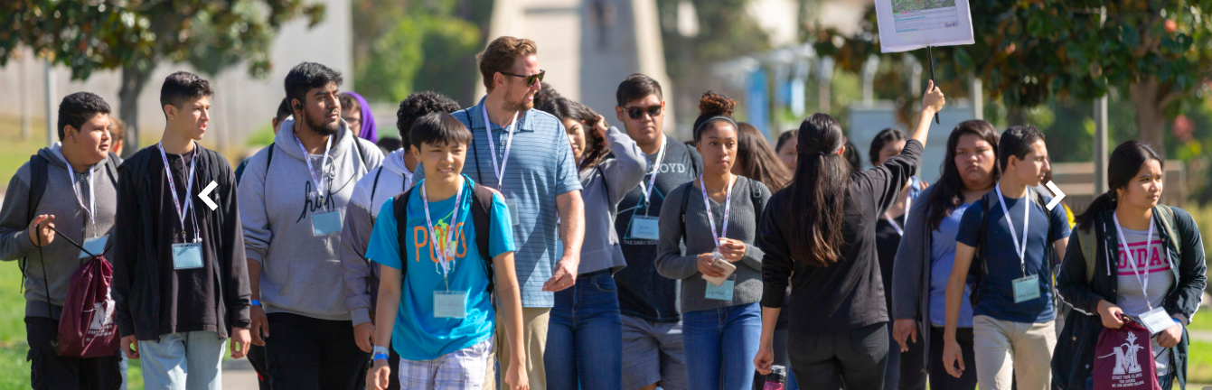

HIGH SCHOOL OUTREACH
CONNECT 4 PROGRAM Early Registration for Fall!
SERVING OUR IN-DISTRICT HIGH SCHOOL SENIORS
CONNECT 4 STEPS
VISIT US TO LEARN MORE!
1. Apply to Mt. SAC
www.mtsac.edu/HSO
2. Assessment Questionnaire
3. Online Orientation + MAP Workshop
4. Register for classes
FOLLOW US FOR UPDATES
@mtsacHSO

Slide 14
Promise+Plus Program

Slide 15
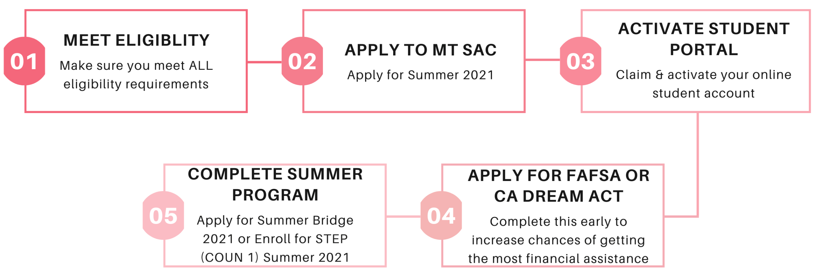

Promise+Plus
The Mt. SAC Promise+Plus program is a combination of financial and support services to help first-time, full time and part time college students be successful in their first year and have access to the life-changing benefits of a college education.

Slide 16
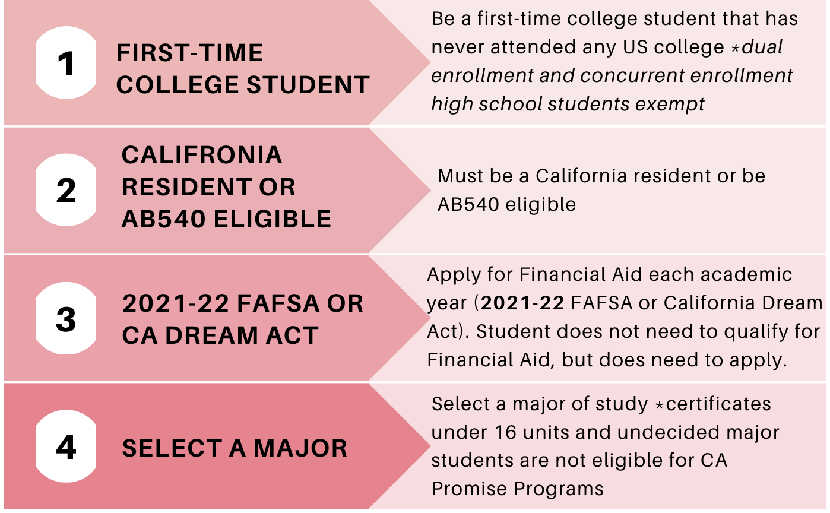
How to Meet Eligibility for Promise+Plus 2021-2022

Slide 17
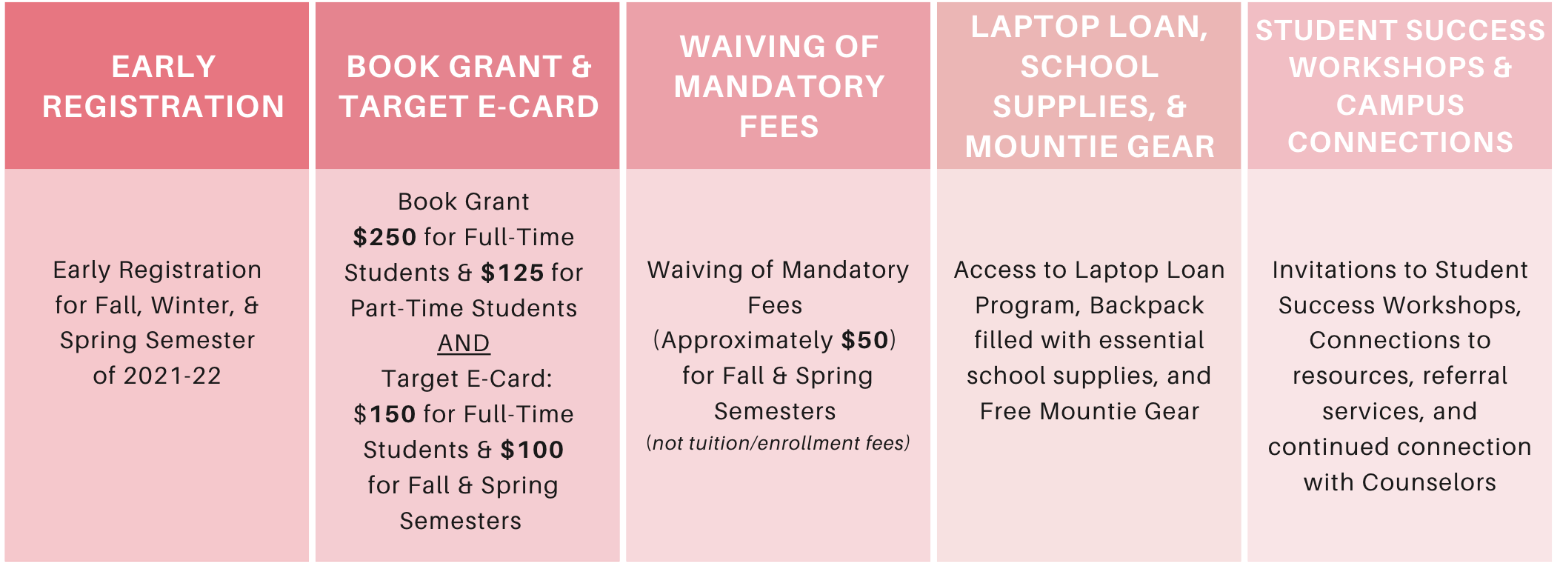

Promise+Plus Benefits

Slide 18
Honors

Slide 19

Mt. SAC Honors Program
What is the Honors Program?
A diverse learning community of motivated individuals
What are the Benefits?
Smaller, dedicated Honors courses
Increased interaction with faculty
Specialized Honors Counselors
Opportunities to present research at research conferences
Participation in transfer agreements to UCLA, UCI, and other universities
Transfer Agreements?
Agreements with universities that grant additional benefits
  UCLA TAP
  UCI Honors to Honors
How to Apply?
Go to our Website (https://www.mtsac.edu/honors/). Then, scroll down and hit APPLY NOW!

Slide 20
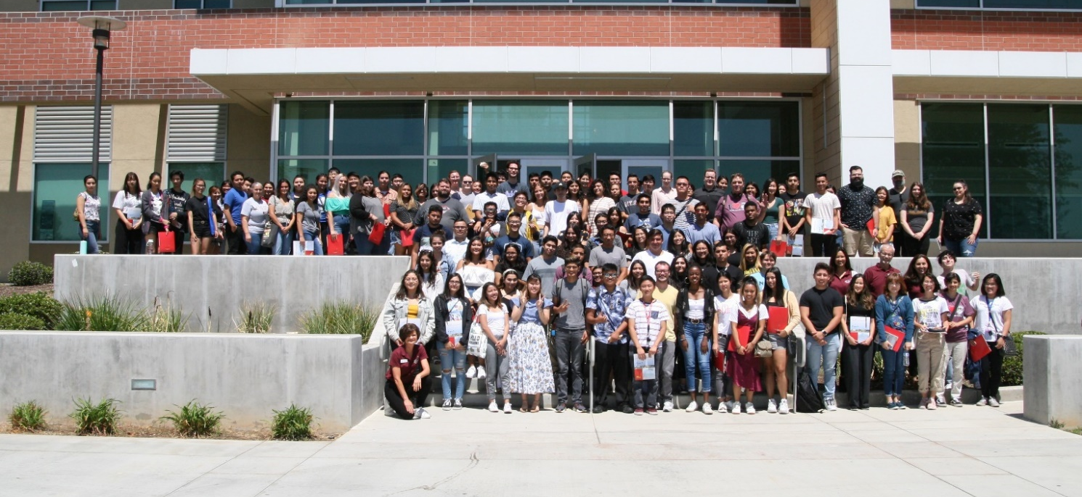
Mt. SAC Honors Program
Virtual Honors Center:
Mondays, Tuesdays, & Thursdays: 12pm -4pm
Wednesdays: 2pm -6pm.
Zoom Link: https://cccconfer.zoom.us/j/567896817 or dialing +1 669 900 6833 (US Toll).
If asked for, the meeting ID is 567-896-817.
Email: Honors@mtsac.edu
Website: https://www.mtsac.edu/honors/

Slide 21
Counseling
Programs and Resources to Help Students Thrive

Slide 22
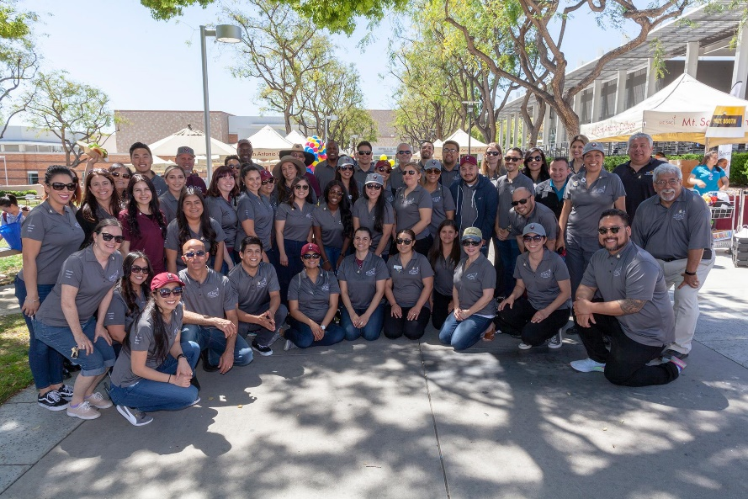
Counseling Services
A Team of Dedicated and Caring Counselors are Waiting to Assist You!
What can a Counselor Help me with?
Academic, Career, and Personal Counseling
  Develop an Education Plan
  General advising on academics and courses
  Transfer options and requirements
Help you decide on a major and/or career
  Career Assessments
  Undecided Workshops
Understand your Mt. SAC Educational Options
Connect you to Campus Resources
Support You Through your Academic Journey at Mt. SAC

Slide 23
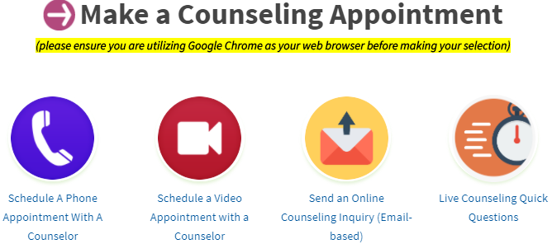
Making a Counseling Appointment
Once you apply to Mt. SAC and receive your ID number you can start meeting with a Counselor!
STEP 1: Go to https://www.mtsac.edu/counseling/
STEP 2: Click on the preferred method of appointment to meet with a counselor (phone, video, email, quick questions). See image below:

Slide 24

STEP: Summer Transfer Enrichment Program
The STEP Program is designed for first time college students
To Participate in STEP
Summer 2021
Assists you with the transition from high school into college
Work with dedicated counselors to guide them every step of the way
Connect to resources that will prepare you for success
Earn one unit of college credit -Counseling 1, Introduction to College course
Opportunities for students to connect and make long-lasting friendships at Mt. SAC
Participate in insightful and supportive workshops
Follow the “STEP’s” on our website at
www.mtsac.edu/step/

Slide 25


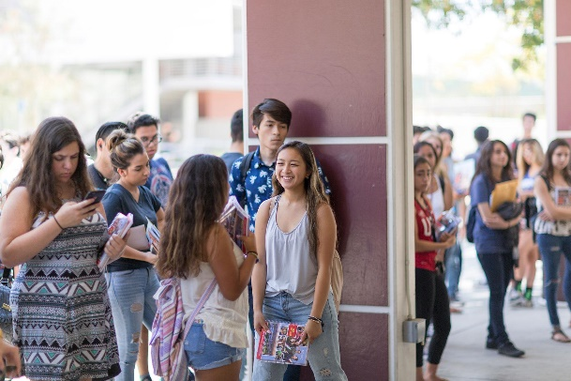
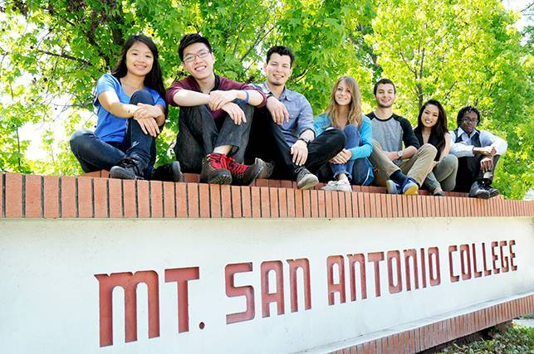
STEP Benefits
Work with caring and supportive Counseling professors in the summer and beyond
Jump Start into College and Be Ready for Fall
Gain Confidence and Awareness for College Success
Access to Resources and Campus Connections
Become Part of the Mountie Family!
Eligibility for Promise+Plus Benefits
Early Registration for Fall
For a detailed list of benefits to STEP Visit: www.mtsac.edu/step/

Slide 26
EOPS/CARE
Extended Opportunity Programs and Services

Slide 27
What is EOPS/CARE
    Extended Opportunity Programs and Services
      A California community college state-funded program
      Provides access to educational opportunities (history: Civil Rights Act)
      Supports eligible underrepresented students along educational journey
      A program that has been advocating for students for more than 50 years!
    Cooperative Agencies Resources for Education (CARE)
      The CARE Program promotes the academic success of EOPS students who are single heads of household and receiving TANF/CalWORKs assistance (cash aid) or Tribal TANF with at least one dependent child under the age of 18.

Slide 28
EOPS/CARE
EOPS/CARE is currently accepting applications ​​
Eligibility Criteria: ​
1) Qualify for the California College Promise Grant ​
(under method A, B or C with an EFC of $0.)​
2) Must enroll in 12 units ​
(ACCESS or Foster Youth only need to enroll in 9 units)​
Some Program Benefits: ​
1) Priority Registration
2) EOPS Book Service ($300) ​
3) One-on-one tutoring services (currently online)​
4) Counseling Services ​
​
For more information or to apply students can visit: www.mtsac.edu/eops​
​

Slide 29
REACH
Reaching, Empowering, Achieving & Completing with Heart

Slide 30


What services do I get when I join the REACH Program?
Priority Registration: register for classes first
REACH textbook loan program: borrow the textbooks you need from REACH
REACH equipment loan program: borrow laptops, tablets and calculators.
Counselors dedicated to REACH students
REACH Workshops and Events
Life Skills Specialist to support your personal goals
Peer Mentor to support you all semester
Housing Resources
Be part of a community

Slide 31

How do I join the REACH program?
Submit a REACH application: start the process
Complete a REACH orientation: learn more on how to be successful in college and how reach can help
Complete a REACH assessment: tell us how can we help you meet your goals
Meet a REACH staff: make sure you have everything set to register for classes
Meet a REACH counselor: learn what classes you need to take
Contact us:
mtsacreach@mtsac.edu
www.mtsac.edu/reach

Slide 32
Student Life

Slide 33

Student Life
LEAD Program
Associated Students
Recognized Student Clubs/Orgs
Lost & Found
Student Conduct
Grievances
Activities Transcript
Student Life Center

Slide 34
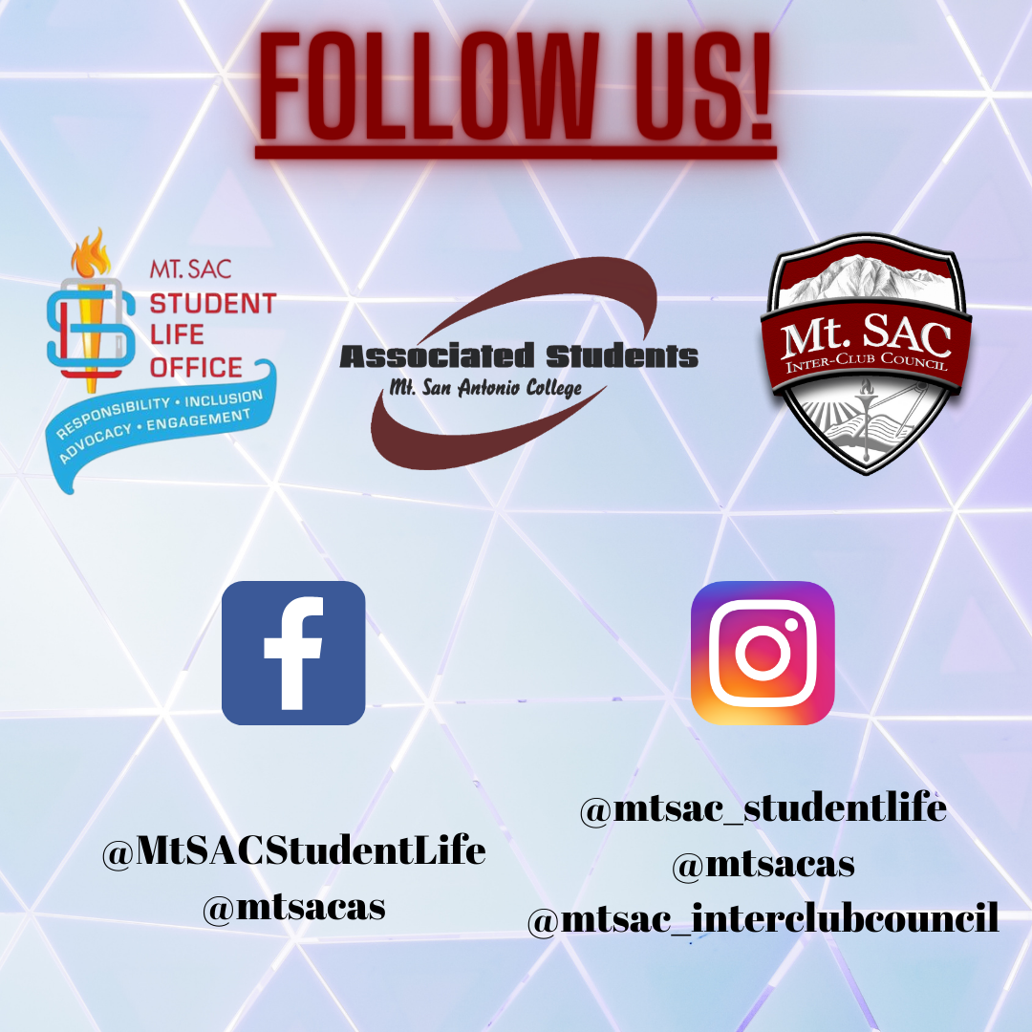
Follow Us on Social Media

