Slide 1
Program
WebCMS 10.0

Slide 2
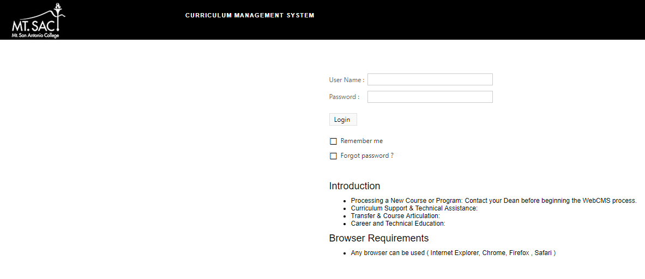
Access WebCMS 10.0
WebCMS 10.0 Link or www.mtsac.edu/curriculum
Username: Mt. SAC Credentials
Password: test
Recommended Browser: Google Chrome

Slide 3
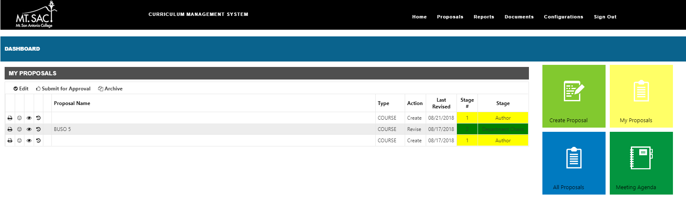
The Dashboard
Ribbon Menu
Dashboard will appear
My Proposals summary displays

Slide 4

The Dashboard
Can also be viewed by selecting My Proposals
Quick Links to make Edits, Submit for Approval and Archive.
All of your proposals will display with an indicator of the current stage.

Slide 5
The Dashboard
Create Proposal – Create a new program or course.
My Proposals – View your current program and course proposals.
All Proposals - View all current program and course proposals.
Meeting Agenda – View minutes/ documents.
1
2
3
4

Slide 6
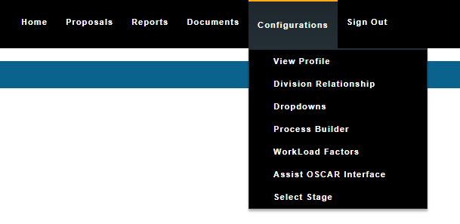
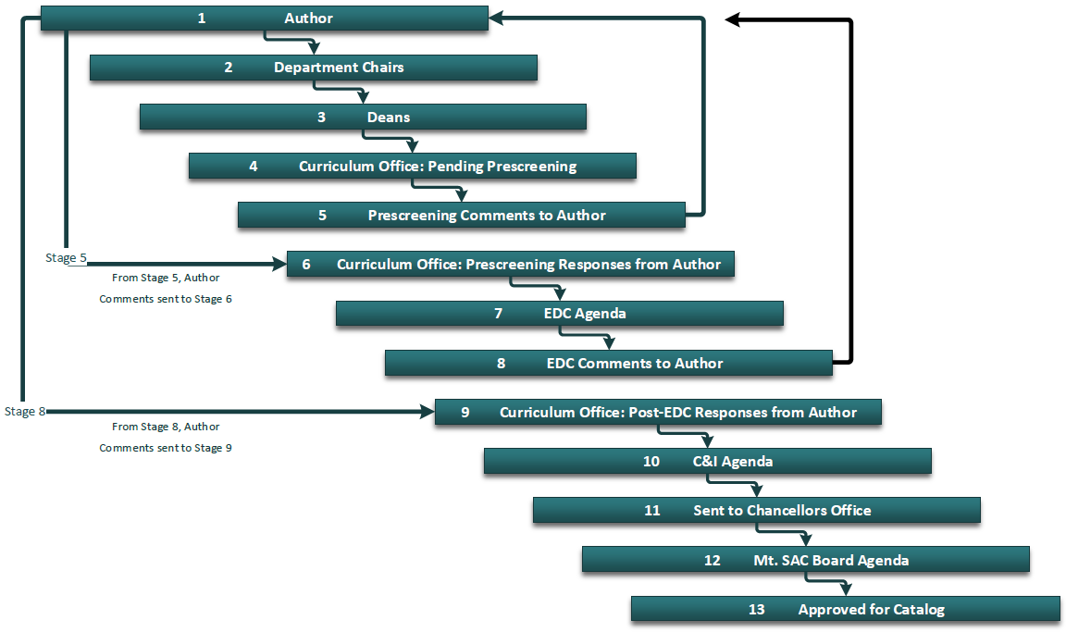
The Process Builder
Process Builder Link

Slide 7
The Dashboard – 1. Create Proposal
1. Create Proposal – Create a new program or course
1

Slide 8
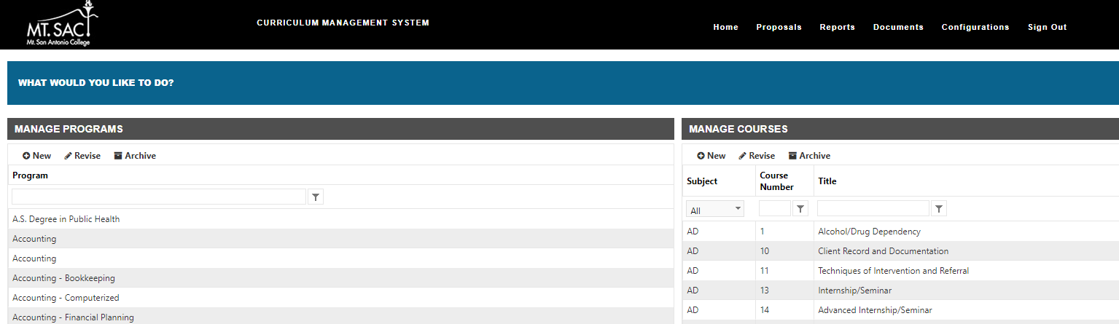
1. Create Proposal - Programs
Add New Program
Revise Program
Archive Program
Filter by Program Name

Slide 9
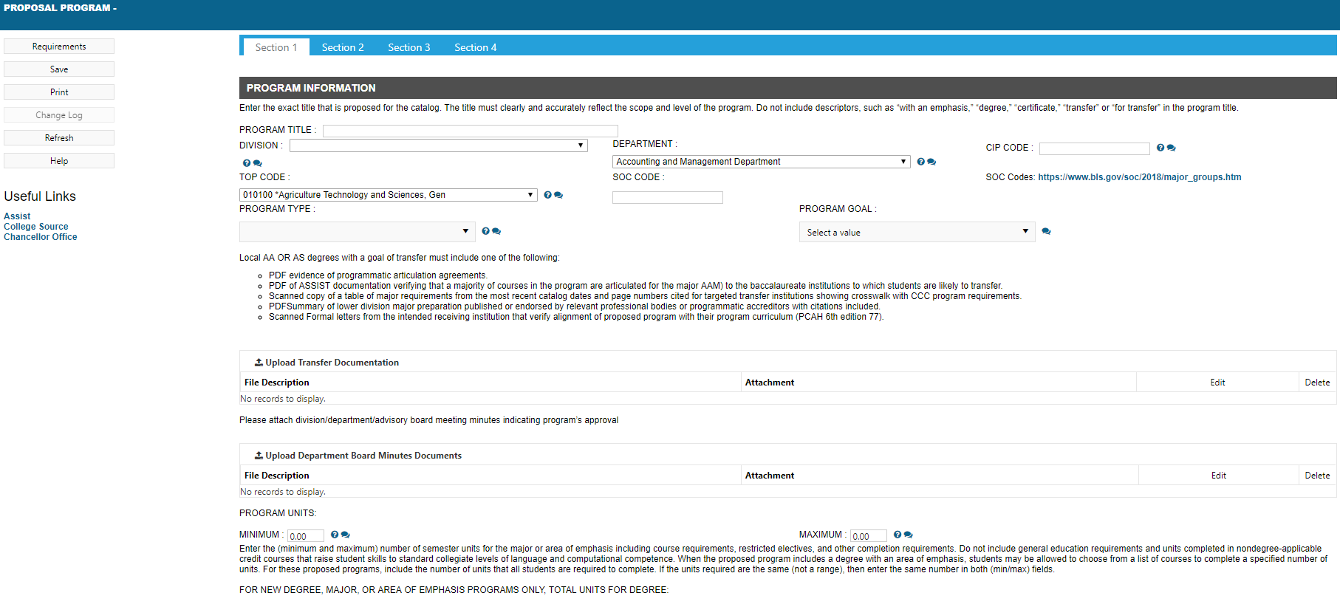
1. Create Proposal – Programs (Section 1)
Enter detailed information for the new program proposal
Make sure to Save!

Slide 10
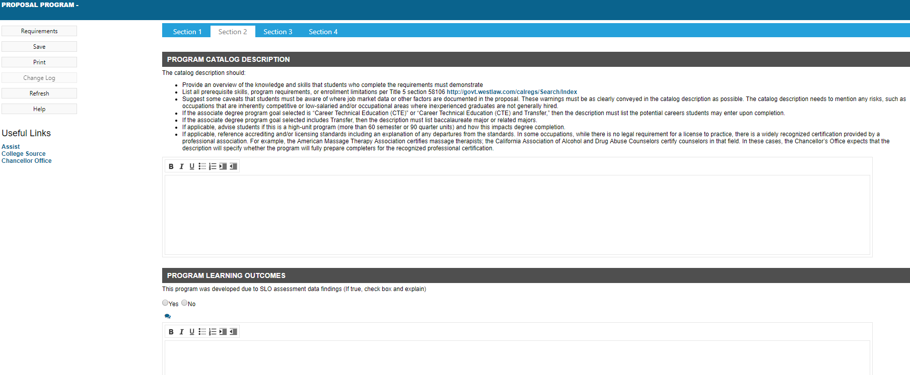
1. Create Proposal – Programs (Section 2)
Enter detailed information for the new program proposal
Make sure to Save!

Slide 11
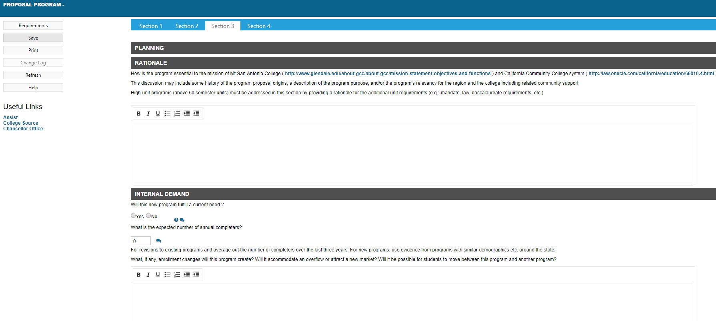
1. Create Proposal – Programs (Section 3)
Enter detailed information for the new program proposal
Make sure to Save!

Slide 12
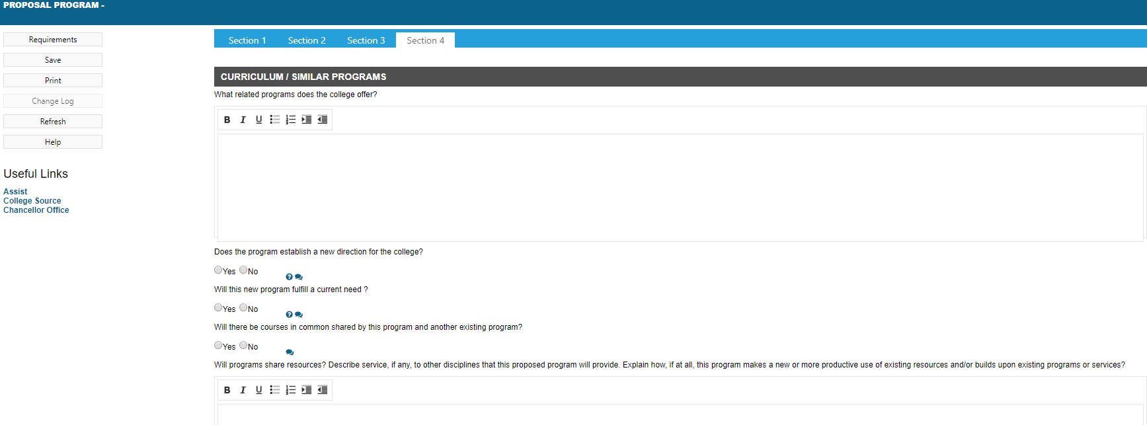
1. Create Proposal – Programs (Section 4)
Enter detailed information for the new program proposal
Make sure to Save!

Slide 13
The Dashboard – 2. My Proposals
2. My Proposals – View your current program and course proposals
2

Slide 14
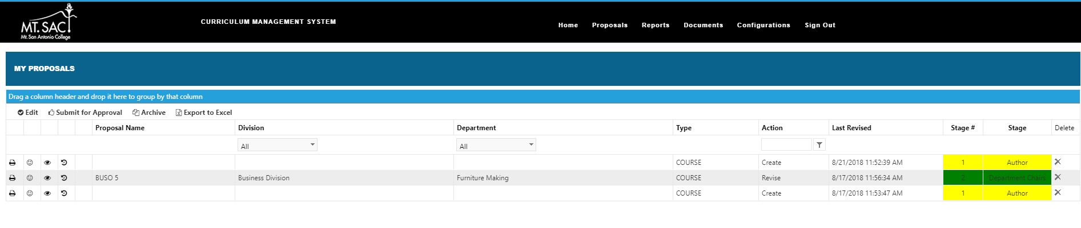
2. My Proposals
Full menu displays with detailed information for your proposals (both Programs & Courses)

Slide 15
2. My Proposals
Quick Links to make Edits, Submit for Approval, Archive and Export to Excel for only your proposals.

Slide 16
The Dashboard – 3. All Proposals
3. All Proposals - View all current program and course proposals.
3

Slide 17
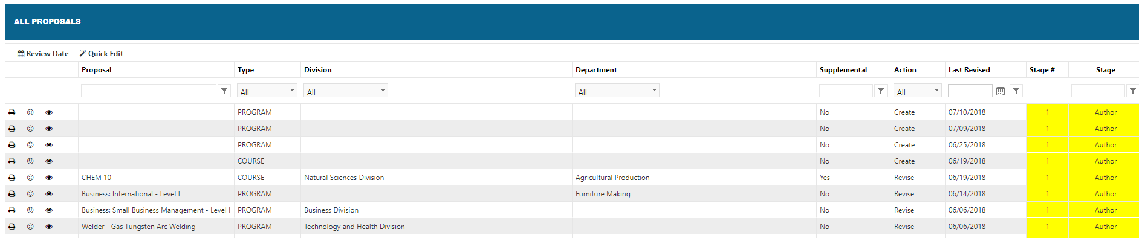
3. All Proposals
Full menu displays with detailed information for all Proposals (both Programs & Courses)
Filters can be applied.

Slide 18
The Dashboard – 4. Meeting Agenda
4. Meeting Agenda – View minutes/ documents.
4

Slide 19
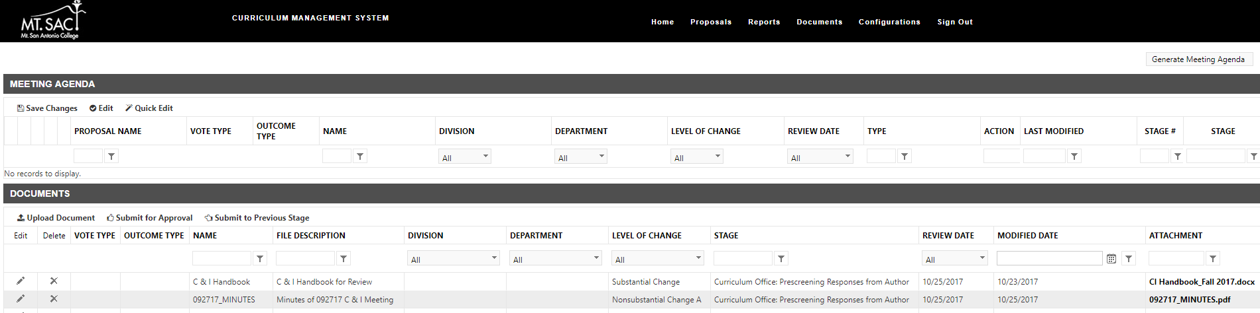
4. Meeting Agenda
Display of previous meeting agendas, documents and notes.
Make updates to Meeting Agendas as well as attach minutes and edit.

Slide 20

FAQ’s
Where can I find more curriculum resources/forms, what happens if I forget to save a section before clicking on the next section?
Does my course or program need Chancellor's Office approval?
How long does it take for a new course/program to be created and offered in the catalog?
What happens if I don't attach meeting minutes but still submit my course or program?
What if my course or program overlaps with another area?
What if I need more help?

