Slide 1
Child Development Permit Overview
Qualifications and Instructions for 1st Time Applicants
Presented by:
Professor Henry & Professor Melendez

Slide 2
Agenda
Overview of Child Development Permits
Review of qualifications
Steps for 1st time applicants

Slide 3

Child Development Permit
Child Development Permits are issued through the California Commission on Teacher Credentialing (CCTC)
Permits are valid for 5 years from the date they are issued
Higher level permits can be renewed (Teacher & above)
  105 Professional Growth Hours
Notes:
Remember to start keeping track/ a log of your professional growth hours for easy renewal

Slide 4
Why Hold a Permit?
Allows you to be employed as a child development teacher or supervisor/director within a state funded, Title 5 or federally funded child development program
  Position requiring permits typically offer higher salaries and better benefits
  Holding a permit can make you more marketable
  Stipends ($$$) are available for permit holders

Slide 5

What Permits are Offered?
  Assistant
  Associate Teacher
  Teacher
  Master Teacher
  Site Supervisor
  Program Director

Slide 6
Unit Requirements for Lower Level Permits
Each level has specific unit requirements
  Assistant (6 units)
  Associate Teacher (12 core units)
  Teacher (24 units + 16 GE units)
Courses must be completed with a “C” or higher

Slide 7
Early Childhood Education Core Units
Must meet a minimum of 3 semester units in each core area
  Child Growth & Development (CHLD 11)
  Child/Family & Community (CHLD 1)
  Program & Curriculum (CHLD 5 & CHLD 6)

Slide 8
General Education (GE) Core Units
Minimum of 16 semester units:
Courses must be degree applicable (Graduation Level)
  English/Language Arts – ENGL 1A
  Arts/Humanities – AREA 3
  Social Studies – AREA 4
  Math or Science – AREA 2 or AREA 5
(More than one course is needed from an AREA to = 16 units)

Slide 9
Work Experience Requirement
Associate teacher level and higher require work experience to obtain a permit
Volunteer experience counts (in a licensed ECE program)
Only experience working with kindergarten and younger counts
Experience is counted by days, not hours - 3 or more hours per day

Slide 10
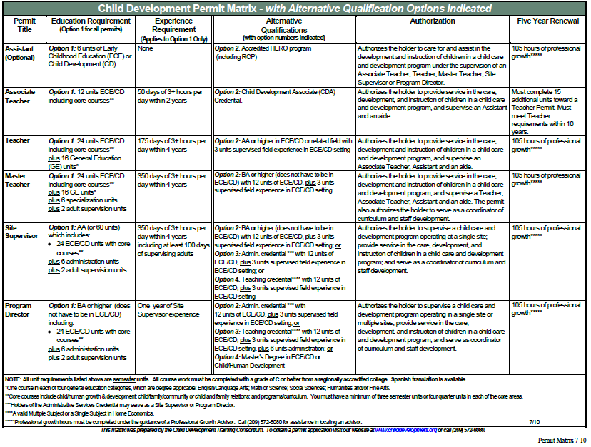

Slide 11

Assistant Permit – 6 units of ECE
Any of the following:
CHLD 1 - Child, Family, School, Community
CHLD 5 - Principles and Practices in Child Development Programs
CHLD 6 - Introduction to Child Development Curriculum
CHLD 11- Child and Adolescent Development
No days of experience needed to apply for this permit

Slide 12

Associate Teacher Permit –
12 units (core courses)
CHLD 11- Child and Adolescent Development
CHLD 1- Child, Family, School, Community
CHLD 5- Principles and Practices in Child Development Programs
CHLD 6- Introduction to Child Development Curriculum
Plus 50 days of experience within the last 2 years

Slide 13
Teacher Permit
24 ECE units-Core courses plus any 12 units of the following:
  CHLD 50 - Teaching in a Diverse Society
  CHLD 51 – Early Literacy in CD
  CHLD 61 - Language Arts & Art Media
  CHLD 62 -Music & Motor Development
  CHLD 63 - Creative Science & Math
  CHLD 64 - Health, Safety, & Nutrition
  CHLD 66/66L- Observation & Assessment
  CHLD 67/67L - Early Childhood Practicum
Plus 16 General Education units
Plus 175 days of experience within the last 4 years

Slide 14
Master Teacher Permit
24 ECE units - including core units
6 specialization units (one area of focused study)
2 adult supervision units – CHLD 75
16 GE units
350 days of experience within the last 4 years

Slide 15
Site Supervisor Permit
AA or 60 units, including the following:
24 ECE units – including core units
Plus 6 administration units (CHLD 71A & CHLD 71B)
Plus 2 adult supervision units (CHLD 75)
16 GE units
350 days of experience including 100 days of supervising adults within the last 4 years

Slide 16

How To Apply
You can find the application for the Permits at: www.ctc.ca.gov or from the Mt. SAC Child Development & Education Webpage https://www.mtsac.edu/childdevelopment/ under the Benefits $$$ pull down tab

Slide 17
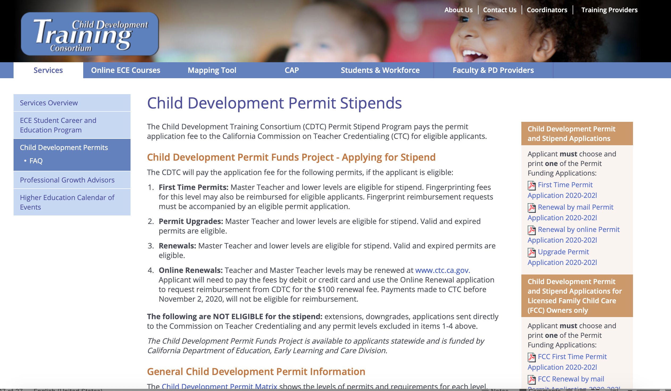

Slide 18
Steps to Complete for 1st Time Applicants
Complete the following forms:
  Child Development Permit Stipend Request form
  Credential Application form 41-4
    Included in the PDF packet or you can access through CTC
  Request for Live Scan Service-form 41-LS
  Verification of Experience form
  Live Scan Reimbursement request form (only if you paid for Live Scan fee yourself)
  Confidential Profile for Direct Service form
Enclose official college transcripts (in sealed envelop)

Slide 19
Contact Child Development Training Consortium (CDTC)
Email – cdtc-permit@yosemite.edu
Phone – (209) 572-6080
OR
Visit any Mt. SAC full time Child Development faculty during their virtual office hours (fall, winter, & spring semesters only)

Slide 20
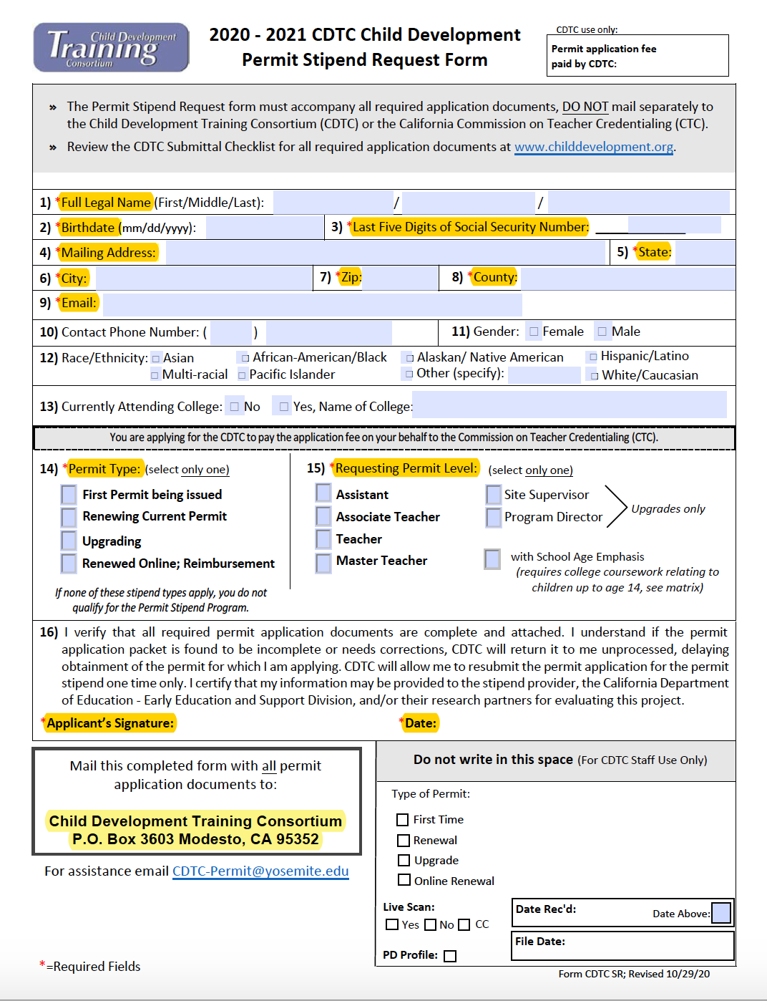
Permit Stipend Request Form

Slide 21
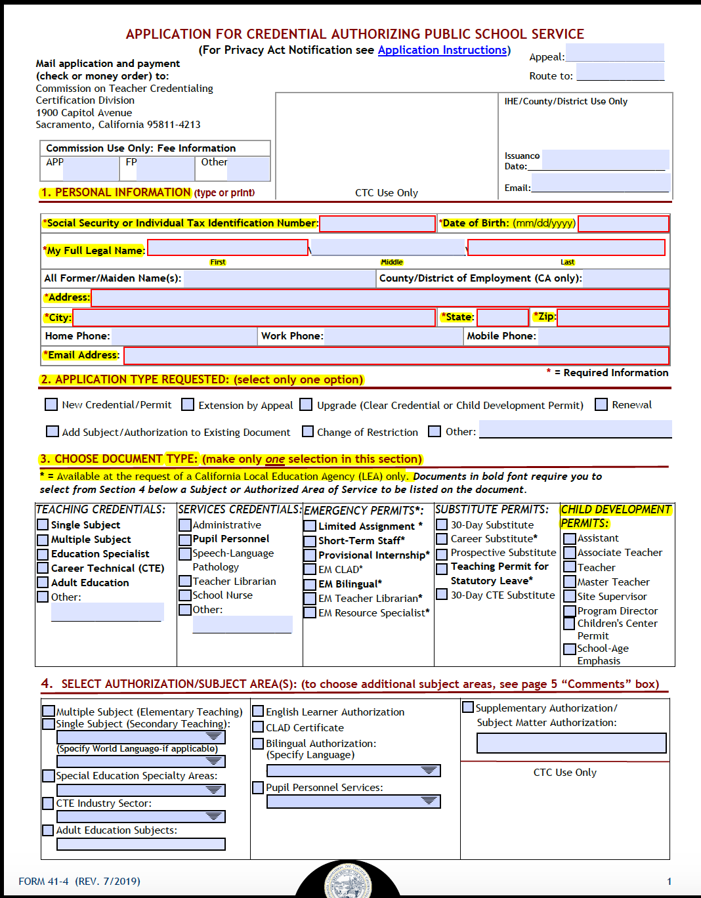
41-4

Slide 22
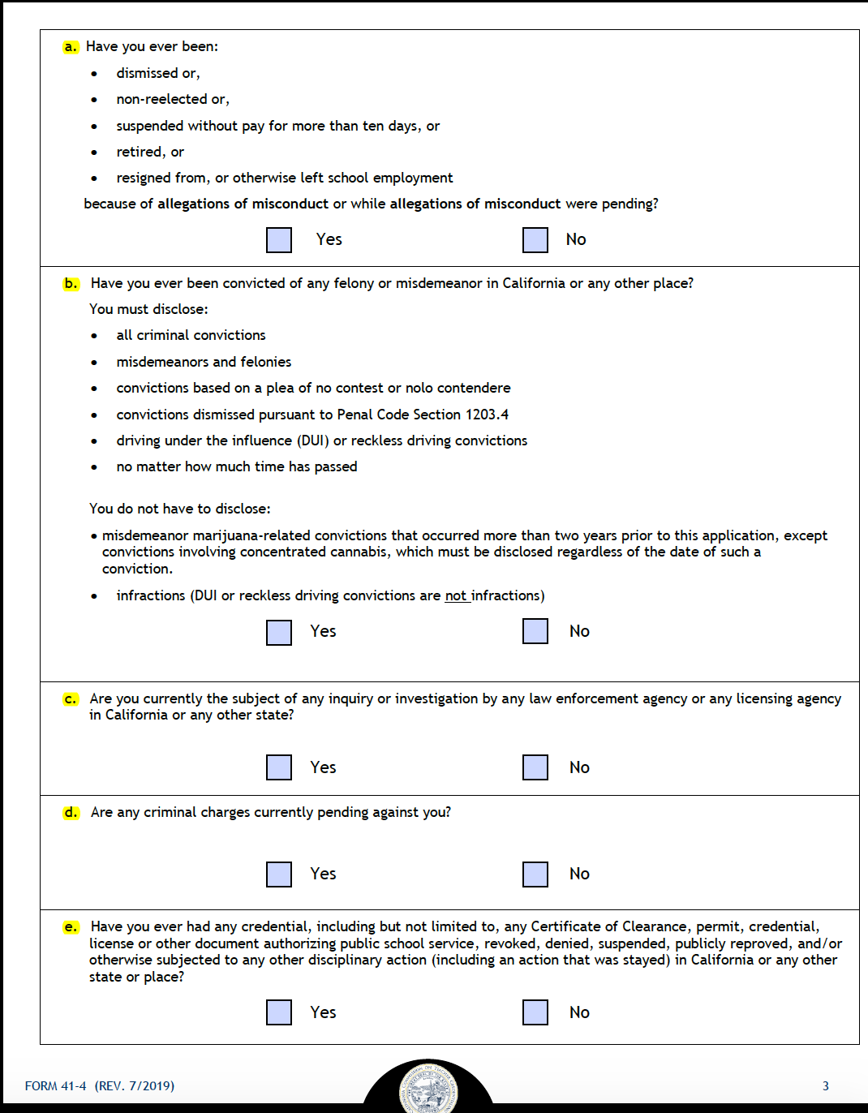
If you answer yes to any Professional Fitness Questions:
41-4 Page 3
You must complete OA-EF Personal and Professional Fitness Explanation Form and add any additional documentation for each yes answer

Slide 23
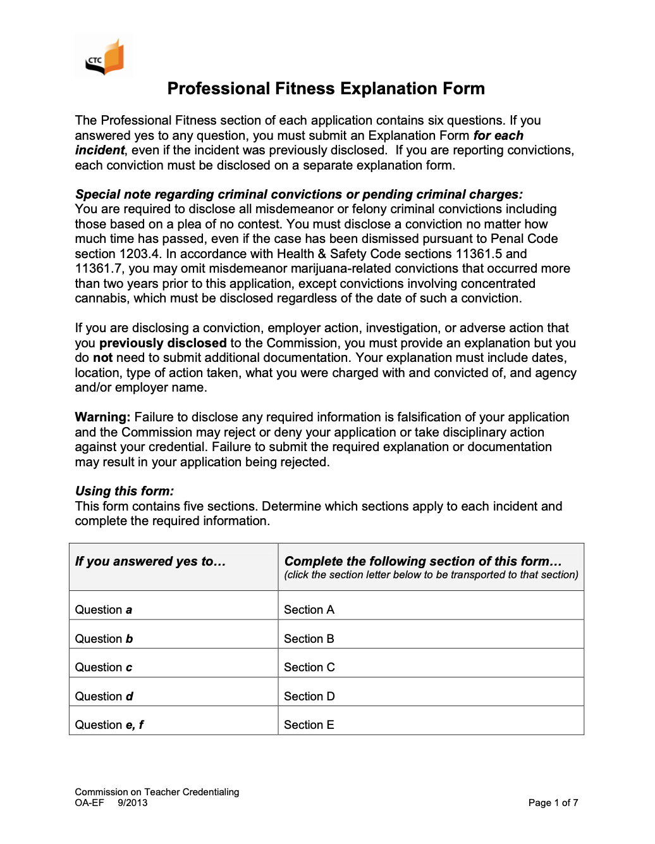
Personal and Professional Fitness Explanation Form OA-EF
Notes:
Section 6. Professional Fitness Questions: answer ALL professional fitness questions (a-f).
If you answer “Yes” to any of the questions, you must complete the Professional Fitness
Explanation Form (Form OA-EF) and submit the required supporting documentation. This form
can be found on the CTC website at ctc.ca.gov.

Slide 24
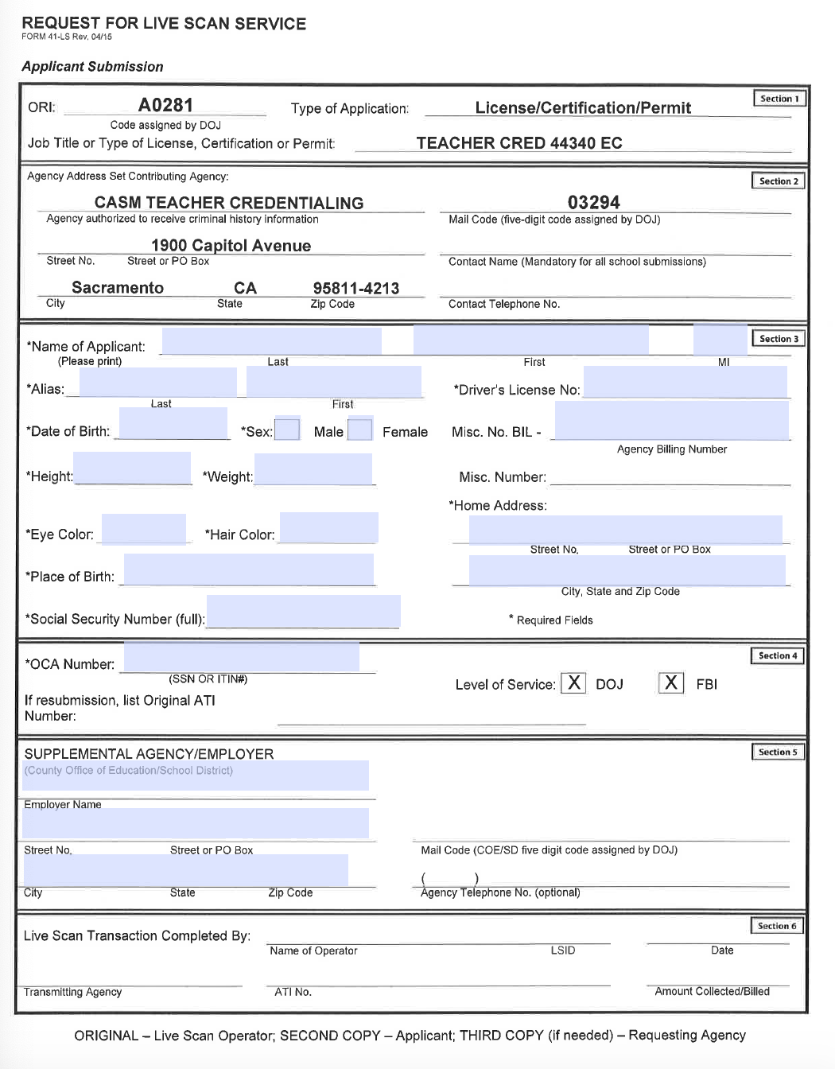
41-LS
Notes:
Request for Live Scan Services

Slide 25
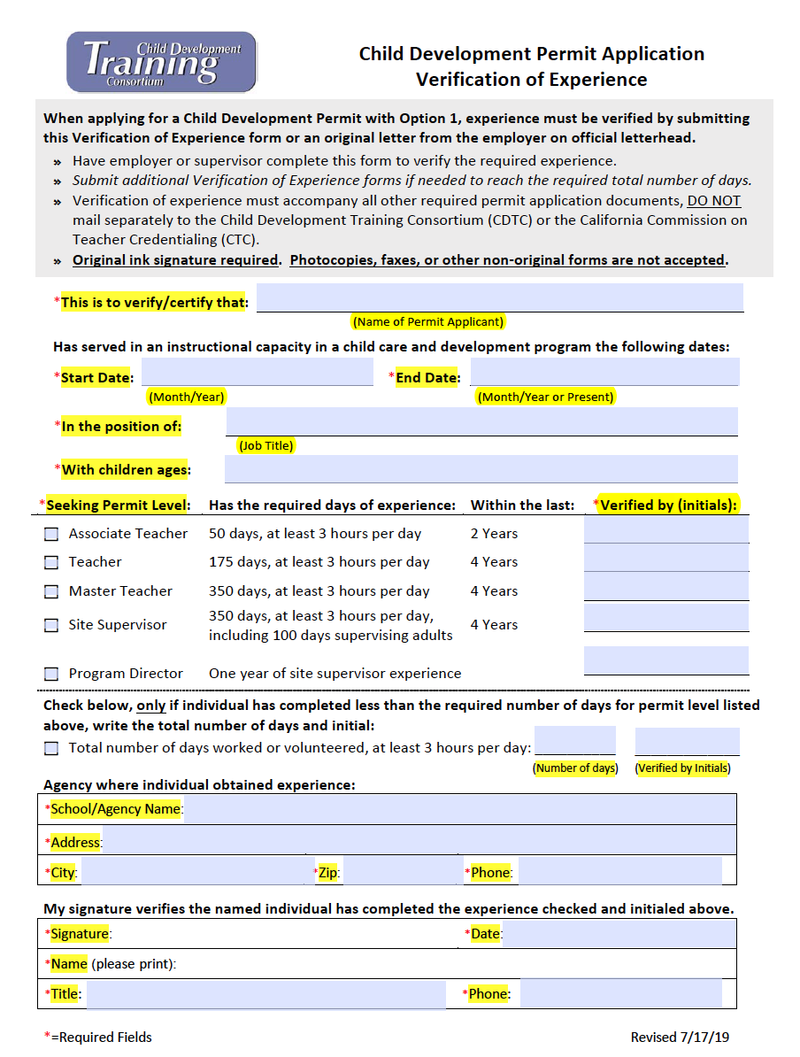
Verification of Experience

Slide 26
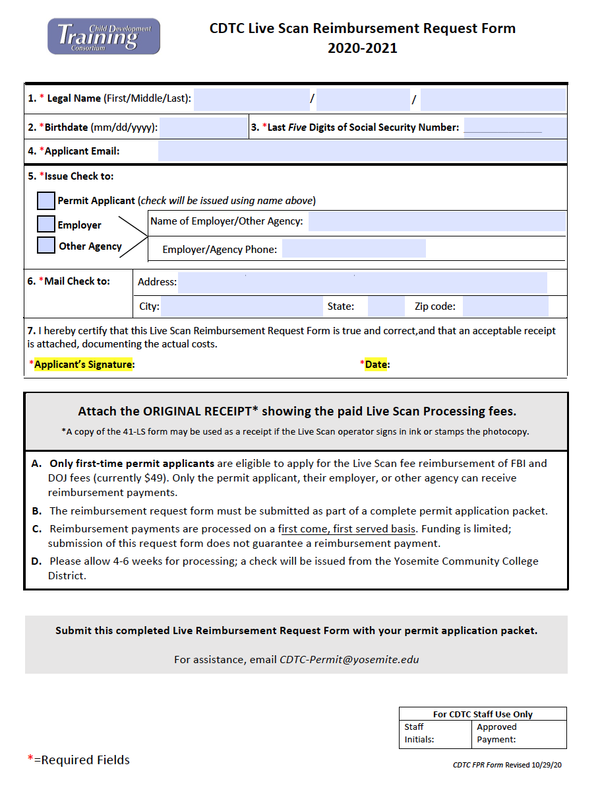
Live Scan Reimbursement

Slide 27
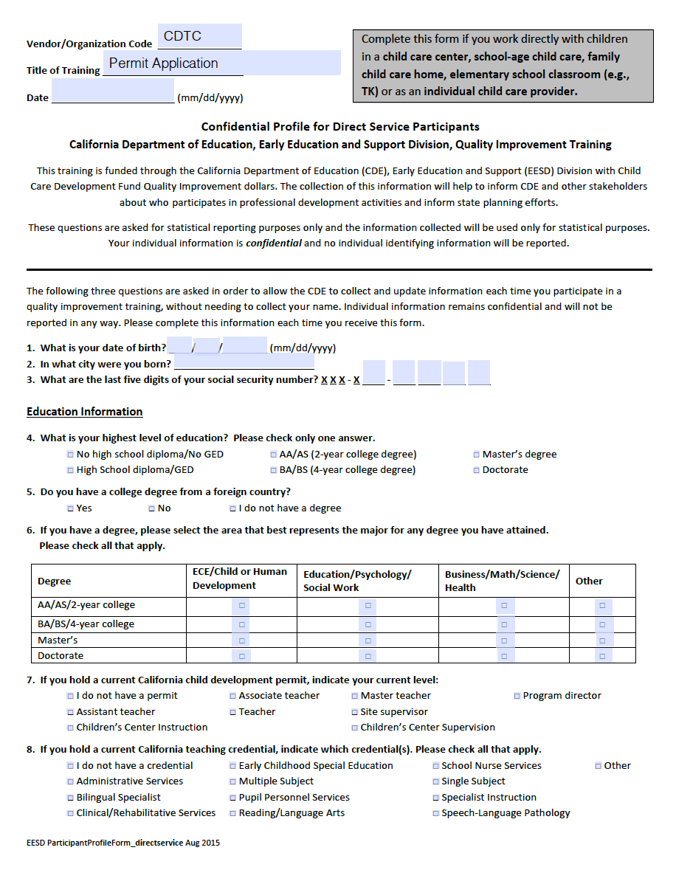
Confidential Profile for Direct Service form

