Slide 1
Child Development and Education Department
General Information Session
Wednesday
March 10, 2021
5:00 pm – 6:30 p.m.

Slide 2
Agenda
Welcome and Introductions
Organizational Structure
Our Mission and Goals
Mt. SAC Child Development Center
Certificates, Permits, Degrees, and Transfer
Mt. SAC Counseling
Mt. SAC Teacher Preparation Institute
Career Opportunities
Questions

Slide 3
Full-Time Faculty
Also Presenting Today
Tony Henry
Cecelia Thay
Doug Hughey
Estela Mejia Gonzalez
Lucie Melendez
Dr. Shireetha Gethers
Patricia Maestro - Counseling

Slide 4
Organizational Structure of Academic Departments
Business Division
Accounting and Management
Business Administration
Child Development and Education
Computer Information Systems
Consumer Science and Design Technologies
http://mtsac.edu/business/

Slide 5
Our Mission
The mission of the Child Development and Education Department is to educate students in Early Care and Education and to support them in achieving their personal and professional goals.
Educate and Support -

Slide 6
Our Goals
Research and maintain paths and structures for program-to-program transfer.
Increase student completion rates in our program's certificates and degrees.
Increase student awareness of the CD permit requirements and the application process.
Maintain a classroom and teaching environment that supports exemplary programs and services.
Increase awareness of the Child Development and Education program to potential students and surrounding communities.
Continue the integral relationship between the Child Development Department and the Child Development Center & Laboratory School.

Slide 7
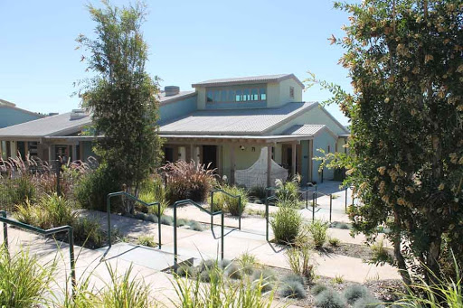
Mt SAC Child Development Center
What is missing?

Slide 8
Certificates, Permits, and Degrees
Mt. SAC Child Development Certificates
California Child Development Permits
Degrees in Child Development and Education

Slide 9
Child Development Certificates
Child Development - Level I
Certificate M0663 12 units
Child Development - Level II
Certificate N0656 19 units
Child Development - Level III
Certificate N0655 28 units

Slide 10
Child Development Certificates
Children’s Program Certificate:Teaching Certificate T0405 39 Units
Infant/Toddler Development Certificate T1318 30 Units
Early Intervention and Inclusion Certificate T0458 37 Units

Slide 11
Child Development Certificates
School Age Child – Specialization Certificate T1314 31-33 Units
Child Development – Administration
Certificate T0654 43 units

Slide 12
Permits
A Child Development Permit confirms that you have fulfilled specific educational and experience requirements.
It authorizes you to teach or supervise in a child development program. Child Development Permits are issued by the State of California Commission on Teacher Credentialing, not by the college.

Slide 13
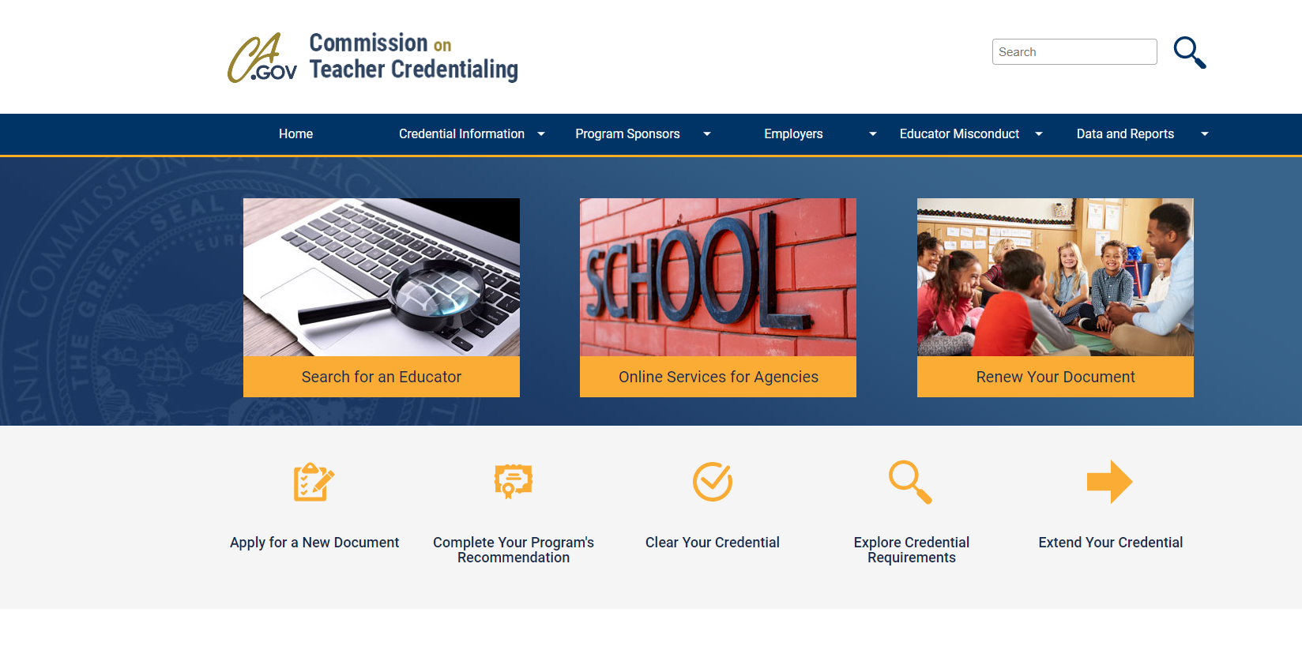
ctc.ca.gov

Slide 14
Degrees
Child Development Associate in Science Degree
Child Development Associate in Science Degree – Transfer Degree
Educational Paraprofessional Associate in Science Degree

Slide 15
Academic Counselor Liaison
Patricia Maestro
Counseling Professor GPS Mapping Coordinator
pmaestro@mtsac.edu
909-274-6231

Slide 16
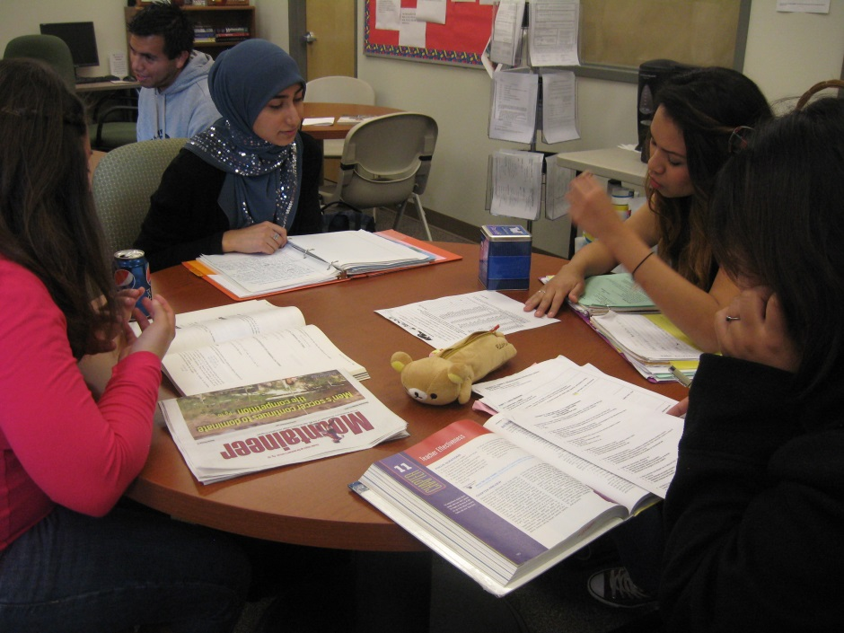
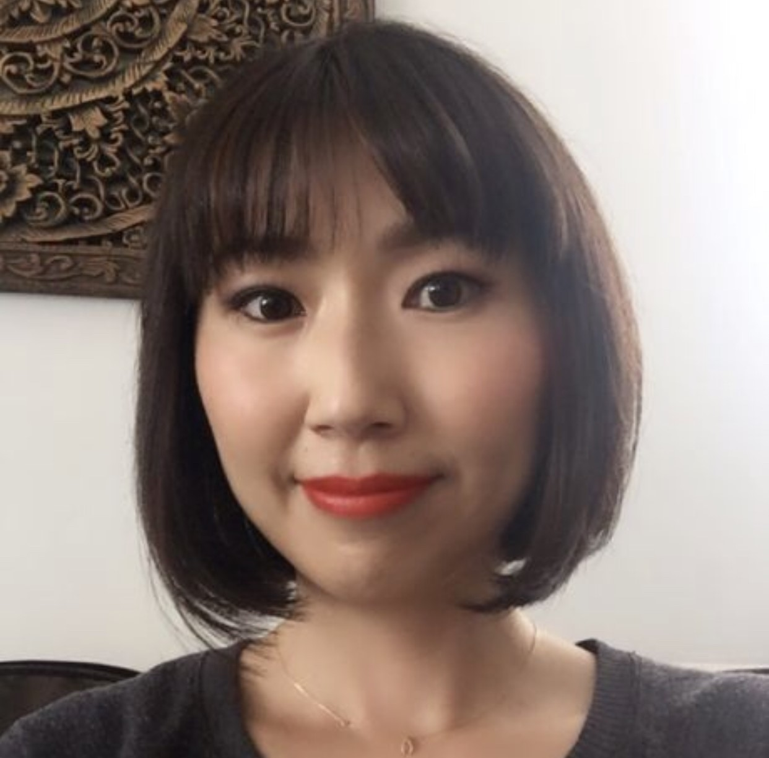
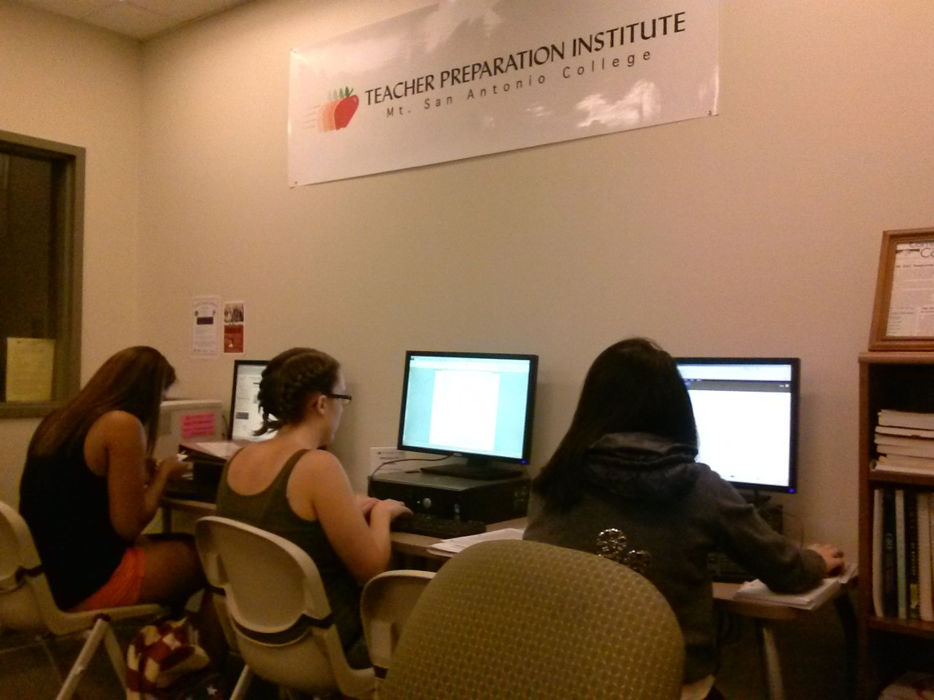
The Teacher Preparation Institute
Keiko Tsurumi
Coordinator, Teacher Preparation Institute
mtsac.edu/TPI

Slide 17
TPI Member Perks–
Support for future Educators and Instructional Aides
CBEST/CSET reimbursement
Teacher related presentations
Designated “apple” courses and textbook loaner books
Specialized Teacher Prep Counselors
Advisement appointments with Cal Poly Pomona, Cal State Fullerton, La Verne University, UCR
Personalized assistance with CSU transfer application

Slide 18
Spring 2021 Spotlight:
Tutoring opportunities with LAUSD's 4th-6th grade students with
Step Up Tutoring
They are willing to reimburse livescan expenses
Currently, about 60 students are waiting to be paired with tutors
Wonderful experiential learning opportunity for future elementary school teachers
The Teacher Appreciation Week workshop series (May)
Financial Smarts for Students Financial Literacy Workshop
A workshop for the future teachers on how to educate K-12 students on the many aspects of fiscal responsibility, including prudent saving, earning, spending, and investing and credit practices.

Slide 19
Teaching Credential 101 with Jeanne M. Reynaga Teacher Preparation and Recruitment Advisor (Cal Poly Pomona)
A counselor from CPP's credential program will explain their teacher credential program process
California Teacher Pension 101 (in the works)
Introducing CalSTRS, California public school teachers pension system - what retirement benefits California public school teachers can receive

Slide 20
A few career opportunities with a degree in Child Development
Child Development Specialist | Family Child Care Provider
Multiple Subjects Credential Teacher | Family Support Specialist
Childcare Center Director | Parent Educator
Child Life Specialist | Classroom Paraprofessional
Counselor | Special Education Paraprofessional
Early Childhood Education Consultant | Training and Development Managers
Early Childhood Education Regulator | Social Worker

Slide 21
Questions?

