Slide 1
A Dynamic Registration Checklist for Students
www.mtsac.edu/checklist
Eric Turner
Asst. Director Web & Portal Services
eturner@mtsac.edu
Kenneth Frank
Senior Systems Integrator
kfrank2@mtsac.edu

Slide 2
Agenda
Problem Statement
The Challenge
Historical View
The Solution
Feedback
Another Challenge & Solution
Development Methodology
Other Applications
Demonstration

Slide 3
Problem Statement
New student matriculants are required to complete Steps for enrollment:
Online orientation
Assessment
In-person 1st-semester course planning workshop to enroll in courses (Optional)
We provide many ways to inform students of these steps, including the Mt SAC website, a welcome letter from Admissions & Records, the student portal, printed materials, including class schedule and catalog, etc.
Students need to find these three steps in three different locations in the student portal.
New students do not know where to find the three enrollment steps in a linear process, they do not know how to complete the steps, and they do not know how to register for accurate classes in their first semester.

Slide 4
The Challenge
Allow students to know at a glance if they have completed all steps to get the best registration date to which they are entitled.
At Mt. SAC these steps include:
Assessment
Orientation
An Education Plan (using DegreeWorks)
Holds on their Account
Note: All this must be done without slowing down the performance of the Portal (especially during enrollment).

Slide 5
History
Have you completed the steps to get the best registration date/time? How would you find out? Those in the know would:
Log into the Portal.
Six clicks later…
Notes:
Six clicks required to get here, no financial aid info, no where to get help

Slide 6
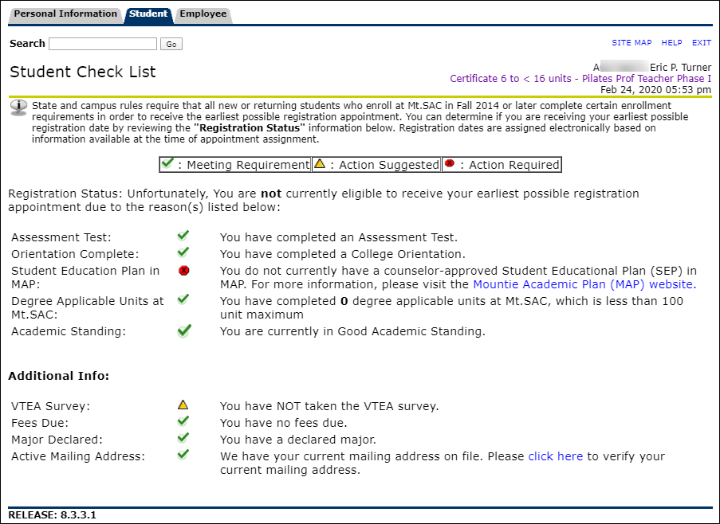
Old Student Checklist
Notes:
Six clicks required to get here, no financial aid info, no where to get help

Slide 7
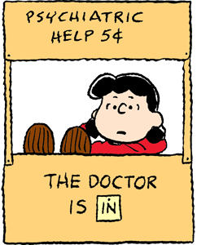
The Consultant
Mt. SAC hired a consultant who had successfully deployed a solution at another college.
We started with requirements gathering, but unfortunately after a nearly a year of planning and development, we found out the consultant’s solution would not work for a school our size.
Their solution required multiple calls to the database each time an element on the checklist was rendered.
This overhead worked for one of their smaller clients, but would have caused a significant degradation to performance since Mt. SAC has over 30,000 students register for each major term.

Slide 8
The Solution
Organize the following in an easy-to-understand manner so the students can know:
What to do to get the best registration date?
Assessment Questionnaire
Orientation
Ed Plan
What is required to Enroll?
Register for Classes
Pay Fees
Additional Recommended Steps:
Apply for Financial Aid
See a Counselor for a Comprehensive Ed Plan

Slide 9
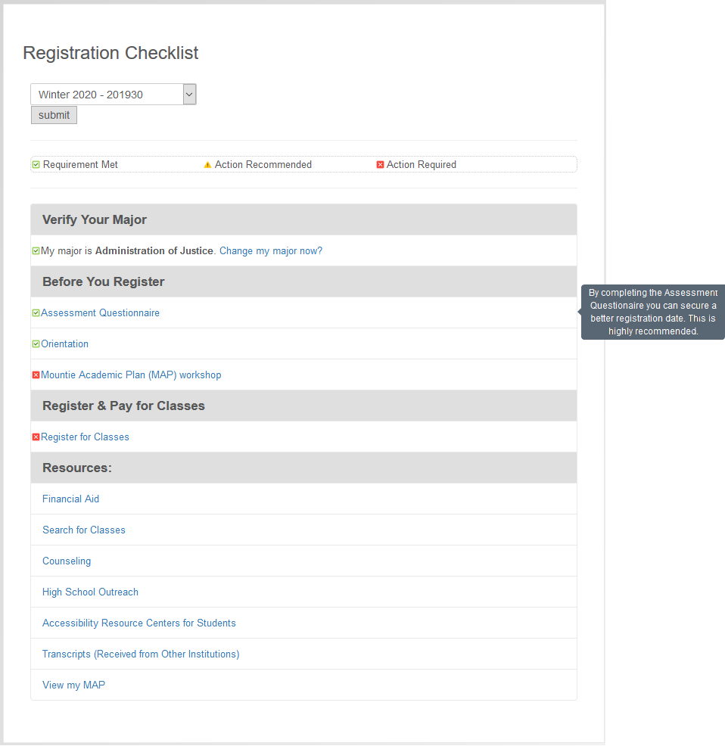
Registration Checklist

Slide 10
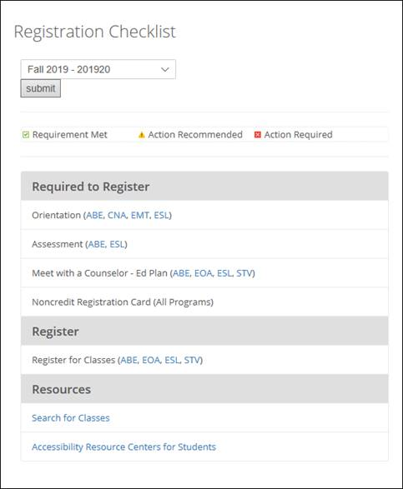
Noncredit Checklist

Slide 11
What do Students Think About the Checklist?
“The Registration Checklist is helpful because it congregates useful information in an easily accessible way.”
“The checklists help students notice any problems that might have occurred, and allows them to correct it, without having to search through multiple pages.”

Slide 12
Faculty Feedback
“Since the launch of the checklist, Counseling has experienced a decrease in students seeking information on how to complete the enrollment steps, registration date, how to pay fees, etc. We have also seen an increase in students asking to complete the first-semester workshop that has led us to offer additional sections. The Student Registration Checklist is a centralized system that provides a quick summary of what is missing to successfully matriculate to Mt SAC with ease.”
--Patricia Maestro
Counseling Professor
Mt. San Antonio College

Slide 13
Faculty Feedback (Continued)
“The checklist allows students to quickly see if their major is correct, change their major if necessary, and serves as a reminder to update their educational plan to stay on track to graduation.”
“The checklist is also a great tool for students when they are working with counselors and other staff that may help them register. Anyone working with the student is able to view the student’s status without having to open up another program and several windows to get the same information.”
--Lina Soto
Associate Dean, Counseling
Mt. San Antonio College

Slide 14
Another Challenge—Financial Aid
How do I know I have met all the requirements to receive financial aid?
Currently, students have to click multiple times to get to their financial aid offers and/or Satisfactory Academic Progress (SAP) status.
Students need to know if they have holds on their account.
Students need to know their award details and if there are any messages.

Slide 15
Similar Solution
The FA Checklist was created to help students navigate their financial aid files with ease, including:
Outstanding Requirements
Financial Aid Offers
Financial Aid Holds
Messages
SAP status
Award Details
Note: The FA Checklist provides all important financial aid information upfront in one page.

Slide 16
Financial Aid Checklist

Slide 17
Development
Kenneth Frank, Senior Systems Integrator, at Mt. SAC, was able to construct real-time checklists in a way that does not drag down performance of the Portal.
The checklists are built on industry standards, which allow the portlet to be both flexible to customization and easy to maintain.
The Java Spring Framework is used in the creation of the portlet, which allows for loose coupling in both the front-end display and back end data retrieval.
Notes:
loose coupling means reducing dependencies of a class that use different class directly.

Slide 18
The Technology
Display technology is based on the JSR-168/JSR-286 portlet specification to handle the Action and Render phases of the portlet.
The project was created using the Maven archetype produced by Liferay and then extended using standard annotations to create data model objects.
The data model objects are cached in the portlet session for performance and displayed using standard JSP (Java Server Pages) web pages.
This checklist delivery strategy can be used by other institutions regardless of Enterprise Resource Planning (ERP) and portal vendor.
Notes:
JAVA and Spring technology.
Display Model that is agnostic to the information provided.

Slide 19
The Technology (Service Layer)
All data (other than obtaining the authenticated user id) is obtained through a service layer.
A standard Java Spring web service is used to supply the data.
The service is similar to the “banportals” service supplied with Luminis to service the Banner Channels, but JSON rather than XML.
The service is secured with Spring Security, which allows for easy swapping of security methods or schemes.
Notes:
JAVA and Spring technology.
Display Model that is agnostic to the information provided.

Slide 20
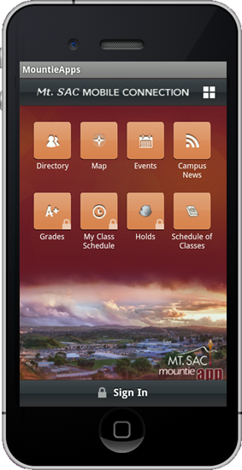
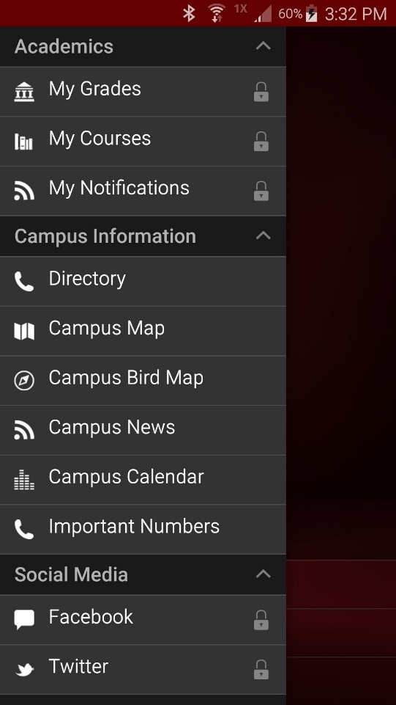
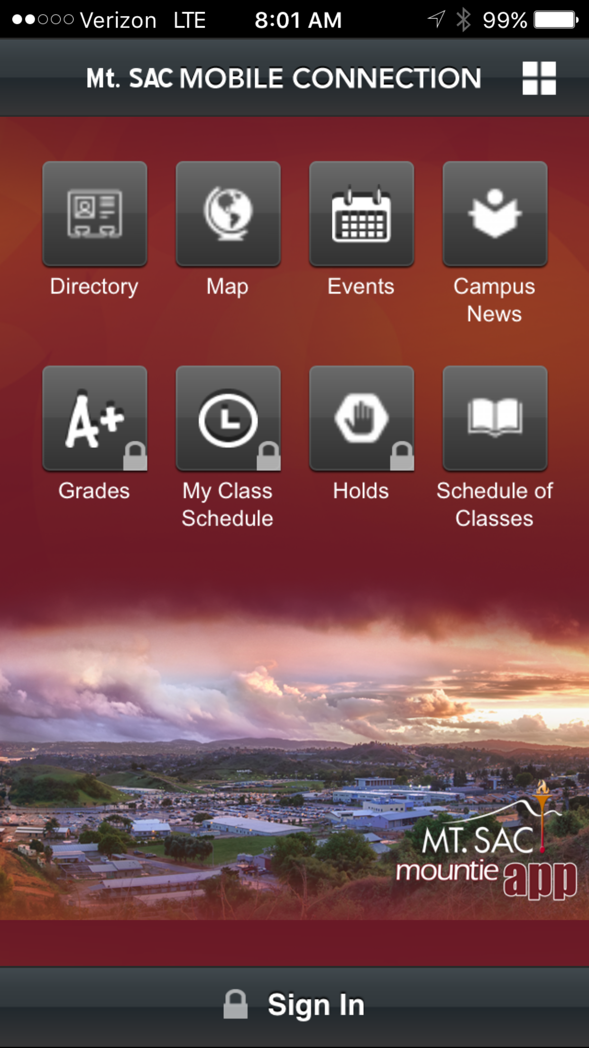
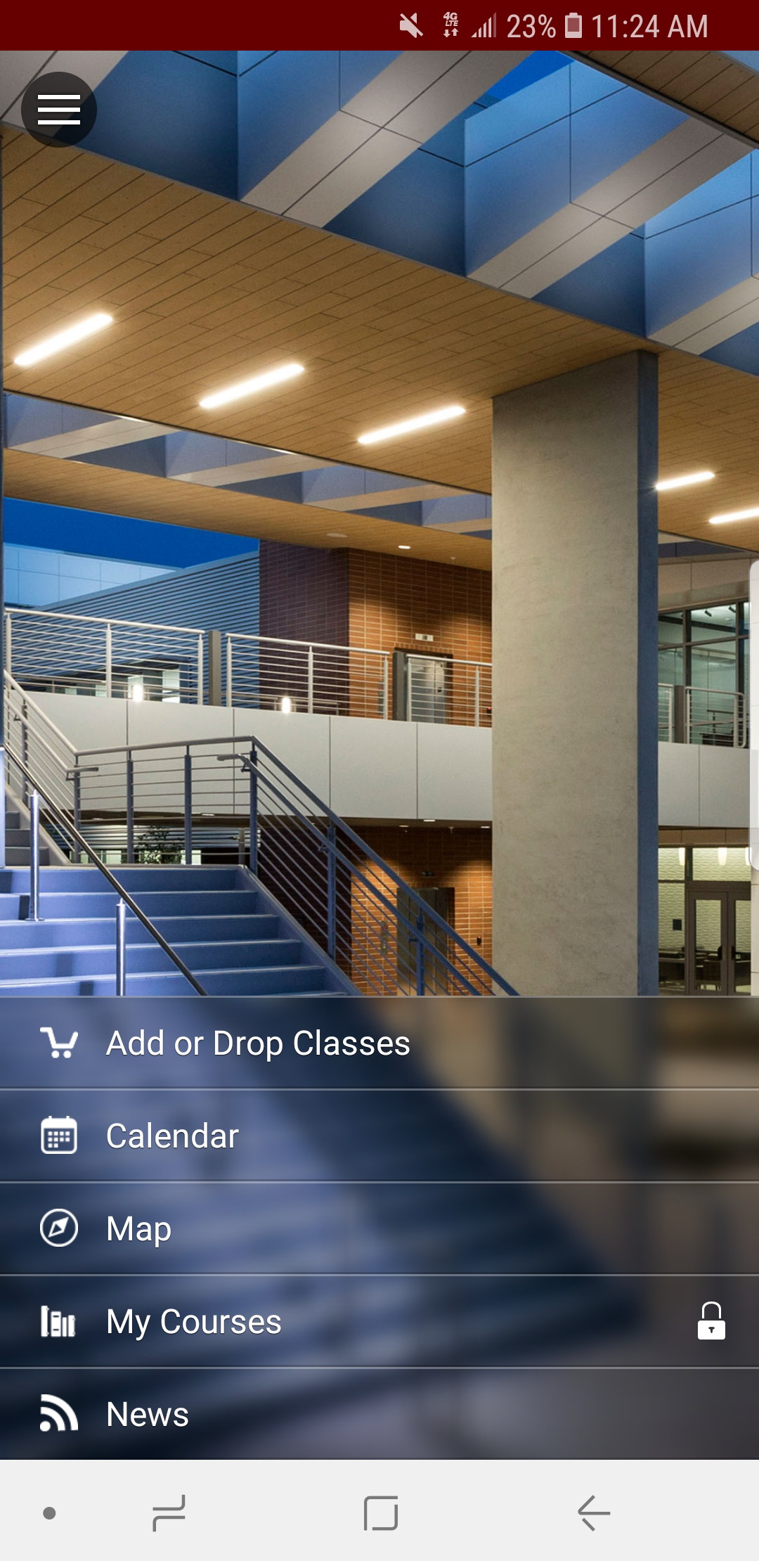
Mobile App Possibilities
The server is written in Java Spring, but could be easily migrated to and implemented within the Mobile Server for Ellucian Mobile.
It would be easy to marry the services provided for other mobile applications into the portal and form “mash-ups” of the services.
The same results appear all display technologies.
Notes:
JAVA and Spring technology.
Display Model that is agnostic to the information provided.

Slide 21
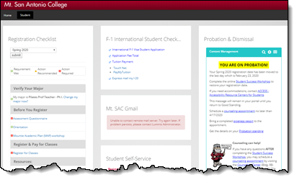
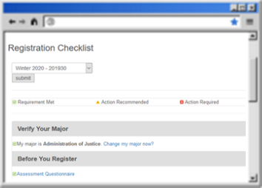
Write Once Read Many (WORM)
If the service layer were built into the Ellucian Mobile App server as a Grails module, this same service could be consumed in the mobile application, portal, and web app without any further alterations.

Slide 22
Display Model
A single portlet can have customized content for multiple student types (Credit, Non-Credit, International, and Transfer) that displays content specific to their specific type as decided at runtime.
When the service is invoked, the student type is quickly determined by the service handler and the appropriate information is extracted and returned.
Since each “item” in the response has only the same 4 attributes (type, content, hovertext, and status) a tailored checklist can be determined at runtime.
Any links and/or html content is escaped and will automatically be displayed in the output.
Type
Content
Hover Text
Status

Slide 23
Display Elements
Type
Content
Hover Text
Status
Type = { header | item } headers identify a section of related items such as Before You Register, etc. Items are individual pieces of information within the sections.
Content = the text displayed on each line.
Hovertext = any pop-up or hover text to be displayed next to the line item (to the right in a pop-up box).
Status = the small symbol preceding the item line if that item has a related status.

Slide 24
CASified Web App
As a proof of concept, a Spring web MVC 3.2 application was coded.
It uses spring-security-cas to protect the resource and obtain identity credentials from the user.
The same service is used that drives the portlet, except instead of supplying the SPRIDEN_ID from the portlet context, it is taken directly from CAS as a SAML attribute release.
To demonstrate the flexibility of the architecture.
The domain model objects,
Service layer,
“Most” of the JSP pages were copied from portlet were copied into this sample web application
The web app was built in between 4 to 6 hours as a proof of concept.

Slide 25
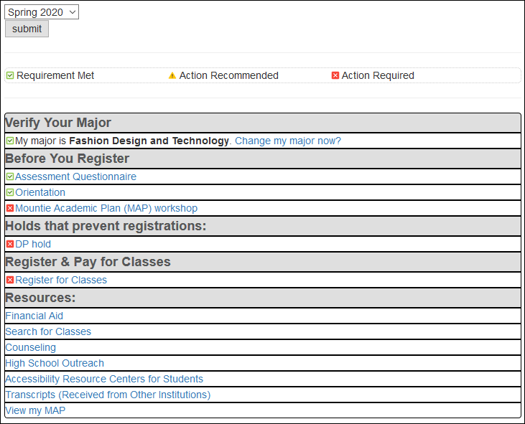
Example of a CASified Web App

Slide 26
The Code
[
{"type":"header","content":"Verify Your Major","hovertext":" ","status":""}, {"type":"item hovertext","content":"My major is <span style='font-weight: 600'>Fashion Design and Technology</span>. <a target='_blank' href='https://prodweb.mtsac.edu:8008/ssomanager/c/SSB?pkg=bwskxmis.p_term_change'>Change my major now?</a>","hovertext":"After you change your major, click 'refresh' to display the change.","status":"met"}, {"type":"header","content":"Before You Register","hovertext":" ","status":""}, {"type":"item","content":"<a target='_blank' href='https://prodweb.mtsac.edu/prodapex/f?p=122'>Assessment Questionnaire</a>","hovertext":"By completing the Assessment Questionaire you can secure a better registration date. This is highly recommended.","status":"met"}, {"type":"item","content":"<a href='https://prodweb.mtsac.edu:8008/ssomanager/c/SSB?pkg=pw_orientation.Orient_Start'>Orientation</a>","hovertext":" ","status":"met"}, {"type":"item","content":"<a target='_blank' href='https://esars2012.mtsac.edu/appointments/orientation/'>Mountie Academic Plan (MAP) workshop</a>","hovertext":"By completing the MAP workshop you can secure a better registration date. This is highly recommended.","status":"required"},

Slide 27
The Code (Continued)
{"type":"header","content":"Holds that prevent registrations:","hovertext":" ","status":""}, {"type":"item","content":"<a target='_blank' href='https://www.mtsac.edu/holds/'>DP hold</a>","hovertext":" ","status":"required"}, {"type":"header","content":"Register & Pay for Classes","hovertext":" ","status":""}, {"type":"item","content":"<a target='_blank' href='https://prodweb.mtsac.edu:8008/ssomanager/c/SSB?pkg=bwskfreg.P_AltPin'>Register for Classes</a>","hovertext":" ","status":"required"}, {"type":"header","content":"Resources:","hovertext":" ","status":""}, {"type":"item","content":"<a target='_blank' href='https://www.mtsac.edu/financialaid'>Financial Aid</a>","hovertext":" ","status":""}, {"type":"item","content":"<a target='_blank' href='https://prodweb.mtsac.edu:8008/ssomanager/c/SSB?pkg=pw_sigsched.p_Search'>Search for Classes</a>","hovertext":" ","status":""}, {"type":"item","content":"<a target='_blank' href='https://www.mtsac.edu/counseling/'>Counseling</a>","hovertext":" ","status":""},

Slide 28
The Code (Continued 2)
{"type":"item","content":"<a target='_blank' href='https://www.mtsac.edu/hso'>High School Outreach</a>","hovertext":" ","status":""}, {"type":"item","content":"<a target='_blank' href='https://www.mtsac.edu/access'>Accessibility Resource Centers for Students</a>","hovertext":" ","status":""}, {"type":"item","content":"<a target='_blank' href='https://prodweb.mtsac.edu:8008/ssomanager/c/SSB?pkg=pw_student_checklist.admission_req_checklist'>Transcripts (Received from Other Institutions)</a>","hovertext":" ","status":""}, {"type":"item","content":"<a target='_blank' href='https://prodssb.mtsac.edu:442/MAP'>View my MAP</a>","hovertext":" ","status":""}
]

Slide 29
Let’s See It …

Slide 30
On the Phone…
Kenneth Frank
Senior Systems Integrator
Mt. San Antonio College

Slide 31
Questions

