Slide 1
Ronda Shutt Former Vice-President Payroll Link Inc (LinkHCM) Adjunct Accounting Instructor Mt San Antonio College Chaffey Community College

Slide 2
Payroll Timeline
Fair Labor Standards Act
FLSA
Equal Pay Act
Age Discrimination in Employment Act
ADEA
1935
1938
1943
1963
1964
1967
Federal Insurance Contributions Act
FICA
1965 Amendment
Current Tax Payment Act
Civil Rights Act

Slide 3
Payroll Timeline (continued)
Migrant and Seasonal Agricultural Worker Protection Act
Americans with Disabilities Act
ADA
Affordable Care Act
ACA
1974
1983
1986
1990
1993
2010
Employee Retirement Income Security Act ERISA
Immigration Reform and Control Act
IRCA
Family and Medical Leave Act
FMLA

Slide 4
COVID-19 Related
Families First Coronavirus Response Act (FFCRA)
March 18th, 2020
2 weeks/80 hours paid sick leave
2 weeks/80 hours 2/3rds pay sick leave
Up to an additional 10 weeks paid expanded family and medical leave 2/3rds pay to care for child
Coronavirus Aid, Relief, and Economic Security (CARES) Act
March 27th, 2020
Workers & Families $1,200 adult / $500 child
Small Business Paycheck Protection Program & Economic Injury Disaster Loans
Job Preservation Employee Retention Credit
State, Local, & Tribal Government Public Health Expense Coverage
Federal Pandemic Unemployment Compensation Program (FPUC) Additional $600 unemployment
Notes:
CARES - $2 trillion
Stimulus payments – $560 billion estimated
Paycheck Protection – $350 billion available; 8 weeks of payroll costs - maximum $10 million; loans which can be fully forgiven if 75% used for payroll; 6-month deferral; maintain or rehire EEs; businesses with 500 or less EEs. The Paycheck Protection Program is implemented by the Small Business Administration with support from the Department of the Treasury
Economic Injury Disaster Loan - $20 billion available; $10,000 advance (does not need to be repaid) due to loss of business revenue ($1000 per EE); first-come, first-served;

Slide 5
COVID-19 Related
Paycheck Protection Program Flexibility Act
June 5th, 2020
PPP Loan application date extended
Extended time from 8 weeks to 24 weeks for spend loan proceeds (not beyond 12/31/20)
Mandatory payroll spending reduced to 60% instead of 75%
Loan payoff extended from 2 to 5 years
Full loan forgiveness possible
Companies can now delay paying payroll taxes
Presidential Memorandum Deferring Payroll Tax
August 8th, 2020
Employees making $4,000 or less bi-weekly
Employee Social Security tax deferral
Repayment due between Jan 1 and Apr 30, 2021
Instructs the Treasury Secretary to explore options to “eliminate the obligation to pay the taxes deferred”
Many employers choose not to implement

Slide 6
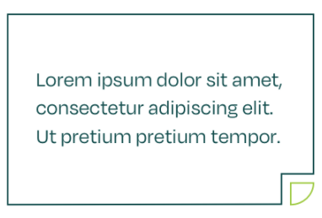
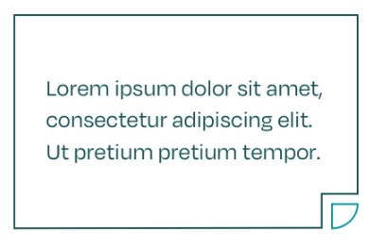
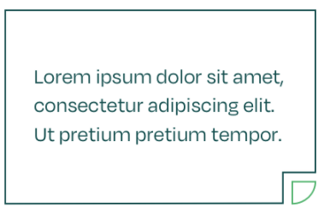
Expected Compensation
Payroll Clerk (CSR)
$35,000 - $50,000
Payroll
Administrator
$52,000 - $70,000
FPC, basic tasks, data entry
CPP, complex tasks, reconciliations
Payroll Manager
$65,000 - $125,000
Payroll Director
$90,000 - $150,000
CPP/CPA, HR coordination
CPP/CPA, C-Suite peers

Slide 7
Employment
Private Business
Internal payroll positions; in-house payroll software or outsourced
Payroll Service Bureau
Outsourced payroll service; companies utilize payroll professionals and software to stay in compliance
Self-Employed Accountant
Bookkeeper, tax preparer, payroll processor – accounting based services for small to mid-sized companies

Slide 8
American Payroll Association Certifications https://www.learnpayroll.com/fpc-cpp-certification-and-exam-details/
Fundamental Payroll Certification (FPC)
Certified Payroll Professionals
(CPP)
No eligibility requirements
Pass exam 80%
3/5 years experience
Complete APA courses
Pass exam 300 pts

Slide 9
Current Trends
Paid Family Leave
State laws that expand FMLA. Some plans funded by employee contributions while others are funded by employer contributions
(CA, CT, DC, MA, NJ, NY, OR, RI, WA)
Paid Sick Leave
State laws that mandate minimum paid sick time off
(3-5 days)
(AZ, CA, CT, DC, ME, MD, MA, MI, NV, NJ, NY, OR, RI, VT, WA)
Retirement Plans
If employer does not have a plan, must allow contributions to be made to state plan or IRA through payroll deductions
(CA, CT, IL, MD, MA, NJ, NY, OR VT, WA)

Slide 10
What Does Payroll Include?
Payroll Checks
Time Records
Gross to Net calculations
Reg, O/T, D/T, Meal Penalties, etc.
Employee Changes
Tax Reporting
Pay rates, W-4, deductions
Payments, quarterly returns, W-2s

Slide 11
Human Resources
Employee Focus
Recruit, screen, interview, hire, train, mentor, mediate, dispute resolution, discipline, counsel, terminate.
Benefits Administration
New plans and plan renewal, open enrollment, employee change reporting,
Payroll Coordination
Benefit costs, raises, legal compliance
Notes:
Certifications
PHR
APHR
SHRM-CP
SPHR

Slide 12
HCM vs HRIS
Human Capital Management
A set of practices related to managing people within a company/organization
Typically focuses on:
- Workforce acquisition (hiring)
- Workforce management
- Workforce optimization
Human Resource Information System
Software system to manage the HR functions
Typically includes:
- Time and Attendance
- EE Maintenance (hire to fire)
- Benefits Management
- Performance Management
- Payroll Processing
- Comprehensive Reporting
- And much, much more!

Slide 13
LinkHCM Human Capital Management Solutions Designed for your Business Mike Demerjian, President linkhcm.com 909-568-2900

Slide 14
Our Promise, Your Experience
The LinkHCM promise means that you can expect a positive experience at every step of our partnership.
A Solution Designed for You
We design the solution to fit your needs, and it actually works the way we say it will.
Real, Hands-on Support
You get access to a dedicated team of experts who you can actually get ahold of whenever you need it.
Commitment to Our Clients
As a privately-owned company, we’re committed to doing the best for YOU, our clients, not a board or shareholders.
Contact LinkHCM
10251 Trademark St, Suite B
Rancho Cucamonga, CA 91730
Main Line 909-568-2900
Job postings on Indeed

Slide 15
Values
Jump through hoops.
Grow and improve every day.
Do the right thing.
Find the fun in every day.
Get it done, right.
Recognize the value in all people.

