Slide 1

Accreditation
Visit
February 28-29, 2024
Spring FLEX Day 2024
Notes:
Kelly

Slide 2


Slide 3

Accreditation Core Team
Kelly Fowler | Accreditation Liaison Officer/ VP Instruction
Barbara Mezaki | Faculty Accreditation Coordinator
Allie Frickert | Faculty Accreditation Co-Coordinator
Lianne Greenlee | Assistant Dean, Accreditation and Planning
Patty Quinones | Director, Research and Institutional Effectiveness​
Michelle Sampat | Dean, Arts Division
Laura Martinez | Executive Assistant to the VP Instruction
Notes:
Kelly

Slide 4

Our Story Timeline
FLEX
Day
Spring 2024
Focused Site Visit
February 28-29
Winter 2024
Response to Core Inquiries
Summer 2024
ACCJC Commission Action
Fall 2023
Technical Review
& Core Inquiries
January ‘24
50 Additional DL Courses Submitted
Notes:
Allie

Slide 5

The Accreditation Process: Short Version…
Following its mission, the College offers educational programs to students using agreed upon policies, procedures, and practices.
The Visiting Team reviews the ISER and asks for additional information as needed in the form of Core Inquiries.
On a regular cycle, the College undertakes a self-study to ensure that the institution is following its policies, procedures, and practices. The College produces its Institutional Self-Evaluation Report (ISER) in an inclusive, transparent process.
The Team visits the College, completes its report, and submits to the Commission.
The ACCJC makes its recommendation based on the team report.

Slide 6
Site Visit Team
February 28-29
Dr. Pedro Avila, Vice Chair
Dr. Linda Carvalho Cooley
Dr. Ulises Velasco
Dr. Gohar Momjian, ACCJC
Dr. Matthew Wetstein, Chair
Notes:
Kelly - Ask Classified who served on a Weaving or Finishing Team to stand and be recognized. Volunteers in aisles will hand out pins.

Slide 7

Let's have some fun by testing your accreditation general knowledge!
If you have the Kahoot! app on your smart phone, pull that up and enter the PIN now.
If you do not have the app, open your cell phone browser to: https://kahoot.it/ and enter the pin.
Enter your name (or your alias, like Starbucks...)
If you have time, you may choose to edit your avatar!
Remember: in Kahoot, points are given for being both accurate and fast.

Slide 8
Accreditation 101
Accreditation is both a process and a status.
Accreditation helps the college focus on educational quality and institutional effectiveness.
Mt. SAC is accredited by the Accrediting Commission for Community and Junior Colleges (ACCJC).
The School of Continuing Education (SCE) has a separate additional accreditation process.
Some programs and certificates are accredited by relevant accrediting agencies and bodies.
ACCJC uses a formative/summative process for accrediting community colleges.
The site visit scheduled for February 28 and 29th will focus only on the Core Inquiries.
The Visiting Team is a peer review team from other community colleges in the state.
The Team reviewing Mt. SAC’s ISER consists of five (5) members of the original 10-member team including the ACCJC Liaison, Gohar Momjian.
ACCJC has changed the accreditation standards; this is Mt. SAC’s last cycle with existing standards.
The accreditation cycle will shift from a 7-year to an 8-year process.
Accredited status allows Mt. SAC to distribute federal financial aid.
Accredited status ensures that students can transfer Mt. SAC credits to other institutions.
The ACCJC will review the report completed by the Visiting Team.
Following review of the report, the ACCJC will recommend an action.
The College will respond and make improvements based on the recommendations.
Notes:
Kelly

Slide 9

Mt.SAC has 5 Core Inquiries!
The Visiting Team identified five (5) areas in ISER requiring clarification or expansion to validate standards alignment.
    Four areas to investigate
    One possible commendation
Mt. SAC responded with additional evidence and narrative.
The Team’s Site Visit will focus only on these five areas.
Notes:
Lianne

Slide 10
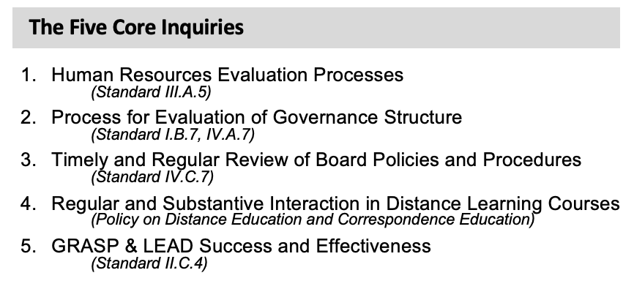
The Visiting Team’s Focus:

Slide 11
Accreditation Visit
Wednesday’s Activities
Meet & Greet with Campus Leaders (8:30 – 9:00 am)
Visiting Team Campus Tour (9:00 – 9:30 am)
Core Inquiry Interviews (10:00 – 11:50 am; 1:00 – 2:50 pm)
Open Forum (4:30 – 5:30 pm)
Thursday’s Activity
Exit Report to the Campus (12:00 – 12:30 pm)
Notes:
Kelly

Slide 12

8:30-9:00 am
Breakfast Meet and Greet
with Campus Leaders
Invited Guests:
Dr. Martha Garcia | Dr. Sokha Song | Dr. Patricia Quinones | Gizelle Ponzillo | Emily Woolery
Dr. Madelyn Arballo | Allie Frickert | Michelle Sampat | George Gutierrez | Tamra Horton
Dr. Melba Castro | Lianne Greenlee | Dr. Tania Anders | Robert Montoya | Daniell'e Silva
Kelly Fowler | Laura Martinez | Dr. Raul Madrid | Yvette Garcia | La Tasha Buie
Morris Rodrigue | Barbara Mezaki | Brandon Gillett | Diana Dzib | Cesar Tlatoani Alvarado

Slide 13
Accreditation Visit
10:00-10:50 am
2:00-2:50 pm
C1 4 – DLC on RSI in DL
CI 5 -- LEAD
CI 1 – Human Resources
CI 2 – Governance Task Force
11:00- 11:50 am
CI 3 – BPs and APs
C! 5 -- GRASP
Core Inquiries (CI)
CI 1 – HR Evaluation Processes
CI 2 – Evaluation of Governance Procedures
CI 3 – Timely Review of BPs and APs
CI 4 – RSI in Distance Learning
CI 5 – LEAD and GRASP
1:00- 1:50 pm
CI 2 – Cabinet on Governance
CI 4 – Deans & Chairs on RSI in DL
Notes:
Kelly

Slide 14
10:00-10:50 am
Core Inquiry 4
Regular and Substantive Interaction in DL Courses
DLC Interviewee/Position: | DLC Interviewee/Position:
Dr. Romelia Salinas, DLC Co-Chair, Dean | John Norvell, Professor Anthropology
Carol Impara, DLC Co-Chair, Faculty | Mike Hood, Professor, Astronomy & Earth Sci
Catherine McKee, Assistant DL Coordinator | Michael Dowdle, Professor Psychology
Hong Guo, Online Learning Librarian | Luis Echeverria-Newberry, Professor Counseling
Katie Datko, Director of DL & Instruction Tech | Matthew Dawood, ARC Program Coordinator
Michael Carr, Director, Academic Computing | L.E. Foisia, Professor SCE
Tamara Knott-Silva, Dean

Slide 15
10:00-10:50 am
Core Inquiry 5
LEAD Success and Effectiveness
Invited Interviewee: | Position:
Dr. Andi Sims | Director, Student Life
Donna Balducci | Administrative Specialist III, Student Life
Dr. Koji Uesugi | Dean, Student Services
Dr. Patricia Quinones | Core Team, Director of Research and Institutional Effectiveness

Slide 16
11:00 -11:50 am
Core Inquiry 3
Timely Review of Board Policies and Procedures
Invited Interviewee: | Position:
Dr. Martha Garcia | President/CEO
Carol Nelson | Director, Office of the President/CEO
Yadira Santiago | Executive Assistant II, Office of the President/CEO
Dr. Tania Anders | Academic Senate President
Dr. Sara Mestas | Academic Senate Secretary
Melissa Aguirre | Classified Senate Treasurer
Tamra Horton | Faculty Association Vice President
Allie Frickert | Core Team, Faculty Accreditation Co-Coordinator
Lianne Greenlee | Core Team, Assistant Dean of Accreditation and Planning

Slide 17
11:00-11:50 am
Core Inquiry 5
GRASP Success and Effectiveness
Invited Interviewee: | Position:
Dr. Melba Castro | Vice President, Student Services
Kelly Fowler | Vice President, Instruction
Tom Mauch | Associate Vice President, Student Services
Joe Jennum | Dean, Kinesiology, Athletics, and Dance
Sapule Taamilo | GRASP Coordinator
Jessica Valdez | Professor of Counseling, Athletics
Lisa DiDinato | Research Analyst

Slide 18
1:00-1:50 pm
Core Inquiry 2
Process for Evaluation of the Governance Structure
Cabinet Interviewee: | Position:
Dr. Martha Garcia | President/CEO
Dr. Madelyn Arballo | Vice President, School of Continuing Education
Dr. Melba Castro | Vice President, Student Services
Kelly Fowler | Vice President, Instruction
Morris Rodrigue | Vice President, Administrative Services
Dr. Sokha Song | Vice President, Human Resources

Slide 19
1:00 -1:50 pm
Core Inquiry 4
Regular and Substantive Interaction in DL Courses
Dean & Department Chair Invitee: | Dean & Department Chair Invitee:
Dr. Tami Pearson, AVP of SCE | Kelly Rivera, Chair Geography & Political Science
Dr. Karelyn Hoover, Dean HSS | Marlene Gallarde, Co-Chair Soc & Philosophy
Dr. Denise Bailey, Dean Natural Sciences | Jean-Pierre Gatillon, Co-Chair Soc & Philosophy
Michelle Sampat, Core Team, Dean of Arts | Andrea Diem, Co-Chair Soc & Philosophy
Fawaz Al-Malood, Associate Dean Business | Joe Denny, Co-Chair Electronics & Comp Tech
Jimmy Tamayo, Associate Dean, Nat Sciences | Steve Burgoon, Chair Comm & Entertain Arts
Allie Frickert, Core Team, Chair, History | Louis Vayo, Chair Business Administration
Barbara Mezaki, Core Team, AmLa Professor | Masoud Roueintan, Chair, Chemistry
Ellen Caldwell, Co-Chair Art History | Ann Walker, Chair American Sign Language

Slide 20
2:00-2:50 pm
Core Inquiry 1
Human Resources Evaluation Processes
Interviewee: | Position:
Dr. Sokha Song | Vice President, Human Resources
Kelly Fowler | Vice President, Instruction
Shannon Carter | Associate Vice President, Administrative Services
Dr. Tami Pearson | Associate Vice President, School of Continuing Education
Alexis Carter | Senior Director, Labor Relations and Employee Services
Ryan Wilson | Director, EEO, Title IX, & Leaves Administration
Lance Heard | Dean, Technology and Health
John Vitullo | Associate Dean, Arts
Lina Soto | Associate Dean, Counseling

Slide 21
2:00 -2:50 pm
Core Inquiry 2
Process for Evaluation of the Governance Structure
Invited Interviewee: | Invited Interviewee: | Invited Interviewee:
Allie Frickert | Tamra Horton | Dr. Raul Madrid
Lianne Greenlee | Barbara Mezaki | Juan Mendoza
Cesar Tlatoani Alvarado | Gizelle Ponzillo | Jose Ramirez
Dr. Tania Anders | Daniell'e Silva | Rosa Royce
Dr. Meghan Chen | Dr. Martha Garcia | Dr. Mica Stewart
Dr. Francisco Dorame | Dr. Madelyn Arballo | Dr. Koji Uesugi
Diana Dzib | Shiloh Blacksher | Emily Woolery
Yvette Garcia | George Gutierrez | Dr. Patricia Quinones

Slide 22
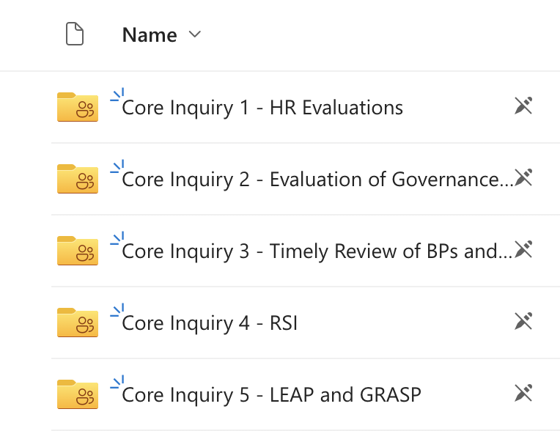
Resources Available to Interviewees:
Prior to the interviews, please refresh your knowledge about the Core Inquiry that you will be addressing with the visiting team.
Refer to the schedule and/or your invitation from Instruction for your interview time and location.
Open the ACCJC 2024 Visit Resources folder, select your Core Inquiry folder, and review the resources designed for you.
Each folder has resources for the specific Core Inquiry & the site visit process

Slide 23
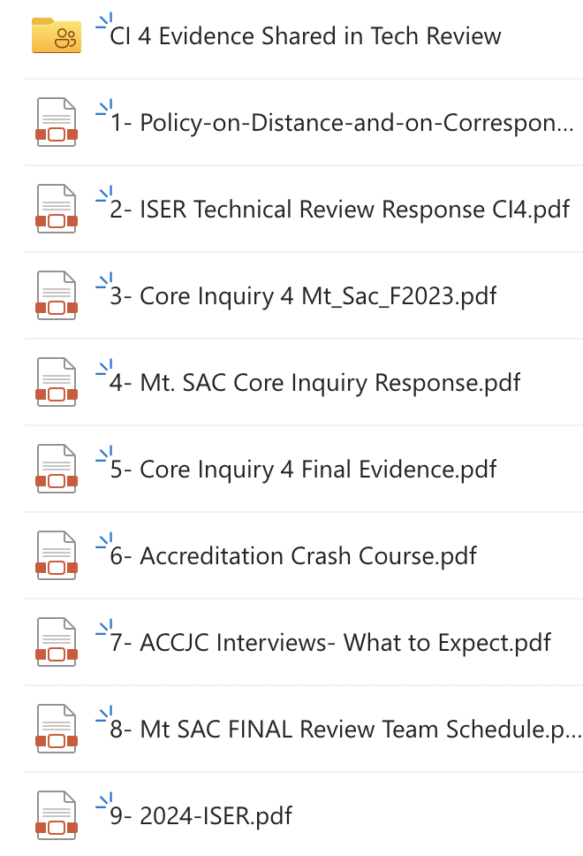
The Resources:
Core Inquiry specific documents and information will help you prepare.
For example, Core Inquiry 4 on RSI has:
the DE policy (serves as the standards)
the tech review response and evidence
the Core Inquiry
the Core Inquiry response and evidence
Each folder also has additional resources:
Accreditation Crash Course
What to Expect in the Interviews
The Team visit schedule
The 2024 ISER

Slide 24
Need additional help or support?
Attend the Accreditation Focused Site Visit Office hour:
Tuesday, February 27, 4-5 pm
Accreditation Focused-Site Visit Office Hour
Zoom ID: 83518626595
Core Team members will answer any questions you have!

Slide 25
What will the Visiting Team members ask?
Visiting team members are likely to ask interviewees to elaborate or expand upon the information submitted in the original ISER, in the follow-up report, and/or in the evidence.
Questions are usually open-ended, such as:
  Tell us about…
  Could you explain…
  Would you elaborate on the process for…
If there are questions you cannot answer, you may direct the team to contact Kelly Fowler, the College Accreditation Liaison Officer (ALO).

Slide 26

Scenario 1
Imagine that a Visiting Team member has just asked you to describe the training that evaluators receive when they are examining on online course, particularly in identifying "regular and substantive interaction."
What would you share?
This Photo by Unknown author is licensed under CC BY-SA.
Notes:
Kelly

Slide 27
Scenario 1: Ideas
Imagine that a Visiting Team member has just asked you to describe the training that evaluators receive when they are examining on online course, particularly in identifying "regular and substantive interaction."
What would you share? Some ideas:
Faculty complete peer evaluations for all courses. Evaluations may be done by the department chair or designee, but for online or hybrid courses the evaluator must be SPOT-certified.
All faculty teaching online now receive RSI training as part of their SPOT certification although some professors may have been certified when REC was the requirement. As part of the recertification process for SPOT, faculty must be knowledgeable on RSI.
The Faculty Association and the District have agreed to establish a work group to make recommendations about RSI, and an RSI rubric has been approved for faculty to use in completing a self-evaluation of RSI in their courses. Negotiations continue on this.
Notes:
Kelly

Slide 28
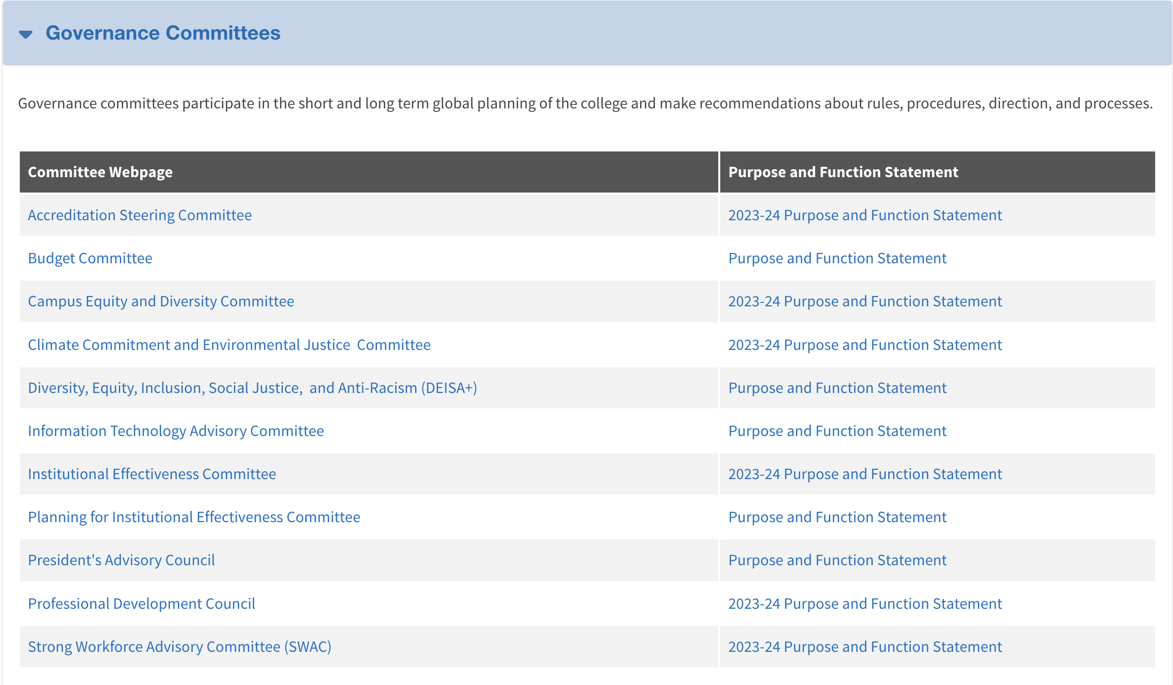
Scenario 2
Imagine that a Visiting Team member has just asked you share your thoughts on how the shared governance process is evaluated at Mt. SAC. What would you share?
Notes:
Kelly

Slide 29
Scenario 2: Ideas
Imagine that a Visiting Team member has just asked you share your thoughts on how the shared governance process is evaluated at Mt. SAC. What would you share?
President's Advisory Council (PAC) is the college body responsible for overseeing the work of college shared governance committees. Each committee or council does an annual review of their purpose, function, and goals. PAC reviews these and provides feedback to the respective committees. Goals are connected to the College's strategic priorities.
At the end of the year, each committee provides PAC with an evaluation of their work on the committee goals.
Notes:
Kelly

Slide 30

Scenario 3
Imagine that a Visiting Team member has just asked you to talk about the GRASP program. What would you share?
Notes:
Kelly

Slide 31
Scenario 3: Ideas
Imagine that a Visiting Team member has just asked you to talk about the GRASP program. What would you share?
The GRASP program provides student athletes with a structured program during their gray or red shirt academic year. The program provides weekly academic workshops, team bonding activities, support services, counseling, retention strategies, and reinforcements.
GRASP collects data on student athlete enrollment and retention rates, pass rates, persistence rates (term to term), GPA, students' sense of confidence, and knowledge gained.
Notes:
Kelly

Slide 32
Scenario 4
Imagine that a Visiting Team member has just asked you to describe the process for updating Board Policies (BPs) and Administrative Procedures (APs) at Mt. SAC.
What would you share?
Notes:
Kelly

Slide 33
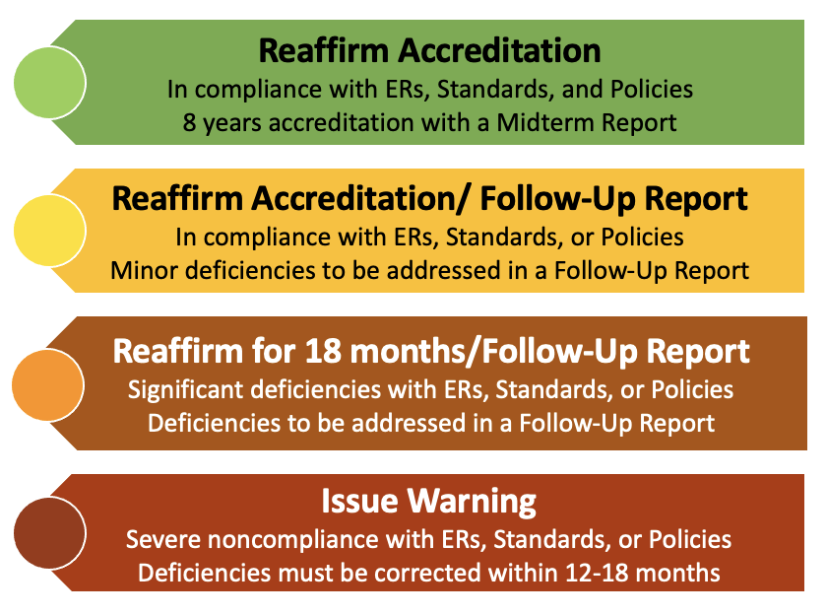
Possible Outcomes of the Site Visit

Slide 34
Campus Community Opportunities
Be part of our story, in person or online!
Open Forum
All Employees Invited *
Wednesday, February 28
4:30 - 5:30 pm
Building 13, Room 1700 & Remote
Exit Report
All Employees Invited *
Thursday, February 29
12:00 - 12:30 pm
Summit Event Center & Remote
*Authorized release time provided to Classified professionals, with supervisor’s approval

Slide 35
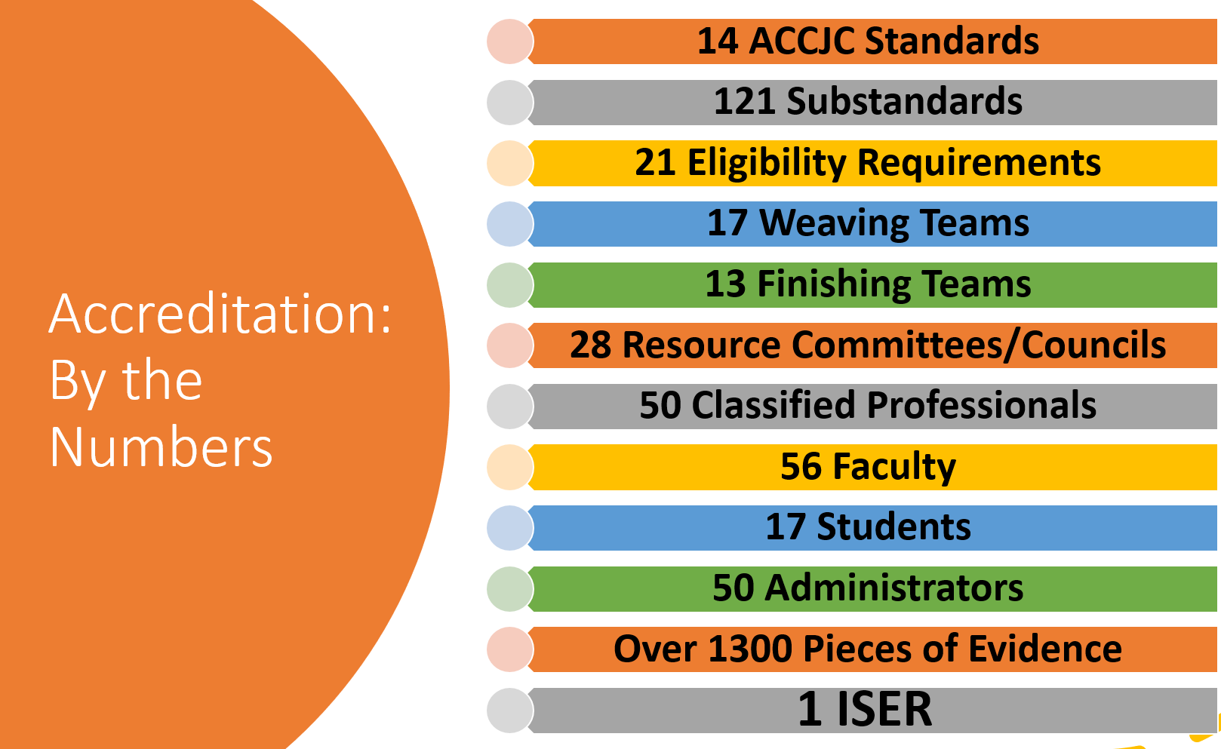
Telling Our Story has been an inclusive process:

Slide 36
Thank You…
For attending this presentation and for your engagement.
For your greatly appreciated feedback. Please submit the electronic Flex Day survey that will be sent via email soon.
This session has ended. Please go to your next breakout session. If you were unable to preregister, the Zoom meeting IDs are below.
Session 2
Event | Meeting ID
Reducing Fraudulent Enrollment | 833 2719 0385
Microsoft Applications Training Series | 889 8277 0507
Regular and Substantive Interaction for Equity and Inclusion | 895 1392 4360
Stepping Into the Shoes of an Access Student: Is "Extra Time" Enough? | 865 6803 6311
American Sign Language and Deaf Culture for Faculty | 814 5856 0587
Introducing Handshake, MT. SAC's New Job Platform for Students | 834 6033 1136
Promoting Domestic Violence/Intimate Partner Violence Awareness and Prevention Within the Mt. SAC Community | 815 0623 7133

