Slide 1


Accreditation Update
Management Meeting
November 3, 2022

Slide 2

Accreditation Core Team
Kelly Fowler | Accreditation Liaison Officer/ VP Instruction
Barbara Mezaki | Faculty Accreditation Coordinator
Allie Frickert | Faculty Accreditation Co-Coordinator
Lianne Greenlee | Assistant Dean, Accreditation and Planning
Patty Quinones | Director, Research and Institutional Effectiveness​
Michelle Sampat | Acting Dean, Arts Division
Laura Martinez | Executive Assistant to the VP Instruction

Slide 3

THANK YOU!

Slide 4

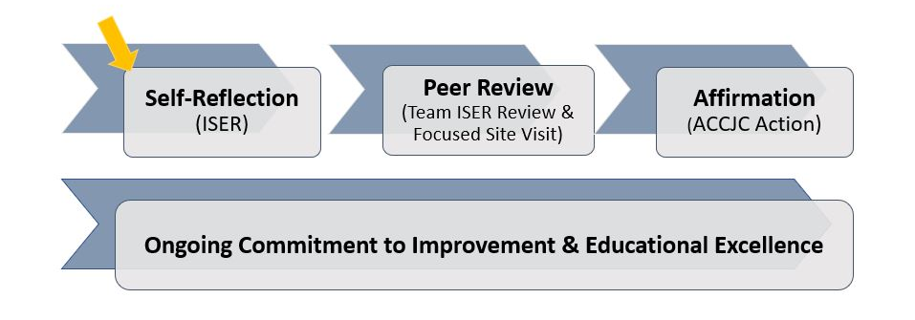
Overview: The Accreditation Evaluation Process

Slide 5

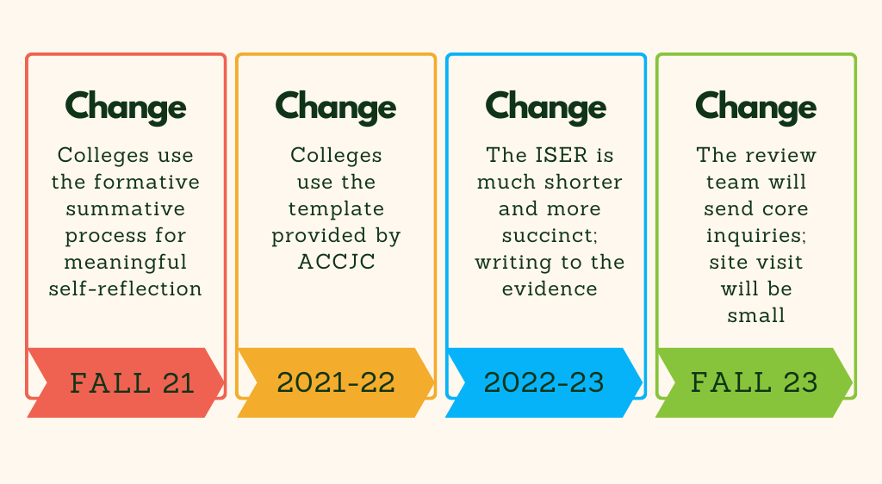
ACCJC Formative-Summative Process

Slide 6

Timeline
Fall 2022
Resource/Review Teams
Finishing Teams
Friday Fall Forums 11/18
Winter 2023
Campus Review of ISER
Board of Trustees Review & Approval
Summer 2023
Submit the ISER
(August 1st)
Fall 2023
Formative review
by ACCJC Peer Team
Spring 2024
ACCJC Focused Site Visit
Summer 2024
Commission
Determination
ISER Edits
Final Evidence Collection
Spring 2023
Winter 2024
Respond to
Core Inquiries

Slide 7

We Need You!
Company is Coming!
Website Updates
Notes:
Barbara

Slide 8

ISER Ice Cream Social
  Read ISER in Spring 2023
  Look for content related to your work
  Validate and give input
Notes:
Barbara

