Slide 1

Fall Forum:
Finishing Team Training
September 16, 2022
Notes:
Kelly

Slide 2
Outcomes for Today:
Understand the Finishing Team process
Be familiar with the roles of Finishing Team members
Know the step-by-step process of the Evaluator
Practice evaluation of a narrative using a review rubric
Know about key due dates & how to get help
Notes:
Lianne

Slide 3
Finishing Team Leaders & Liaisons
STANDARD | LEADERS & LIAISONS
I.A. Mission | Sarah Plesetz Liaison: Barbara Mezaki
I.B. Assuring Academic Quality and Institutional | Fawaz Al-Malood Liaison: Barbara Mezaki
I.C. Institutional Integrity | Tammy Knott-Silva Liaison: Barbara Mezaki
II.A. Instructional Programs | John Vitullo Liaison: Allie Frickert-Murashige
II.B. Library and Learning Support Services | Romelia Salinas Liaison: Allie Frickert-Murashige
II.C. Student Support Services | Tom Mauch Liaison: Allie Frickert-Murashige
III.A. Human Resources | Ryan Wilson Liaison: Lianne Greenlee
III.B. Physical Resources | Gary Nellesen Liaison: Lianne Greenlee
III.C. Technology Resources | Anthony Moore Liaison: Lianne Greenlee
III.D. Financial Resources | Morris Rodrigue & Rosa Royce Liaison: Lianne Greenlee
IV.A. Decision-Making Roles and Processes | Michelle Sampat Liaison: Allie Frickert-Murashige
IV.B. Chief Executive Officer | Kelly Fowler & Madelyn Arballo Liaison: Lianne Greenlee
IV.C. Governing Board | Lance Heard Liaison: Barbara Mezaki

Slide 4


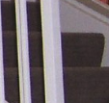
Identify the Images
A
B
C

Slide 5
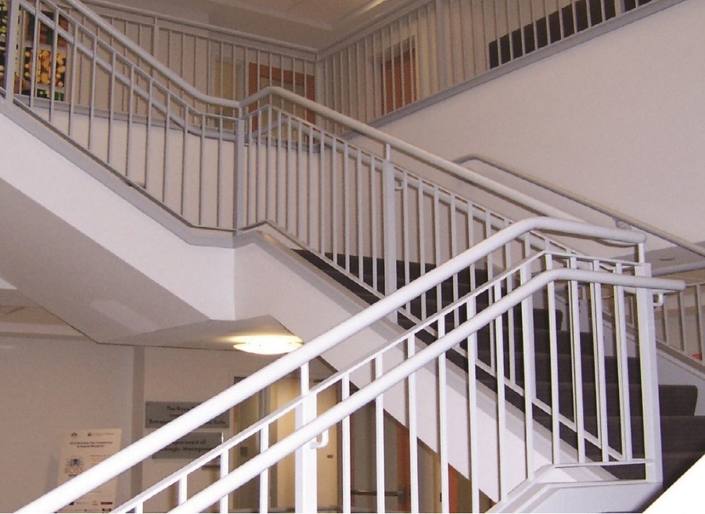

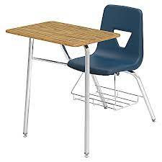
The bigger Picture

Slide 6
Finishing Team Process Overview
Sept 16
Week of Sept 19
Team Leads and Liaison email team member assignments, instructions, and access to narratives/evidence
Sept 26 – Oct 14
Finishing Team work continues
October 17
Individual evaluator rubrics due to Finishing Team Leads
November 1
Finishing Team Training
Finishing Team work begins
Finishing Team Drafts and Evidence complete
Evidence Collectors check in with Team Leads with progress
Resource Committees/Councils provide input to Core Team: September - October
Notes:
Kelly

Slide 7
Resource/Review Teams
College committees and councils identified by the Accreditation Steering Committee
Invited to give feedback on accreditation standards relating to their purpose/function
October – November 2022
Leverage expertise: “Does the ISER accurately reflect the policies, procedures, and practices related to the committee or council's work?”
Notes:
Allie

Slide 8
Standard III Resources
The institution effectively uses its human, physical, technology, and financial resources to achieve its mission and to improve academic quality and institutional effectiveness.

Slide 9
IIIC.4
The institution provides appropriate instruction and support for faculty, staff, students, and administrators, in the effective use of technology and technology systems related to its programs, services, and institutional operations.
Policies, Practices, Procedures
Professional development
Help Desk
Fresh Service – IT Technicians
Up-skilling
Growth
Efficiency & Effectiveness
Evidence
POD Connect Data
# of Calls, emails received
# of tickets resolved
Personal POD Connect transcripts
Well-being
Time-Saved due to automations

Slide 10
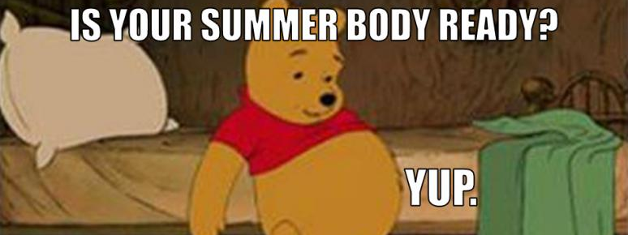
Evidence
We can’t just say it in the ISER, we must prove it
The narrative must be supported by a policy, process, or practice

Slide 11

Finishing Team Step-By Step Instructions
Link

Slide 12

Standard Rubrics
Standard Language and Review Criteria are used to ensure elements of each substandard are met.
Notes:
Review Criteria – car Inspection

Slide 13

Your Turn to Practice
Use the rubric to evaluate the draft narrative
Notes:
Barbara

Slide 14
Finishing Team Process Overview
Sept 16
Week of Sept 19
Team Leads and Liaison email team member assignments, instructions, and access to narratives/evidence
Sept 26 – Oct 14
Finishing Team work continues
October 17
Individual evaluator rubrics due to Finishing Team Leads
November 1
Finishing Team Training
Finishing Team work begins
Finishing Team Drafts and Evidence complete
Resource Teams provide input to Core Team
Evidence Collectors check in with Team Leads with progress
Notes:
Kelly

Slide 15
Your Accreditation Core Team
Kelly Fowler
Lianne Greenlee
Michelle Sampat
Barbara Mezaki
Allie Frickert
Patty Quiñones
Vice President of Instruction; Accreditation Liaison Officer
Assistant Dean of Accreditation
Associate Dean of Arts; Core Team member
Director of Research and Institutional Effectiveness
Professor of American Language; Faculty Accreditation Coordinator
Professor of History; Faculty Assistant Accreditation Coordinator
Laura Martinez
Executive Assistant to the Vice President of Instruction
Notes:
Barbara

Slide 16
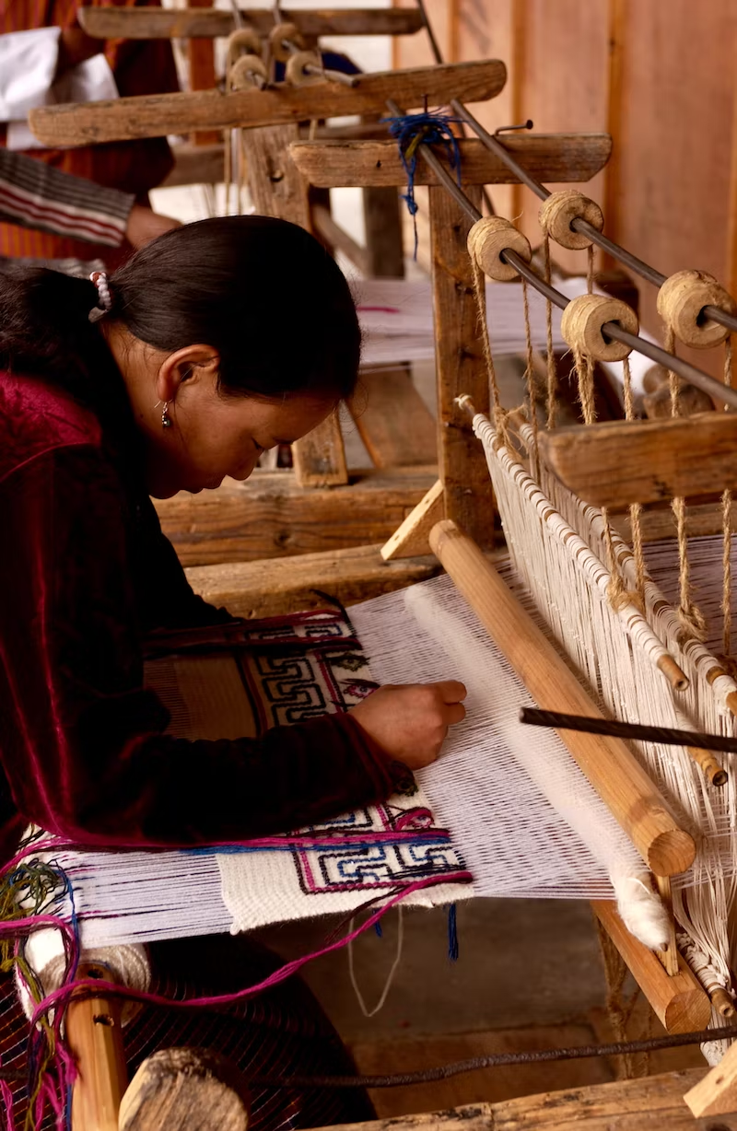
Thank you!
We appreciate your volunteering to be part of a finishing team and part of our College accreditation process.

