Slide 1
Accreditation with CLASS!
April 8, 2022

Slide 2
Today’s Agenda
Insights from college leadership on the important role of classified staff in accreditation
Purpose of accreditation
Importance of accreditation
Your role in ongoing accreditation work
Opportunities to be involved
Mt. SAC accreditation timeline

Slide 3
Co-Facilitators
Kelly Fowler, Vice President of Instruction
Robert Stubbe, CSEA 262 President
Brandon Gillett, CSEA 262 2nd Vice President
Sangvan Thaysangkram, CSEA 262 Member, Core Team Support
Barbara Mezaki, Faculty Accreditation Co-Lead
Allie Frickert, Faculty Accreditation Assistant
Lianne Greenlee, Assistant Dean of Accreditation & Planning

Slide 4

Insights from Campus Leaders

Slide 5





Kahoot! Game prizes and information
Compete for Prizes
T-shirt
Insulated Tumbler
Wireless Charging Pad
WINNERS who use a “Nickname” will need to email Barbara Mezaki to claim your prize.

Slide 6

What is Accreditation ?
Accreditation is a practice of academic quality control
  Promotes institutional excellence through application of standards
  Advances meaningful and effective student learning and achievement
  Provides assurance to students, general public, & others of quality of educational offerings
  Completed through peer review

Slide 7
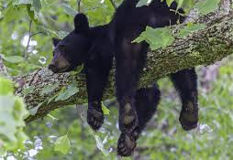
Why Bother?
  Access to Federal Student Aid
  Assure quality to the public and students
  Credibility for degrees and credentials (transfer & employment)
  Stimulates institutional innovation and improvement
  Provides assurance to students, the public, and other institutions that you are achieving your mission

Slide 8
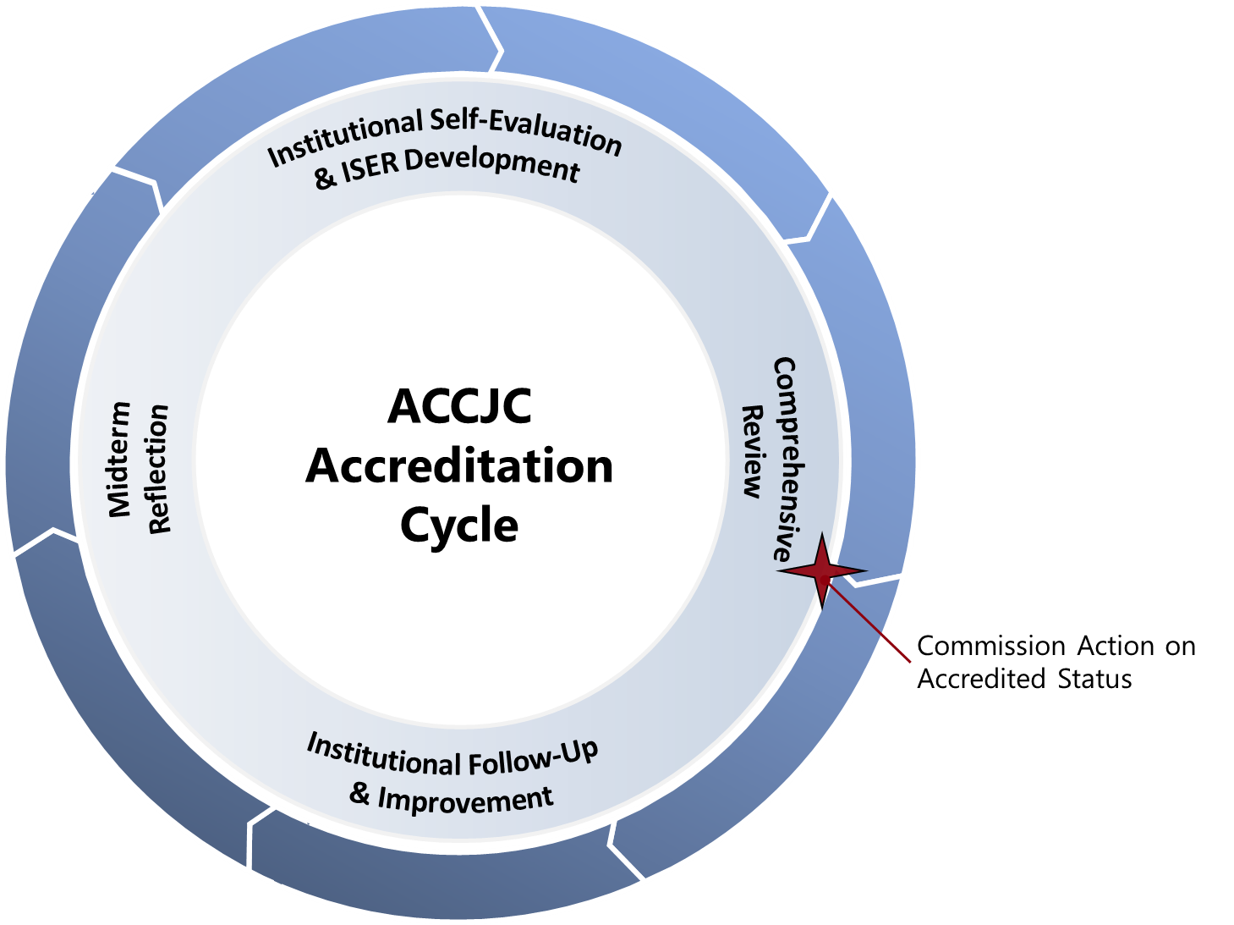
Accreditation Cycle and Reports
Self Evaluation & Comprehensive Review (every 7 years)
Follow Up Reports (if required)
Midterm Reflection (4th year
    after comprehensive review)
Ongoing Reporting
  Annual Report
  Annual Fiscal Report
  Substantive Change

Slide 9
Continuous Accreditation Process
FEAR NOT !!
We spend the majority of our time in Institutional Follow-up…
Ongoing, daily accreditation work!
Peer Evaluation & Visit
Commission Evaluation & Decision
Institutional Follow-up
Self Evaluation

Slide 10
What the ACCJC Accreditation Process is…
Streamlined Report (approximately 200 pages)
Best evidence Growth mindset approach to the process.
It is a formative – summative process
Process happens over three semesters, Spring, Fall, Spring.
No "Gotcha!" or surprise
Core inquiries inform the triangulation of evidence for reviewers
A small visiting team will conduct a Focused Site Visit on Core Inquiries
Opportunity for collaboration, celebration, and community
Inclusive
Focused on Growth and improvement

Slide 11
Four Interconnected Standards of Institutional Practice
Standard I
Standard II
Standard III
Standard IV
Mission
Instructional Programs
Human Resources
Decision-Making Roles & Processes
Physical Resources
Chief Executive Officer
Assuring Academic Quality & Institutional Effectiveness
Library & Learning Support Services
Technology Resources
Governing Board
Institutional Integrity
Student Support Services
Financial Resources
Multi-College Districts

Slide 12
Ongoing Day to Day Work of the College
Standard 1: Institutional Mission & Effectiveness Annual PIE Process Use mission statement for planning & decision-making Classified Senate Committees (IEC, PAC) | Standard II: Student Learning Programs & Services Teaching Assessing & evaluating SLOs Curriculum design Counseling & information literacy support Support Services
Standard III: Resources Hiring committees Facilities Advisory Committee ITAC Professional development committees Budget Committee President’s Advisory Council | Standard IV: Leadership & Governance All Committee work Classified Senate CSEA Academic Mutual Agreement Council President’s Advisory Council

Slide 13
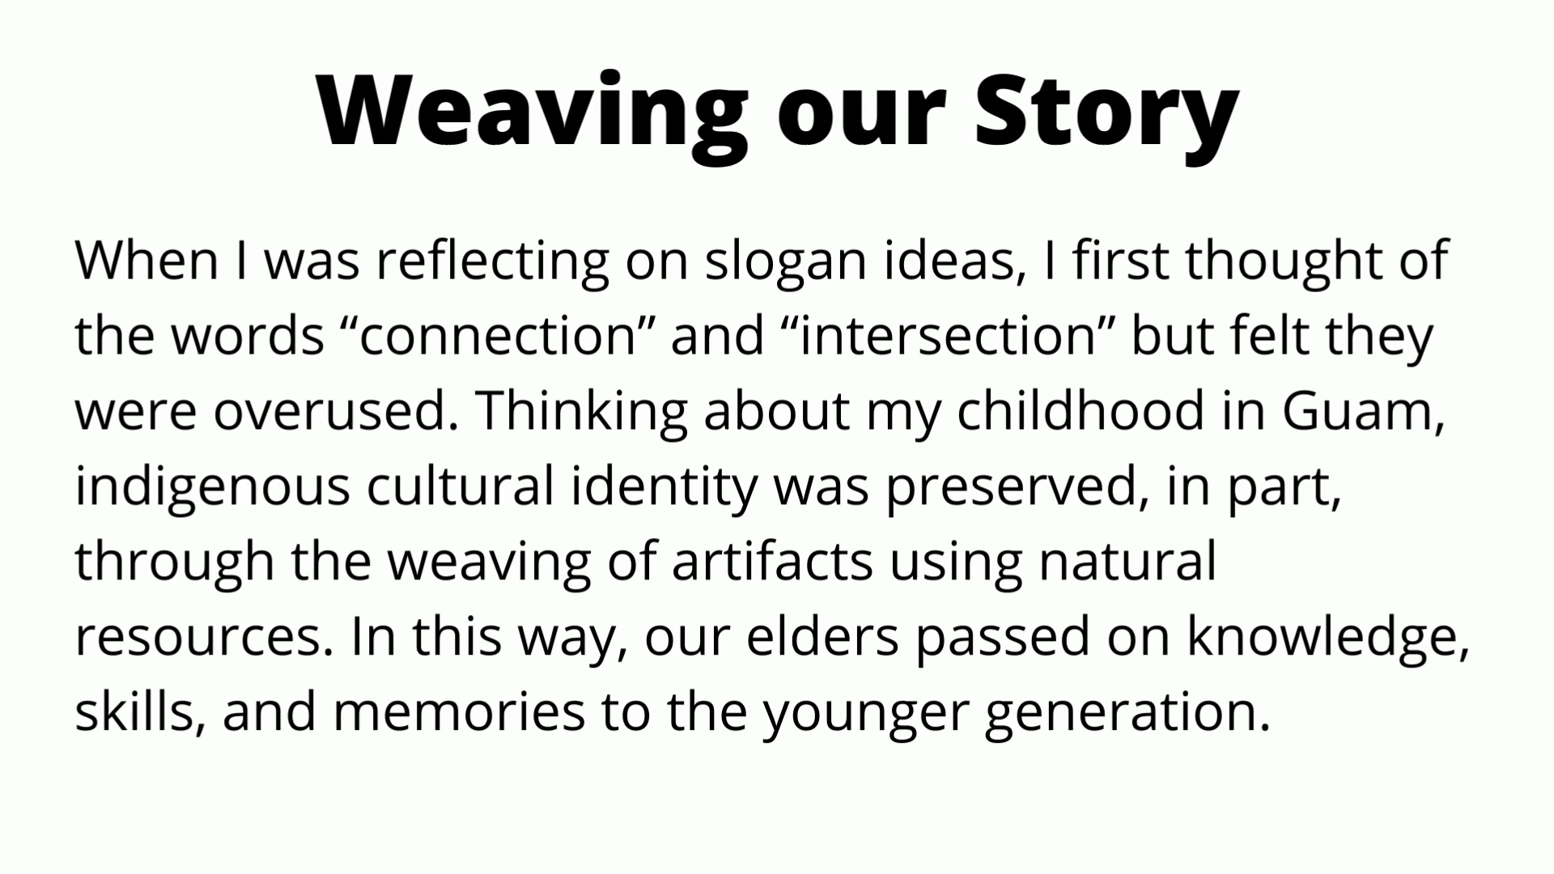
Our Accreditation Theme
Introduction to the Video: Aida Cuenza-Uvas

Slide 14

The Accreditation Logo

Slide 15


Developing the College Report
Our college report is called an ISER (Institution Self-Evaluation Report)
Collaborative Partnership
Multiple groups and perspectives working together!

Slide 16
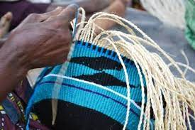
What are "Weaving Teams" & What will they do?
      Weaving teams will write the ISER Report
      Represent the campus committees and work groups with expertise pertaining to each standard
      Have faculty, classified, administrative, and student representation to include diverse voices and perspectives
      Engage in discussions about the representative samples of evidence
      Identify and engage in discussions about representative samples of evidence
      Identify areas for improvement
Classified staff serving on Weaving Teams represent you.
If you are not on a Weaving Team, there are other ways to participate!!

Slide 17
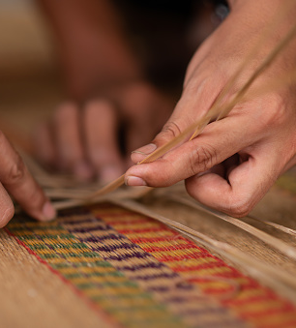

The ISER Report focuses on our ongoing work in action:
Process
Procedures
Practices
Our College will explain the process that the College uses on a daily/monthly/yearly cycle, the procedures in that process, and how that works in practice. add text

Slide 18
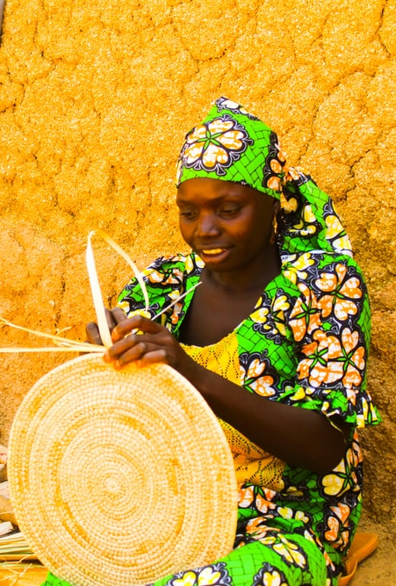
Ways to Get Involved
Continue to be GREAT at your job!
Participate on a Weaving Team
Be a Resource to Weaving Teams
ISER Review Teams – Fall 2022
Campus Feedback on ISER
Attend Accreditation Forums

Slide 19
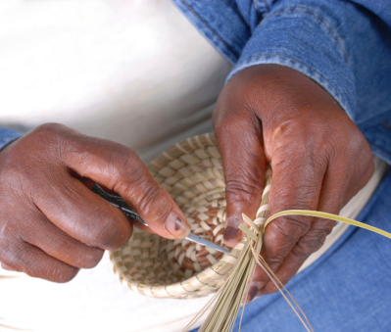
Accreditation Steering Committee (ASC)
Governance committee that guides the accreditation process.
Your CSEA Representatives:
Diana Dzib – Classified Senate Rep
Robert Stubbe – CSEA 262 Rep
Kimberly Butler – CSEA 651 Rep
Interested in getting involved?
Contact Brandon Gillett
Email bgillett@mtsac.edu

Slide 20
Accreditation Timeline – Leading to Fall 2024
Spring 2022
Monthly Accreditation Forums
Weaving (Writing) Teams formed and trained
Weaving Teams collect Initial evidence
Weaving Teams submit initial drafts
Summer 2022
Initial drafts edited
Review of process effectiveness
Progress update to President
Fall 2022
Update to campus community at FLEX Day & CPD-Day
Gap Analysis conducted and distributed
Weaving Teams and Review Teams read ISER draft and give feedback
Weaving Teams submit final evidence
Quality Focus Essay drafted
We are Here!

Slide 21
Do you want more information?
Email us!
Barbara Mezaki and Allie Frickert, Faculty Accreditation Coordinators
Bmezaki@mtsac.edu AND Africkert@mtsac.edu
Office Hours!
Office hours provide an opportunity to speak with the members of the Accreditation Core committee.
  Kelly Fowler (Mt. SAC ALO/VPI)
  First Friday of the month 8 am – 9 am
  Barbara and Allie (Faculty Coordinators)
  Fridays from 1:00 – 2:00 pm on Zoom

Slide 22

What Questions Do You Have?

