Slide 1
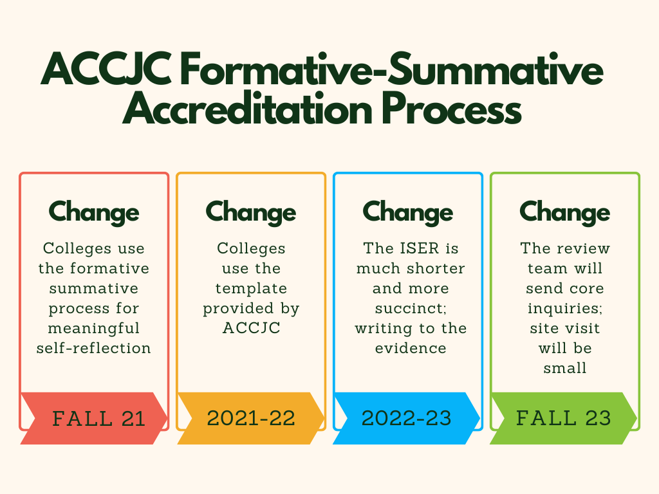
The New ACCJC Accreditation Process
Key changes in the accreditation process result in a more meaningful self-reflection process and ISER.

Slide 2
Accreditation Report to President’s Cabinet | September 13,2022
The Accreditation team is providing multiple opportunities for input on the ISER:
  Preparation Phase (Spring 22)
    Logo design
    Slogan “Weaving Our Story”
    Open information forums
    Weaving Teams were formed with students, staff, faculty, and management involvement
    Core Team coordinated with the School of Continuing Ed (SCE)
  Weaving Team Participation (Spring 22)
    Approximately 18 teams and groups were formed
    Weavers wrote or edited narrative drafts
    Weaving team members gathered evidence to support the narrative, made the evidence accessible, and uploaded the evidence to folders
  Summer Core Team Review
    Core members and one adjunct volunteer did a read-around
    Drafts were changed, amended and edited
    Evidence was audited

Slide 3
Accreditation Report to President’s Cabinet | September 13,2022
Opportunities for input on the ISER (continued):
  Finishing Team Preparation/Recruitment (Fall 22)
    Presentation at CPD day
    Presentation at FLEX day
    Consultation with Academic Senate Executive Board
    Presentation to Associated Students
    Presentation to Classified Senate
    Approximately 90 volunteers signed up
  Finishing Team Assignment and Instructions (this week)
    Finishing Teams have an assigned team lead from the ILT
    Finishing Teams have an assigned liaison
    Teams will have training at the September 16 Open Forum
    Team Leads will have one-on-one training with liaisons
    Teams will review narrative drafts and evidence
    Completion in this iterative process is slated for November 16, 2002
  Resource Committee/Council Review (Sept – Nov 22)
    Cross walk created between committees and standards (Allie)
    Committees and Councils have the option to review the standards and evidence related to their committee work

Slide 4
Accreditation Report to President’s Cabinet | September 13,2022
Opportunities for input on the ISER (continued):
Emerging Areas of Focus discussion (Fall 2022)
  Discussion in Accreditation Steering Committee
Quality Focus Essay (QFE) Discussion
  Roll out to the campus and community (Spring 23)
    Multiple Feedback opportunities will be given
      Open Forums
      SmartSheet submissions
      Liaison office hours
      Listening tours
  Presentation to the Board of Trustees
    Roll out similar to the campus
    First reading: June Board Meeting
    Second reading: July Board Meeting
ISER submission date = August 1, 2023

Slide 5
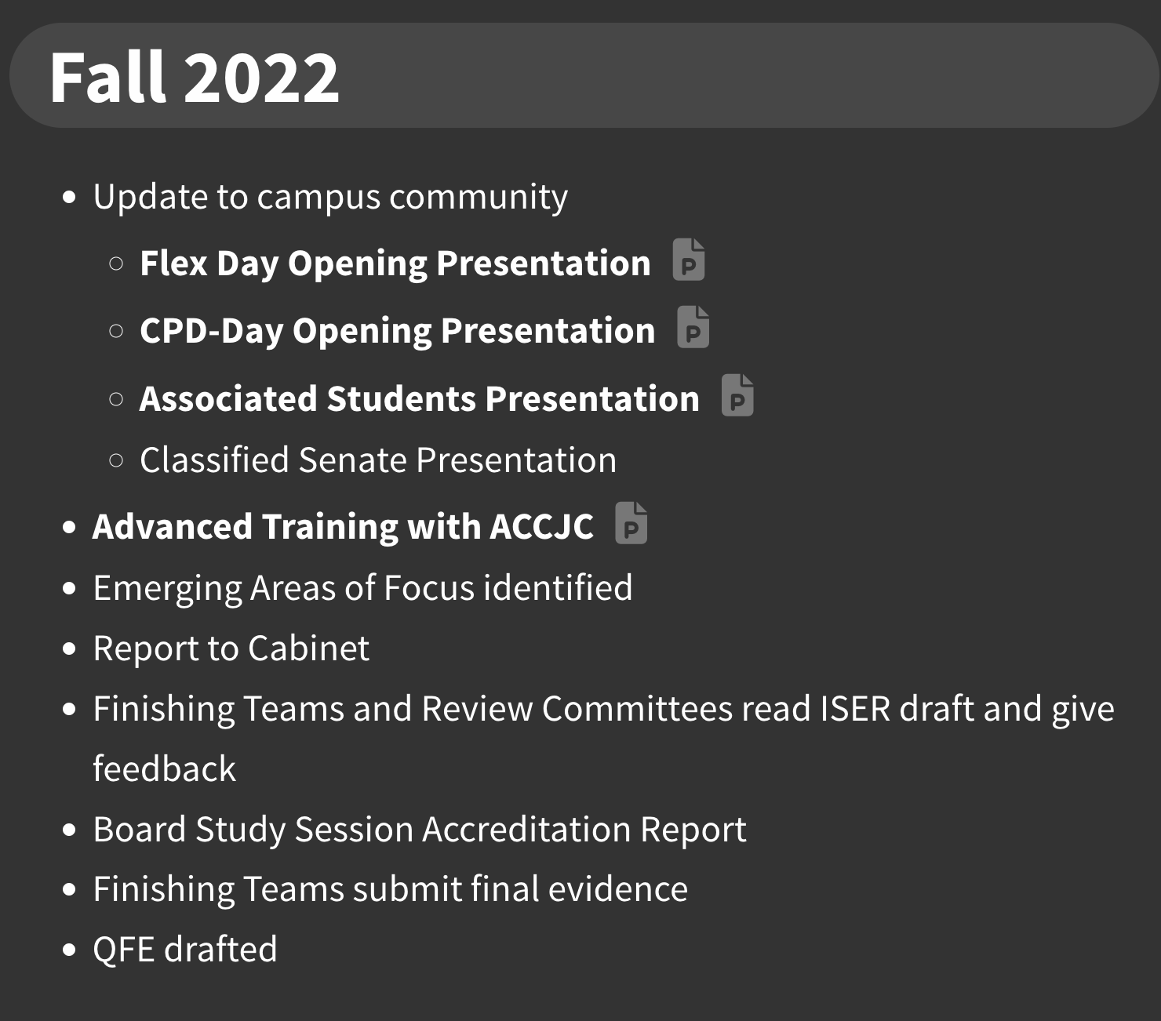
Accreditation Update to President’s Cabinet | September 13, 2022
Additional Information and Links on the Accreditation Webpage: https://www.mtsac.edu/accreditation/college_accreditation/2024/index.html

Slide 6
Upcoming Trainings and Information Meetings
Fall Forums
  September 16, 2022 “Finishing Team Training”
  October 21, 2002 “Accreditation and Distance Education (DE/DL)”
  November 18, 2022 “Data Informed Decision making”
Board of Trustees
  November 12, 2022 Training with ACCJC Liaison Dr. Gohar Momjian and the Mt. SAC Accreditation Core Team
  Winter 2023 | Special BOT Study Session
Accreditation Core Team:
Kelly Fowler, VPI/ALO
Lianne Greenlee, Dean of Accreditation and Planning
Patty Quiñones, Director of Research and Institutional Effectiveness
Michelle Sampat, Acting Dean of Arts
Barbara Mezaki, Faculty Accreditation Coordinator
Allie Frickert, Faculty Accreditation Coordinator

