Slide 1


Welcome to Spring!
- Accreditation Core Team

Slide 2
Accreditation Core Team
Kelly Fowler, Vice President of Instruction, ALO
Lianne Greenlee, Assistant Dean of Accreditation
Barbara Mezaki, Faculty Accreditation Coordinator
Allie Frickert, Faculty Accreditation Coordinator
Michelle Sampat, Dean of Arts
Patty Quiñones, Director of Research and Institutional Effectiveness
Laura Martinez, Executive Assistant to the VP of Instruction

Slide 3

FLEX Day
Three Pillars:
Prosperous: the condition of being successful or thriving (Merriam Webster)
People
Planet
Prosperity
Our ISER work has focused on demonstrating how Mt. SAC is successful and thriving

Slide 4
Reminder of where we have been and a look at where we’re going…
Core + Friends
Core Team
The Core Team and Volunteers edited drafts
Core members are editing narratives and evidence
Weaving
Summer
Finishing
Winter
Spring
Weaving Teams
Finishing Teams
All Campus
Teams created or modified a draft
Teams edited both evidence and narratives
The ISER narrative will be released to the campus and input sought

Slide 5

Some Special Shout-outs!
Thank you to the colleagues for providing ongoing support in the ISER process:
Eric Turner and his team of student workers
Jeffrey George
Lee Jones
Rick Nguyen
John Lewallen

Slide 6
Thank you to the Finishing Teams!
I.A. Mission Rosa Asencio (Classified – CSEA 262) Missy Cunningham (Faculty – Admin Justice) Michael Engelhardt (Faculty – music) Yen Mai (Mgmt) Sarah Plesetz (Mgmt) | I.B. Assuring Academic Quality and Institutional Effectiveness Minerva Avila (Mgmt) Nathan Tharp (Faculty - Music) Stacy Bradshaw (Adj Fac - Comm) Ken Klawitter (Faculty - Comm) Irving Lai (Faculty - Math) Doris Torres (Classified) Cathy Stute (Classified) Patty Quinones (Mgmt) Chris Jackson (Faculty - Outcomes) Eva Figueroa (Classified) Fawaz Al-Malood (Mgmt)

Slide 7
Thank you to the Finishing Teams!
I.C. Institutional Integrity Minerva Avila (Mgmt) Malcolm Rickard (Faculty - Physics) Kim Earhart (Faculty – History) Sierra Powell (Faculty – Poly Sci) Mark Cooper (Faculty - BIology) James Reed (Classified) Loralyn Isomura (Classified) Sylvia Ruano (Mgmt) Tammy Knott-Silva (Mgmt) | II.A. Instructional Programs L.E. Foisia (Faculty - SCE) Irene Pinedo (Classified) Scott Guth (Faculty - Math) Victoria Abatay (Faculty – Nursing) Carmen Rexach (Faculty - Biology) Denise Bailey (Mgmt) Katie Datko (Manager- FCLT) Zina McFarland-Stagg (Adj Faculty) Maura Palacios Mejia (Faculty - Biology) Kelly Coreas (Faculty - Outcomes) John Vitullo (Mgmt) Michelle Sampat (Mgmt)

Slide 8
Thank you to the Finishing Teams!
II.B. Library and Learning Support Services Tiffany Rusich (Classified) Kolap Samel (Faculty - Library) Jannet Ortiz (Classified) Pauline Swartz (Faculty - Library) Andrea Gonzales (Classified) Romelia Salinas (Mgmt) | II.C. Student Support Services Alix Lopez (Faculty - Forensics) Cameron Troxell (Faculty - Math) Ana Uriarte (Classified) Lesley Johnson (Mgmt) Gio Rodriguez (Classified) Koji Uesugi (Mgmt) Maridelle Acero (Classified) Cathi Hilario-Alvarado (Classified) Tom Mauch (Acting VP of SS)

Slide 9
Thank you to the Finishing Teams!
III.A. Human Resources Jorge Basilio (Faculty - Math) Sangvan Thaysangkram (Classified) Jennifer Galbraith (Mgmt) Emily Woolery (Faculty - FA) Tami Pearson (Mgmt) Carolyn Lake-Bain (Faculty - Counseling) Mary McGee (Classified) Liz Jauregui (Classfied) Laura (Maile) Murillo (Classfied) Ryan Wilson (Mgmt) | III.B. Physical Resources Tami Pearson (Mgmt) Joe Jennum (Mgmt) Caitlin Rodriguez (Classified) Cathy Hayward (Classified) James Stone (Faculty - Poly Sci) Frances Loera (Classified) Gary Nellesen (Mgmt)

Slide 10
Thank you to the Finishing Teams!
III.C. Technology Resources Fawaz Al-Malood (Mgmt) Hong Guo (Faculty - Library) Richard Genovese (Faculty - Fire Tech) Tom Cao (Classified) Krystal Yeo (Classified) Kate Morales (Classified) Chris Schroeder (Manager IT) Anthony Moore (Mgmt) | III.D. Financial Resources Madelyn Arballo (SCE Provost) Mary McGuire (Faculty - Art History) Masoud Roueintan (Faculty - Chemistry) Julie Moreno (Classified) Martha Hall (Faculty - Math) Rajni Chawla (Classified) Ralph Jagodka (Faculty - Business) Marisa Ziegenhohn (Manager) Yadira Santiago (Confidential) Morris Rodrigue (VP) Rosa Royce (Mgmt)

Slide 11
Thank you to the Finishing Teams!
IV.A. Decision-Making Roles and Processes Madelyn Arballo (Provost) Carol Nelson (Confidential) Phil Wolf (Faculty - Physics) Juan Mendoza (Student Trustee) Marlene Espina (Classified) Tamra Horton (Faculty - FA) Karelyn Hoover (Mgmt) Cynthia Orr (Classified) Marcell Gilmore (Classified) Kim Garcia (Classified) Michelle Sampat (Mgmt) | IV.B. Chief Executive Meghan Chen (Mgmt) Brigitte Hebert (Confidential) Adrienne Price (Mgmt) Jill Dolan (Mgmt) Beta Meyer (Faculty - Biology) Kelly Fowler (VP of Instruction) Madelyn Arballo (Provost)

Slide 12
Thank you to the Finishing Teams!
IV.C. Governing Board Yvette Garcia (Classified) Karen Schnurbusch (Faculty - Physics) Jessica Jun (Faculty - Nursing) Carola Wright (Faculty - Biology) Nicole Blean (Mgmt) Lance Heard (Mgmt) | Thank you to all of these People For helping highlight how Mt. SAC is thriving and successful, our Prosperity And for helping us make Mt. SAC a premiere college on the Planet

Slide 13
Core Team’s Winter Work
Introduction
Introduction, history, data, ISER process, ERs
IA, IB,IC
Identifying any areas of focus
Rewriting sections of the narrative
IIA, IIB,IIC
Ensuring active language (not passive)
IIIA, IIIB, IIIC, IIID
IVA, IVB, IVC
Condensing, editing, and rearranging drafts
Evidence
Searching for the “best evidence”

Slide 14

The ISER will be released for campus feedback…
You will have the opportunity to offer feedback as the ISER is released to the campus and community in sections throughout the spring semester.

Slide 15
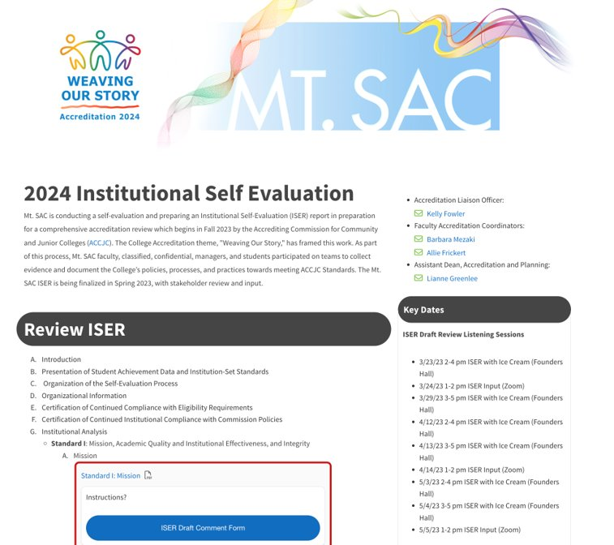
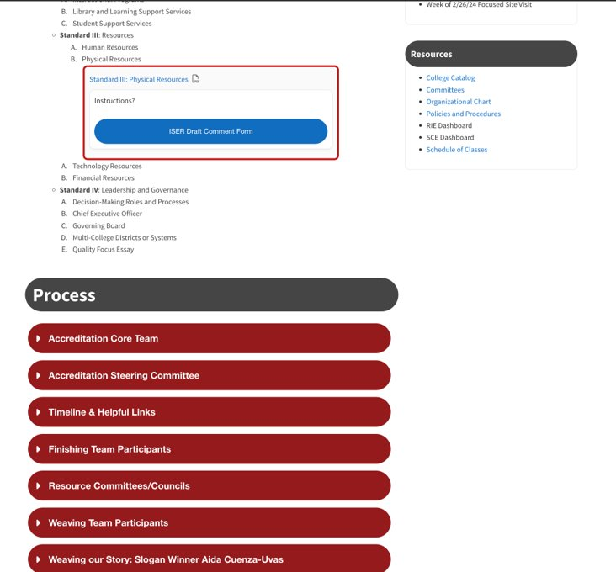
2024 Mt. SAC ACCJC website

Slide 16
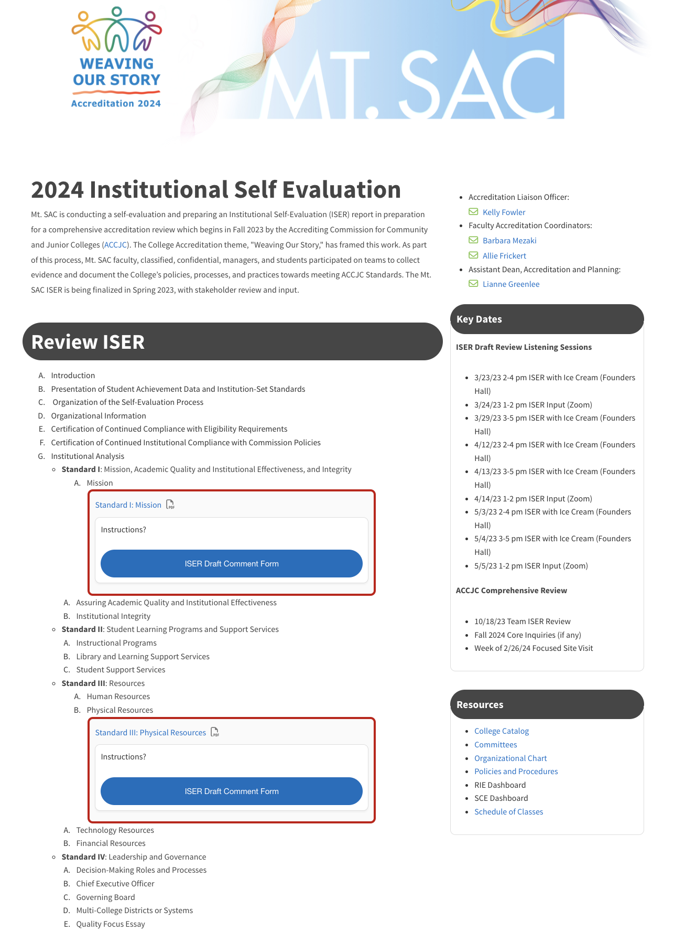
The Accreditation webpage has a link for feedback on a few standards at a time.
Click here!

Slide 17
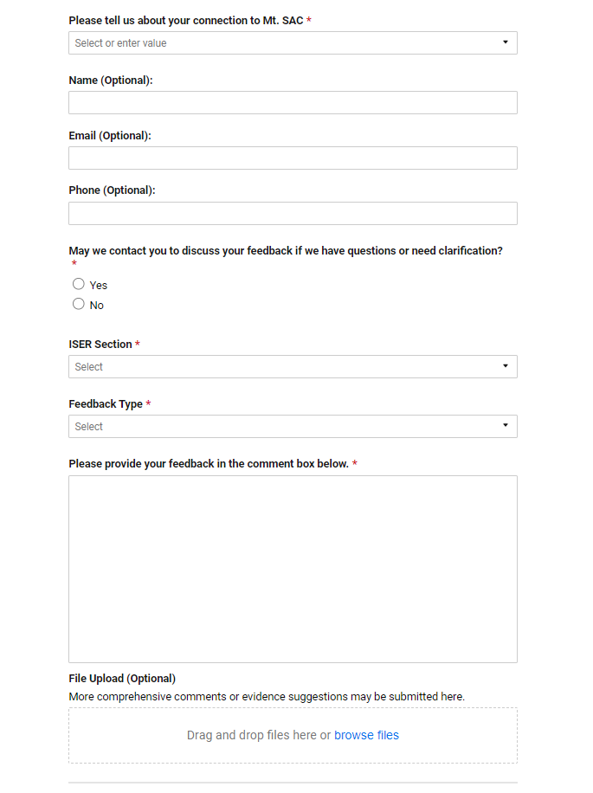

Use SmartSheets to submit your comments or to upload a file

Slide 18
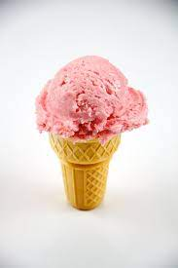

Flexibility for your Feedback!
1
2
SMART Sheet
ISER with Ice Cream
Use fhis form to give your input
Come to in-person sessions to offer input
4
3
Chat
Zoom Hours
Talk to one of the Core Team to offer input
Drop in on Zoom

Slide 19
Other Spring Work
The campus and community have the opportunity to give input
The “Best” evidence gathering will continue
All groups (students, classified staff, faculty, managers, and community) have opportunity for input
ISER to Campus
The Quality Focus Essay will be completed
Evidence
Constituencies
QFE

Slide 20

We will begin preparing for the Team Visit…
Key dates to remember:
Spring 2023 DL courses (50) will be pulled at random
Core Team will seek input all spring
ISER goes to the BOT in June and July
ISER is due on August 1, 2023

Slide 21
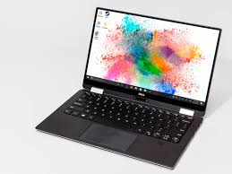
FCLT has RSI and technology resources for faculty
Self-paced RSI class is being developed – look for details in Spring
Find Out Fridays: Session every other Friday beginning in March in coordination with the LIEAL (OER) folks.
Learning Center Tech Week: Pronto, Perusall, Flipgrid. Scheduled during Find Out Fridays.
FCLT NewsBytes is weekly:
  information on booking RSI appointments
  articles or links to RSI or DEISA-related topics from the web or our blog
Look for Training on Tools for RSI: Speedgrader Comments, Analytics, Announcements, Pronto

Slide 22
Thank you!
The Core Team appreciates everyone’s help so that we can demonstrate our prosperity.

