Slide 1
Distance Learning and RSI
Accreditation Forum – October 21, 2022

Slide 2

Accreditation Core Team
Kelly Fowler
Lianne Greenlee
Michelle Sampat
Barbara Mezaki
Allie Frickert
Patty Quiñones
Vice President of Instruction; Accreditation Liaison Officer
Assistant Dean of Accreditation
Associate Dean of Arts; Core Team member
Director of Research and Institutional Effectiveness
Professor of American Language; Faculty Accreditation Coordinator
Professor of History; Faculty Assistant Accreditation Coordinator
Laura Martinez
Executive Assistant to the Vice President of Instruction

Slide 3
DL Team Members
Dr. Romelia Salinas
Katie Datko
Carol Impara
Catherine McKee
Dean of Library and Learning Resources
Director of Distance Learning & Instructional Technology
Professor of Nutrition and Foods; Distance Learning Coordinator
Professor of Paralegal Studies; Assistant Distance Learning Coordinator
Mike Dowdle
Professor of Psychology, Academic Senate Exec Board, DLC member

Slide 4
Faculty Leadership
Roger Willis
Tania Anders
Sara Mestas
Professor, Communications, Academic Senate President
Professor, Earth Sciences and Astronomy, Academic Senate Co-Vice President
Emily Woolery
Professor, Library & Learning Resources, Faculty Association President
Tamra Horton
Professor, English, Literatiure, and Creative Writing, Faculty Association Vice President
Professor, Counseling and Leadership, Academic Senate Co-Vice President

Slide 5
Welcome & Outcomes
We are glad that you are here to discuss the alignment of regulations regarding accreditation and RSI, regular and substantive interaction.
Outcomes for today:
Be aware of federal, state, and local alignment of RSI policies
Be knowledgeable of Distance Learning/DE accreditation requirements and peer team review processes
Be familiar with resources and support opportunities for implementation of RSI
Understand the elements of the RSI rubric and how DL course design facilitates ongoing communication with students.
Notes:
Lianne

Slide 6

Welcome!
Federal Law changed the language about distance education from “regular and effective contact” (REC) to “regular and substantive interaction” (RSI)
  ACCJC, our accrediting body, adopted the change from REC to RSI
  California law changed from REC to RSI
  Mt. SAC is responding to these changes:
            Reviewed of AP 4105
            RSI Rubric for self-assessment

Slide 7

The Accreditation Process and DL…
RSI Changes
Federal and State Law, ACCJC standards = RSI
Local Processes
AP 4105; Academic Senate and Faculty Association
Accreditation Cycle
Includes peer team review of DL classes for RSI

Slide 8
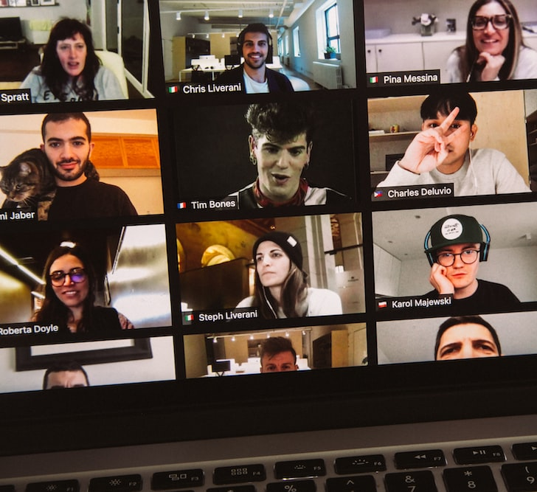
For Mt. SAC, this means:
The peer review team will be looking for patterns and practices in the distance education courses.
Random sample of DL sections
Fully online sections only
Completed in Spring 2023
50 sections will be pulled
Confidential process
Note: one section of one class will not result in loss of accreditation.

Slide 9
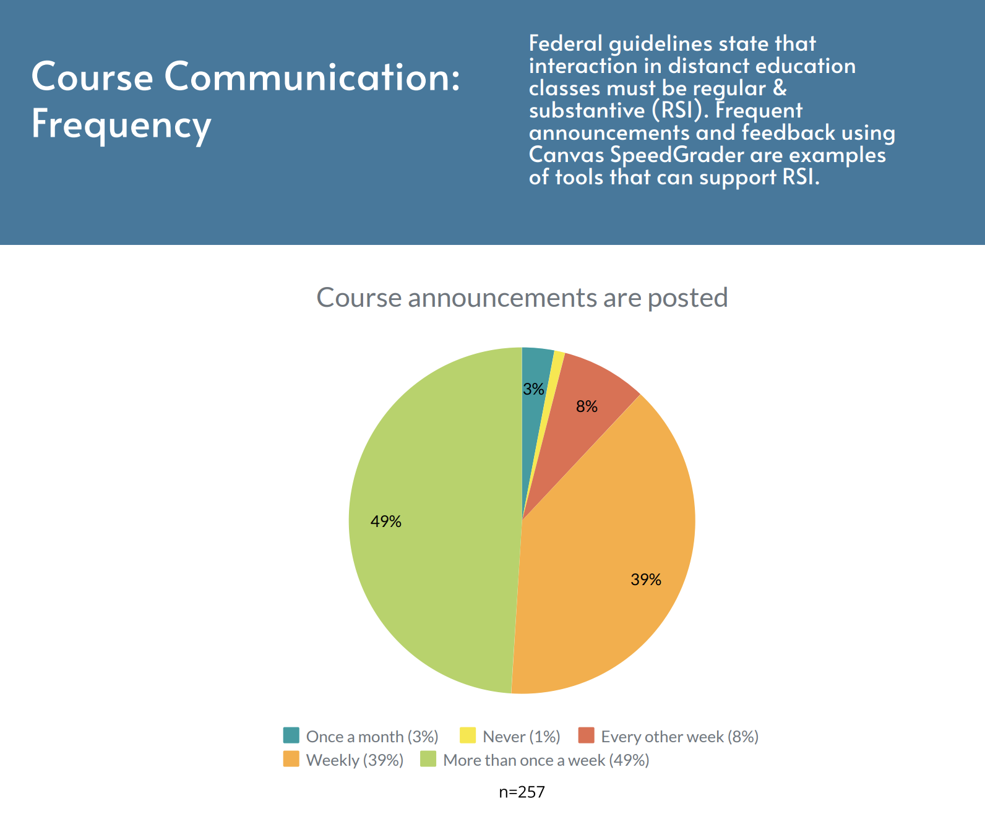
Why do faculty need to know about RSI?
All DL/DE courses must have regular and substantive interaction, RSI.
According to the recent survey by the FCLT, faculty have already built RSI into their courses.

Slide 10
Substantive Interaction
For purposes of this definition, substantive interaction is engaging students in teaching, learning, and assessment, consistent with the content under discussion, and also includes at least two of the following -
Providing direct instruction;
Assessing or providing feedback on a student's coursework;
Providing information or responding to questions about the content of a course or competency;
Facilitating a group discussion regarding the content of a course or competency; or
Other instructional activities approved by the institution's or program's accrediting agency.

Slide 11
Regular Interaction
An institution ensures regular interaction between a student and an instructor or instructors by, prior to the student's completion of a course or competency -
Providing the opportunity for substantive interactions with the student on a predictable and scheduled basis commensurate with the length of time and the amount of content in the course or competency; and
Monitoring the student's academic engagement and success and ensuring that an instructor is responsible for promptly and proactively engaging in substantive interaction with the student when needed on the basis of such monitoring, or upon request by the student.
California law requires “among student” interactions as well.

Slide 12
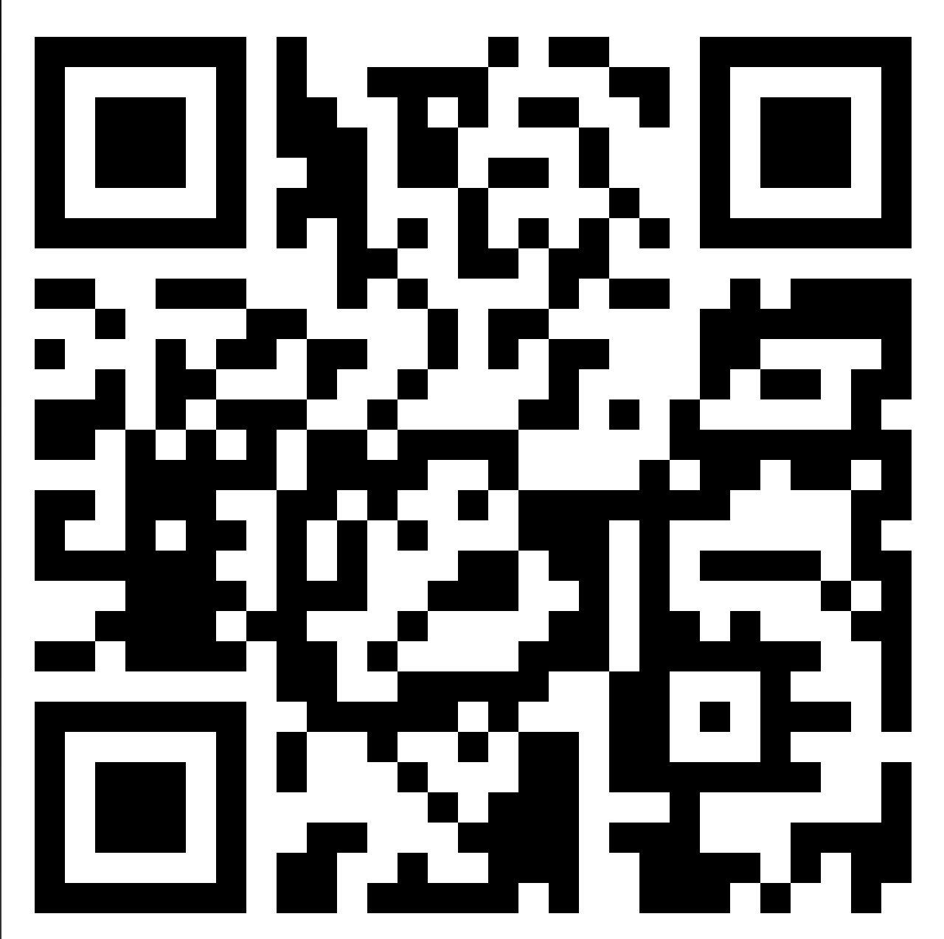
Before we get into RSI, let’s share what we already do…
We would like to invite you to share on the Padlet types of things you do in your online classes.
Instructor to student contact
Predictable and scheduled
Student to student interaction
Recurring
https://padlet.com/bmezaki/2xhsw37dz93ranct

Slide 13

Poll Question

Slide 14
The RSI Rubric
This is a document to help faculty members do a meaningful self-assessment of their courses – not yet negotiated by the FA
This is a way to think about your class retention and success
Consider the resources or training you may need to make improvements to your online classes

Slide 15
The RSI Rubric
Starts with a self-assessment
Capture both the interaction you have with students, and that students have with each other
Download this rubric so you can access the drop-down boxes
          Use the drop-down boxes to log what you do
Indicate in the column where and how often you demonstrate this interaction

Slide 16
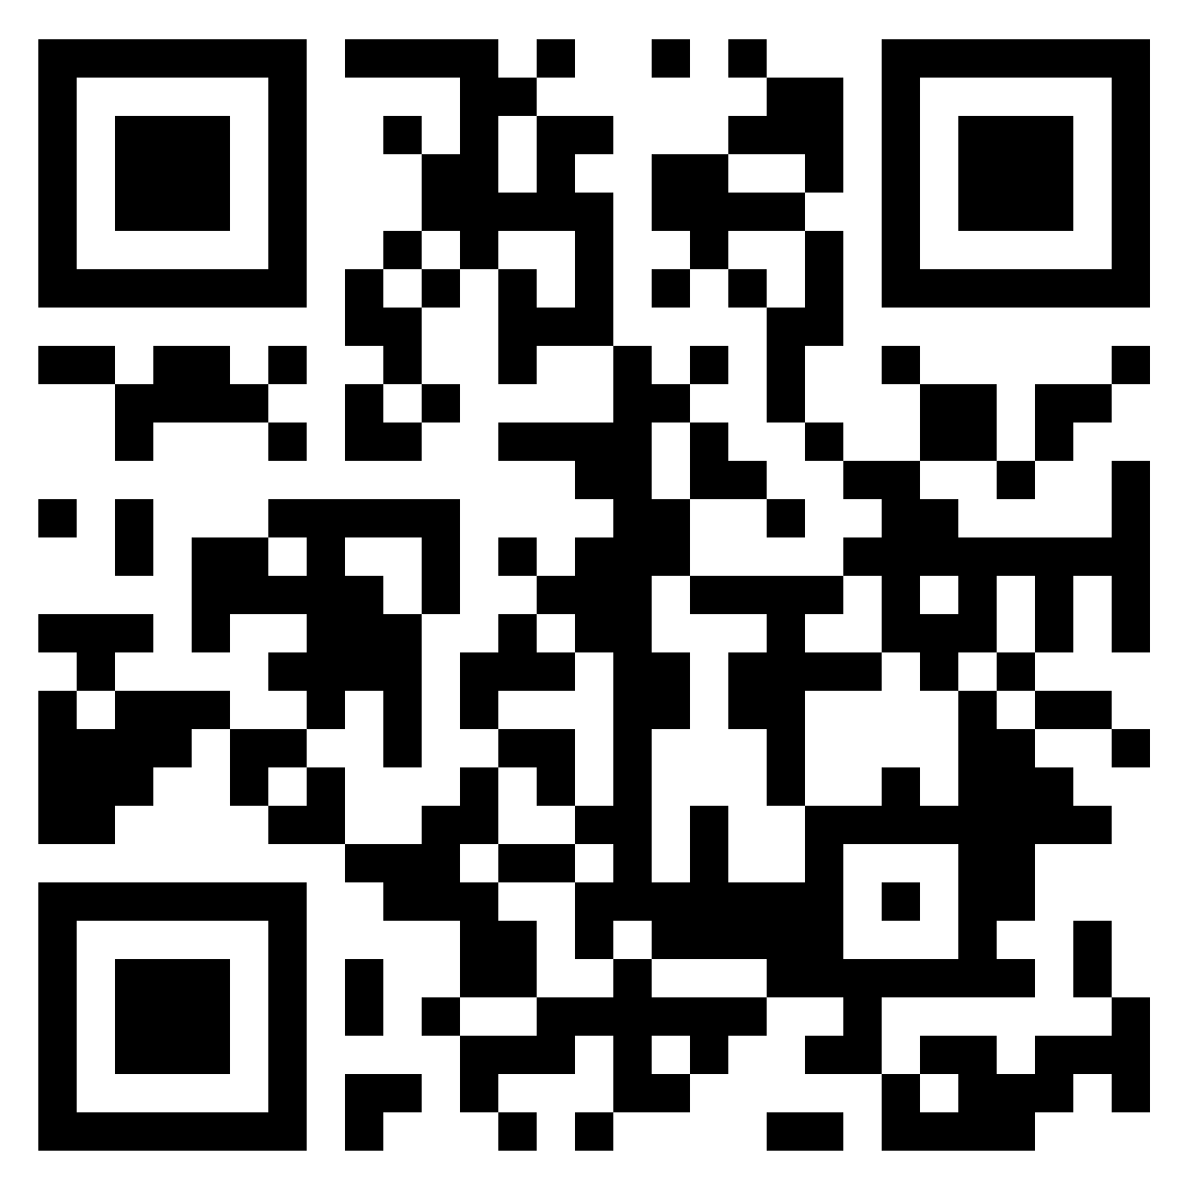

Resources and Support:
Use this QR code to access another Padlet to describe the resources and support you may need.
Support and resources could include, but are not limited to, training.
Click on the + in the bottom right corner to post.

Slide 17
Poll Question

Slide 18

Join us for the November Accreditation Forum!
Friday, November 18
3:00 – 4:00 pm
Data and Institution Set Standards (ISS)

