Slide 1
My Document is not 508 Compliant, Now What?
-Eric Turner | eturner@mtsac.edu | (909) 274-4379

Slide 2
Agenda
Know what the Law says…
Whenever possible, delete documents with errors
Whenever possible, use a webpage instead of a PDF document
Keep original copies made from Microsoft Word, Excel, PowerPoint…
    Documents are more accessible in their native form
    Documents can be made to be read-only in their native form
Live Remediation Demonstration
Questions

Slide 3

Accessibility Scan Not Passed, Now What?

Slide 4

What does Web “accessibility” mean to you?
Accessibility for the Web is actively designing, developing, and creating content in such a way that it does not hinder any person from interacting with the website. - Web Access Initiative (WAI)
A document is accessible when everyone, regardless of ability or disability, can use it and get the information they need.

Slide 5
Accessibility--Non-Technical Definition
Usable by someone who…
  Cannot use a mouse
  Cannot hear
  Cannot see
  Cannot easily distinguish color differences
  Uses assistive technology (adaptive hardware and software) to access
  the system
Used with permission from the High-Tech Center Training Unit (www.htctu.net)

Slide 6
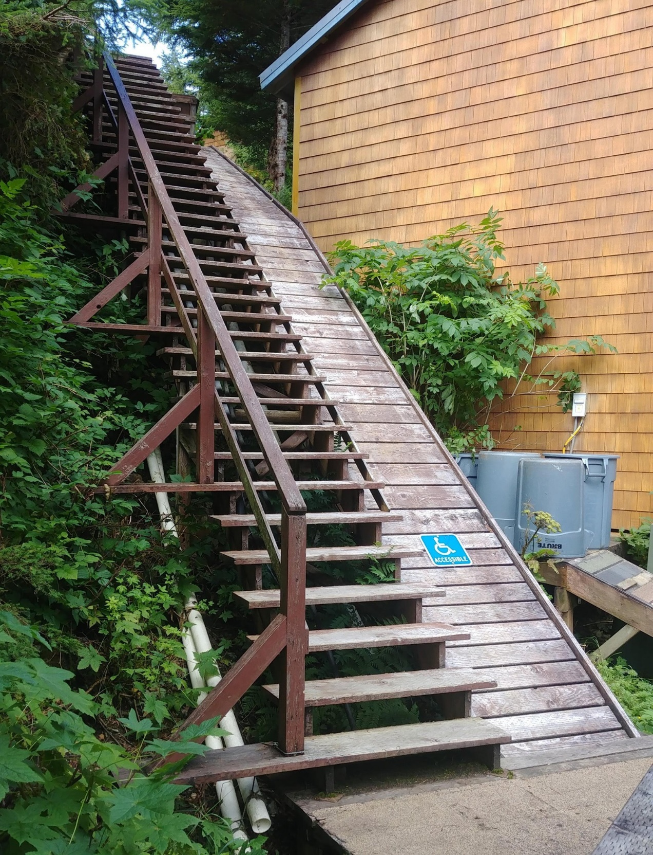
Non-accessible stairway
504/508 Compliant?

Slide 7
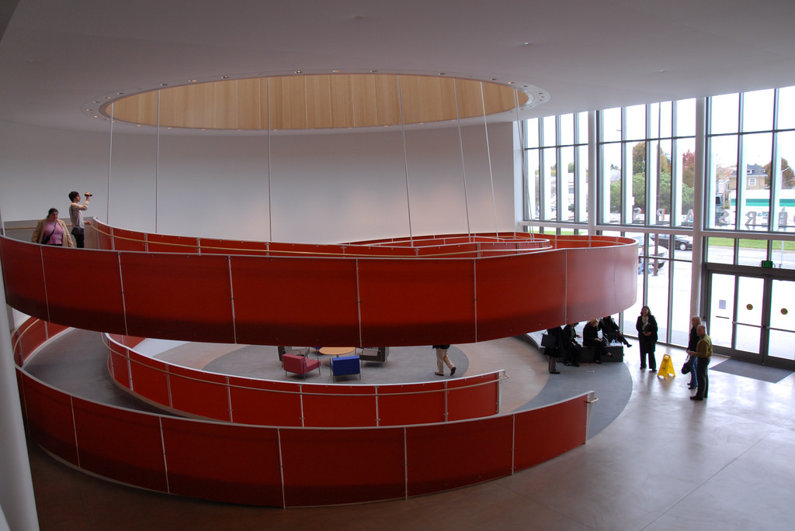
Ed Roberts Center
Ed Roberts Campus
3075 Adeline,
Suite 220
Berkeley, CA 94703
510.225.6300
edrobertscampus.org

Slide 8
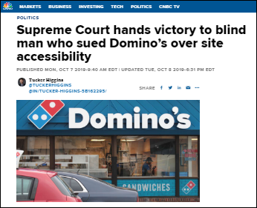
Know What the Law Says Regarding Accessibility
Section 508 of the Rehabilitation Act of 1973 has been refreshed. As of
January 18, 2018 institutions (anyone who receives federal funding) must ensure websites, emails and MORE are accessible or face possible litigation!
1,700 cases pending with the Office of Civil Rights (OCR)
The OCR tasked College of the Siskiyous to make their online courses/websites accessible by the next term or take them down
Essentially, you must follow
WCAG Guidelines to comply!
Notes:
Organized around 4 Principles and 12 Guidelines
• Perceivable: Information and user interface components must be presentable to users in ways they can perceive.
• Operable
• Understandable
• Robust

Slide 9
Web Content Accessibility Guidelines (WCAG) - Principles and Guidelines
WCAG 2.1 is organized as follows:
  Perceivable
    Guideline 1.1 – Text Alternatives
    Guideline 1.2 – Time-based Media
    Guideline 1.3 – Adaptable
    Guideline 1.4 – Distinguishable
  Operable
    Guideline 2.1 – Keyboard Accessible
    Guideline 2.2 – Enough Time
    Guideline 2.3 – Seizures
    Guideline 2.4 – Navigable
  Understandable
    Guideline 3.1 – Readable
    Guideline 3.2 – Predictable
    Guideline 3.3 – Input Assistance
  Robust
    Guideline 4.1 – Compatible
Notes:
Perceivable:
Provide text alternatives for not-text content
Place headings in logical sequential order
Operable:
Make all functionality available from a keyboard
Understandable:
Use consistent navigation
Write out acronyms
Robust:
Use good design that work with all assistive technology, not just JAWS, e.g., Dragon voice assisted technology

Slide 10
WCAG 2.0 vs. 2.1
Sites which conform to WCAG 2.1 also conform to WCAG 2.0
WCAG 2.1 extends WCAG 2.0 by adding new success criteria, definitions to support them, guidelines to organize the additions, and a couple additions to the conformance section.
Example:
  Perceivable
  Information and user interface components must be presentable to users in ways they can perceive.
  Guideline 1.1 Text Alternatives
  Provide text alternatives for any non-text content so that it can be changed into other forms people need, such as large print, braille, speech, symbols or simpler language.
  Success Criterion 1.1.1 Non-text Content
  (Level A)
  All non-text content that is presented to the user has a text alternative that serves the equivalent purpose…
  Alexander Skogberg’s blog explains the new additions to WCAG 2.1

Slide 11
What Information Must be Accessible?
Emergency Notifications
Decisions adjudicating administrative claim or proceeding
Program or policy announcements
Notices of benefits, program eligibility, employment opportunity, or personnel action
Formal acknowledgements of receipt
Survey questionnaires
Templates and forms
Educational and training materials
Used with permission from the High-Tech Center Training Unit (www.htctu.net)

Slide 12
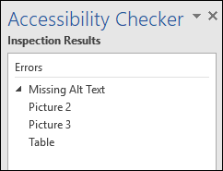
Scan Microsoft Office Documents
  To scan Office (Word, Excel, PowerPoint, etc.) Documents:
  Use built-in Accessibility Checker
  Open the document
  Open the File menu
  Click the Check for Issues button
  Click Check Accessibility

Slide 13
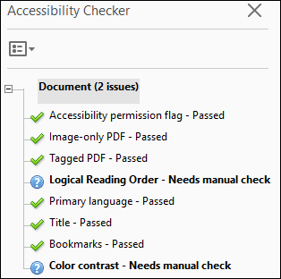
Scan PDF Documents
To scan PDF Documents:
  Use Adobe Acrobat Pro scanning tool
  Launch the Accessibility Pane
  Click Full Check
  Click Start Checking

Slide 14

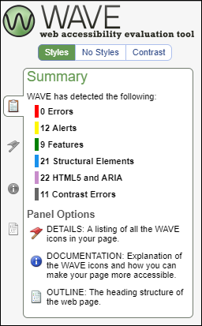
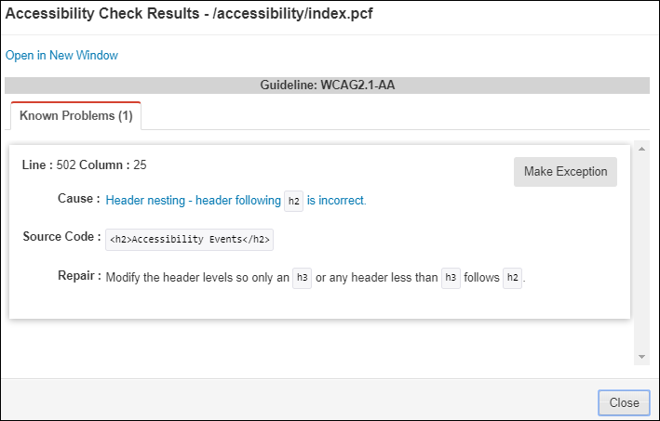
Scan Webpages
To scan Webpages:
WAVE (WAVE Webpage Scanning)
CMS

Slide 15
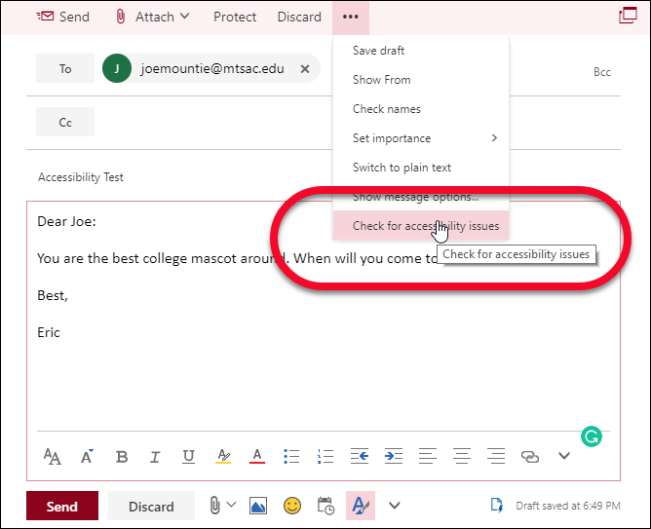
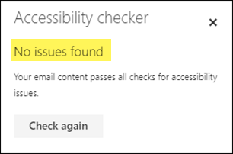
Scan Your Email (Office 365)
To scan an email:
Open Office 365
Click Outlook
Click New Message to compose an email or forward an existing one
Click Check for Accessibility Issues from the … menu
Fix issues until No Issues Found
Note: Check Accessibility works in Office 365, but not in all versions of Outlook

Slide 16
Creating Accessible Documents from Scratch
Tip
Microsoft Office (Word, PowerPoint, etc.)
  Links
  Images
  Structure & Styles
  Tables
Used with permission from the High-Tech Center Training Unit (www.htctu.net)

Slide 17
Links
Links should clearly show where the user will be taken when clicked.
Example:
  To apply for FAFSA, click here.
Becomes:
Use the FAFSA application to apply.

Slide 18

Images: Which is the best alternative text for this image?
    “Image”
    “Two girls and a boy leaning over”
    “Three smiling students”
    “Image of three smiling students”
    “Girl with blue shirt and shell necklace, next to girl with black shirt and hoop earrings, boy with plaid shirt in second row.”

Slide 19
Style/Structure
Headings communicate the organization and structure of the content.
  Assistive technologies use headings to provide in-page navigation.
  Make sure headings and sub-headings are in logical sequential order
Example Code:
  <h1>Plant Foods that Humans Eat</h1>
    <h2>Fruit</h2>
      <h3>Apple</h3>
      <h3>Orange</h3>
      <h3>Banana</h3>
    <h2>Vegetables</h2>
      <h3>Broccoli</h3>
      <h3>Brussels sprouts</h3>
      <h3>Green beans</h3>

Slide 20
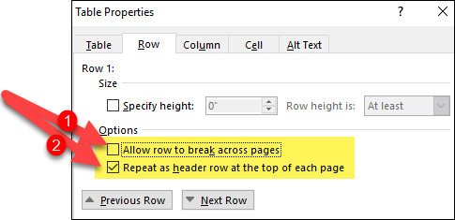

Tables – Making Tables Accessible
Split nested tables into multiple tables
Remove merged cells
Set row headers in your tables using Table Properties
  Uncheck the Allow row to break across pages check box in the Options section.
  Check the Repeat as header row at the top of each page
  Note: Do not forget to add Alt-text to your tables

Slide 21
Other Considerations: Color
  Colors should not be used to communicate information
    If you were to use red text to communicate bad information and green text to communicate good information
        Those who use screen readers would not get that information
        Those who are color blind would not get that information
  Use bold or italics to communicate information
  If you use color, it must be high contrast (i.e., dark text on light background
  or vice-versa)
  Color Test (http://www.mtsac.edu/accessibility/colortest)

Slide 22
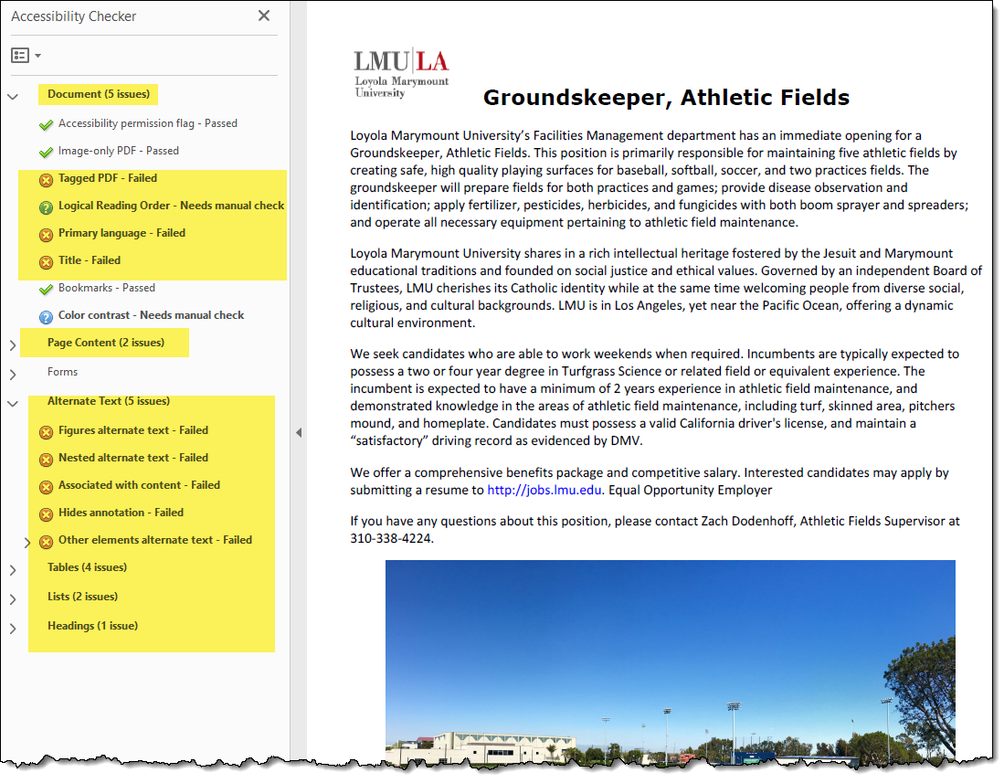
My PDF Doesn't Pass. Now What?

Slide 23

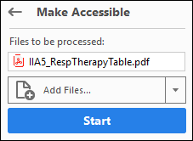
Use the Adobe Acrobat Action Wizard
Tip

Slide 24
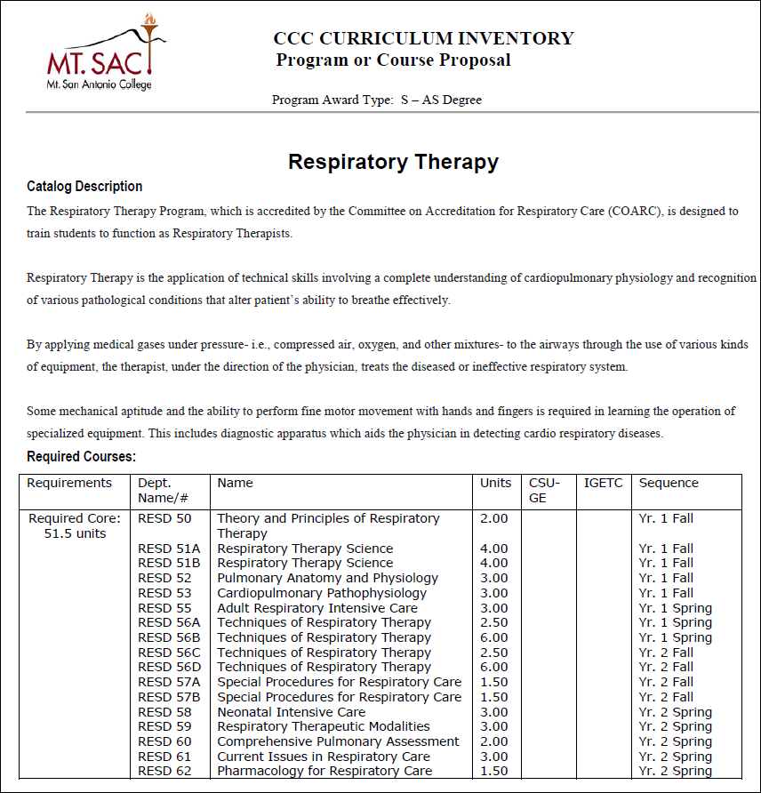
What About Tables?

Slide 25
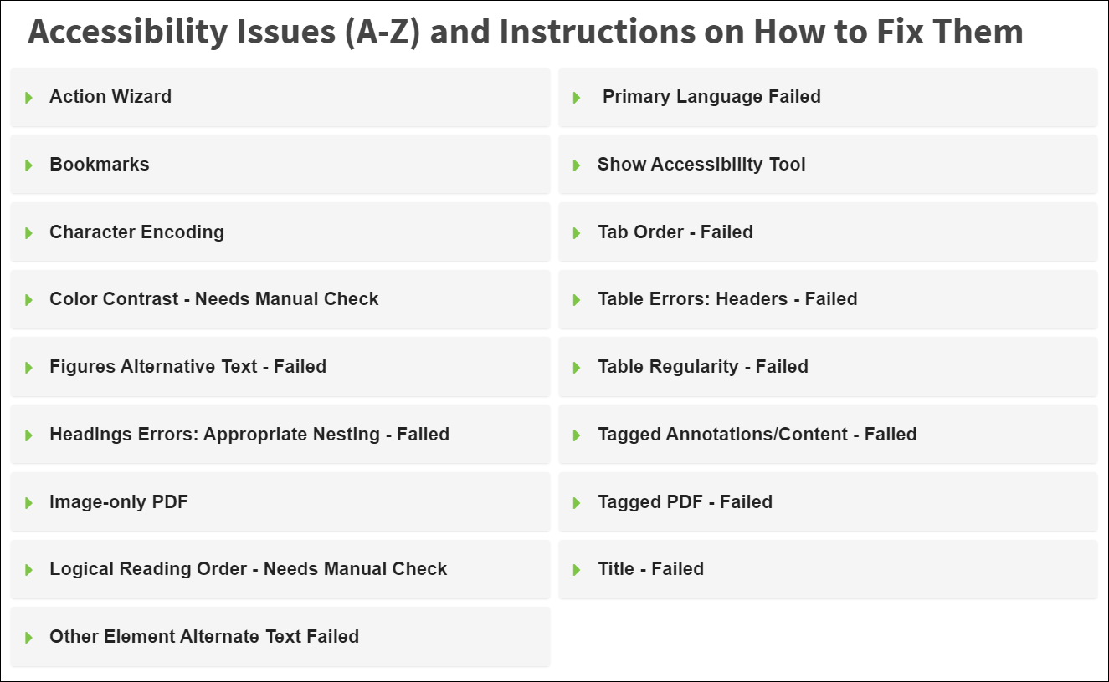
Accessibility Fixes

Slide 26

Mt. SAC – By the Numbers
Statistic | Oct-18 | Oct-19
Misspelled Words | 10 | 108
Broken Links | 138 | 893
PDF Documents to be Fixed | 8515 | 4820

Slide 27
Need help making an accessible document?
Tip
  Get Training and Fix It Yourself
  Get Training for Your Colleagues (We supplemented our team with student workers)
  Send It to an Accessibility Vendor
  Talk to an Accessibility Consultant
  All of the above

Slide 28
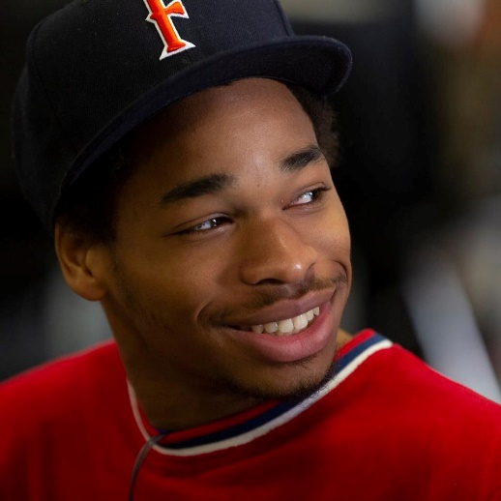


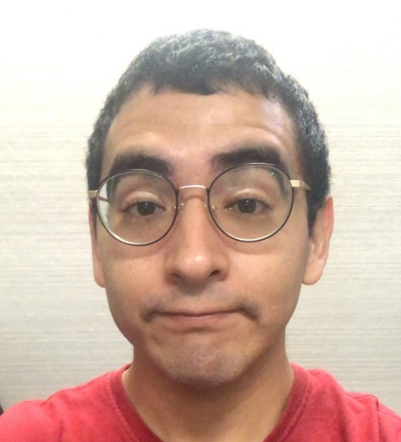

Dream Team of Student Workers
Aaron
Dallas
Richard
Carlos
Mark

Slide 29
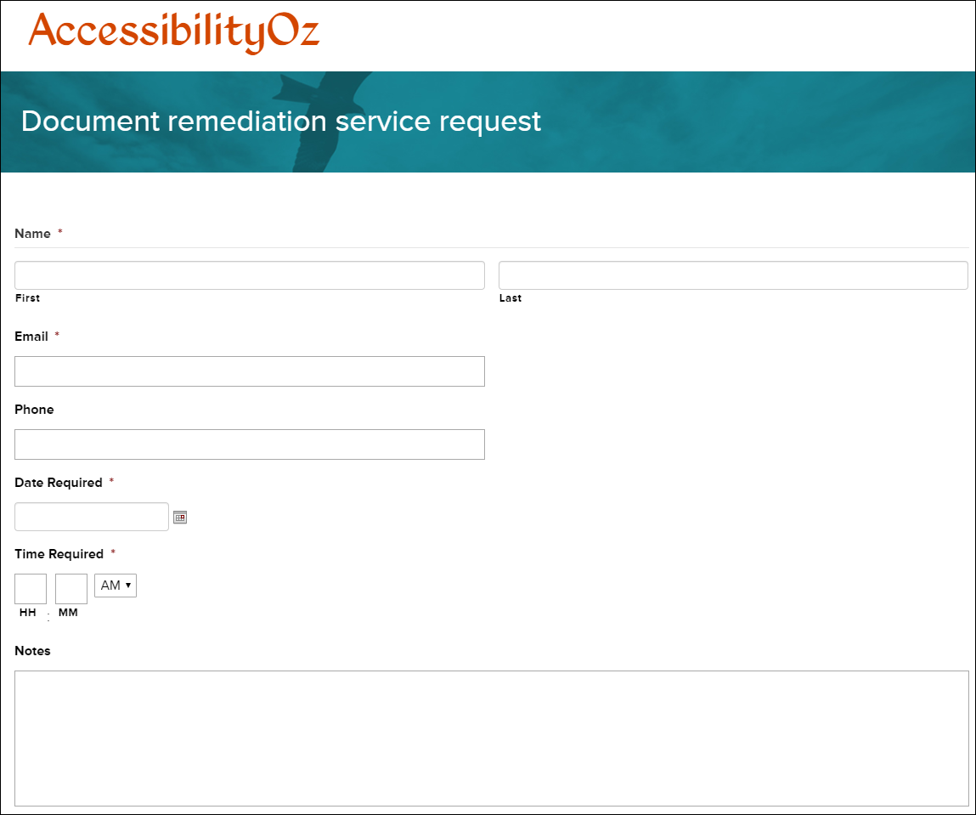
Accessibility Vendor

Slide 30
Let’s See It…

Slide 31
Resources
Need help making an accessible document?
  Check out the Mt. SAC Accessibility webpage for common errors and fixes.
Other Resources:
WCAG Guidelines
Alexander Skogberg’s blog that explains the new additions to WCAG 2.1
WAVE (Web Page Scanning)
OmniUpdate OU Campus Accessibility Scanning
Siteimprove (Website Scanning, PDF Scanning, and Quality Assurance)
AccessibilityOz Document Remediation
Andrew Soderberg Consulting
Color Test using Color Oracle

Slide 32

Questions

Slide 33
Are you ready for a Quiz?

Slide 34

Links: The Khora Art Exhibit Question
The Art Gallery wants to add a link to their webpage for their new exhibition. What is the best link description?
  You are cordially invited to experience Khôra. For more information, click here.
  You are cordially invited to experience Khôra. For more information, click here.
  You are cordially invited to experience Khôra.
  You are cordially invited to experience Khôra, the Art Gallery’s latest exhibition.

Slide 35
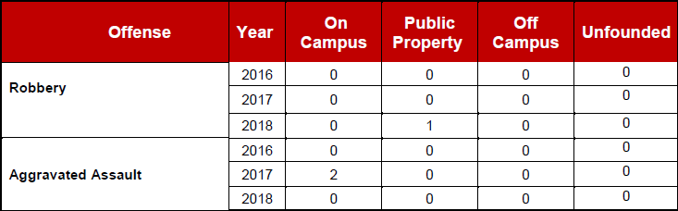
Tables - Is this table 508 compliant?
  Yes
  No, it uses merged cells.
  No, it uses nested tables that should be split into multiple tables?
  No, it uses both merged cells and nested tables.

Slide 36
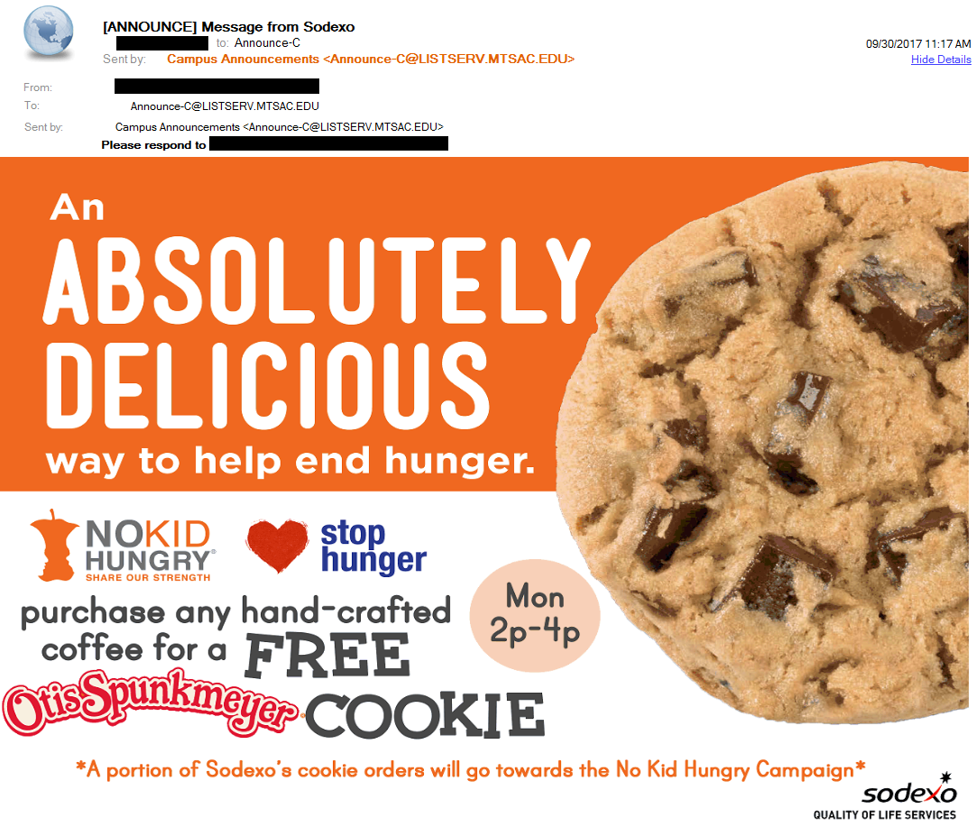
Is this a good email?
Yes
No
Maybe

Slide 37
My Email is Required to be Accessible if
  I am sending to all employees
  I am only sending to a small group, all of whom I know
  I am only sending to one other person
  My email contains a survey
  My email contains educational or training material

