Slide 1
Hands-On Website and Accessibility Preparation Training
Presented by: Rick Nguyen and Matt Bidart

Slide 2

Recap
What is accessibility?
  refers to the design of products, devices, services, or environments for people who experience disabilities

Slide 3
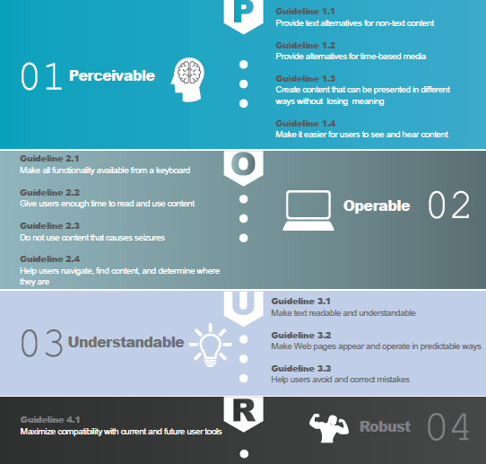
What are the Web Content Accessibility Guidelines (WCAG)?
Refer to your handouts
  1. Perceivable
  2. Operable
  3. Understandable
  4. Robust

Slide 4
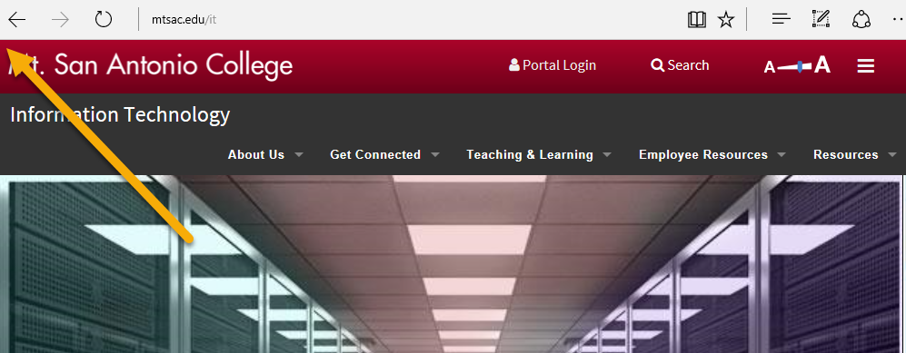
Let’s begin!
Navigate to your department page and login into OU

Slide 5
1. Open up another tab and navigate to mtsac.edu/accessibility
2. Under Resources click on “Accessibility Checklist”
3. Keep this page open as we go through numbers 1-9 on your handout

Slide 6
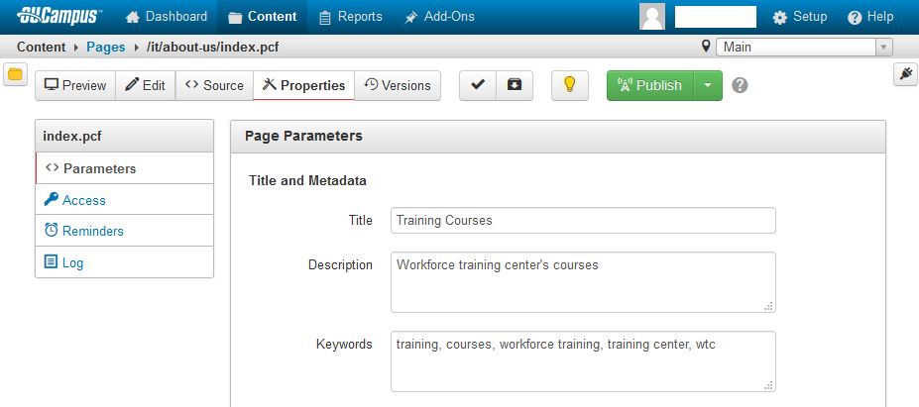
1. Make sure you have a descriptive page title
Navigate to your page within OmniUpdate
Check Out the page
Click Properties
Review and update your page Title, Description, and Keywords

Slide 7

2. Run an accessibility scan on your page
Make sure your page is checked out
Click the Page Check button
Click the Accessibility button

Slide 8
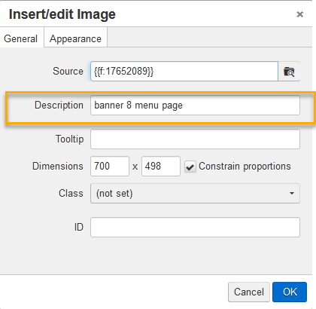
3. Check images for meaningful Alternate Text
Make sure your pages is checked out
Click the Edit button for regions with images
Click the image to select it
Click the Insert/Edit button
Edit/Update the image Description

Slide 9
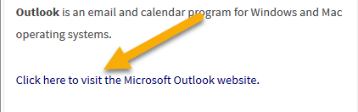
4. Check links
Make sure links clearly show where they go. Test links to make sure they go to the desired place.

Slide 10

5. Check videos for captions
Click the CC button to confirm captions.

Slide 11
6. Check page navigation
Can you use the tab key to navigate around your page?
Is that navigation logical?

