Slide 1


Mt. SAC 2035 Overview

Slide 2

Context
Since completion of Mt. SAC’s 2018 Education & Facilities Master Plan, significant, transformative shifts have occurred in higher education that necessitate a re-evaluation of the campus’s highest level integrated planning document and the processes it informs.
Vision 2030
DEISA+
Healing Centered Engagement
From Mt. SAC IEC Report to PAC 5/1/24

Slide 3

















Integrated Planning At-a-Glance
Mt. SAC 2035 will serve as the foundation for integrated planning processes and cycles of continuous quality improvement. It is accomplished through Mt. SAC’s participatory governance, implementation of focused plans, and the work of College units.
Vision
The College aspiration for the future
Mission
The College purpose
Core Values
Enduring beliefs and principles that individuals of the College hold in common and endeavor to put into action
The foundation of integrated planning. Gives direction to accomplish the Mission and means to assess progress toward that goal
Focused Plans
Guide specialized work of the College in alignment with the EFCP
Elements of student achievement used to evaluate how well the College is fulfilling the Mission
ISS
Program Review
Planning process used to assess unit progress in support of student learning and the mission

Slide 4
Focus for the Comprehensive Plan
Existing Plans (Strategic & Facilities)
Decision- Making
Tool to Guide Prioritization of and use of resources for College Work
DEISA+ Lens
Institutional Goals with Instructional, Programmatic Priorities & Comprehensive Student Services
Facilities Guiding Principles
Facilities Prioritization Rubric
Data Analysis
Constituent Engagement

Slide 5
Mt. SAC 2035 Task Force
President’s Advisory Council convened the Mt. SAC 2035 Task Force with the charge to, guide and support the research, review, and development of the Educational and Facilities Comprehensive Plan, with a recommendation to the Board no later than June 25, 2025.
The Mt. SAC 2035 Task Force includes 30 members with broad-based representation:
Students
Faculty
Classified Professionals
Managers
Participatory Governance Leadership

Slide 6

Mt. SAC 2035 Task Force
Develop the Comprehensive Integrated Plan, Mt. SAC 2035, utilizing Mt. SAC Mission, Vision and Values, Vision 2030, DEISA+, and healing centered engagement as the foundation, with alignment noted throughout.
Utilize a comprehensive plan development schedule, using four phases of equity-minded planning, and ensure that Mt. SAC 2035 can be presented to the Board for approval no later than June 25, 2025.
Validate and recommend incorporation of applicable elements of the 2022-2025 Strategic Plan.
Collaborate with the IEC to include integrated planning elements and identify governance committees and college units responsible for implementing plan activities.
Recommend methodologies and tools to be utilized for regular evaluation of progress toward realization of the comprehensive plan.
Review and recommend revisions as needed to BP3250 and AP3250.
Document lessons learned and recommendations for future planning task forces.

Slide 7

EQUITY BY DESIGN
&
HEALING-CENTERED

Slide 8
Defining Equity and Equity-Mindedness
DEFINING STUDENT EQUITY
Equity means Mt. SAC provides every student with a college experience that gives them the conditions to develop their full academic and social potential.
PRINCIPLES FOR A PLANNING PROCESS TO QUALIFY AS EQUITY-MINDED
Engages historically and currently underrepresented students where they are, empowering them with identifying problems, imagining futures, and making decisions.
Actively confronts inequities present in student experiences and outcomes, policy and practices, and neighborhoods.
DEFINING STUDENT INEQUITY
Inequity means student groups are significantly more likely have adverse experiences and outcomes based on racial, cultural, economic, and social factors, including less funding and learning environments that are less innovative and culturally unresponsive.

Slide 9
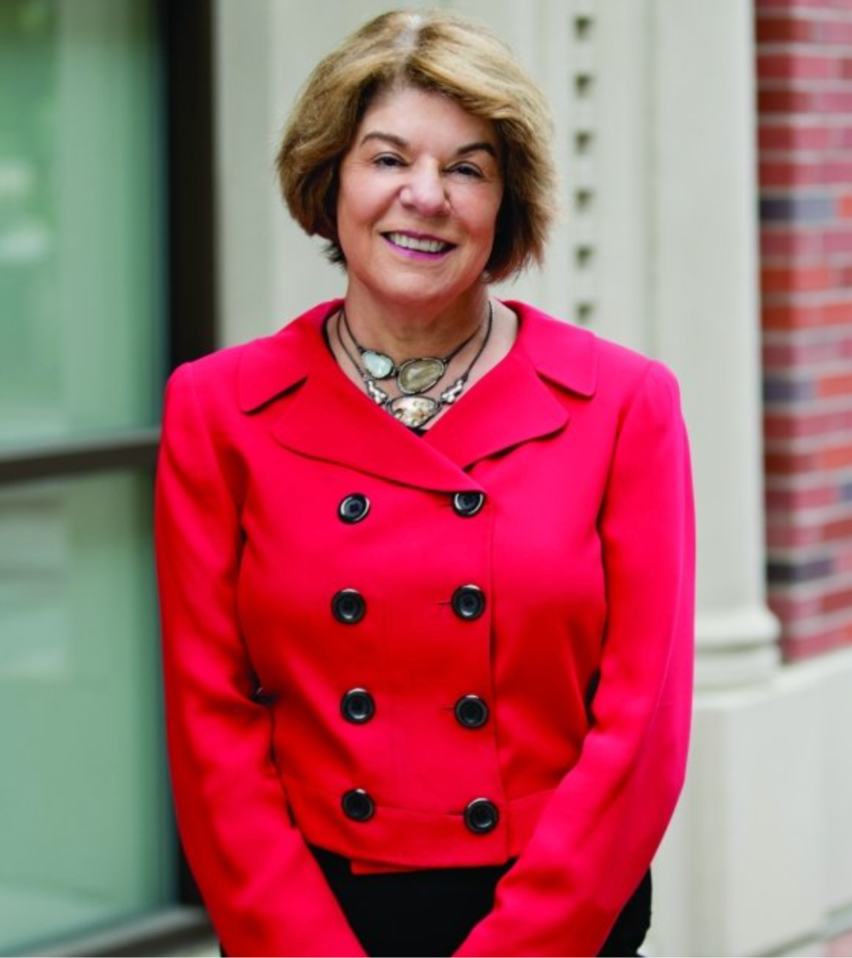
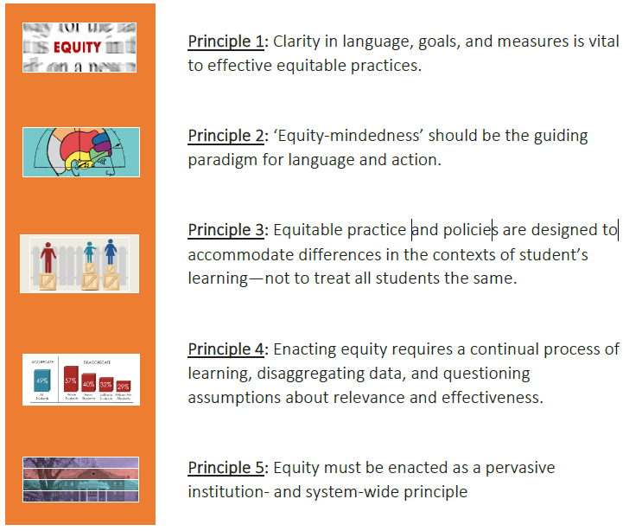
Equity By Design Principles
Developed by Dr. Estela Bensimon

Slide 10
Healing-Centered Principles
DEFINING HEALING-CENTERED
Healing Centered Engagement is an asset-based and culturally-rooted approach to healing and well-being for people of color.
The term was coined by Dr. Shawn Ginwright in 2018, and is based on more than 30 years of research and practice.
PRINCIPLES FOR A PLANNING PROCESS TO QUALIFY AS HEALING-CENTERED
Healing-centered planning recognizes the assets of students from disproportionately impacted groups and prioritizes their success in institutional goal-setting and decision-making

Slide 11
Equity by Design and Healing-Centered Planning
Prioritizes the success of students from disproportionately impacted groups in institutional goal-setting and decision-making (e.g., planning, resource allocation, program development, hiring)
Designs programs and spaces that contribute to students’ sense of belonging, validation, engagement, receptivity, and success (e.g., course success, persistence, completion).
Eliminates institutional policies, embedded practices, and systemic barriers that have enabled inequity to exist and persist.

Slide 12




Traditional vs. Equity-Minded Healing-Centered Planning
 | Traditional Master Plan | Mt. SAC 2035
Focus | Institutional with a facilities emphasis | Student- and community- centered with instructional and support services emphasis
Process | Hierarchical, centers the institutional perspective | Inclusive, broad, diverse, centers the student voice
Data | Program vitality and future program growth (e.g. FTES, efficiency) | Qualitative and Quantitative (e.g. student success, FTES, room utilization, student experiences)
Integration | Linkages fragile | Embedded in Program Review
Implementation | Not addressed or limited to facilities | Clear, aligned with planning and resource allocation
Impact | Limited buy-in, commitment, accountability | Broad ownership, commitment, accountability
Notes:
Lianne

Slide 13
The Four Phases of Equity-Minded Healing-Centered Planning
Listen
Uncover
Design
Decide
Listen to understand what is and is not working well for historically underserved students.
Decisions are informed by diverse people and perspectives.
Uncover the underlying conditions of inequities in student experiences and outcomes.
Decisions address predictable and systemic harm to students from underserved communities.
Co-design the plan to serve students’ needs and aspirations.
Decide how to deliver the plan within the available resources.
Decisions directly address underlying conditions and are based on supporting evidence.
Decision-makers commit to actively disrupting harm and are held accountable for outcomes.
Providing students with decision-making power throughout the process.

Slide 14
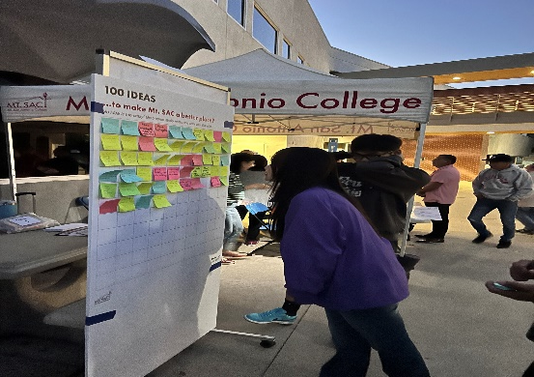
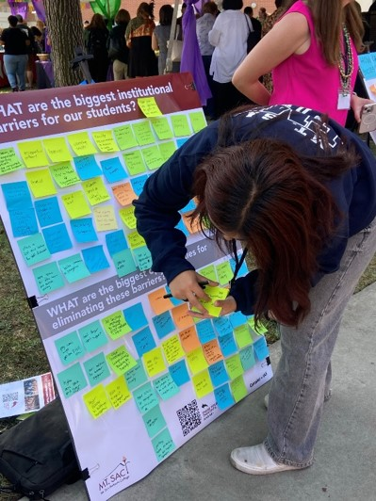
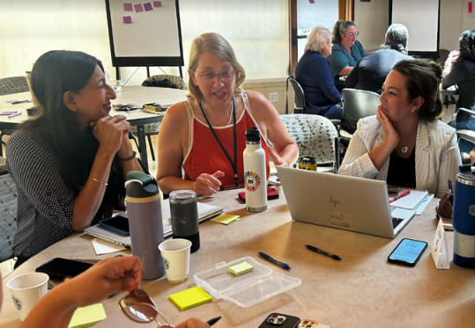
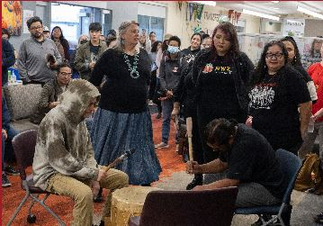
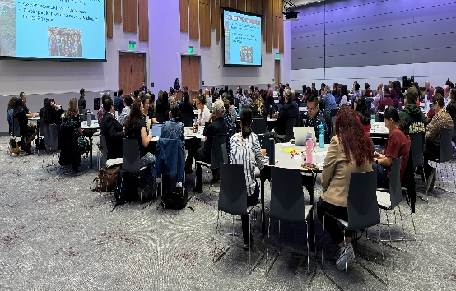
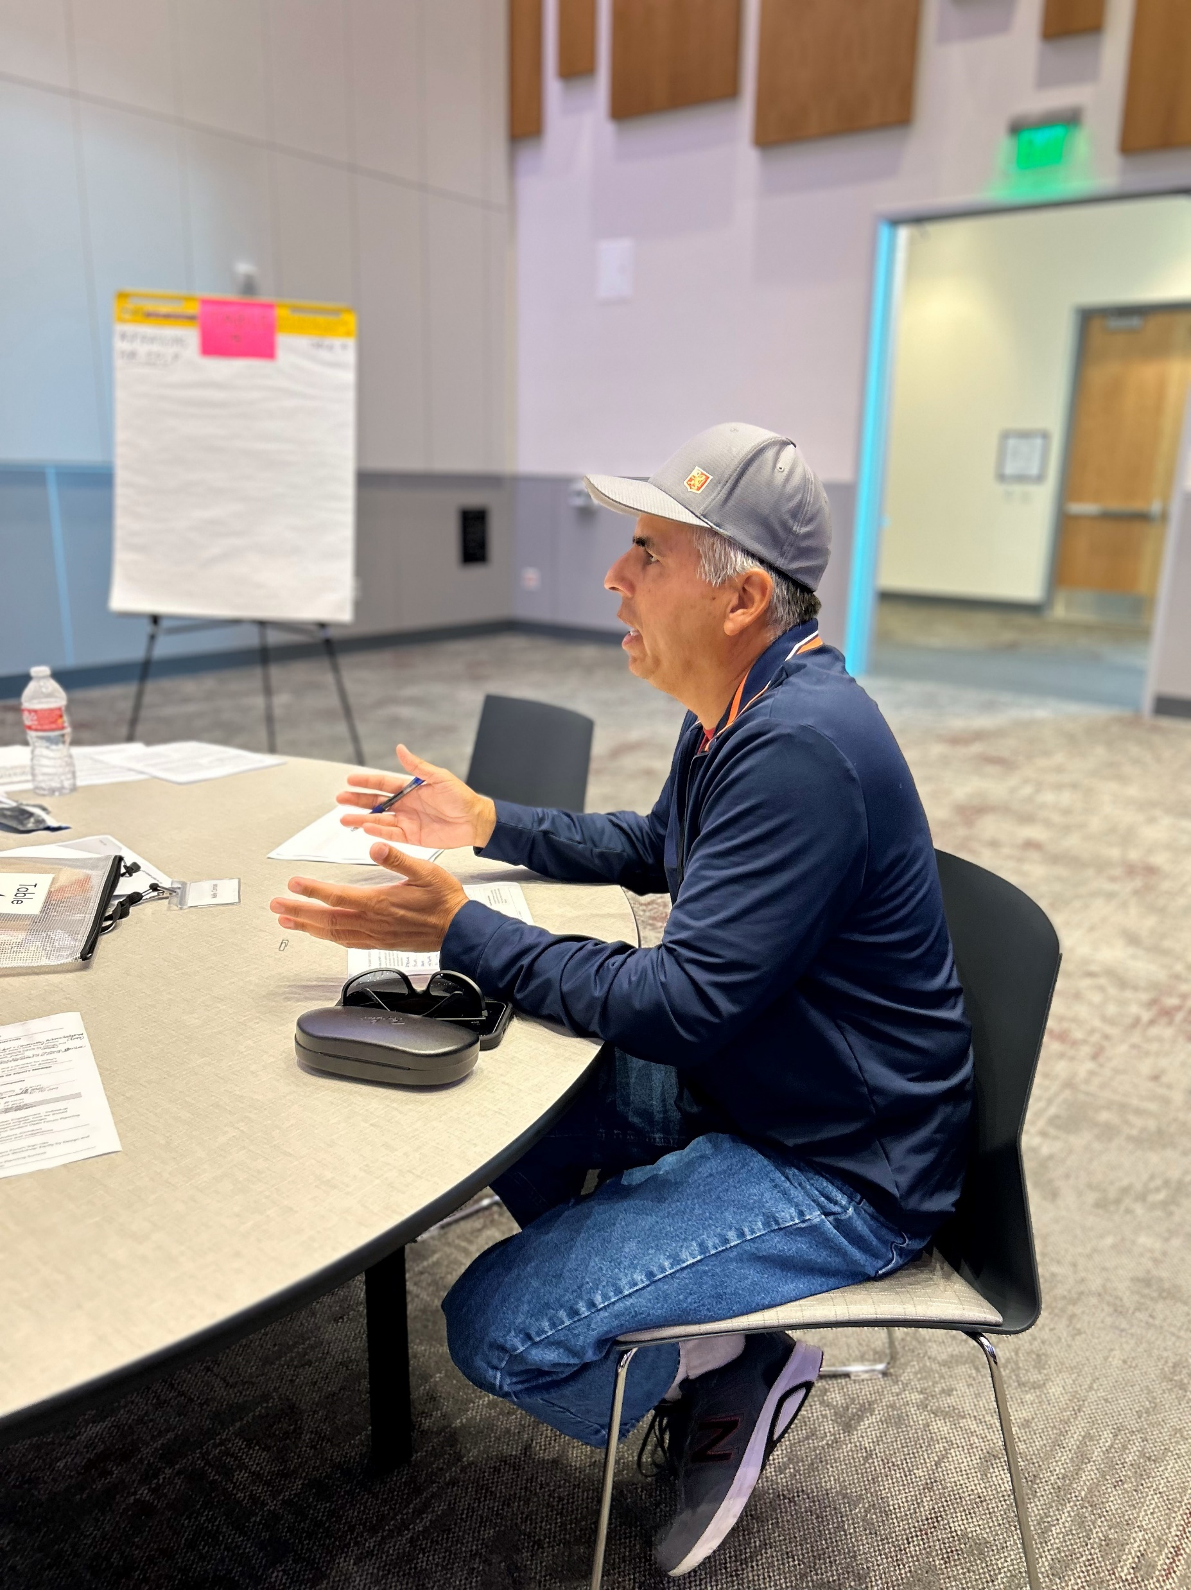
Engagement Activities Thus Far
Welcome Back Luncheon Listening Session
(August)
Task Force Workshops
(August, September, October)
Student Listening Sessions
(October)
Focused Student Forum
(September)
Joint Planning Summit
(October)
Faculty & Staff Listening Sessions (November)

Slide 15

OUTCOMES

Slide 16
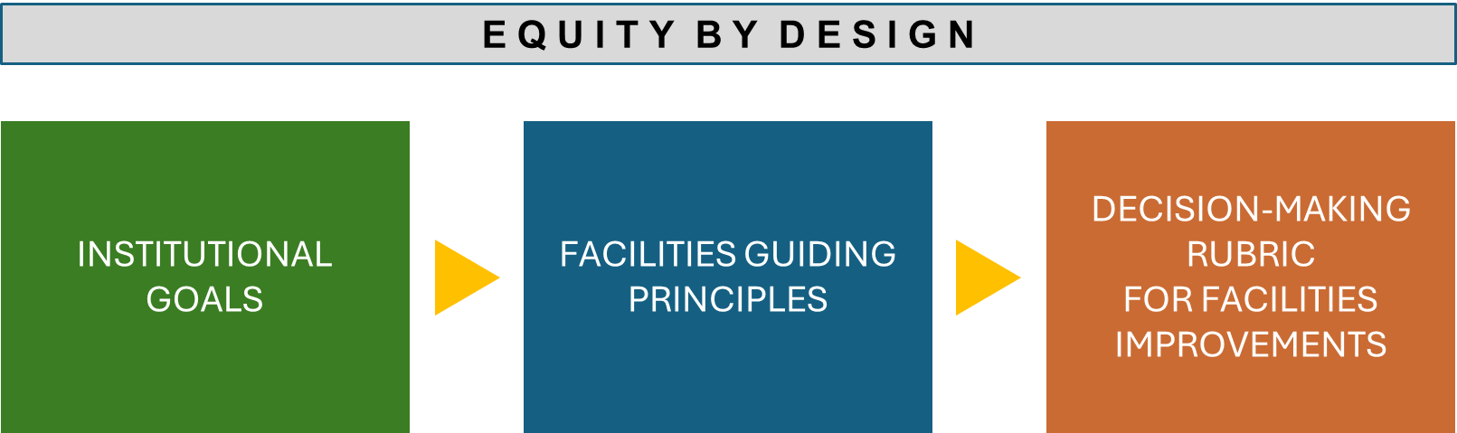
Mt. SAC 2035 Final Result: PLANNING FRAMEWORK
Decision- Making Tool
to Guide Prioritization of and use of resources for College Work

Slide 17

Opportunities for Additional Insight
The Four Pivots
by Shawn A Ginwright
Five Principles for Enacting Equity by Design
by Estela Mara Bensimon, Alicia C. Dowd, and Keith Witham

