Slide 1

Results from Fall Faculty and Staff Listening Sessions
What is Working Well for Students?
Challenges for Students
Faculty: Student basic needs (housing, childcare, mental health)
SCE Faculty: DEISA efforts (accessibility); Temporary facilities with limited space; Safety
Counselors: Mt. SAC is not yet student-centered: non-traditional students are not receiving enough support
Faculty: Mt. SAC’s robust academic programs and student services
Student Needs
Faculty: Accessible space that is culturally representative & communal; Updated classroom technology
SCE Faculty: Permanent facilities; On-campus transportation; Seating areas for students
Counselors: Spaces for students’ specific needs; Improved support; Technology
SCE Faculty: The many student-focused programs
Counselors: Multiple courses and programs supported by dedicated faculty
16 Sessions
109 Participants

Slide 2
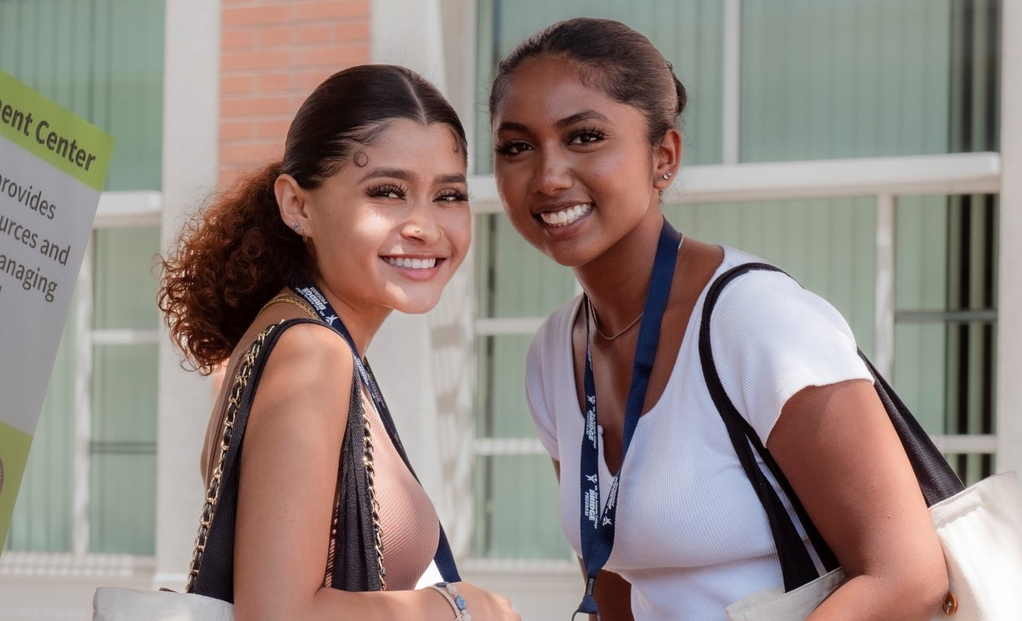
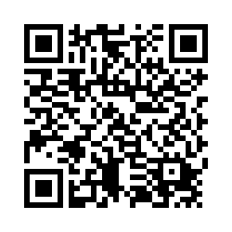
Mt. SAC 2035 Priorities Survey
WHAT MATTERS MOST TO YOU?
Tell us your priorities for the future of Mt. SAC
Notes:
We have listened to over 200 students, over 100 employees, and surveyed over 1000 students about what's working and what's not at Mt. SAC.
Now we want to know what matters most to you.
Survey Link: https://mtsac.co1.qualtrics.com/jfe/form/SV_6r5znuYOUP9d7iS

