Slide 1


Spring 2025
Joint Planning Summit
March 21, 2025

Slide 2
WELCOME
Dr. Martha Garcia
Notes:
Dr. Garcia

Slide 3
Land Acknowledgement
We at Mt. San Antonio College acknowledge that the land which we occupy is unceded ancestral territory of the Gabrielino-Tongva people, Indigenous to this region for thousands of years.
We recognize the Gabrielino-Tongva people have suffered an immense loss of their people, culture, lands, water, and other natural resources due to the theft, murder, kidnapping, and enslavement. These injustices started with colonization, and most Indigenous people consider colonization a current and ongoing process.
The Gabrielino-Tongva view this land as a source of healing, nourishment, and protection.
As students, faculty, staff, and alumni of Mt. San Antonio College, we honor the Gabrielino-Tongva by acknowledging their legacy and current lived experiences.
We recognize this land acknowledgement as an opportunity for Mt. SAC to advocate for Indigenous students through support of the First Peoples Native Center and continued learning and shared knowledge for Native American and Indigenous peoples.
SOURCE: Mt. SAC Associated Students Labor Acknowledgement
Notes:
Primavera & Tash

Slide 4
Life and Labor Acknowledgement
As all of our liberations are tied together, and so is our history, we also acknowledge that this country was built up from the free, enslaved labor of Black people, and we honor the legacy of the African diaspora. We pay respects to Black life, knowledge and skills stolen due to violence and White supremacy.
We also share grief, hold space, and stand in solidarity with our Asian Pacific Islander Desi American (AAPIDA) and LGBTQ+ communities. We condemn not only repeated acts of violence endured by vulnerable members of intersecting communities and the pervasive discrimination and stereotyping that attacked one’s humanity.
We shall not forget the oppression faced by Black, Indigenous, and People of Colors (BIPOC) and individuals who face multifaceted threats to their existence based on gender identity, sexual orientation, or religious affiliations. With this Land, Labor, and Community acknowledgement, we also recognize a duty to give honor through our work and continue to stand up for racial and social justice every day. Please join us in a moment of silence and a collective breath.
SOURCE: Mt. SAC Associated Students Labor Acknowledgement
Notes:
Primavera & Tash

Slide 5
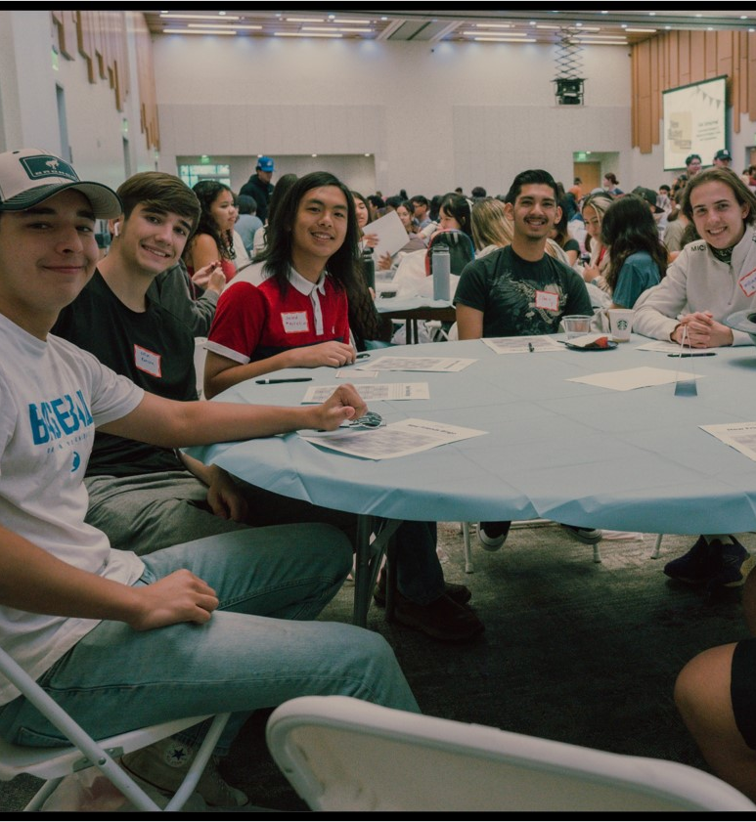
TABLE ACTIVITY
Notes:
David

Slide 6

Purpose of an Educational and Facilities Comprehensive Plan
To ensure that the College will continue to meet its mission by answering two questions:
How will our communities change in the next 10 years?
How can our programs, services, and facilities prepare to meet these changes?
Notes:
Lianne

Slide 7

















Mt. SAC Integrated Planning
Mt. SAC 2035 will serve as the foundation for integrated planning processes and cycles of continuous quality improvement. It is accomplished through Mt. SAC’s participatory governance, implementation of focused plans, and the work of College units.
Vision
The College aspiration for the future
Mission
The College purpose
Core Values
Enduring beliefs and principles that individuals of the College hold in common and endeavor to put into action
The foundation of integrated planning. Gives direction to accomplish the Mission and means to assess progress toward that goal
Focused Plans
Guide specialized work of the College in alignment with Mt. SAC 2035
Elements of student achievement used to evaluate how well the College is fulfilling the Mission
ISS
Program Review
Planning process used to assess unit progress in support of student learning and the mission
Notes:
Lianne

Slide 8
Overview: Plan Approach
Mission-Aligned
Vision 2030 Aligned
Direction and Flexibility
Measurable Outcomes
Foundation for Implementation and Accountability
Comprehensive & Holistic
Notes:
Lianne

Slide 9

EQUITY-MINDED
&
HEALING-CENTERED
Notes:
Tania
shift from a facilities focus, to a lens of starting with students

Slide 10

Our Common Purpose: Equitable Student Success
Chancellors Office
“We want to reaffirm that California’s community colleges remain steadfast in our mission: every student belongs here, and their privacy and well-being are our priority.”
ASCCC President’s March Update
“It is imperative that we all work to welcome and support students in our teaching, counseling, library, and campus spaces, continue work to use culturally affirming practices, and acknowledge historical and lived experiences of diverse populations.”
Notes:
Tania

Slide 11
Defining Equity and Equity-Minded Planning Principles
DEFINING STUDENT EQUITY
Equity means Mt. SAC provides every student with a college experience that gives them the conditions to develop their full academic and social potential.
PRINCIPLES FOR A PLANNING PROCESS TO QUALIFY AS EQUITY-MINDED
Engages historically and currently underrepresented students where they are, empowering them with identifying problems, imagining futures, and making decisions.
Actively confronts inequities present in student experiences and outcomes, policy and practices, and neighborhoods.
DEFINING STUDENT INEQUITY
Inequity means student groups are significantly more likely have adverse experiences and outcomes based on racial, cultural, economic, and social factors, including less funding and learning environments that are less innovative and culturally unresponsive.
Notes:
Tania

Slide 12
Defining Healing-Centered Principles
DEFINING HEALING-CENTERED
Healing Centered Engagement is an asset-based and culturally-rooted approach to healing and well-being for people of color.
The term was coined by Dr. Shawn Ginwright in 2018, and is based on more than 30 years of research and practice.
PRINCIPLES FOR A PLANNING PROCESS TO QUALIFY AS HEALING-CENTERED
Healing-centered planning recognizes the assets of students from disproportionately impacted groups and prioritizes their success in institutional goal-setting and decision-making
Notes:
Tania

Slide 13
Equity-Minded and Healing-Centered Planning
Prioritizes the success of students from disproportionately impacted groups in institutional goal-setting and decision-making
Designs programs and spaces that contribute to students’ sense of belonging, validation, engagement, receptivity, and success
Eliminates institutional policies, embedded practices, and systemic barriers that have enabled inequity to exist and persist.
Notes:
Tania

Slide 14

PROCESS AND TIMELINE
Notes:
Yvette

Slide 15
Phases of Equity-Minded Healing-Centered Planning
Listen
Uncover
Design
Decide
Listen to understand what is and is not working well for historically underserved students.
Decisions are informed by diverse people and perspectives.
Uncover the underlying conditions of inequities in student experiences and outcomes.
Decisions address predictable and systemic harm to students from underserved communities.
Co-design the plan to serve students’ needs and aspirations.
Decide how to deliver the plan within the available resources.
Decisions directly address underlying conditions and are based on supporting evidence.
Decision-makers commit to actively disrupting harm and are held accountable for outcomes.
Providing students with decision-making power throughout the process.
Notes:
Yvette
We are in Design Phase

Slide 16

Layered, Equity-Minded Approach
Campus Sessions
Community
Sessions
LISTEN: Qualitative
Student
Listening
Sessions
Conditions
for
Success Survey
Campus Open-Engagement Sessions
Student Listening Sessions
Faculty, Staff, & Management Listening Sessions
Trustee Engagement Session
Conditions for Success Survey: Employees & Students
Community Listening Sessions
Trustee
Engagement
Employee
Listening
Sessions
LISTEN: Qualitative
Notes:
Yvette
Thank RIE – ask to stand and be recognized for their expertise and support. They have been an important partner in this data-driven process
7 weeks worth of qualitative data team analysis between RIE and our partners

Slide 17
Layered, Equity-Minded Approach
UNCOVER: Qualitative + Quantitative
Student Bridging Session
External: census, labor market
College Success Metrics
Student Bridging Session
Facilities
  Building Age
  Facility Condition Index
  Space Inventory
  Room Utilization
External Regional Data
Facilities Data
College Success Metrics
UNCOVER: Qualitative + Quantitative
Campus Sessions
Community
Sessions
LISTEN: Qualitative
Student
Listening
Sessions
Conditions
for
Success Survey
Campus Open-Engagement Sessions
Student Listening Sessions
Faculty, Staff, & Management Listening Sessions
Trustee Engagement Session
Conditions for Success Survey: Employees & Students
Community Sessions
Trustee
Engagement
Employee
Listening
Sessions
LISTEN: Qualitative
Notes:
Yvette
Qualitative and quantitative data analysis during this time

Slide 18
Layered, Equity-Minded Approach
DESIGN: Qualitative + Quantitative
Strategic
Priorities
Survey
Joint Planning:
Areas of Focus
Priority Goals
Strategic Priorities Survey (Employees and Students)
Spring Joint Planning: Areas of Focus and Priority Goals
DESIGN: Qualitative + Quantitative
UNCOVER: Qualitative + Quantitative
Student Bridging Session
External: census, labor market
College Success Metrics
Student Bridging Session
Facilities
  Building Age
  Facility Condition Index
  Space Inventory
  Room Utilization
External Regional Data
Facilities Data
College Success Metrics
UNCOVER: Qualitative + Quantitative
Campus Sessions
Community
Sessions
LISTEN: Qualitative
Student
Listening
Sessions
Conditions
for
Success Survey
Campus Open-Engagement Sessions
Student Listening Sessions
Faculty, Staff, & Management Listening Sessions
Trustee Engagement Session
Conditions for Success Survey: Employees & Students
Community Sessions
Trustee
Engagement
Employee
Listening
Sessions
LISTEN: Qualitative
Notes:
Yvette
Strategic Priorities Survey closed on 3-10-25 with over 1500 responses from students and employees. That data is currently being analyzed, results are not shared here today.

Slide 19

Layered, Equity-Minded Approach
DECIDE:
Institutional Goals & Commitments, Facilities Decision- making Rubric
DESIGN: Qualitative + Quantitative
Strategic
Priorities
Survey
Joint Planning:
Areas of Focus
Priority Goals
Strategic Priorities Survey (Employees and Students)
Spring Joint Planning: Areas of Focus and Priority Goals
DESIGN: Qualitative + Quantitative
UNCOVER: Qualitative + Quantitative
Student Bridging Session
External: census, labor market
College Success Metrics
Student Bridging Session
Facilities
  Building Age
  Facility Condition Index
  Space Inventory
  Room Utilization
External Regional Data
Facilities Data
College Success Metrics
UNCOVER: Qualitative + Quantitative
Campus Sessions
Community
Sessions
LISTEN: Qualitative
Student
Listening
Sessions
Conditions
for
Success Survey
Campus Open-Engagement Sessions
Student Listening Sessions
Faculty, Staff, & Management Listening Sessions
Trustee Engagement Session
Conditions for Success Survey: Employees & Students
Community Sessions
Trustee
Engagement
Employee
Listening
Sessions
LISTEN: Qualitative
Notes:
Yvette
Board of Trustees will decide on 6-25-25

Slide 20
Equity By Design Principle
Enacting equity requires a continual process of learning, disaggregating data, and questioning assumptions about relevance and effectiveness.
Notes:
Tania
Data-Driven process, questioning our assumptions

Slide 21
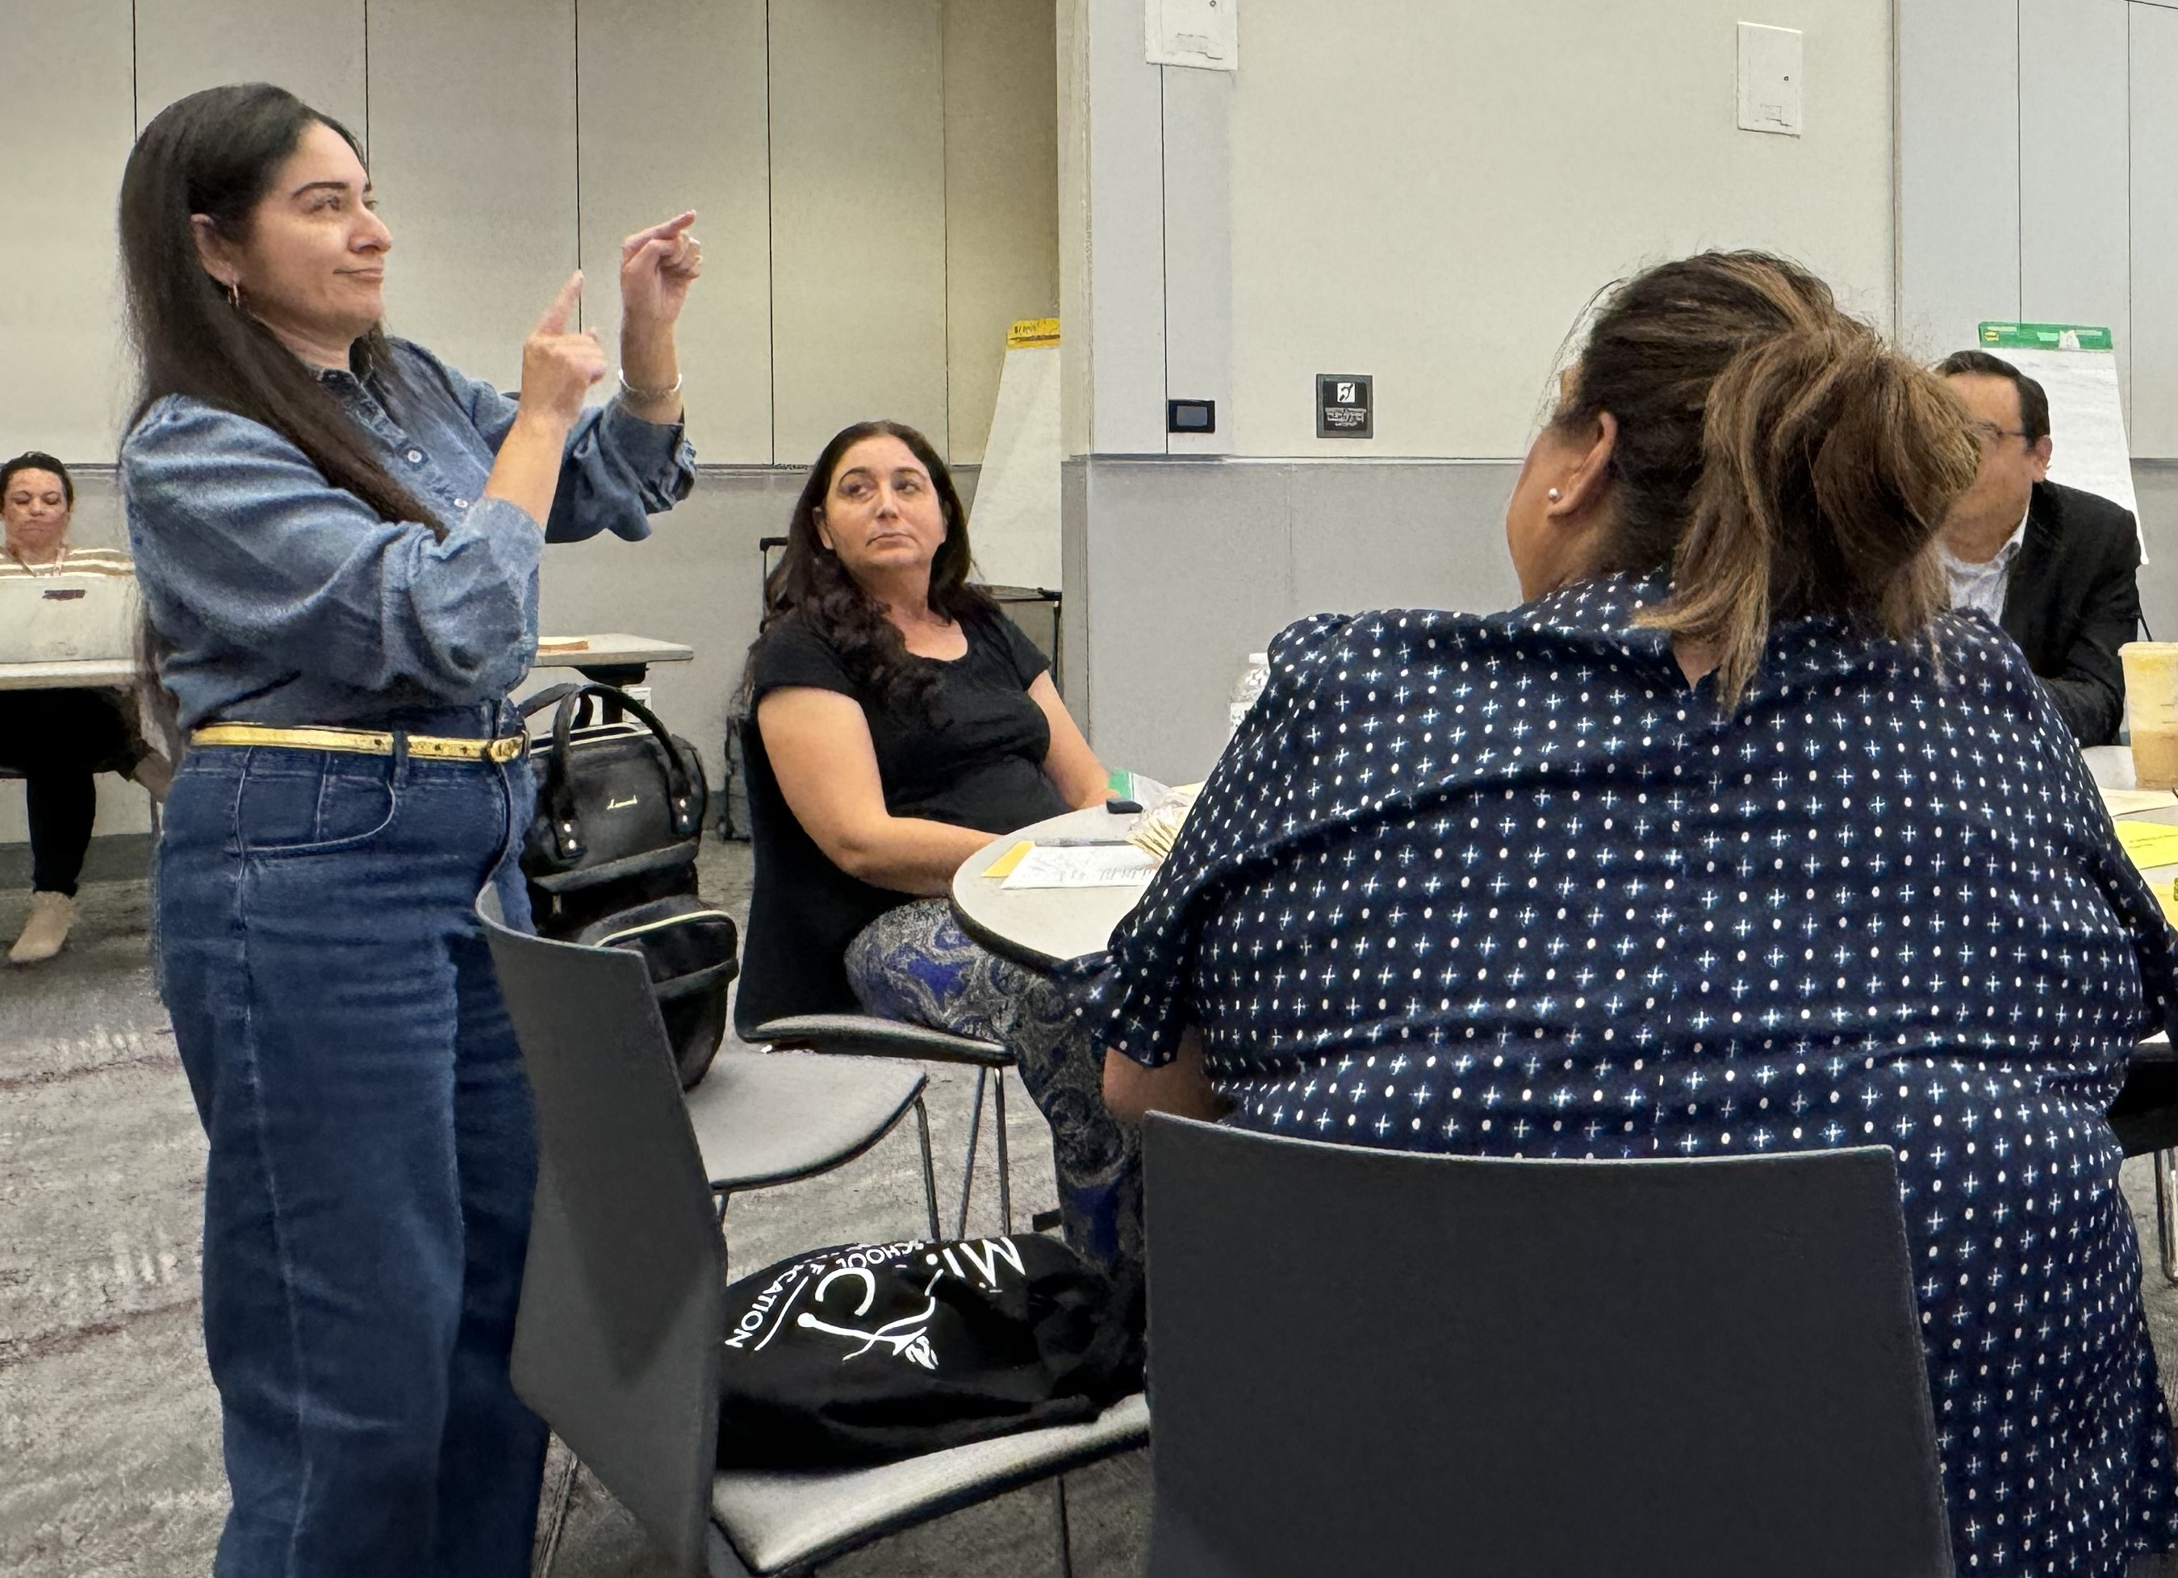
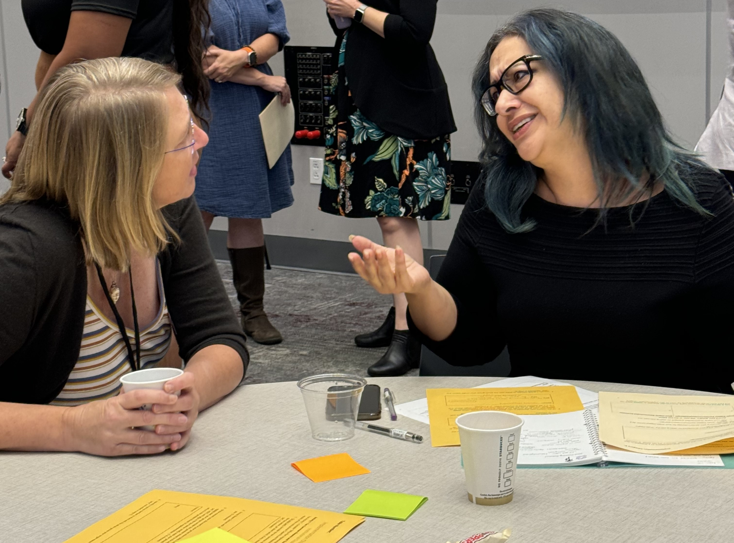
Employee Listening Sessions: Student Needs Themes
16 Sessions
113 Participants
5 Themes
Clear and Efficient Processes
  Simplified systems for enrollment, registration, and personalized assistance.
Effective Communication
  Timely, clear communication to keep students informed and engaged.
Campus Facilities and Safety
  Safe, well-maintained spaces that support students' focus and security.
Tailored Student Support
  Customized services to address diverse student needs (e.g., academic, personal, and financial).
Environments of Safety and Belonging
  Fostering trust, empathy, and inclusivity for student well-being and success.
Notes:
Tania
What we’ve learned

Slide 22
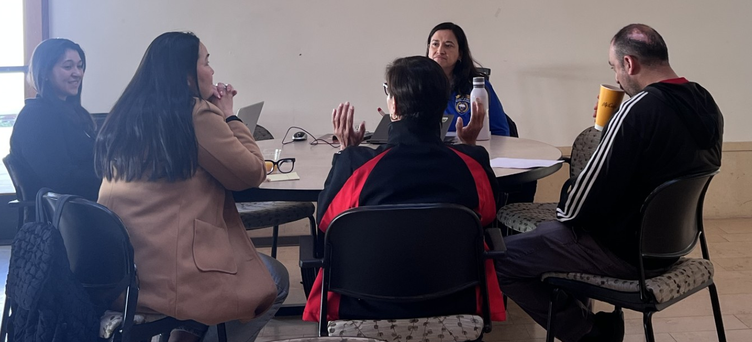
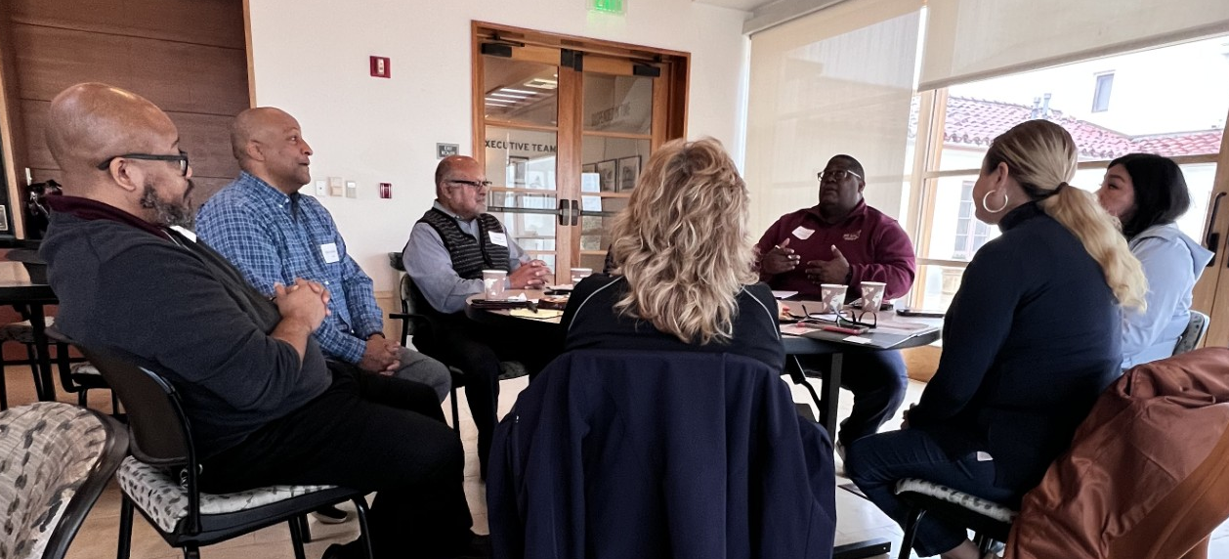
3 Community Listening Sessions
Educational & Parent Partners
Bonita USD
Baldwin Park USD
Cal Poly Pomona
Charter Oak USD
Hacienda La Puente USD
Pomona USD
Rowland USD
Walnut Valley USD
West Covina USD
Workforce Partners
East San Gabriel Valley AJCC-MCS
ISACA
Latino & Latina Roundtable, PJP
Primerica
Regional Chamber of Commerce
Notes:
Tania

Slide 23
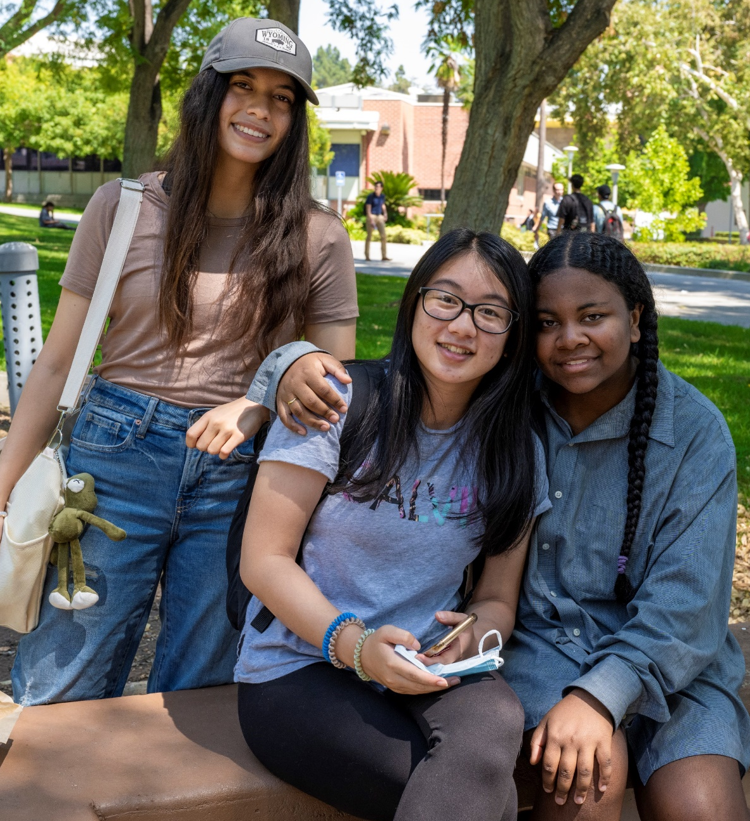
Community Listening Session Themes
Communication
  Clear information on programs, support services, and community resources to improve communication between Mt. SAC and stakeholders.
Career and College Counseling
  Guidance on pathways to workforce certificates, ensuring a clear transition to a career or advanced degree.
Connecting Early
  Connect with students before high school to make their education more meaningful and prepare them for future opportunities.
Collaboration
  Building strong partnerships between schools, families, and the workforce is key to student success and fundamental to community growth.
Notes:
Tania
Alignment with Employee identified student needs

Slide 24
Student Co-Creation in Planning
Listening Sessions
154 Students
20 Affinity Groups
Sensemaking Workshops
30 Task Force Members
40 Anchor Insights
Online Student Survey
1024 Responses
Bridging Workshop 38 Students 8 Conditions for Success
Clear, Easily-Accessible Information
Rigorous and Relevant Learning
Environment of Belongingness and Inclusivity
Physical and Emotional Well-being
Strong Counseling, Customized Personal Support, and Mentorship
Student-Centered Course Scheduling
Supportive Community
Welcoming, Safe, Inclusive Environment
Notes:
Tania
Affinity Groups
Noncredit (ESL, ABE, Short-term Vocational, Older Adults, Adults with Disabilities)
Collegewide (DHH, Rising Scholars, El Centro, ARISE, Pride Center, Basic Needs, Center for Black Culture and Student Success, EOPS, Foster Youth, First Peoples Native Center, ACCESS, , CARE, CalWORKS, Parent Scholars, Student Athletes)
Ask Task Force Members to stand and be recognized
Online student survey in the fall
6 students are here today to tell you more about the Bridging experience

Slide 25
STUDENT PANEL
Notes:
Anton

Slide 26

PLANNING FRAMEWORK
Notes:
Lianne

Slide 27
Layered, Equity-Minded Approach
DESIGN: Qualitative + Quantitative
Strategic
Priorities
Survey
Joint Planning:
Areas of Focus
Priority Goals
Strategic Priorities Survey (Employees and Students)
Spring Joint Planning: Areas of Focus and Priority Goals
DESIGN: Qualitative + Quantitative
UNCOVER: Qualitative + Quantitative
Student Bridging Session
External: census, labor market
College Success Metrics
Student Bridging Session
Facilities
  Building Age
  Facility Condition Index
  Space Inventory
  Room Utilization
External Regional Data
Facilities Data
College Success Metrics
UNCOVER: Qualitative + Quantitative
Campus Sessions
Community
Sessions
LISTEN: Qualitative
Student
Listening
Sessions
Conditions
for
Success Survey
Campus Open-Engagement Sessions
Student Listening Sessions
Faculty, Staff, & Management Listening Sessions
Trustee Engagement Session
Conditions for Success Survey: Employees & Students
Community Sessions
Trustee
Engagement
Employee
Listening
Sessions
LISTEN: Qualitative
Notes:
Lianne

Slide 28
Strategic Priorities Survey Results Overview
General Survey: 530 Responses
SCE Student Survey: 977 Responses
Role at Mt SAC | Number | %
Administrator | 50 | 34%
Classified Professional | 149 | 21%
Confidential Employee | 9 | 60%
Full-time Faculty | 133 | 30%
Other, please specify | 13 | ND
Part-time Faculty | 65 | 7%
Student | 76 | 0.2%
Temporary Employee | 13 | ND
did not indicate | 22 | ND
Largest % Respondents:
By Ethnicity
  Asian 67%
  Hispanic/Latino 20%
By Age
  40-49 30%
  50+ 24%
Respondents by Gender:
  Female 65%
  Male 28%
  Prefer not to say .81%
  Blank 6%
Next Step: Triangulation of other data collected, and inquiries completed.
Notes:
Lianne
We are in the design phase.

Slide 29
Mt. SAC 2035 Planning Framework
Mt. SAC MISSION
CONDITIONS FOR SUCCESS
INSTITUTIONAL GOALS + COMMITMENTS
ACCOMPLISHED THROUGH PLANS AND RESOURCE ALLOCATION
VISION 2030
DECISION-MAKING RUBRIC
GUIDE FOR FACILITIES IMPROVEMENTS
Notes:
Lianne

Slide 30
What this Plan is NOT
NOT tied to specific include initiatives
NOT a list of college programs (e.g., dual enrollment, high school outreach)
NOT specific “tasks” or “activities” to complete (e.g., use the same logos/colors, offer mini-semesters)
NOT details of specific construction projects or furniture/fixtures
NOT a bond spending plan or a 5-year capital outlay plan
NOT a Gap Analysis (Some commitments build on what is working)
Notes:
Lianne

Slide 31

Vision 2030
Socio-economic mobility, closing equity gaps, and expanding access to higher education for underserved students through 3 GOALS:
01
02
03
Equity in Success
Equity in Access
Equity in Support
Ensuring the academic and career success of all students.
Expanding opportunities for all Californians to participate in higher education.
Partnering with systems, agencies,
and community organizations to provide the necessary academic, financial, and social supports.
Notes:
Lianne

Slide 32
Mt. SAC 2035 Planning Framework
Mt. SAC MISSION
CONDITIONS FOR SUCCESS
VISION 2030
Notes:
Lianne

Slide 33



Student Co-Creation in Planning
Bridging Workshop 38 Students 8 Conditions for Success
Clear, Easily-Accessible Information
Rigorous and Relevant Learning
Environment of Belongingness and Inclusivity
Physical and Emotional Well-being
Strong Counseling, Customized Personal Support, and Mentorship
Student-Centered Course Scheduling
Supportive Community
Welcoming, Safe, Inclusive Environment
      Welcoming, Inclusive, Safe, Supportive Environment
      Rigorous and Relevant Teaching & Learning
      Clear, Easily Accessible Information
Notes:
Lianne

Slide 34
Mt. SAC 2035 Planning Framework
Mt. SAC MISSION
CONDITIONS FOR SUCCESS
VISION 2030
      Welcoming, Inclusive, Safe, Supportive Environment
      Rigorous and Relevant Teaching & Learning
      Clear, Easily-Accessible Information
Notes:
Lianne The conditions for success are the fundamental categories that student have told us they need to be successful.

Slide 35
Mt. SAC 2035 Planning Framework
Mt. SAC MISSION
CONDITIONS FOR SUCCESS
INSTITUTIONAL GOALS + COMMITMENTS
ACCOMPLISHED THROUGH PLANS AND RESOURCE ALLOCATION
VISION 2030
Notes:
Lianne

Slide 36
Mt. SAC 2035: Norming Planning Terminology
Goal: A broad, general statement of intended outcomes or results.
(SCUP Integrated Planning Glossary)
Commitment: an agreement or pledge to do something in the future; something pledged; the state or an instance of being obligated
(Merriam Websters)
Notes:
Lianne

Slide 37
BREAK
Notes:
15 Minute book timer with jazz music

Slide 38
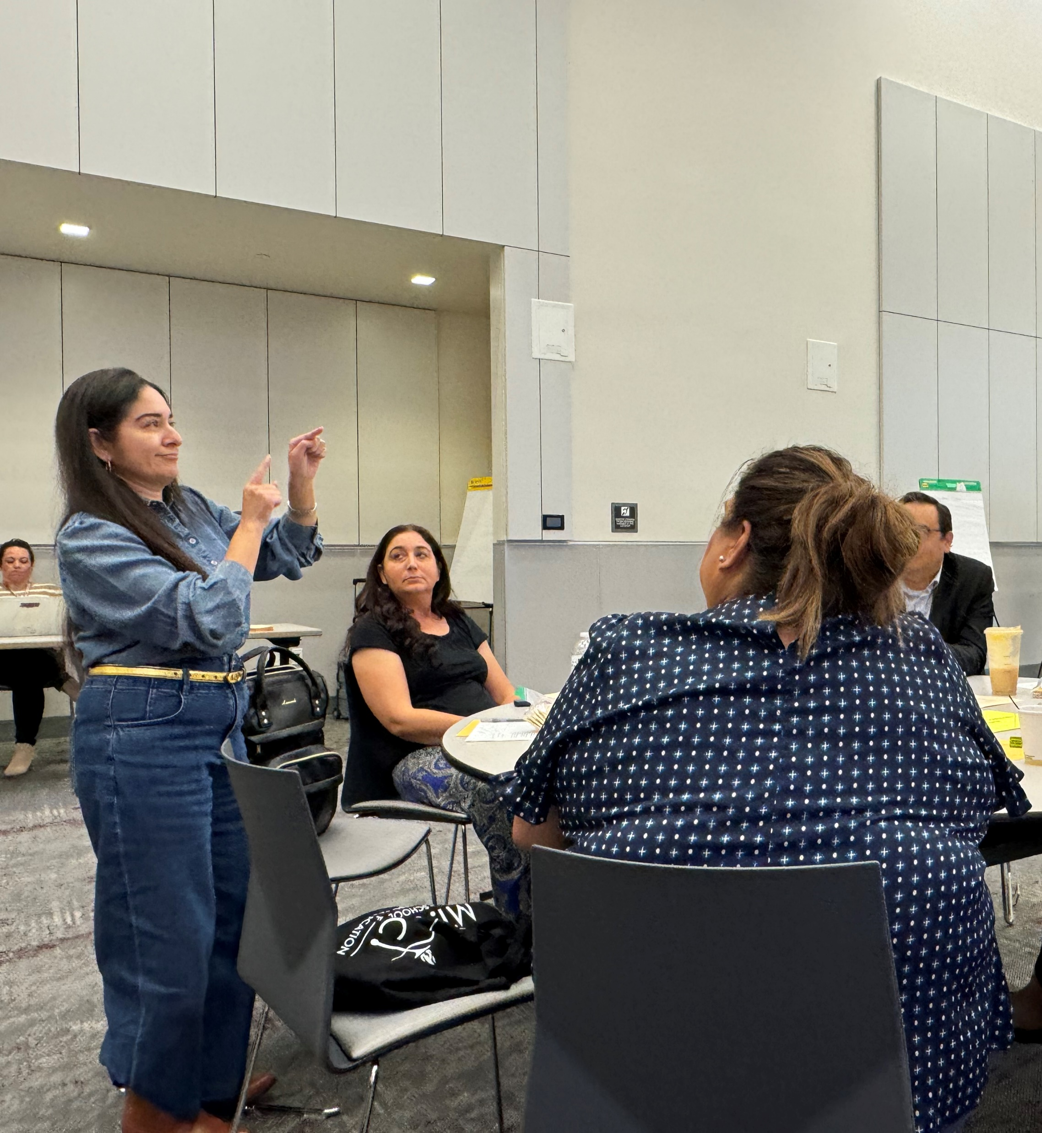
TABLE ACTIVITY

Slide 39

IMPLEMENTATION IN MOTION

Slide 40

Healing-Centered Engagement (HCE) at Mt. SAC
Based on more than 30 years of research and practice
HCE is a strengths-based approach that re-centers culture and identity as a central feature in personal well-being
Will help support Mt. SAC employees in exploring ways to more effectively reach and impact students of color

Slide 41

HCE Timeline
Spring 2025
HCE Certification - 54 Mt. SAC employees from units across the College
Summer 2025
Four Pivots Workshop (Instructional Focus)
Fall 2025
Four Pivots Convening at the Fall 2025 Joint Planning Summit

Slide 42
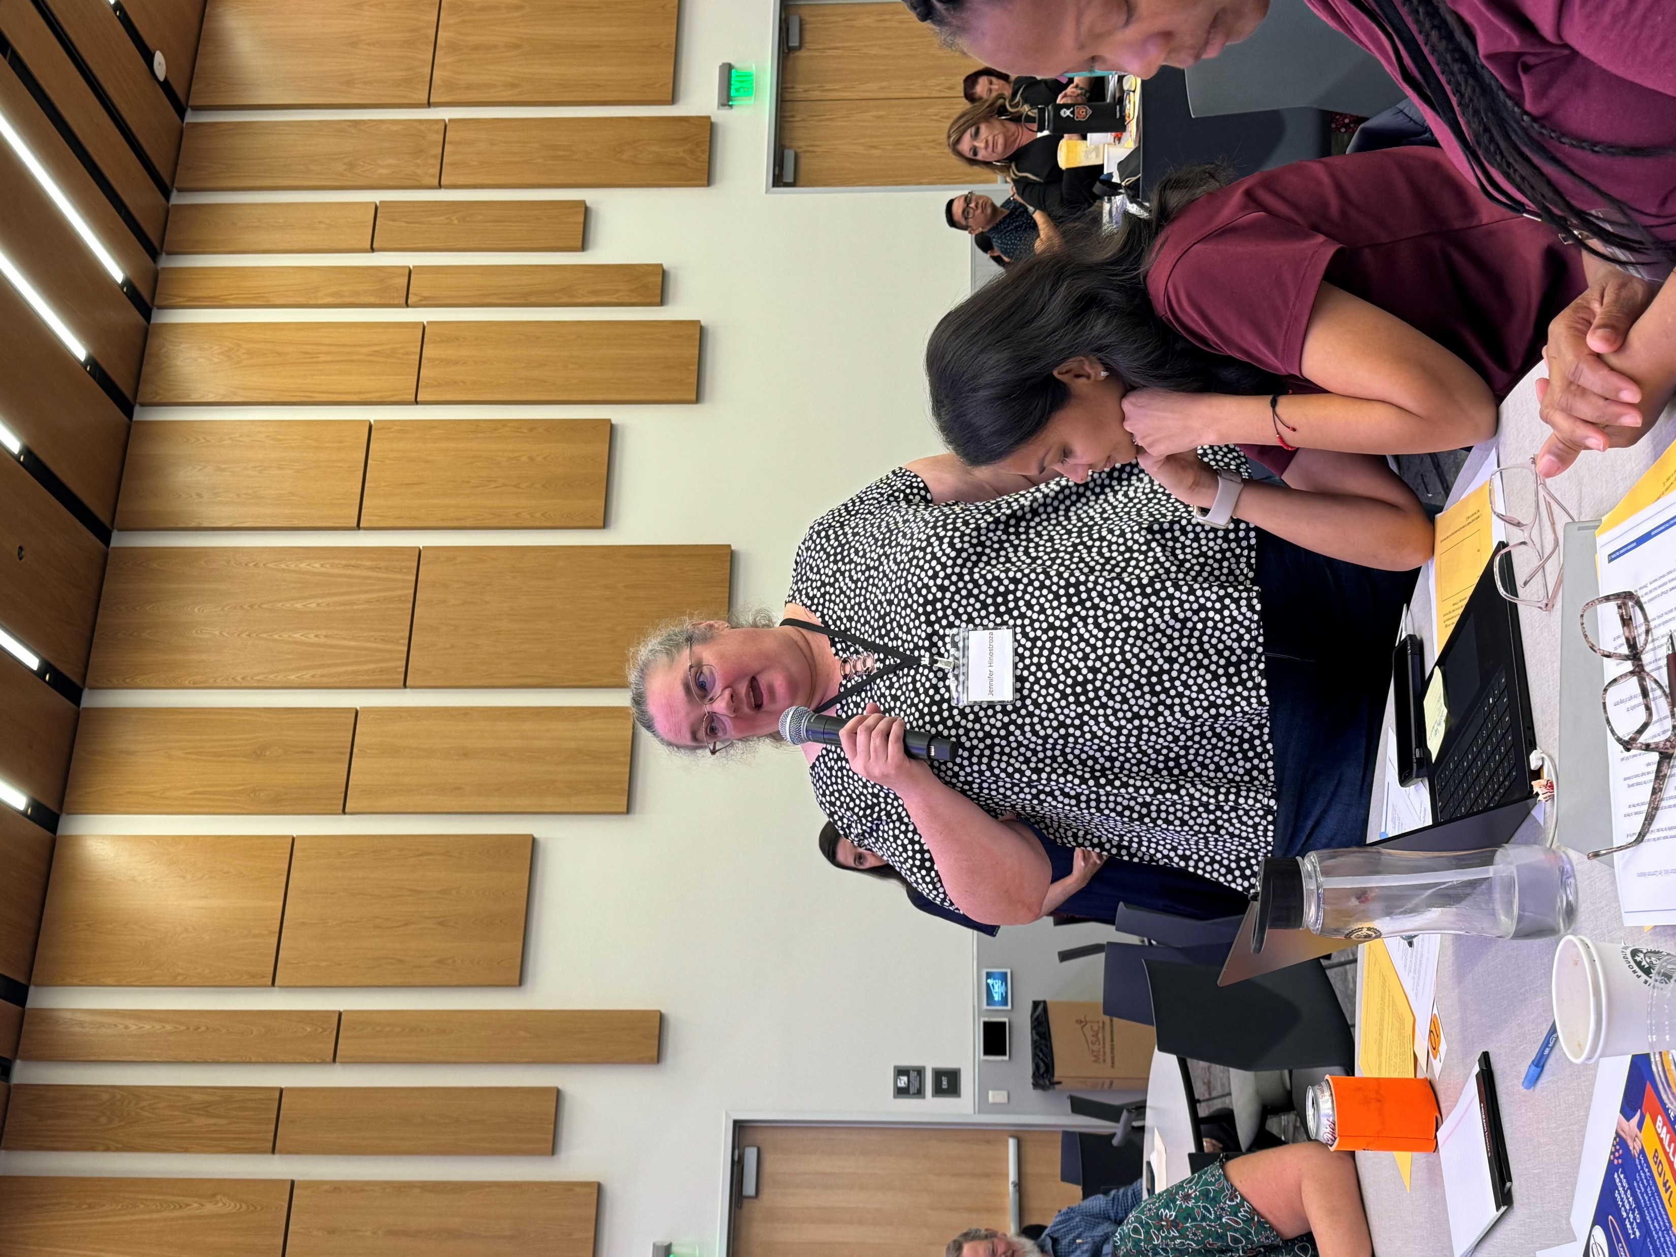
IMPLEMENTATION CHALLENGES & STRATEGIES

Slide 43
Ten Common Reasons & Your Mt. SAC Experience
Ownership: few, if any, have stake in and/or responsibility for plan.
Communication: plan not communicated, so lack of understanding about its importance or how to contribute.
Overwhelming: where to begin?? numerous goals and actions because the College failed to make tough choices around prioritizing.
Meaningless: “fluffy” feel good but unobtainable goals and objectives, or no clear actions, or plan just “checks-the-box.”
Out of the ordinary (separate and apart): disconnected from operations (spins in its own universe).

Slide 44
Ten Common Reasons & Your Mt. SAC Experience
Mired down managers: people with responsibility for implementation are consumed by daily operating problems.
Not considered: Implementation not discussed in the planning process.
Progress reporting: no method to track progress = no momentum.
Accountability: each initiative, goal, objective, activity, measurement, and/or data source must have an owner.
Empowerment: those accountable must also have the authority, responsibility, resources, knowledge, and tools needed.

Slide 45
Fall Joint Planning Session Implementation Activity Results
Need more clear, consistent, inclusive communication to break-down silos and foster understanding of and buy-in for Mt. SAC 2035.
    “Lack of communication prevents knowing what to prioritize.”
    “Control flow of info - small groups have discussions/make decisions and info does not trickle down.”

Slide 46
Fall Joint Planning Session Implementation Activity Results
Need to address time and capacity constraints.
    “There aren't enough people to implement the plan. The same people are working on multiple projects, and they don’t have the human capacity to do it all.”
    “Overwhelming, complicated plans, too many goals, hard to implement.”

Slide 47
Fall Joint Planning Session Implementation Activity Results
Need to address path dependence (i.e., the tendency for the institution to continue a practice even when newer, more effective alternatives become known).
    “Too many 'this is how we've always done it.’”
    “The Mt. SAC way: Some things that I used to be proud of. I am not proud of this anymore = complaints.”
    “We are awesome, perfect. So, we don't need to change.”

Slide 48
Fall Joint Planning Session Implementation Activity Results
Most Highly Recommended Strategies for Implementation
Solicit student insights on plan goals – ask them how things are working and what may be improved.
Provide straightforward, inclusive communications about the plan goals and activities.
Provide professional learning opportunities related to the plan and its implementation.
Promote collaboration around shared goals, on a monthly basis, have all campus groups reflect on and analyze specific themes, particularly progress toward equity, current processes, and strategies for potential improvements.
Explain “What’s in it for me?” to encourage engagement and support for the goals and planned activities.

Slide 49
Critical Implementation Factors
Trust and communication are critical!
Low trust means every detail debated, rumor mill in “high-negative” gear, assumptions (incorrect) abound.
Middle Management
Need to meet on a periodic basis (monthly or quarterly) to focus ONLY on plan implementation – think, problem solve, collaborate, build “relational capital”
Adhocracy
Recruit unofficial leaders/doers –who can be relied upon to get things done –to be leads on high-priority tasks
Small, early wins and “chewable chunks “
Build positive momentum as the wins are celebrated and communicated.
Conversations, not presentations
Provide periodic opportunities for small teams to come together to tackle tough issues/challenges to implementation.
Have doers collaborate regularly with senior leadership to discuss progress, give honest feedback on challenges

Slide 50
Promising Practices
Plan Roll-Out
Plan Communication Plan
Senior Leadership + Middle Managers – discuss the plan + get feedback (e.g., questions, concerns, potential challenges, support they will need to help implement, what they will have to give up in order to focus on implementation tasks (hardest part).
Senior Leadership’s Visible Priority
Plan and actions undertaken are regular agenda items for discussion and problem solving
Quarterly Implementation Review – reports on actions completed, progress, challenges, collaborative solution development.

Slide 51
Promising Practices
Implementation Action Teams
Form small teams to take on high-priority, high-impact tasks (especially for some immediate small wins)
Assign a process owner/team leader to oversee and help problem solve
Assign do-able tasks to each team member, meet for monthly check-ins to identify progress and any challenges.
Delegation Map
Increase capacity for “process owners” with additional implementation responsibilities.
Map for Direct Reports:
Bucket A (essential responsibilities that cannot be off-loaded, @50-65% of responsibilities)
Bucket B (activities that can shift to someone with some coaching and support)
Bucket C (activities that are non-essential, low priority (but often time-consuming) that can be delegated or suspended (or assessed in terms of any ongoing need to continue).

Slide 52
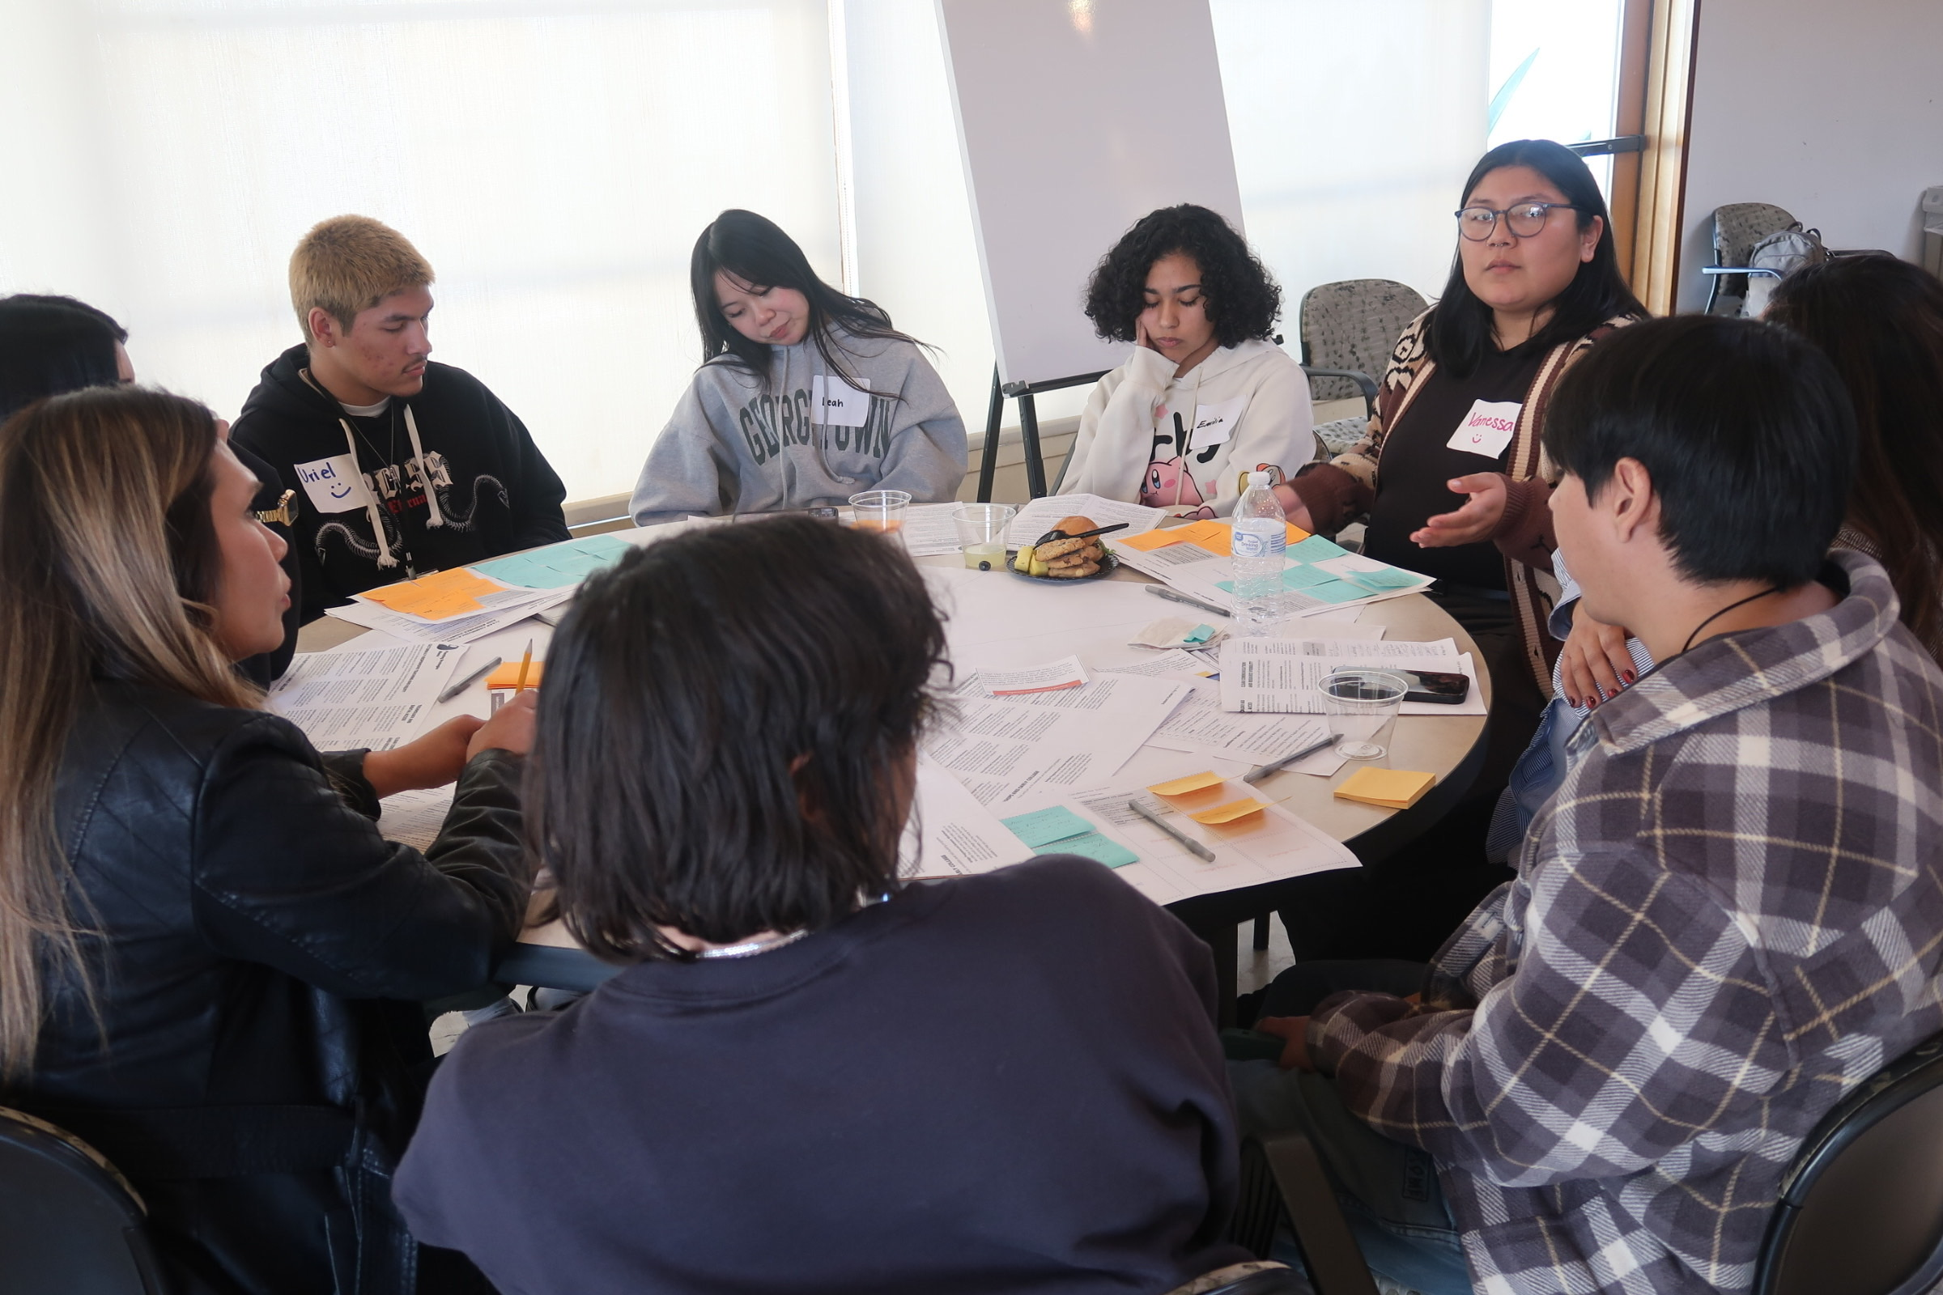
TABLE ACTIVITY & GALLERY WALK

Slide 53
CLOSURE
Dr. Martha Garcia

Slide 54
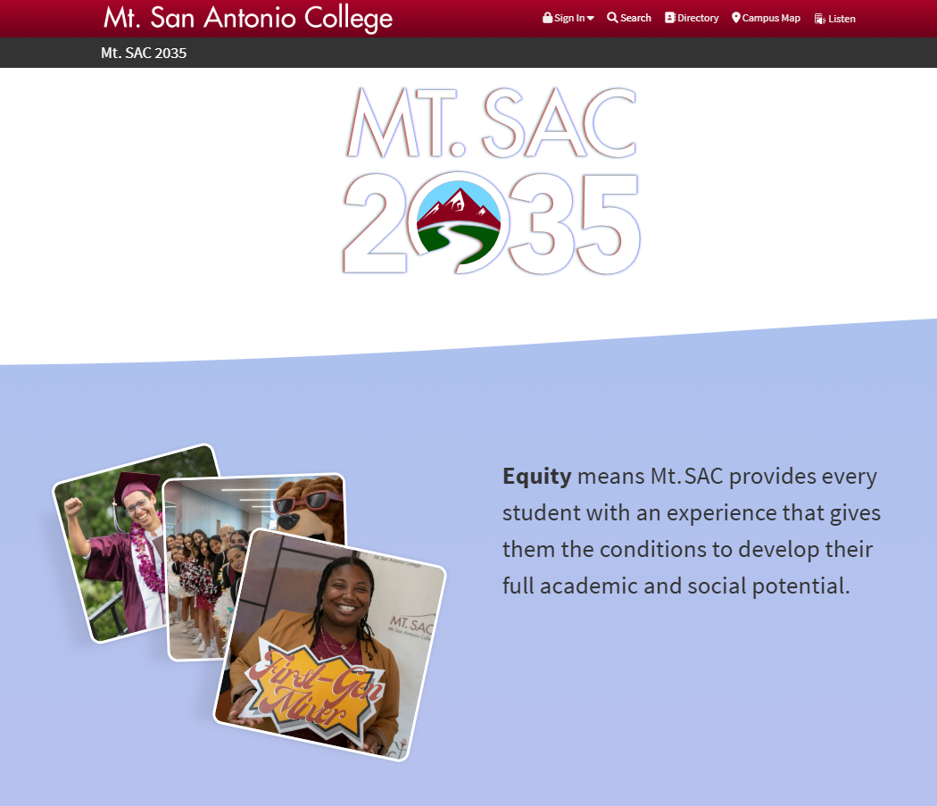
Follow Our Progress at the Mt. SAC 2035 Website
Mtsac.edu/2035

Slide 55

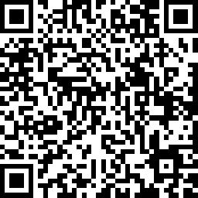
Spring ‘25 Joint Planning Summit Evaluation

