Slide 1



Mt. SAC 2035
Update to Managers
November 7, 2024
Notes:
Workshop Outcomes
Develop aspirations from the student composite that we began developing in Workshop 1
Use insights to shape how we will build our equity minded & healing centered EFCP process
Co-Design Student Listening Sessions
Before we begin our work today we invite you to get organized within each table group
Hand out packets; Notify that they’ll be turned in as part of our qualitative data
Every table selects a facilitator and a recorder for today’s workshop.
Coordinating Team representative at each table for guidance.

Slide 2

Defining Equity and Equity-Minded Planning Principles
DEFINING STUDENT EQUITY
Equity means Mt. SAC provides every student with a college experience that gives them the conditions to develop their full academic and social potential.
PRINCIPLES FOR A PLANNING PROCESS TO QUALIFY AS EQUITY-MINDED
Engages historically and currently underrepresented students where they are, empowering them with identifying problems, imagining futures, and making decisions.
Actively confronts inequities present in student experiences, outcomes, policy and practices.
DEFINING STUDENT INEQUITY
Inequity means student groups are significantly more likely have adverse experiences and outcomes based on racial, cultural, economic, and social factors, including less funding and learning environments that are less innovative and culturally unresponsive.
Notes:
Lianne –
The foundation of integrated planning is the Mt. SAC Mission, Vision, and Values
As leaders of the EFCP process we recognize that it is important to focus on our mission of serving students each time we begin our work.
Today, I invite us to read out loud together

Slide 3

Phases of Equity-Minded Comprehensive Planning
Listen
Uncover
Design
Decide
Listen to understand what is and is not working well for historically underserved students.
Decisions are informed by diverse people and perspectives.
Uncover the underlying conditions of inequities in student experiences and outcomes.
Decisions address predictable and systemic harm to students from underserved communities.
Co-design the plan to serve students’ needs and aspirations.
Decisions directly address underlying conditions and are based on supporting evidence.
Decide how to deliver the plan within the available resources.
Decision-makers commit to actively disrupting harm and are held accountable for outcomes.
Providing students with decision-making power throughout the process.
Notes:
Diane

Slide 4
Planning Framework
E Q U I T Y B Y D E S I G N
INSTITUTIONAL
GOALS
FACILITIES GUIDING PRINCIPLES
DECISION-MAKING RUBRIC
FOR FACILITIES IMPROVEMENTS
Notes:
Lianne –
The foundation of integrated planning is the Mt. SAC Mission, Vision, and Values
As leaders of the EFCP process we recognize that it is important to focus on our mission of serving students each time we begin our work.
Today, I invite us to read out loud together

Slide 5

Mt. SAC 2035 Ongoing Communication
Task Force
Chair
  Notifies governance chairs, constituency groups, and units across the College that Task Force Members will request time on meeting agendas.
Task Force Members
  Contact governance chairs, constituency groups, and units to request time on agendas.
Task Force Members
  Report constituents’ questions and comments to the Task Force at each monthly Workshop (standing agenda).
Task Force Workshop
  Identify 3-4 Priority Messages for dissemination to constituency groups.
Key Highlight
Mt. SAC 2035 Task Force Members are the primary information conduit to communicate with constituency groups regarding the project purpose, planning process, and opportunities for input.

Slide 6
Mt. SAC 2035 November Communication Items
Equity by Design Planning Process
Listen – September-November 2024
Uncover - Late October-November 2024
Design - January-February 2025
Decide – Late February-Early March 2025
Coming Up
Conditions for Success Survey: November 18 – December 15
Faculty and Classified Professionals Listening Sessions:
November 12-22
Follow Up
Fall Joint Planning Session:
Overview & Recommended Strategies

Slide 7
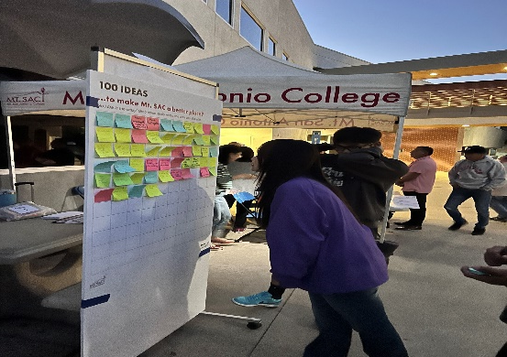
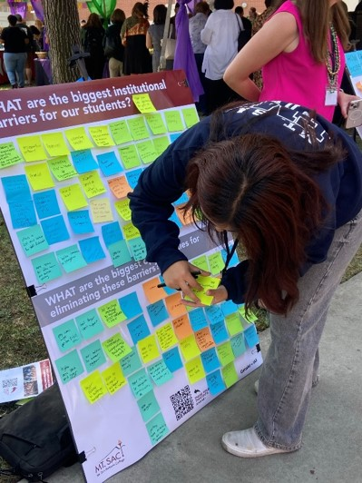
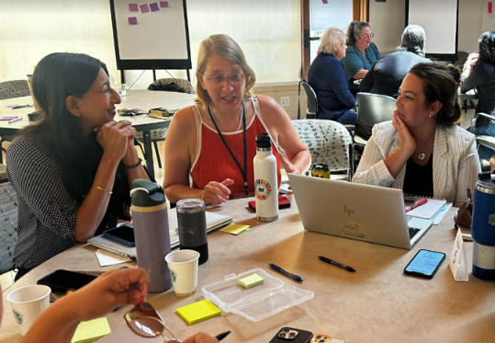
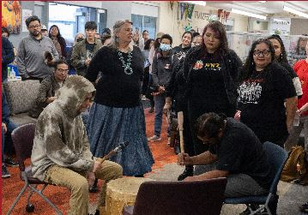
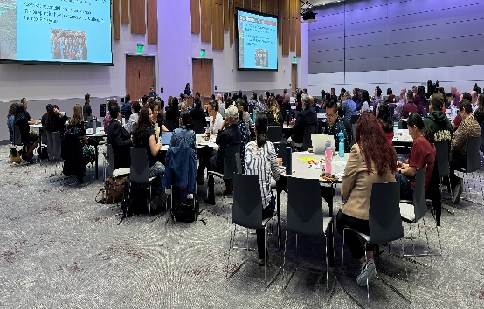
Engagement Activities Thus Far
Welcome Back Luncheon Listening Session
(August)
Task Force Workshops
(August, September, October, November)
Student Listening Sessions
(October)
Focused Student Forum
(September)
Joint Planning Summit
(October)

Slide 8

Upcoming Engagement Activities
Faculty and Classified Professionals Listening Sessions 11/12 - 11/22
Student Conditions for Success Survey 11/18 - 12/15
Task Force Empathy Walk 11/20
Manager Listening Session 12/6

Slide 9
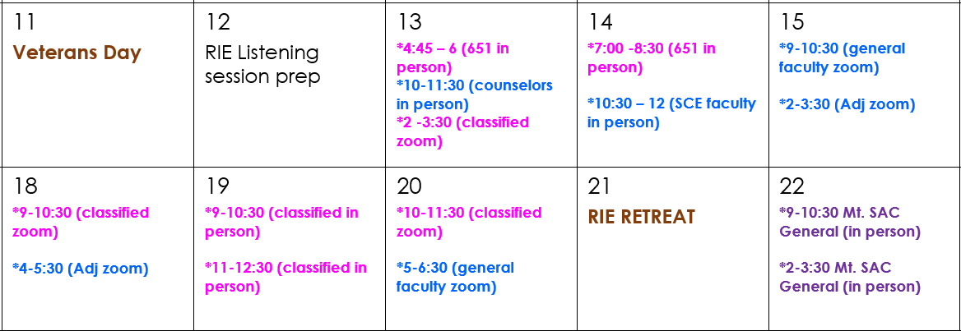
Faculty and Staff Listening Sessions

