Slide 1
Mt. SAC 2035:
Education & Facilities Comprehensive Plan
Lianne Greenlee, Deborah Shepley, Diane White
October 19, 2024
Notes:
Lianne

Slide 2

Context
Since completion of Mt. SAC’s 2018 Education & Facilities Master Plan, significant, transformative shifts have occurred in higher education.
Vision 2030
DEISA+
Healing Centered Engagement
Notes:
Lianne

Slide 3
BP 3250 Institutional Planning
“The College President/CEO shall ensure that the College has a comprehensive, broad-based ongoing planning and evaluation cycle that is driven by the College’s Mission and Goals and supported by institutional effectiveness research.
This planning process involves appropriate segments of the College and is inclusive of all constituent groups".
Mt. SAC 2035 is the College’s broad-based, long-range Education & Facilities Comprehensive Plan.
      Assesses accomplishment of the Mission
    The blueprint for how best to serve our students for the next 9-10 years
Notes:
Lianne

Slide 4
Our Mission
The mission of Mt. San Antonio College is to support and empower all students in achieving their educational goals in an environment of academic excellence.
Specifically, the College is committed to providing quality education, services, and workforce training, empowering students to attain success in an ever-evolving diverse, sustainable, global society.
The College pledges to serve students so they may achieve their full educational potential for lifelong learning, for attaining certificates and associate and bachelor's degrees, for employment, and for the completion of career and transfer pathways.
The College will carry out this commitment by providing an engaging and supportive teaching and learning environment for students of diverse origins, experiences, needs, abilities, and goals.
The College is dedicated to serving our community through improving economic achievement; advancing civic engagement and environmental responsibility; enhancing personal and social well-being; developing information and technological literacy, communication, and critical thinking; and enriching aesthetic and cultural experiences.
Notes:
Lianne –
The foundation of integrated planning is the Mt. SAC Mission, Vision, and Values
As leaders of the EFCP process we recognize that it is important to focus on our mission of serving students each time we begin our work.
Today, I invite us to read out loud together

Slide 5


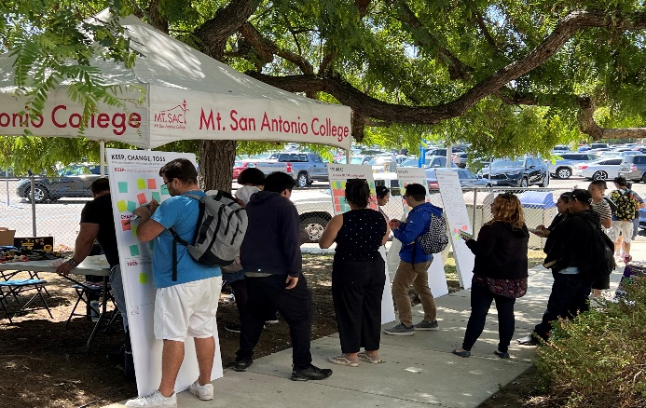
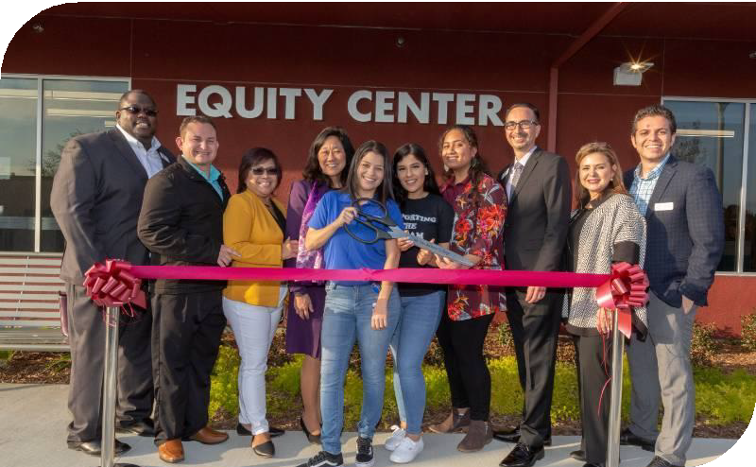
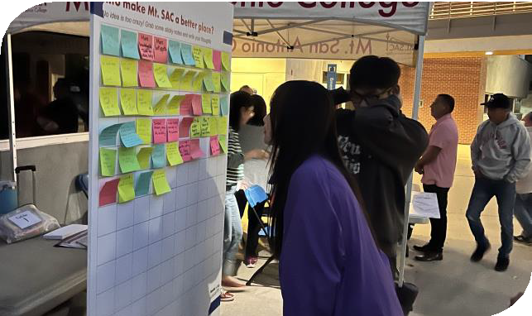



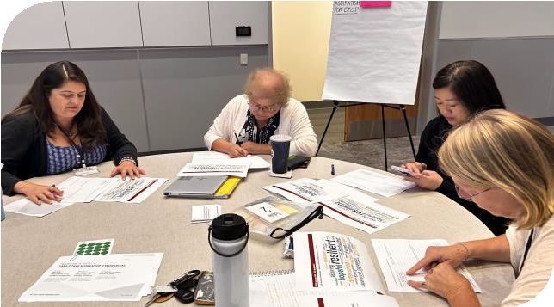
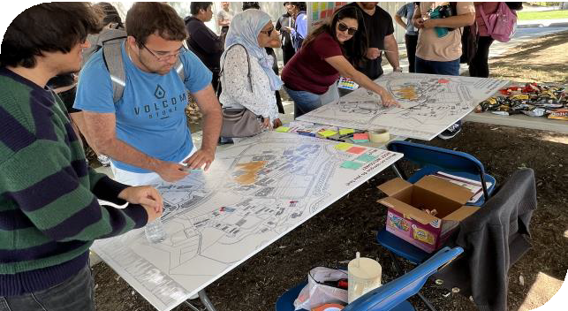
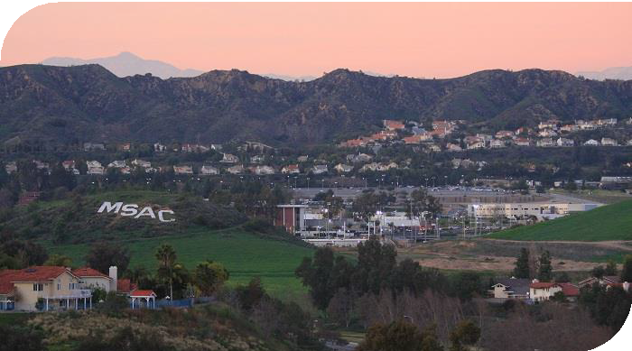
Our Core Values
Student Focus:
We address the basic human and academic development needs of students and the community both in our planning and in our actions.
Equity and Diversity:
We value a diverse, equitable, inclusive, socially just, accessible learning, and anti-racist working environment.
Integrity:
We treat each other honestly, ethically, and respectfully in an atmosphere of empathy and trust.
Community Building:
We collaborate in responsible partnerships through open communication, authentic care, and a cooperative spirit.
Lifelong Learning:
We promote the continuing pursuit of learning through equal access to high-quality teaching and support services.
Sustainability and Stewardship:
We value the three pillars of sustainability people, planet, and prosperity.
Notes:
Lianne

Slide 6

















Integrated Planning At-a-Glance
Mt. SAC 2035 will serve as the foundation for integrated planning processes and cycles of continuous quality improvement. It is accomplished through Mt. SAC’s participatory governance, implementation of focused plans, and the work of College units.
Vision
The College aspiration for the future
Mission
The College purpose
Core Values
Enduring beliefs and principles that individuals of the College hold in common and endeavor to put into action
Mt. SAC 2035
The foundation of integrated planning. Gives direction to accomplish the Mission and means to assess progress toward that goal
Focused Plans
Guide specialized work of the College in alignment with Mt. SAC 2035
Elements of student achievement used to evaluate how well the College is fulfilling the Mission
ISS
Program Review
Planning process used to assess unit progress in support of student learning and the mission
Notes:
Lianne

Slide 7
A New Focus for the Comprehensive Plan
DEISA+ Healing Centered Lens
Existing Plans (Strategic & Facilities)
Mt. SAC 2035
Decision- Making Tool to Guide Prioritization of all College Work
Institutional Goals, Strategies, Outcomes, & Implementation Protocols
Instructional Priorities
Comprehensive Student Services
Facilities Planning Principles & Decision-making Rubric for Facilities Improvement
Recommendations for Campus Development
Data Analysis
Constituent
Engagement
Notes:
Lianne

Slide 8




Traditional vs. DEISA+ Comprehensive Plans
 | Traditional | DEISA+
Focus | Institutional with a facilities emphasis | Student- and community- centered with instructional and support services emphasis
Process | Hierarchical, limited stakeholder inclusion | Inclusive, broad, diverse
Data | Program vitality and future program growth (e.g. FTES, efficiency) | Quantitative and qualitative
Integration | Linkages lacking or fragile | Clear, interdependent linkages
Implementation | Not addressed or limited to facilities | Clear, aligned with planning and resource allocation
Impact | Limited buy-in, commitment, accountability | Broad ownership, commitment, accountability
Notes:
Lianne

Slide 9
President’s Advisory Council Task Force
President’s Advisory Council convened the Mt. SAC 2035 Task Force with the charge to, guide and support the research, review, and development of the Educational and Facilities Comprehensive Plan, with a recommendation to the Board no later than June 25, 2025.
The Mt. SAC 2035 Task Force includes 30 members with broad-based representation:
Students
Faculty
Classified Professionals
Managers
Participatory Governance Leadership
Notes:
Lianne

Slide 10

Mt. SAC 2035 Task Force Outcomes
Develop the Comprehensive Integrated Plan, Mt. SAC 2035, utilizing Mt. SAC Mission, Vision and Values, Vision 2030, DEISA+, and healing centered engagement as the foundation, with alignment noted throughout.
Utilize a comprehensive plan development schedule, using four phases of equity-minded planning, and ensure that Mt. SAC 2035 can be presented to the Board for approval no later than June 25, 2025.
Validate and recommend incorporation of applicable elements of the 2022-2025 Strategic Plan.
Collaborate with the IEC to include integrated planning elements and identify governance committees and college units responsible for implementing plan activities.
Recommend methodologies and tools to be utilized for regular evaluation of progress toward realization of the comprehensive plan.
Review and recommend revisions as needed to BP3250 and AP3250.
Document lessons learned and recommendations for future planning task forces.
Notes:
Lianne

Slide 11

Defining Equity and Equity-Minded Planning Principles
DEFINING STUDENT EQUITY
Equity means Mt. SAC provides every student with a college experience that gives them the conditions to develop their full academic and social potential.
PRINCIPLES FOR A PLANNING PROCESS TO QUALIFY AS EQUITY-MINDED
Engages historically and currently underrepresented students where they are, empowering them with identifying problems, imagining futures, and making decisions.
Actively confronts inequities present in student experiences and outcomes, policy and practices, and neighborhoods.
DEFINING STUDENT INEQUITY
Inequity means student groups are significantly more likely have adverse experiences and outcomes based on racial, cultural, economic, and social factors, including less funding and learning environments that are less innovative and culturally unresponsive.
Notes:
Diane

Slide 12
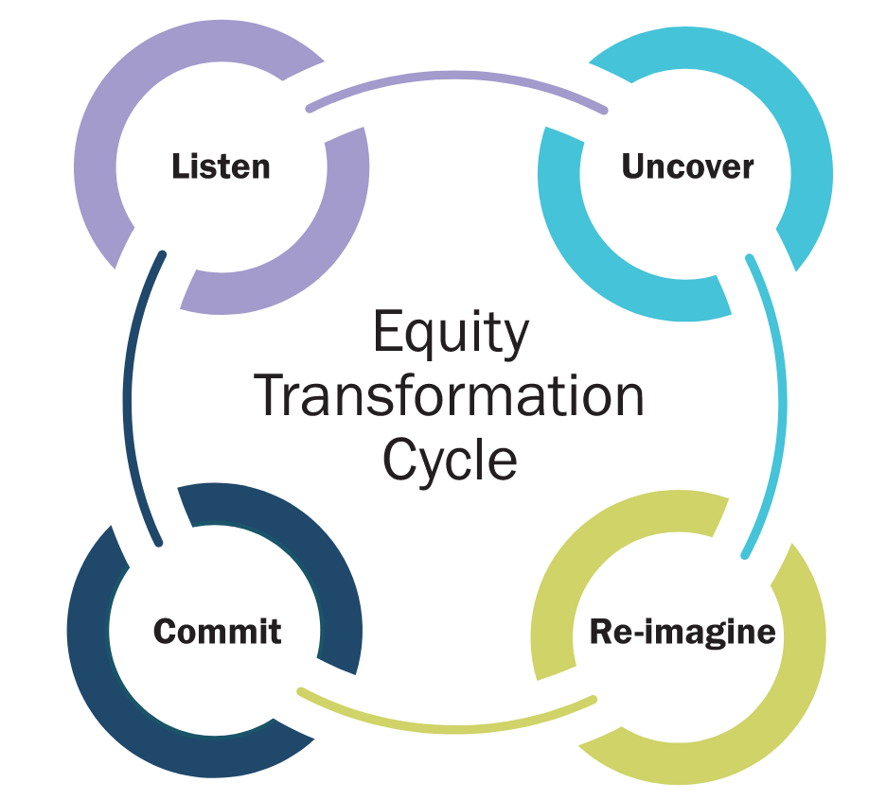
Equity-Minded Comprehensive Planning
EQUITY BY DESIGN FOR
COMPREHENSIVE PLANNING
In 2019, Dr. Stephanie Hawley, the Chief Equity Officer for Austin ISD, applied Dr. Bensimon’s Equity by Design principles to comprehensive planning. Responding to the significant impact of planning processes on historically underserved students and identifying that most (if not all) processes are not equity-minded, Dr. Hawley and educational equity researchers at UT Austin developed Equity by Design for long-range planning.
Implementation of the framework led to Austin ISD’s long-range plan being written by community and the facility project list being co-developed by community, including students.
START
Listen
Uncover
Equity by Design
Planning Cycle
Decide
Design
Notes:
Diane

Slide 13
Equity-Minded Comprehensive Planning
PART 1
History and Data Matters
Analyzing outcomes from a racial and demographic perspective.
START
Listen
Uncover
PART 2
Stories Matter
Incorporating community priorities into comprehensive planning.
Equity by Design
Planning Cycle
PART 3
Collaboration and Outcomes Matter
Developing a prioritization methodology to deliver strategies within available resources.
Decide
Design
Notes:
Diane

Slide 14
Phases of Equity-Minded Comprehensive Planning
Listen
Uncover
Design
Decide
Listen to understand what is and is not working well for historically underserved students.
Decisions are informed by diverse people and perspectives.
Uncover the underlying conditions of inequities in student experiences and outcomes.
Decisions address predictable and systemic harm to students from underserved communities.
Co-design the plan to serve students’ needs and aspirations.
Decisions directly address underlying conditions and are based on supporting evidence.
Decide how to deliver the plan within the available resources.
Decision-makers commit to actively disrupting harm and are held accountable for outcomes.
Providing students with decision-making power throughout the process.
Notes:
Diane

Slide 15
Knowledge Flow
Identify and prioritize conditions for success with student voices.
Identify underlying conditions that the plan must address with student voices.
Identify and prioritize strategies that work with student voices.
Develop a strategic goal and key actions that define intended student impact.
LISTENING SESSIONS
Conditions for Success
Student Groups
WORKSHOP
Bridging Conditions to Design
Students, Community Partners, Task Force
WORKSHOP
Strategic Goals
Students, Community Partners, Faculty, Staff, Task Force
SURVEY
Conditions for Success
Students
WORKSHOP
Bridging Conditions to Design
Faculty, Staff, Task Force
SURVEY
Strategic Themes
Students, Families, CBOs, Faculty, Staff
Notes:
Diane

Slide 16
Framework Development
PART 1
History Matters
PART 2
Stories Matter
PART 3
Outcomes And Collaboration Matter
September
October
November
December
January
February
March
April
Identify Student Groups
Listen
Listening Sessions
Survey
Listening Report
Uncover
Design
Workshop
Workshop
Survey
Themes Report
Decide
Workshop
Strategic Goal and Key Actions
Fall
Winter
Spring

Slide 17
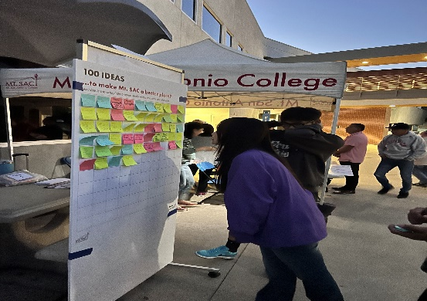
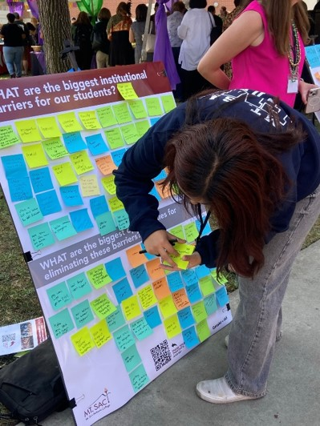
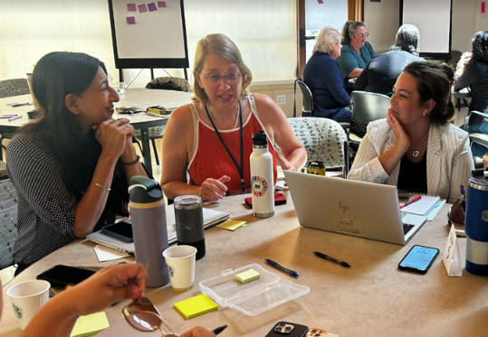
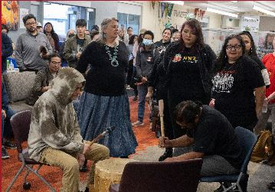
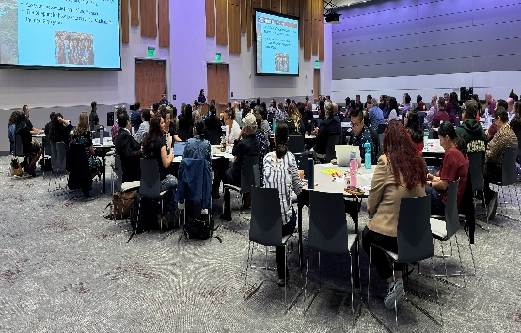
Engagement Activities Thus Far
Welcome Back Luncheon Listening Session
(August)
Task Force Workshops
(August, September, October)
Student Listening Sessions
(October)
Focused Student Forum
(September)
Joint Planning Summit
(October)

Slide 18
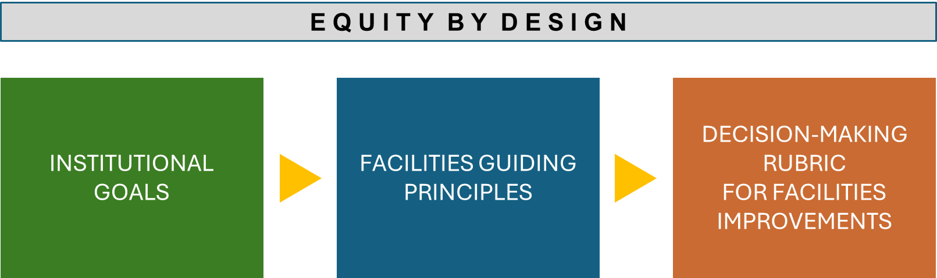
Project Outcome: PLANNING FRAMEWORK
Notes:
Deb

Slide 19
Creating Equitable Experiences
IN THE PHYSICAL ENVIRONMENT
DESIGN THE PHYSICAL ENVIRONMENT TO CONTRIBUTE TO STUDENT’S
Design from each student’s perspective
Enhance classroom spaces for equitable learning
  Sense of Belonging
  Validation
  Engagement
  Receptivity
  Success
Develop welcoming and inviting environments
Create spaces where students feel represented and valued
Develop spaces to support collaboration and build community
Improve navigation and wayfinding experiences
Notes:
Deb

Slide 20
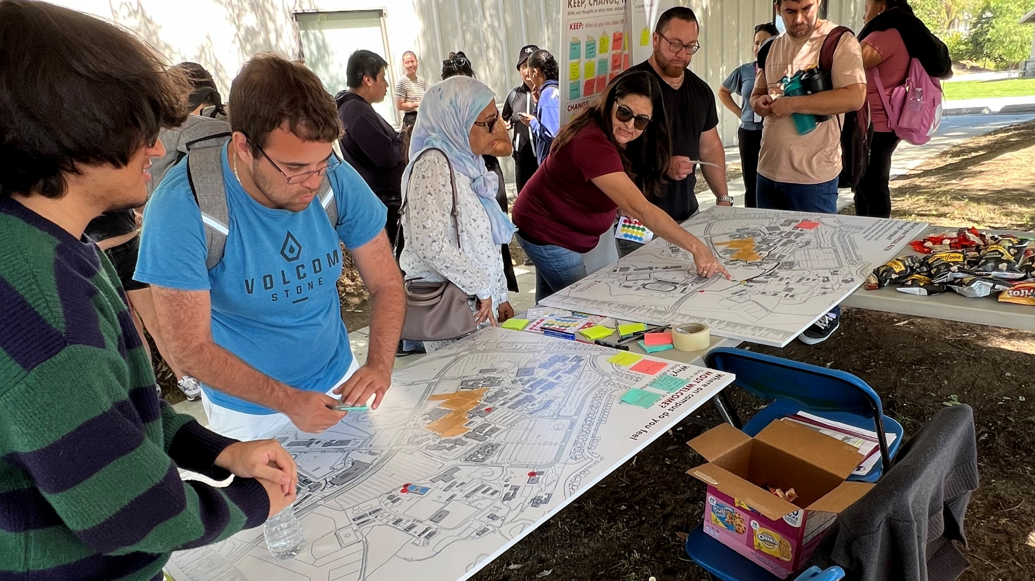
Creating Equitable Experiences – Building Social Infrastructure
I like seeing people like me
I love meeting new friends here
A space that considers mobility / accessibility
I would like more quiet places
Hangout centers!
Amenities/services with longer hours
Places that feel like home
Access to Wi-Fi / Plugin
More outdoor seating and tables
Places to nap and rest
THE HUB
THE HANGOUT
THE HAVEN
Notes:
Deb

Slide 21

Upcoming Engagement
Student Listening Sessions: October 7 – 24
Conditions for Success Student Survey: November 11 – 22
Faculty and Staff Listening Sessions
Community Listening Sessions
Notes:
Lianne

Slide 22
Community Engagement
Notes:
Lianne

Slide 23
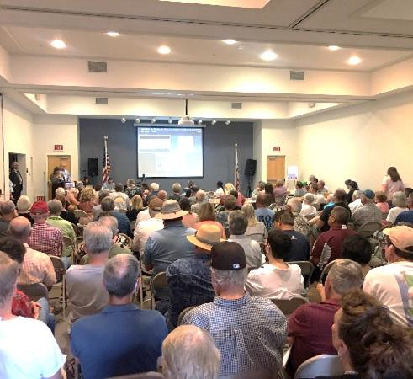
Approaches to Community Engagement
TRADITIONAL ENGAGEMENT
Engagement format limits or excludes the participation of people who have been harmed (i.e., townhall)
Input at beginning, then community consulted after decisions have been made
Limited ability to meaningfully act upon and
incorporate community insights
Perpetuates historical inequities intrinsic to our political and institutional systems by failing to prioritize them
Notes:
Diane

Slide 24

Approaches to Community Engagement
EQUITY-MINDED ENGAGEMENT
Starts with authentic listening so people who have been harmed can share their lived experiences and expertise
Provides a framework for participation and input that’s iterative, ongoing, and accessible in all manners of speaking
Ensures that the community voice is
centered in the discussion
Students, caregivers and families, staff, and community partners participate in decision- making
Notes:
Diane

Slide 25
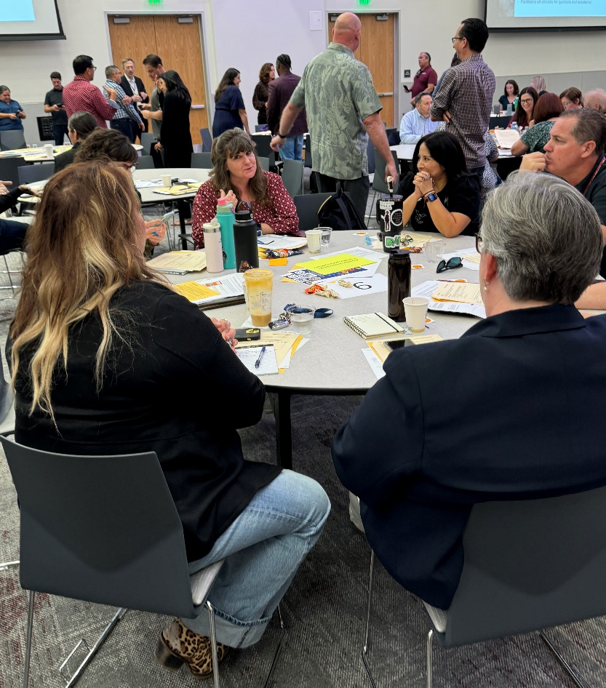
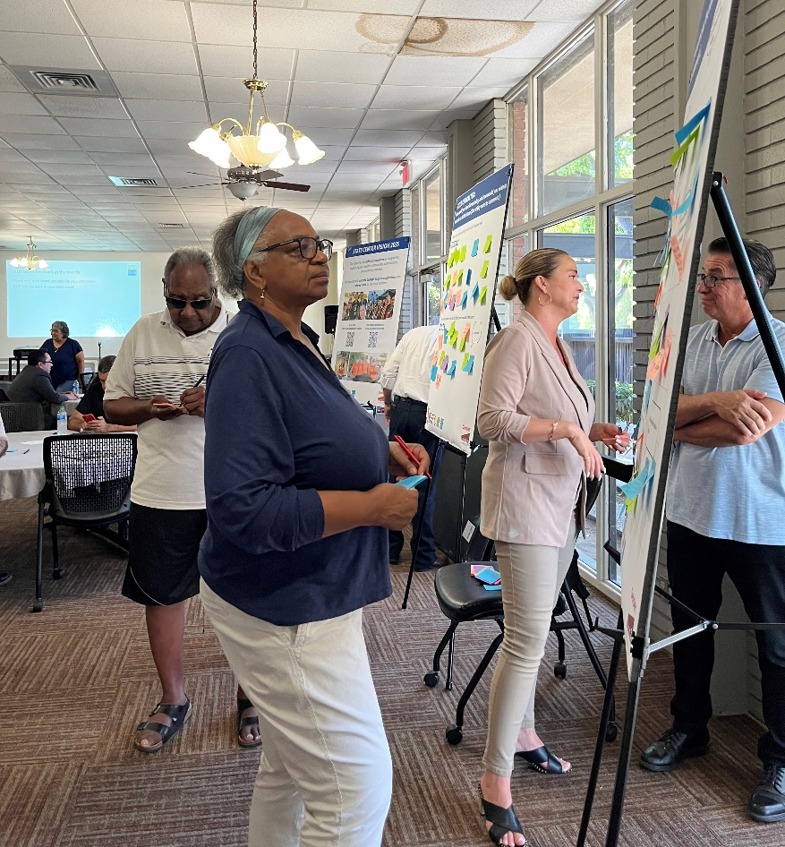
Mt. SAC 2035 Community Engagement
Notes:
Deb

Slide 26
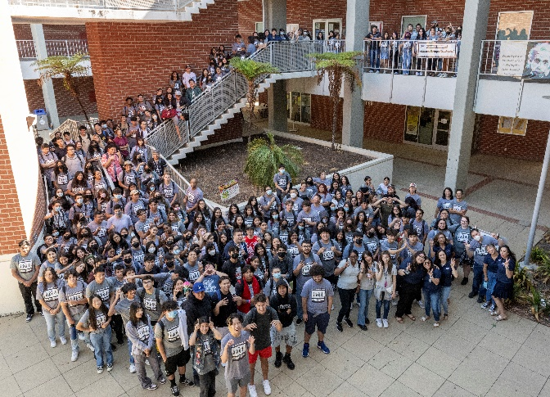


Mt. SAC 2035 Community Engagement
Education Partners
Business/Industry
Parents
Notes:
Deb

Slide 27
Mt. SAC 2035 Workshop Experience
Education Partners
Business/Industry
Parents
What is most important to learn from each community group in order to achieve our Mission and Core Values?
Notes:
Deb

Slide 28
Questions?
Notes:
Lianne

Slide 29

Opportunities for Additional Insight
The Four Pivots
by Shawn A Ginwright
Five Principles for Enacting Equity by Design
by Estela Mara Bensimon, Alicia C. Dowd, and Keith Witham

