Slide 1
Mt. SAC 2035:
Education & Facilities Comprehensive Plan
Joint Planning Summit
Friday, October 11, 2024

Slide 2
Dr. Martha Garcia
Mt. SAC President
Welcome and Introductions

Slide 3
Agenda and Session Overview
Objectives and Outcomes, and Core Values
Land and Labor Acknowledgements
Setting the Context: Digital Story and Connections to Our Work
Overview of journey to Mt. SAC 2035 (EFCP): The Why; Traditional vs Equity-minded Process; Integrated Planning Overview
Conceptual Framework of Equity By Design and Implications for Planning Processes and Products
Equity-Mindedness in the Physical Environment
Equity By Design Process Flow and Engagement Activities for Fall 2024 and Spring 2025
Implementation Challenges and Strategies
Closure
Notes:
Primavera
Although Mt. SAC has not officially adopted a Labor Acknowledgement, outreach confirmed that Mt. SAC’s Associated Students developed a Land and Labor Acknowledgement in 2021-22 which has been included as an Opening Item all AS Senate meetings since that time. Currently this is the only Labor Acknowledgement in use at Mt. SAC.
This is an opportunity to affirm the advocacy of our students and identify an area for action related to our Core Value of “Equity and Diversity: We value a diverse, equitable, inclusive, socially just, accessible learning, and anti-racist working environment”
Our AS President (and TF member) Dani Silva has graciously agreed to give the Labor Acknowledgement, using the version developed by Associated Students.

Slide 4
Outcomes
Shared understanding and agreement on principles of equity and equity-mindedness and implications for Planning processes and development of Mt. SAC 2035.
Understanding of Equity By Design applied to the student experience in the physical campus environment.
Understanding of Equity By Design process flow and timing of engagement activities for Fall 2024 and Spring 2025.
Understanding and anticipating challenges to the implementation of Mt. SAC 2035 and identifying strategies to address those challenges.

Slide 5


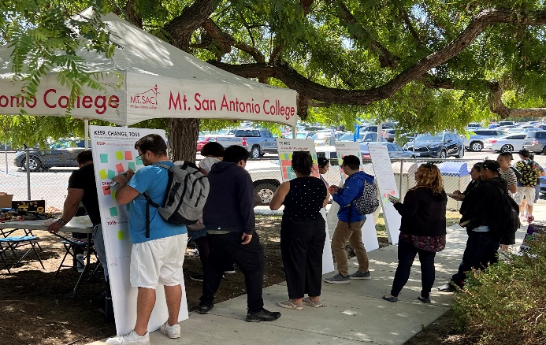
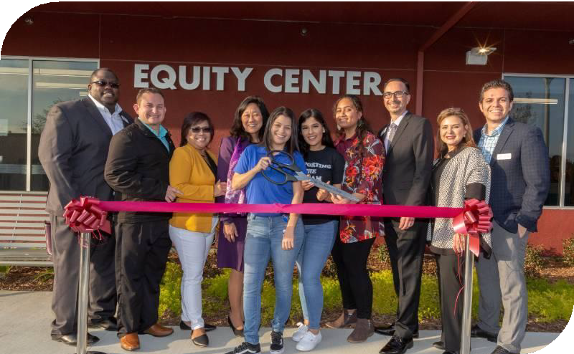
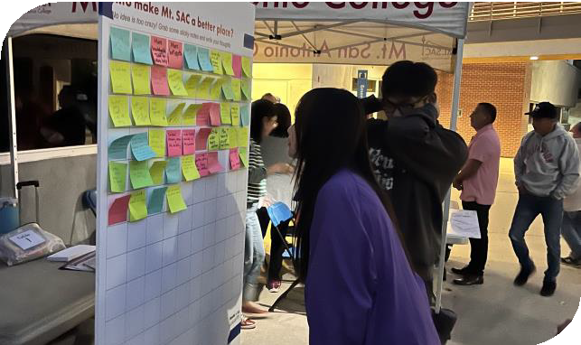



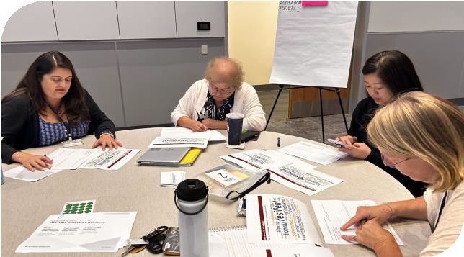
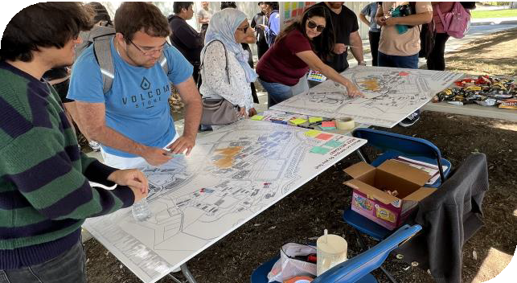
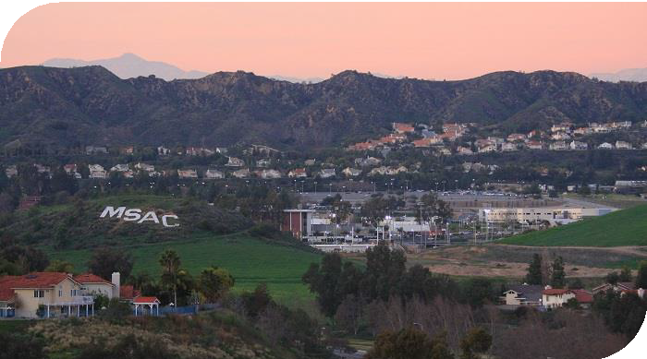
Core Values
Student Focus:
We address the basic human and academic development needs of students and the community both in our planning and in our actions.
Equity and Diversity:
We value a diverse, equitable, inclusive, socially just, accessible learning, and anti-racist working environment.
Integrity:
We treat each other honestly, ethically, and respectfully in an atmosphere of empathy and trust.
Community Building:
We collaborate in responsible partnerships through open communication, authentic care, and a cooperative spirit.
Lifelong Learning:
We promote the continuing pursuit of learning through equal access to high-quality teaching and support services.
Sustainability and Stewardship:
We value the three pillars of sustainability people, planet, and prosperity.

Slide 6
Land Acknowledgement
We at Mt. San Antonio College acknowledge that the land which we occupy is unceded ancestral territory of the Gabrielino-Tongva people, Indigenous to this region for thousands of years.
We recognize the Gabrielino-Tongva people have suffered an immense loss of their people, culture, lands, water, and other natural resources due to the theft, murder, kidnapping, and enslavement. These injustices started with colonization, and most Indigenous people consider colonization a current and ongoing process.
The Gabrielino-Tongva view this land as a source of healing, nourishment, and protection.
As students, faculty, staff, and alumni of Mt. San Antonio College, we honor the Gabrielino-Tongva by acknowledging their legacy and current lived experiences.
We recognize this land acknowledgement as an opportunity for Mt. SAC to advocate for Indigenous students through support of the First Peoples Native Center and continued learning and shared knowledge for Native American and Indigenous peoples.
SOURCE: First Peoples Native Center; June 2024 DRAFT
Notes:
Primavera
Although Mt. SAC has not officially adopted a Labor Acknowledgement, outreach confirmed that Mt. SAC’s Associated Students developed a Land and Labor Acknowledgement in 2021-22 which has been included as an Opening Item all AS Senate meetings since that time. Currently this is the only Labor Acknowledgement in use at Mt. SAC.
This is an opportunity to affirm the advocacy of our students and identify an area for action related to our Core Value of “Equity and Diversity: We value a diverse, equitable, inclusive, socially just, accessible learning, and anti-racist working environment”
Our AS President (and TF member) Dani Silva has graciously agreed to give the Labor Acknowledgement, using the version developed by Associated Students.

Slide 7
Mt. SAC Associated Students Life & Labor Acknowledgment
As all of our liberations are tied together, and so is our history, we also acknowledge that this country was built up from the free, enslaved labor of Black people, and we honor the legacy of the African diaspora. We pay respects to Black life, knowledge and skills stolen due to violence and White supremacy.
We also share grief, hold space, and stand in solidarity with our Asian Pacific Islander Desi American (AAPIDA) and LGBTQ+ communities. We condemn not only repeated acts of violence endured by vulnerable members of intersecting communities and the pervasive discrimination and stereotyping that attacked one’s humanity.
We shall not forget the oppression faced by Black, Indigenous, and People of Colors (BIPOC) and individuals who face multifaceted threats to their existence based on gender identity, sexual orientation, or religious affiliations. With this Land, Labor, and Community acknowledgement, we also recognize a duty to give honor through our work and continue to stand up for racial and social justice every day. Please join us in a moment of silence and a collective breath.
SOURCE: Mt. SAC Associated Students Labor Acknowledgement

Slide 8

Context
Since completion of Mt. SAC’s 2018 Education & Facilities Master Plan, significant, transformative shifts have occurred in higher education that necessitate a re-evaluation of Mt. SAC’s highest level integrated planning document and the processes it informs.
Vision 2030
DEISA+
Healing Centered Engagement

Slide 9

BP 3250 Institutional Planning
Mt. SAC 2035 is the College’s broad-based, long-range Education & Facilities Comprehensive Plan.
Assesses accomplishment of the Mission
The blueprint for how best to serve our students for the next 9-10 years

Slide 10
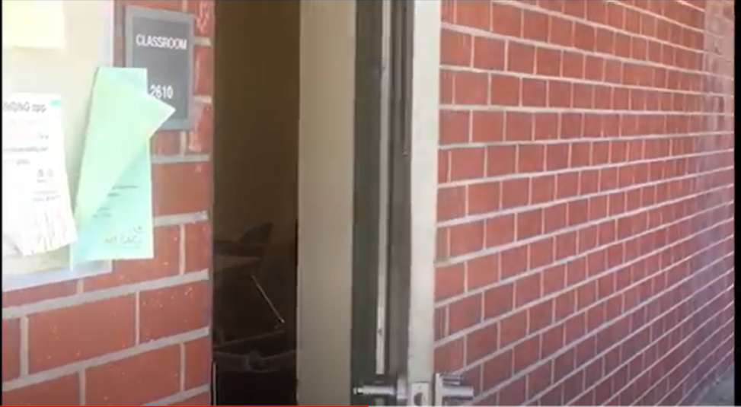
Arise Digital Stories Project

Slide 11

















Integrated Planning At-a-Glance
Mt. SAC 2035 will serve as the foundation for integrated planning processes and cycles of continuous quality improvement. It is accomplished through Mt. SAC’s participatory governance, implementation of focused plans, and the work of College units.
Vision
The College aspiration for the future
Mission
The College purpose
Core Values
Enduring beliefs and principles that individuals of the College hold in common and endeavor to put into action
Mt. SAC 2035
The foundation of integrated planning. Gives direction to accomplish the Mission and means to assess progress toward that goal
Focused Plans
Guide specialized work of the College in alignment with Mt. SAC 2035
Elements of student achievement used to evaluate how well the College is fulfilling the Mission
ISS
Program Review
Planning process used to assess unit progress in support of student learning and the mission

Slide 12
A New Focus for the Comprehensive Plan
DEISA+ Healing Centered Lens
Existing Plans (Strategic & Facilities)
Mt. SAC 2035
Decision- Making Tool to Guide Prioritization of all College Work
Institutional Goals, Strategies, Outcomes, & Implementation Protocols
Instructional Priorities
Comprehensive Student Services
Facilities Planning Principles & Decision-making Rubric for Facilities Improvement
Recommendations for Campus Development
Data Analysis
Constituent
Engagement

Slide 13




Traditional vs. DEISA+ Comprehensive Plans
 | Traditional | DEISA+
Focus | Institutional with a facilities emphasis | Student- and community- centered with instructional and support services emphasis
Process | Hierarchical, limited stakeholder inclusion | Inclusive, broad, diverse
Data | Program vitality and future program growth (e.g. FTES, efficiency) | Quantitative and qualitative
Integration | Linkages lacking or fragile | Clear, interdependent linkages
Implementation | Not addressed or limited to facilities | Clear, aligned with planning and resource allocation
Impact | Limited buy-in, commitment, accountability | Broad ownership, commitment, accountability

Slide 14
President’s Advisory Council Task Force
President’s Advisory Council convened the Mt. SAC 2035 Task Force with the charge to, guide and support the research, review, and development of the Educational and Facilities Comprehensive Plan, with a recommendation to the Board no later than June 25, 2025.
The Mt. SAC 2035 Task Force includes 30 members with broad-based representation:
Students
Faculty
Classified Professionals
Managers
Participatory Governance Leadership

Slide 15
Foundations of Equity, Equity-Mindedness, and Implications for Institutional Planning

Slide 16
“Every system is perfectly designed to achieve the results that it gets.”
Edwards Deming and Paul Batalden

Slide 17
Equity and Equity-Mindedness

Slide 18
Equity
“Equity refers to a heightened focus on groups experiencing disproportionate impact in order to remediate disparities in their experiences and outcomes.”
Community College Equity Assessment Lab (CCEAL)

Slide 19
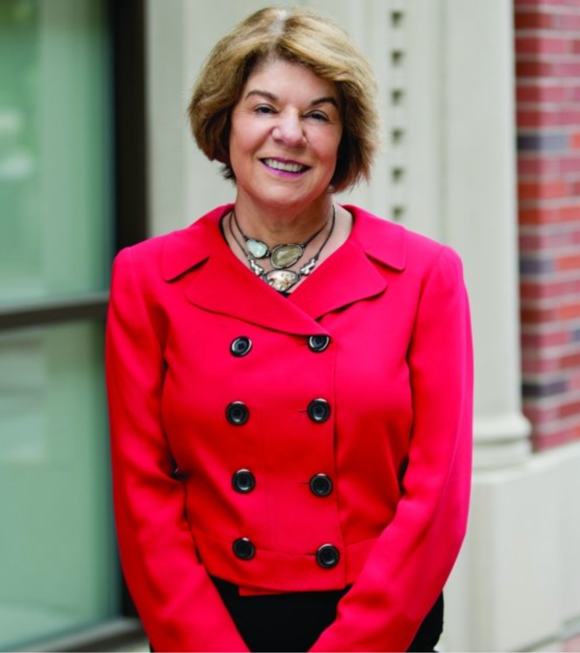
Equity-Mindedness Defined
“Developed by Dr. Estela Bensimon (2005), equity-mindedness is a type of ‘cognitive frame,’ a mental map of attitudes and beliefs a person maintains to make sense of the world. A cognitive frame determines which questions are asked, what information is collected, what is noticed, how problems are defined, and what course of action should be taken” (CUE, 2020, p. 24).
Given the history and impact of systemic racism in United States education, racial equity is the central focus of equity-mindedness.

Slide 20
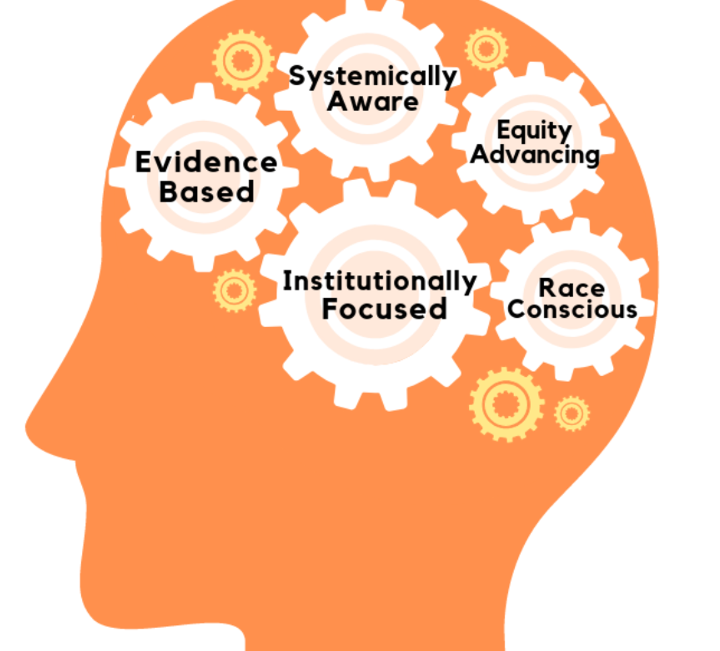
Equity-Mindedness
Center for Urban Education. (2020). Laying the groundwork: Concepts and activities for racial equity work . Rossier School of Education, University of Southern California.

Slide 21
Equity-Mindedness
The Problems with Current Practices and Understanding of Equity-Mindedness
The tendency to see one’s self as “not-racist” and therefore “equity-minded” by default.
The popularity of term has led to it mostly being used “without reflecting on its critical and antiracist intents” (p. 4).
Bensimon, E.M. (2024). What is Equity-Mindedness? Los Angeles: Bensimon & Associates

Slide 22
Equity-Mindedness
Being equity-minded requires educators to recognize:
The history and legacy of racial exclusion in the U.S. and its impact on educational access and outcomes today.
U.S. higher education institutions were primarily designed by and for white students and educators
Most educational practices are not race conscious; all have racial consequences and can do racial harm.
No one is “naturally” equity-minded. It requires specialized knowledge and ongoing professional learning.
Racial equity and diversity are not the same.
Systems, policies, structures, institutions, and educators are the points of intervention to achieve racial equity–not students.
Data disaggregated by race/ethnicity are necessary to reveal patterns of racial inequity.
Educators must assume personal accountability and responsibility to disrupt patterns of racial inequity.
Bensimon, E.M. (2024). What is Equity-Mindedness? Los Angeles: Bensimon & Associates

Slide 23
What Derails Equity-Mindedness?
A culture of compliance
A culture of complacency
Deficit perspectives
A lack of data transparency
Instability
Misappropriation and a lack of intentionality
Poor conceptualization of equity
Marginalization
Siloing
A lack of institutional buy-in
Exceptionalism
Toxic Resistance
Toxic Support

Slide 24
What Derails Equity-Mindedness?
COMPLIANCE: “Listen. Let’s just do what we have to do to secure our funding and get the state/district of our a***s.”
COMPLACENCY: “Why do we have to do this? Nothing’s going to change. The problem is so much bigger than me/us.”
DEFICIT PERSPECTIVES: “Now they want everyone to go right into college level math/English. That’s crazy. Some of these students have no chance of succeeding.”
DATA TRANSPARENCY: “We have all this data, but what does it mean? What should I make of it?”
INSTABILITY: “We had an amazing VP who was an equity champion, but she left to be president at another college.”
MISAPPROPRIATION AND INTENTIONALITY: “Can we use equity monies to buy this copier? It’s not exactly aligned with equity, but everyone will eventually benefit from it.”

Slide 25
What Derails Equity-Mindedness?
POOR CONCEPTUALIZATION: “Let’s be honest, equity really means lowering standards and rigor.”
MARGINALIZATION: “All of our equity work takes place in EOP/Umoja/Puente.”
SILOING: “Oh no, the equity plan is due soon! Let’s have the dean and [one other person] write it.”
INSTITUTIONAL BUY-IN: ”We have an equity plan, but no one really takes it seriously. We did what we had to do to get the money.”
EXCEPTIONALISM: “We aren’t like the other CSUs . . . . ”
TOXIC RESISTANCE AND SUPPORT . . . . .

Slide 26
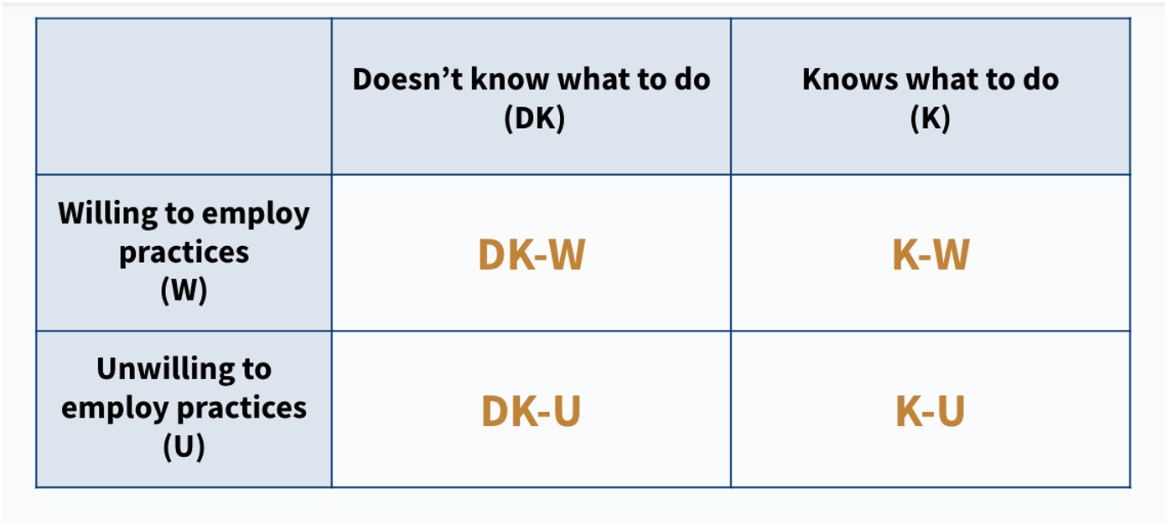
A Taxonomy of Educators Perspectives on Equity-Mindedness
Wood & Harris III (2015)

Slide 27
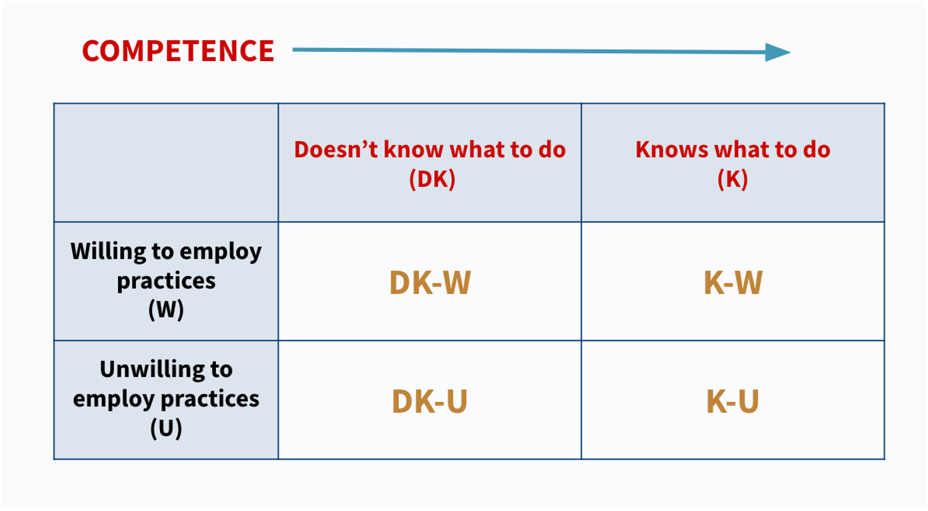
A Taxonomy of Educators Perspectives on Equity-Mindedness
Wood & Harris III (2015)

Slide 28
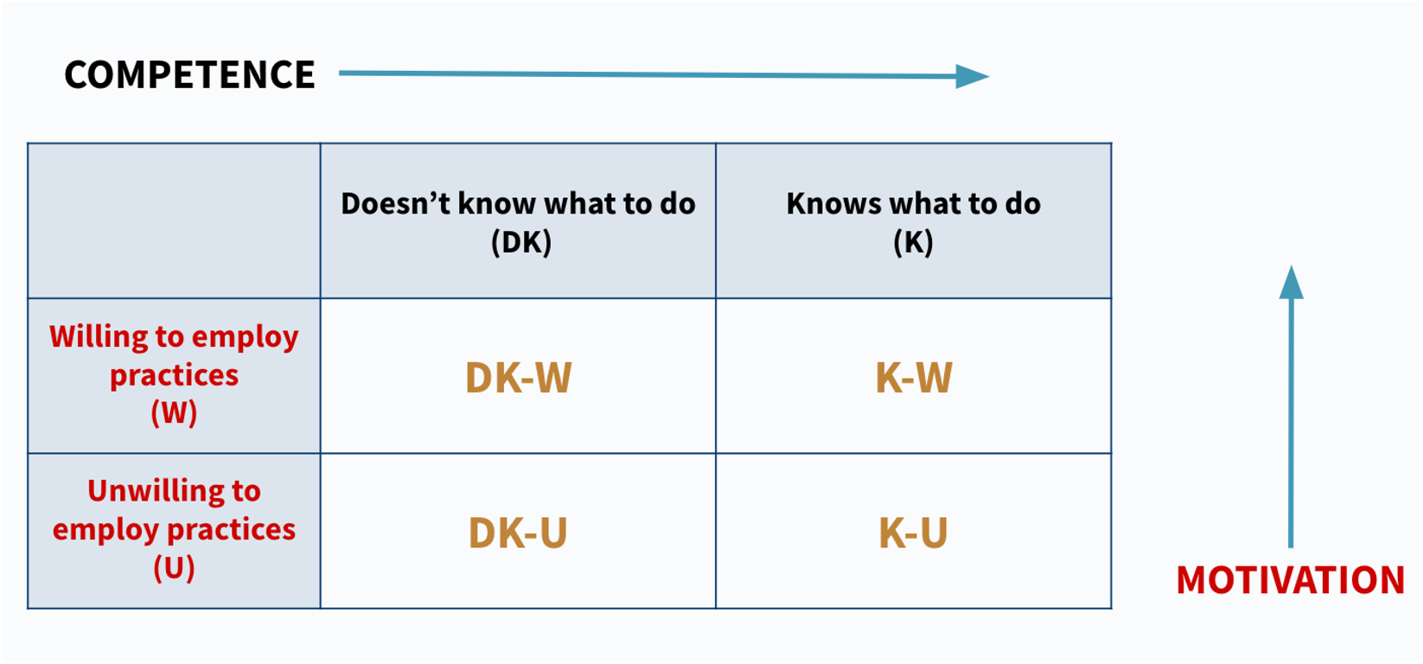
A Taxonomy of Educators Perspectives on Equity-Mindedness
Wood & Harris III (2015)

Slide 29
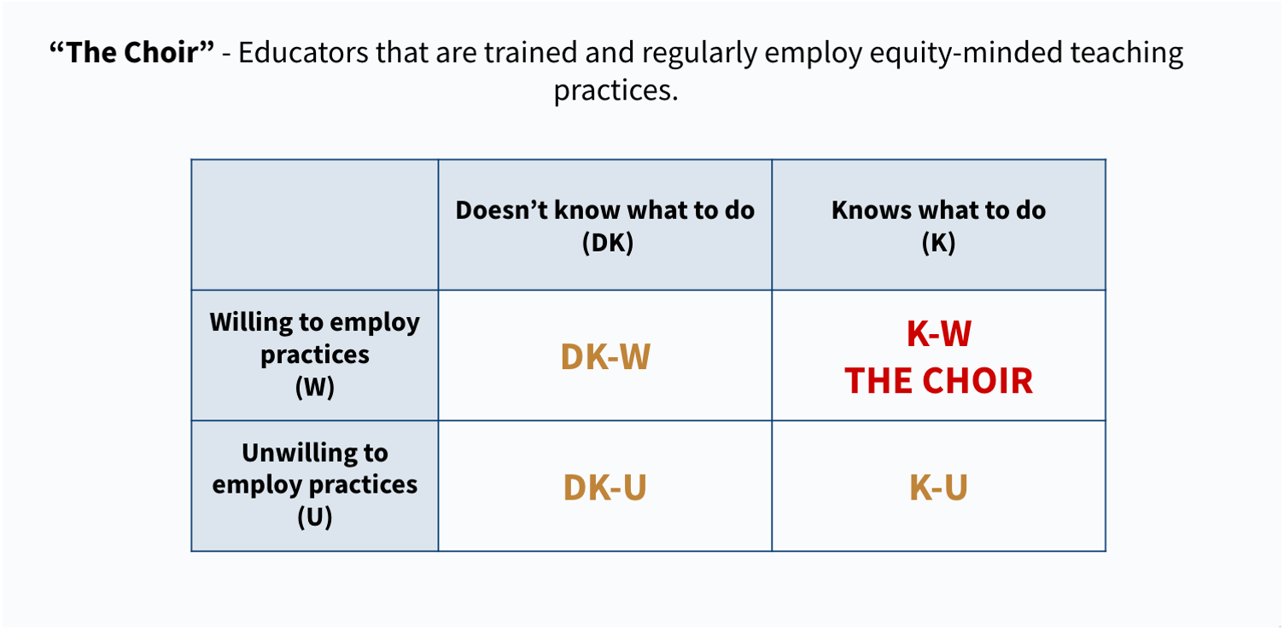
A Taxonomy of Educators Perspectives on Equity-Mindedness
Wood & Harris III (2015)

Slide 30
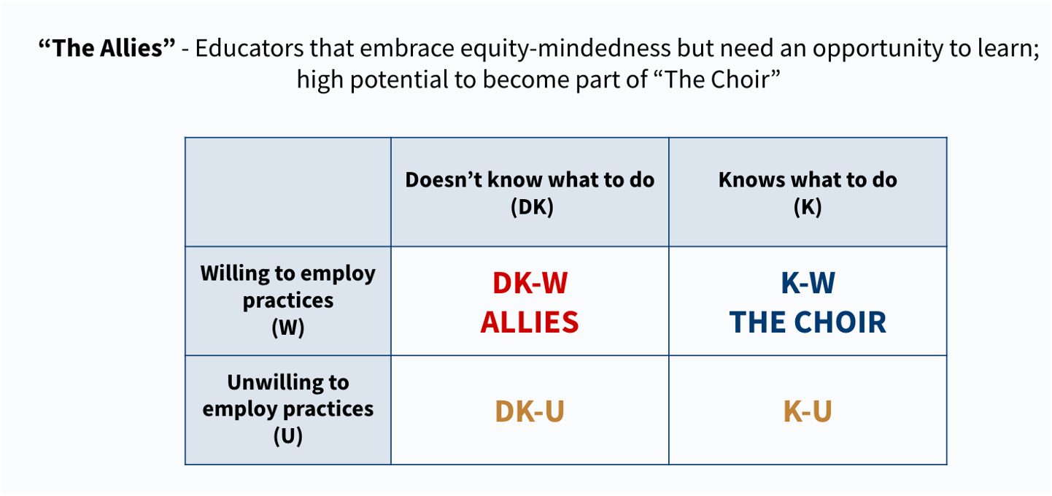
A Taxonomy of Educators Perspectives on Equity-Mindedness
Wood & Harris III (2015)

Slide 31
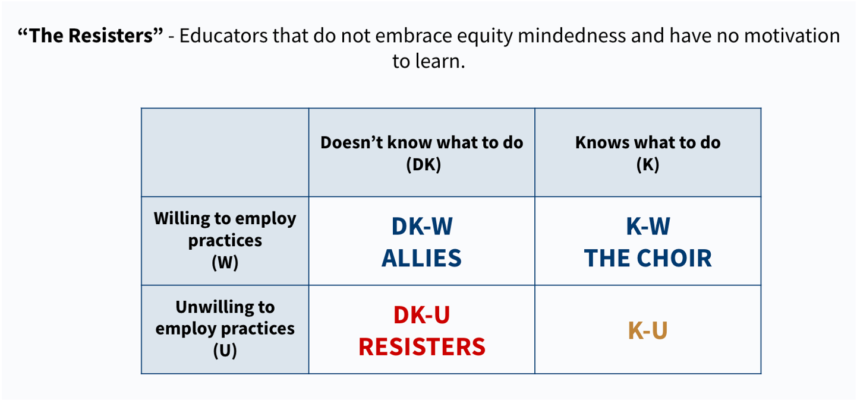
A Taxonomy of Educators Perspectives on Equity-Mindedness
Wood & Harris III (2015)

Slide 32
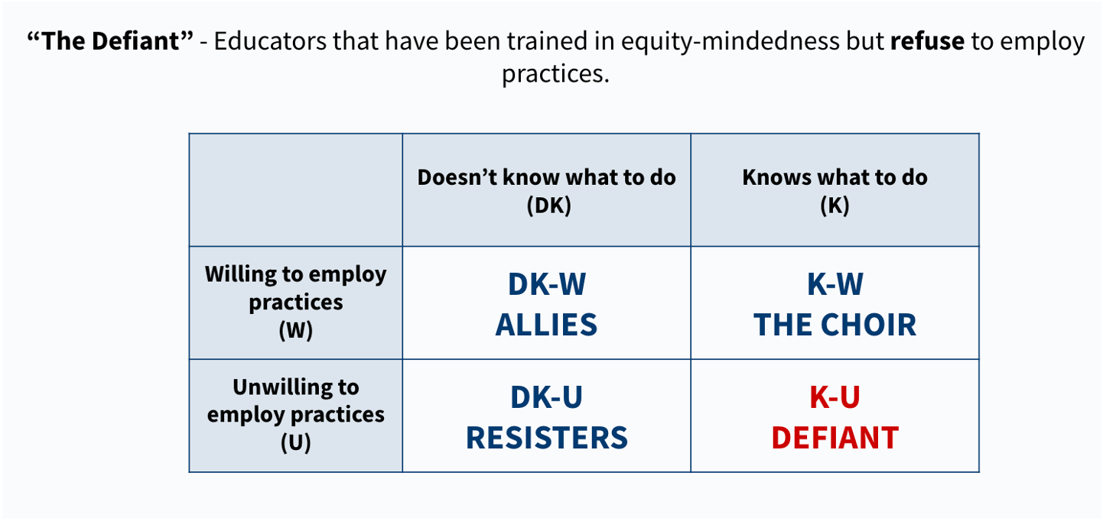
A Taxonomy of Educators Perspectives on Equity-Mindedness
Wood & Harris III (2015)

Slide 33
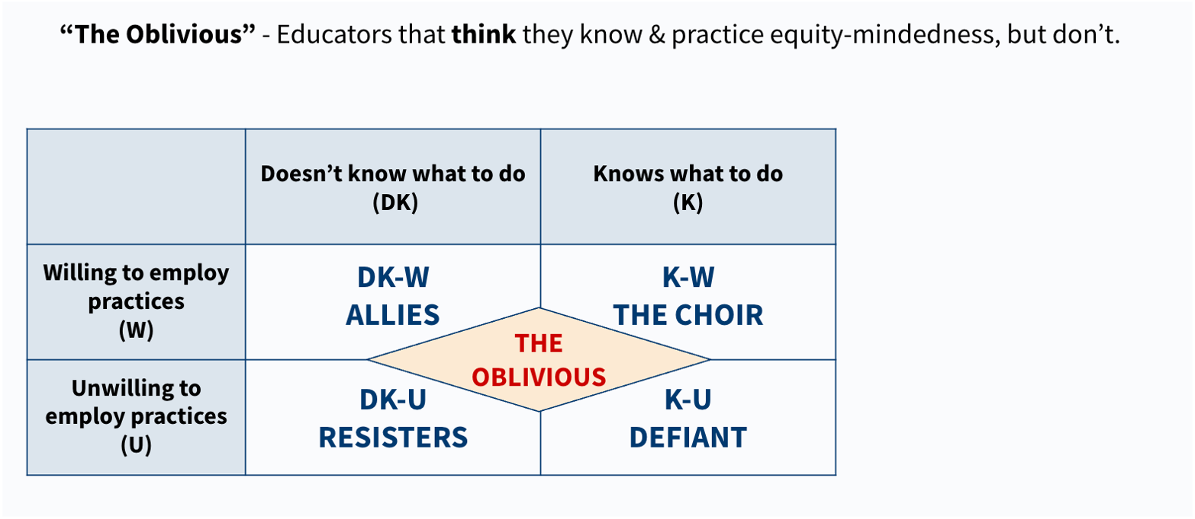
A Taxonomy of Educators Perspectives on Equity-Mindedness
Wood & Harris III (2015)

Slide 34
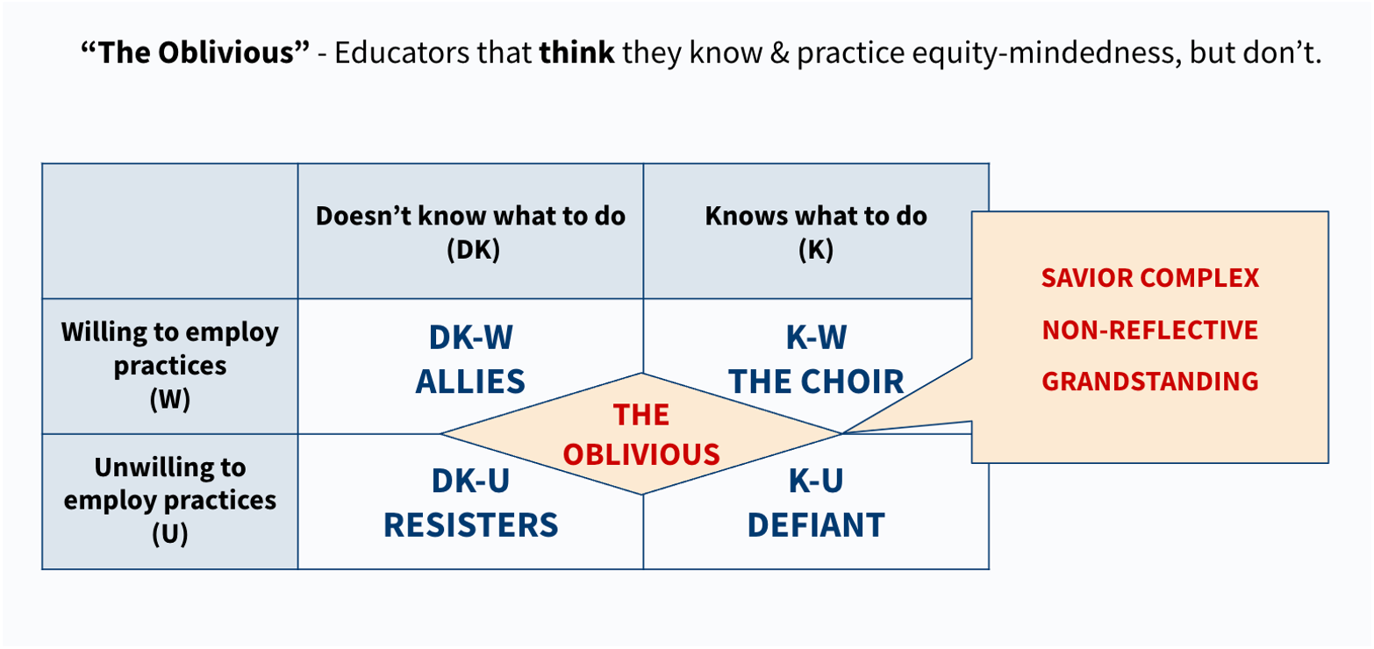
A Taxonomy of Educators Perspectives on Equity-Mindedness
Wood & Harris III (2015)

Slide 35
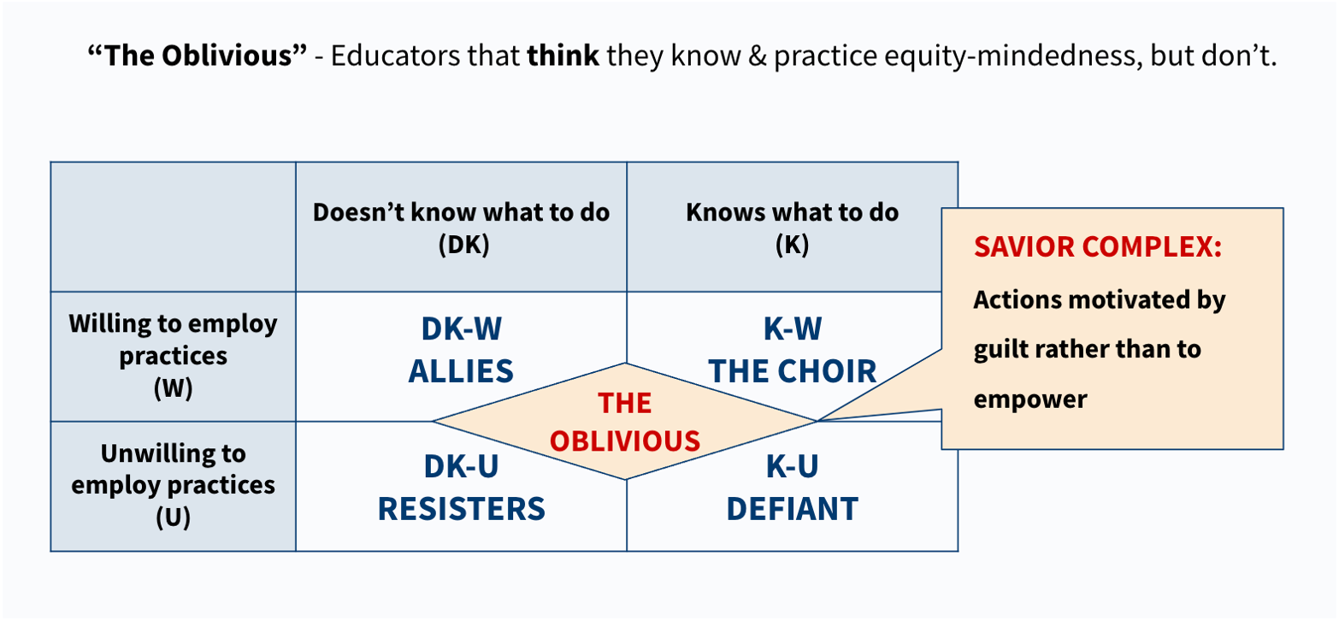
A Taxonomy of Educators Perspectives on Equity-Mindedness
Wood & Harris III (2015)

Slide 36
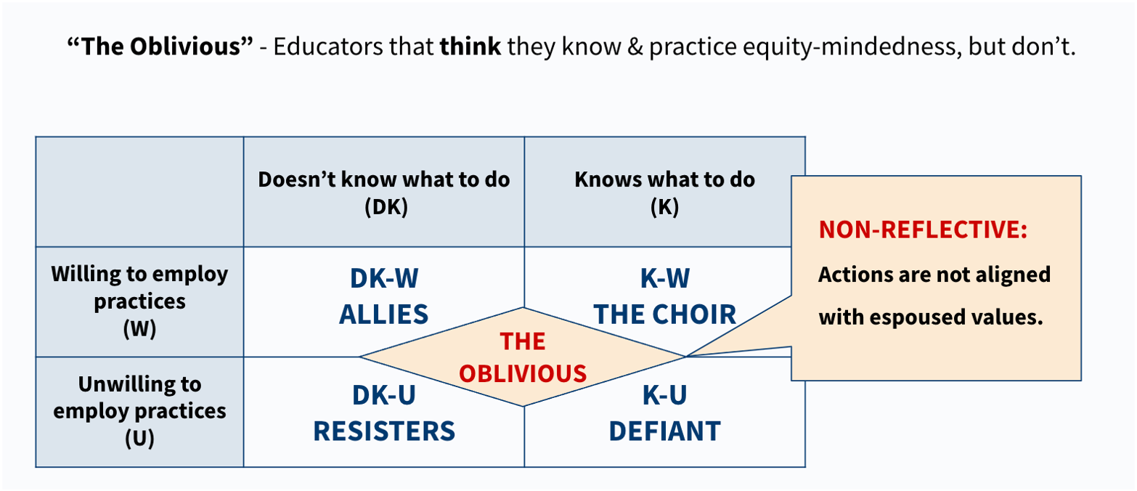
A Taxonomy of Educators Perspectives on Equity-Mindedness
Wood & Harris III (2015)

Slide 37
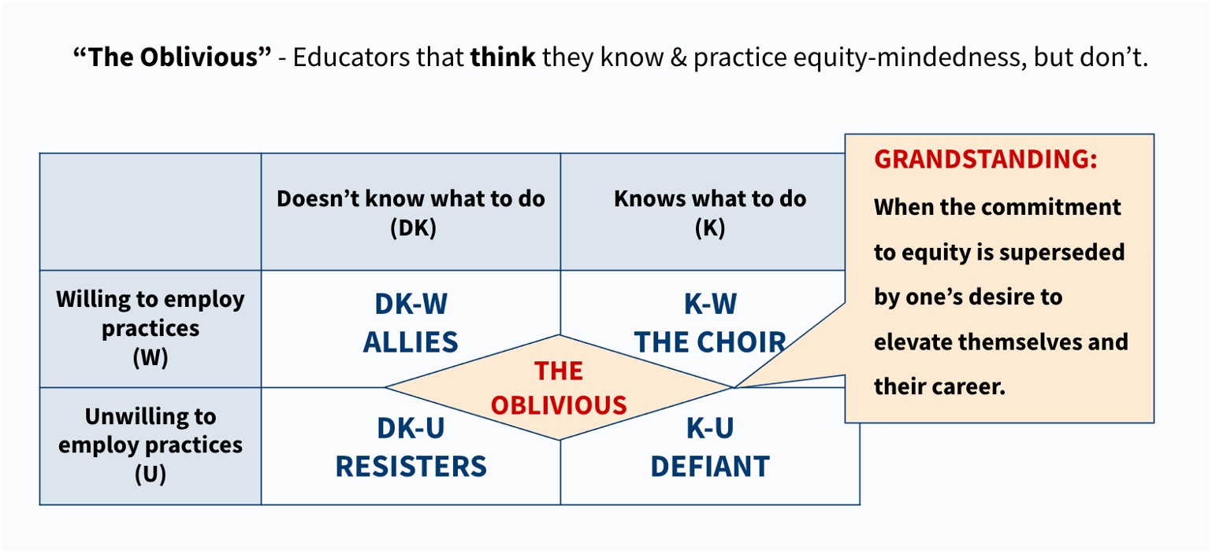
A Taxonomy of Educators Perspectives on Equity-Mindedness
Wood & Harris III (2015)

Slide 38
Equity By Design and Institutional Planning

Slide 39
Equity and Institutional Planning
Equity within the context of institutional planning refers to
Prioritizing the success of students from disproportionately impacted groups in institutional goal-setting and decision-making (e.g., planning, resource allocation, program development, hiring)
Designing programs and spaces that contribute to students’ sense of belonging, validation, engagement, receptivity, and success (e.g., course success, persistence, completion).
Eliminating institutional policies, embedded practices, and systemic barriers that have enabled inequity to exist and persist.

Slide 40
Mt. Sac EFCP Task Force - Guiding Principles for Equity-Minded Engagement
Student led: The college practices student engagement in ways that allow voices, perspectives, and input from historically underserved students to drive the purpose and overall decision-making of the plan.
Listen well: The college commits to deep, sustained listening through methods like empathy interviews and qualitative engagement, centering student voices to truly understand their lived experiences and work with them to develop meaningful actions that address their unseen needs and challenges.
People before process: The college starts planning by building capacity in its practitioners for equity-minded engagement versus letting outcomes drive the process.
Safe spaces: The college ensures a sense of belonging by offering safe, welcoming spaces where all students, especially those with different voices, can express themselves without fear, feel respected, and build trust through authentic, nonjudgmental engagement.
Relationship building: The college intentionally identifies and builds two-way relationships with historically underserved students as key, relevant stakeholders.
Inclusive events: When planning student engagement, the college considers accessibility and inclusion factors like schedule, language access/interpretation, accommodations for disabilities, childcare, food, and proximity.
Inclusive communication: The organization consistently uses media channels preferred by students in both internal and external communications

Slide 41
Mt. Sac EFCP Task Force - Guiding Principles for Equity-Minded Engagement
Go to the students: The college must meet historically underserved students where they are using new methods to reach and uplift them, especially the most marginalized.
Work with partners: The college engages internal and external advocates, organizations, and coalitions as partners in reaching students.
Strengths-based: The college must adopt a strengths-based approach that highlights students' aspirations, cultural wealth, and potential, empowering them to achieve their goals and creating a culture of action and shared vision for the future.
Accountability: The college clearly defines how student voices will affect planning decisions and results and transparently communicates places where they can’t so that students are aware of and understand planning decisions as they are made.
Equity lens: The college evaluates structural barriers that prevent historically underserved students from participating in the planning process, takes responsibility for low participation, and takes steps to address them.
Responsiveness: The college seeks input from students to improve the process and allows for responsiveness when students identify issues and provide critical feedback.
Ongoing: The college continues engaging historically underserved students throughout the planning process.

Slide 42
BREAK
15 MINUTES

Slide 43
Equity-Mindedness in the Physical Environment
Creating equitable experiences

Slide 44
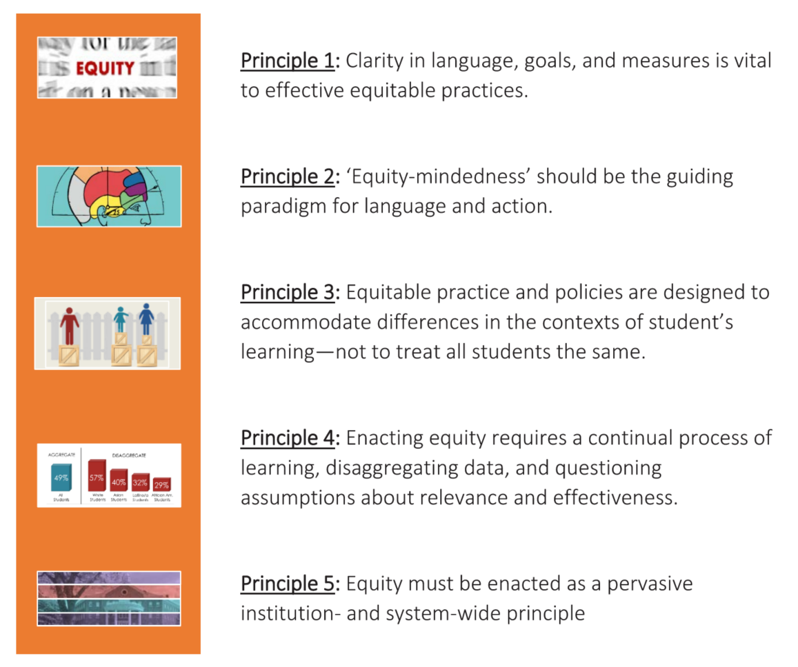
EQUITY BY DESIGN PRINCIPLES

Slide 45
DATA-INFORMED PLANNING
QUALITATIVE
Student Listening Sessions
Faculty and Staff Listening Sessions
Conditions for Success Surveys
Community Listening Sessions
Observations
QUANTITATIVE
College Success Metrics
Enrollment
Retention + Success
Persistence + Completion
Employment
Labor Market Trends
Census Data
Building Age
Facility Condition Index
Space Inventory
Room Utilization

Slide 46
PLANNING FRAMEWORK
E Q U I T Y B Y D E S I G N
INSTITUTIONAL
GOALS
FACILITIES GUIDING PRINCIPLES
DECISION-MAKING RUBRIC
FOR FACILITIES IMPROVEMENTS

Slide 47
CREATING EQUITABLE EXPERIENCES
IN THE PHYSICAL ENVIRONMENT
DESIGN THE PHYSICAL ENVIRONMENT TO CONTRIBUTE TO STUDENT’S EXPERIENCES
Design from each student’s perspective
Enhance classroom spaces for equitable learning
Sense of Belonging
Validation
Engagement
Receptivity
Success
Develop welcoming and inviting environments
Create spaces where students feel represented and valued
Develop spaces to support collaboration and build community
Improve navigation and wayfinding experiences

Slide 48
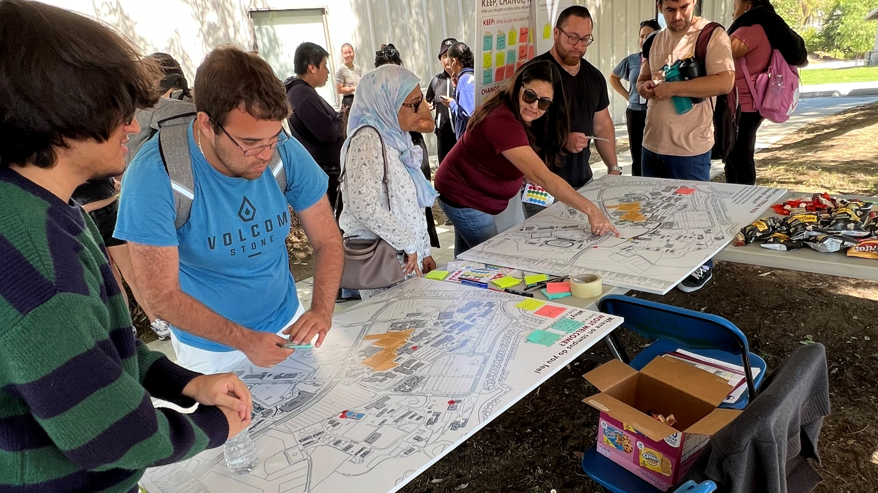
CREATING EQUITABLE EXPERIENCES
BUILDING SOCIAL INFRASTRUCTURE
I like seeing people like me
A space that considers mobility / accessibility
I love meeting new friends here
I would like more quiet places
Hangout centers!
Amenities/services with longer hours
Places that feel like home
Access to Wi-Fi / Plugin
More outdoor seating and tables
Places to nap and rest
THE HUB
THE HANGOUT
THE HAVEN

Slide 49
PLANNING FRAMEWORK
E Q U I T Y B Y D E S I G N
INSTITUTIONAL
GOALS
FACILITIES GUIDING PRINCIPLES
DECISION-MAKING RUBRIC
FOR FACILITIES IMPROVEMENTS

Slide 50
Equity By Design: Process Flow and Timing of Engagement Activities Fall 2024 and Spring 2025

Slide 51

Defining Equity and Equity-Minded Planning Principles
DEFINING STUDENT EQUITY
Equity means Mt. Sac provides every student with a college experience that gives them the conditions to develop their full academic and social potential.
PRINCIPLES FOR A PLANNING PROCESS TO QUALIFY AS EQUITY-MINDED
Engages historically and currently underrepresented students where they are, empowering them with identifying problems, imagining futures, and making decisions.
Actively confronts inequities present in student experiences and outcomes, policy and practices, and neighborhoods.
DEFINING STUDENT INEQUITY
Inequity means student groups are significantly more likely have adverse experiences and outcomes based on racial, cultural, economic, and social factors, including less funding and learning environments that are less innovative and culturally unresponsive.

Slide 52
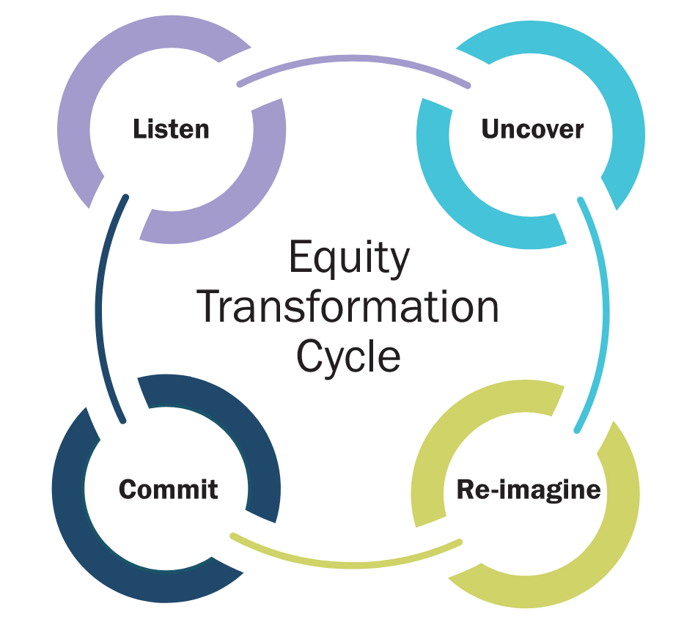
Introducing a framework for Equity-Minded Comprehensive Planning
START
EQUITY BY DESIGN FOR COMPREHENSIVE PLANNING
In 2019, Dr. Stephanie Hawley, the Chief Equity Officer for Austin ISD, applied Dr. Bensimon’s Equity by Design principles to comprehensive planning. Responding to the significant impact of planning processes on historically underserved students and identifying that most (if not all) processes are not equity-minded, Dr. Hawley and educational equity researchers at UT Austin developed Equity by Design for long-range planning.
Implementation of the framework led to Austin ISD’s long-range plan being written by community and the facility project list being co-developed by community, including students.
Listen
Uncover
Equity by Design
Planning Cycle
Decide
Design

Slide 53
Introducing a framework for Equity-Minded Comprehensive Planning
PART 1
History and Data Matters
Analyzing outcomes from a racial and demographic perspective.
START
Listen
Uncover
PART 2
Stories Matter Incorporating community priorities into comprehensive planning.
Equity by Design
Planning Cycle
PART 3
Collaboration and Outcomes Matter
Developing a prioritization methodology to deliver strategies within available resources.
Decide
Design

Slide 54
The four phases of Equity-Minded Comprehensive Planning
Listen
Uncover
Design
Decide
Listen to understand what is and is not working well for historically underserved students.
Decisions are informed by diverse people and perspectives.
Uncover the underlying conditions of inequities in student experiences and outcomes.
Decisions address predictable and systemic harm to students from underserved communities.
Co-design the plan to serve students’ needs and aspirations.
Decisions directly address underlying conditions and are based on supporting evidence.
Decide how to deliver the plan within the available resources.
Decision-makers commit to actively disrupting harm and are held accountable for outcomes.
Providing students with decision-making power throughout the process.

Slide 55
Knowledge Flow
Identify and prioritize conditions for success with student voices.
Identify underlying conditions that the plan must address with student voices.
Identify and prioritize strategies that work with student voices.
Develop a strategic goal and key actions that define intended student impact.
LISTENING SESSIONS Conditions for Success
Student Groups
WORKSHOP Bridging Conditions to Design
Students, Community Partners, Task Force
WORKSHOP Strategic Goals
Students, Community Partners, Faculty, Staff, Task Force
SURVEY Conditions for Success
Students
WORKSHOP Bridging Conditions to Design
Faculty, Staff, Task Force
SURVEY Strategic Themes
Students, Families, CBOs, Faculty, Staff

Slide 56
Simple timeline
PART 1
History Matters
PART 2
Stories Matter
PART 3
Outcomes And Collaboration Matter
September
October
November
December
January
February
March
April
Identify Student Groups
Listen
Listening Sessions
Survey
Listening Report
Uncover
Design
Workshop
Workshop
Survey
Themes Report
Decide
Workshop
Planning Framework
Fall
Winter
Spring

Slide 57
Timeline by week
OCT
NOV
DEC
JAN
FEB
MAR
7-11 | 14-18 | 21-25 | 28-1
4-8 | 11-15 | 18-22
2-6 | 9-13
6-10 | 13-17 | 20-24 | 27-31
3-7 | 10-14 | 17-21 | 24-28
3-7 | 10-14 | 17-21 | 24-28
31-4
Listen
Student Listening Sessions
Student Conditions Survey
Uncover
Student Bridging Workshop
Staff Bridging Workshop
Design
Student and Staff Priorities Survey
Decide
Goal Workshop
Framework development

Slide 58
Plan Implementation: Challenges and Strategies

Slide 59
Ten Common Reasons and Your Mt. SAC Experience
Ownership: few, if any, have stake in and/or responsibility for plan.
Communication: plan not communicated, so lack of understanding about its importance or how to contribute.
Overwhelming: where to begin?? numerous goals and actions because the College failed to make tough choices around prioritizing.
Meaningless: “fluffy” feel good but unobtainable goals and objectives, or no clear actions, or plan just “checks-the-box.”
Out of the ordinary (separate and apart): disconnected from operations (spins in its own universe).

Slide 60
Ten Common Reasons and Your Mt. SAC Experience
6. Mired down managers: people with responsibility for implementation are consumed by daily operating problems.
7. Not considered: Implementation not discussed in the planning process.
8. Progress reporting: no method to track progress = no momentum.
9. Accountability: each initiative, goal, objective, activity, measurement, and/or data source must have an owner.
10. Empowerment: those accountable must also have the authority, responsibility, resources, knowledge, and tools needed.

Slide 61
Institutional Capacity and Readiness: Survey Indicators
Indicators of Capacity & Readiness
Department/Unit Relationships, Communication, Expertise.
Department/unit has strong relationships with external groups needed for collaboration to implement goals or plans.
51.92% Agree 11.54% Strongly Agree Combined 63.46%
Department/unit knows where to go for information or content expertise to implement goals or plans.
40.38% Agree 15.38% Strongly Agree Combined 55.76%
Department/unit communicate effectively with each other.
42.31% Agree 11.54% Strongly Agree Combined 53.85%

Slide 62
Institutional Capacity and Readiness: Survey Indicators
Indicators of Challenges
Collegewide communication, resources, practices.
Enough resources to accomplish goals and objectives.
25.00% Strongly Disagree 38.46% Disagree Combined 63.46%
Effective communication processes keep us informed about progress toward goals.
17.31% Strongly Disagree 50.00% Disagree Combined 67.31%
Natural boundaries between divisions, departments, and units do not interfere with getting things done.
21.57% Strongly Disagree 43.14% Disagree Combined 64.71%
Overall trust level is high.
17.65% Strongly Disagree 47.06% Disagree Combined 64.71%
Don’t get bogged down in endless “processes.”
43.14% Strongly Disagree 37.25% Disagree Combined 80.39%

Slide 63
Implementation Activity 1: Ten Common Reasons and Your Mt. SAC Experience
See table handout for instructions for this 20-minute self-directed activity on institutional capacity and readiness for implementation.
Facilitators will be available to assist as needed.
Please be prepared to share out with the larger group at the end of the 20-minute activity.

Slide 64
Implementation Activity 2
Mt. SAC 2035: Pre-Mortem Assessment

Slide 65
Mt. SAC 2035: Pre-Mortem Activity Overview (60 minutes)
Materials:
Instructions and Table Activity Worksheet (“Activity 2: Mt. SAC Pre-mortem”)
On Worksheets, please note Table Number and Implementation Category # (1-6, assigned by table on yellow 8 ½ x 11 paper)
2. Orange and Green Post-its
3. “Sharpies”
Purpose:
Anticipate implementation hurdles, pitfalls, challenges
Identify strategies in advance to address these

Slide 66
Mt. SAC 2035: Pre-Mortem Activity Overview (60 minutes)
Setting:
Imagine it’s October 2026 and little/no progress has been made on implementing Mt. SAC 2035.
We are here to diagnose why and devise strategies to gain momentum on implementing plan goals/objectives using six categories of elements.

Slide 67
Mt. SAC 2035: Pre-Mortem Activity Overview (60 minutes)
Six Categories (See Activity 2 Handout for descriptions & example.)
Organizational Politics: behaviors and practices to influence or control resources or policies.
Organizational Culture: “the way things are done around here.”
Organizational Priorities: most important activities, initiatives, services that the institution provides.
Resources: assets necessary for effective organizational operations.
People: institutional human capacity.
Communication: interactions that take place for the purpose of working together or conducting business in general (e.g., oral, written electronic, formal and informal, interpersonal, internal and external).

Slide 68
Mt. SAC 2035: Pre-Mortem Activity Overview (60 minutes)
Instructions: See page 2 “Activity 2: Mt. SAC 2035 Pre-Mortem”
Phase 1: Diagnose (Barriers/Hurdles/Challenges)
Step 1: on your own
Steps 2-4: with your table group
Step 5: Gallery Walk (flip charts)
Phase 2: Strategize
Step 6: on your own
Steps 7-9: with your table group
Pay attention to time limits noted on Worksheet.
Facilitators will circulate for questions and assistance/

Slide 69
Closure
Upcoming Engagements
Project Communication: Staying Informed and Involved
Spring 2025 Joint Planning Session March 14th: Priority Goal
Setting and Facilities Planning Principles; Implementation
Joint Planning Session Feedback Survey (QRC)

Slide 70

Upcoming Engagement
Student Listening Sessions: October 7–24
Conditions for Success Student Survey: Nov 11- 22
Faculty and Staff Listening Sessions
Community Listening Sessions

Slide 71


Mt. SAC 2035 October Communication
Equity by Design Four Phase Planning Process and Timeline:
Listen - September-October 2024
Uncover - Late October-November 2024
Design – December 2024 - February 2025
Decide – Late February – April 2025
Coming Up: Listening
Listen - September-October 2024
Student Sessions: October 7 - 24
Conditions for Success Student Survey: November 11 - 22
Faculty and Staff Sessions: Dec - Feb
EFCP Webpage – Coming Soon!

Slide 72

Save the Date!
Spring 2025 Joint Planning Summit
March 14th

Slide 73
A Returning Student’s Perspective
“Mt. SAC is a place of second chances, where anyone can be a college student at any point in their lives.”

Slide 74
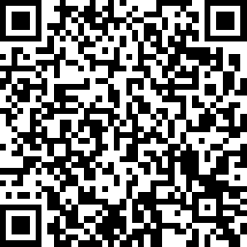
Summit Feedback
Please use this QRC to provide us with your feedback on today’s Joint Planning Summit!

