Slide 1
EFCP Collaboration with SCE
Lianne Greenlee
September 12, 2024

Slide 2
Agenda
EFCP Overview
9/18 Open Forum
Locations
Interpreter support needed?
Communication
Listening Sessions
Which Programs, Dates, Times
10/11 Planning Summit 8:30-Noon
SCE Participant List

Slide 3

BP 3250 Institutional Planning
The Education & Facilities Comprehensive Plan (EFCP) is the College’s broad-based, long-range plan
Assesses accomplishment of the Mission
The blueprint for how best to serve our students for the next 9-10 years.

Slide 4













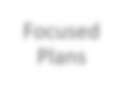



Integrated Planning At-a-Glance
The EFCP serves as the foundation for integrated planning processes and cycles of continuous quality improvement. It is accomplished through Mt. SAC’s participatory governance, implementation of focused plans, and the work of College units.
Vision
The College aspiration for the future
Mission
The College purpose
Core Values
Enduring beliefs and principles that individuals of the College hold in common and endeavor to put into action
EFCP
The foundation of integrated planning. Gives direction to accomplish the Mission and means to assess progress toward that goal
Focused Plans
Guide specialized work of the College in alignment with the EFCP
Elements of student achievement used to evaluate how well the College is fulfilling the Mission
ISS
Program Review
Planning process used to assess unit progress in support of student learning and the mission

Slide 5
A New Focus for the Comprehensive Plan
Education & Facilities Comprehensive Plan
Existing Plans (Strategic & Facilities)
Decision- Making Tool to Guide Prioritization of all College Work
DEISA+ Lens
Data Analysis
Instructional and Programmatic Priorities
Comprehensive Student Services
Healing Centered Engagement
Stakeholder Feedback

Slide 6
Phases of Equity-Minded Comprehensive Planning
Listen
Uncover
Design
Decide
Listen to understand what is and is not working well for historically underserved students.
Decisions are informed by diverse people and perspectives.
Uncover the underlying conditions of inequities in student experiences and outcomes.
Decisions address predictable and systemic harm to students from underserved communities.
Co-design the plan to serve students’ needs and aspirations.
Decisions directly address underlying conditions and are based on supporting evidence.
Decide how to deliver the plan within the available resources.
Decision-makers commit to actively disrupting harm and are held accountable for outcomes.
Providing students with decision-making power throughout the process.

Slide 7

Knowledge Flow
Identify and prioritize conditions for learning with student voices.
Identify underlying conditions that the plan must address with student voices.
Identify and prioritize strategies that work with student voices.
Develop a vision and key principles that define intended student impact.
LISTENING SESSIONS
Conditions for Learning
Student Groups
WORKSHOP
Bridging Learning Conditions to Design
Students, Community Partners, Task Force
WORKSHOP
Vision and Key Principles
Students, Community Partners, Faculty, Staff, Task Force
SURVEY
Conditions for Learning
Students
WORKSHOP
Bridging Learning Conditions to Design
Faculty, Staff, Task Force
SURVEY
Student Design Priorities
Students, Families, CBOs, Faculty, Staff

Slide 8


Simple timeline
PART 1
History Matters
PART 2
Stories Matter
PART 3
Outcomes And Collaboration Matter
September
October
November
December
January
February
March
Listen
Identify Student Groups
Listening Sessions
Survey
Listening Report
Uncover
Workshop
Workshop
Design
Survey
Themes Report
Decide
Workshop
Final Deliverable
Fall
Winter

Slide 9
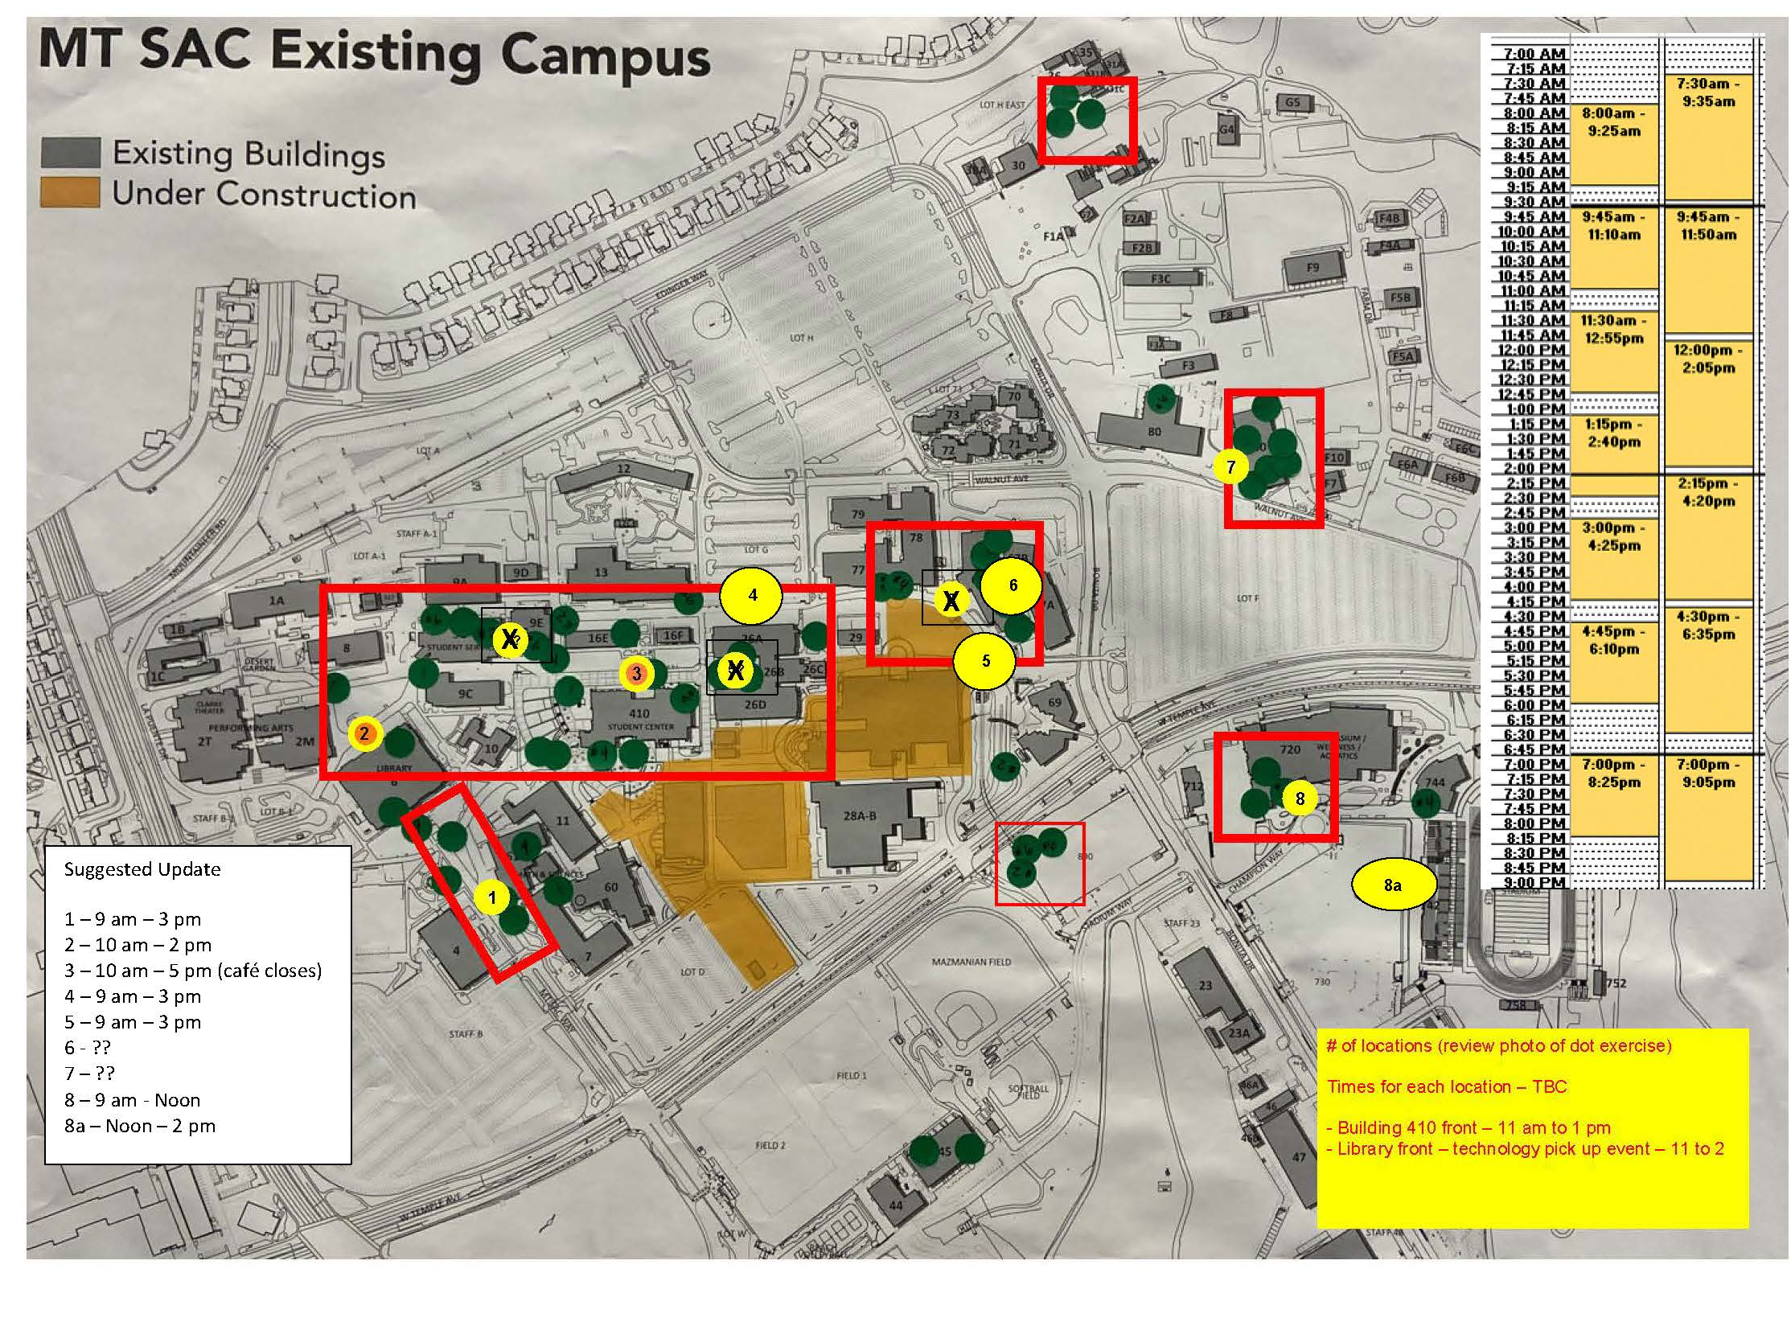
9/18 Student Open Forum
Locations
Interpreter support needed?
Communication Plan

Slide 10
Listening Sessions
Who?
When?
How?

Slide 11
10/11 Planning Summit
8:30-Noon
SCE Participant List

