Slide 1


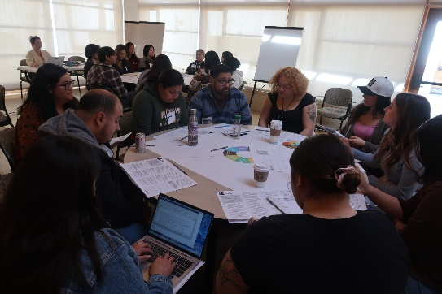
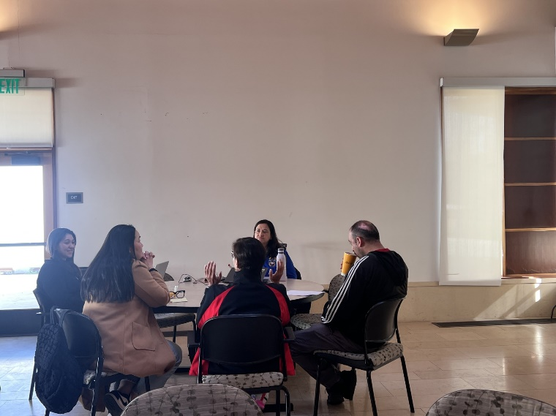

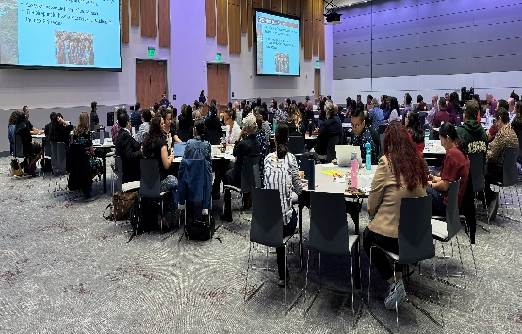
Mt. SAC 2035 January-February 2025 Communication Items
Conditions for Success Student Survey (Nov)
Student Bridging Session (January)
Strategic Priorities Survey (February)
Community Listening Sessions (Feb)
March 21 Joint Planning Summit
Website

