Slide 1

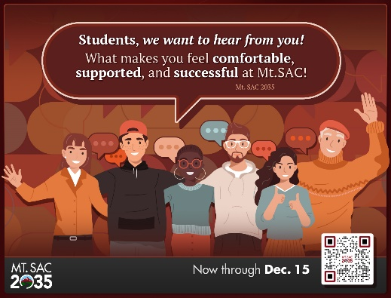
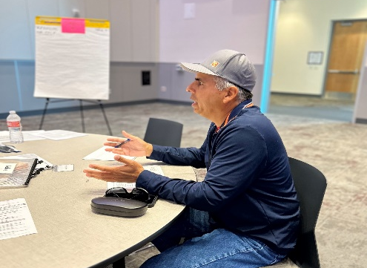
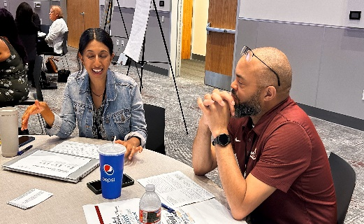
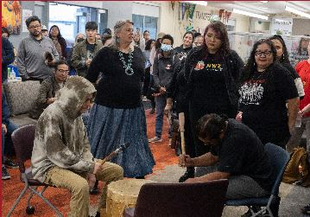
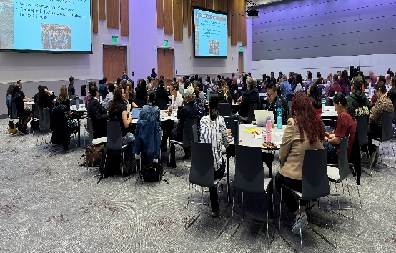
Mt. SAC 2035 December Communication Items
Conditions for Success Survey ends 12/15
Faculty & Staff Listening Sessions Complete
Student Listening Sessions Complete
Manager Listening Session Complete
Community Listening Sessions
(January 2025)
Website Launched

