Slide 1
Have You Used A Snippet Lately?
presented to Mt. SAC Website Editors
presented by
Eric Turner, Web and Portal Services
Notes:
Eric welcomes

Slide 2
Agenda
Tips for Working in OmniUpdate
Helping People Find Your Page
Web Design Site (www.mtsac.edu/webdesign)
Hands-On Training

Slide 3
Ready for a Creativity Test?

Slide 4
What Do You Envision Here?
Did you see a fabulous department or program website?
1
3
2

Slide 5
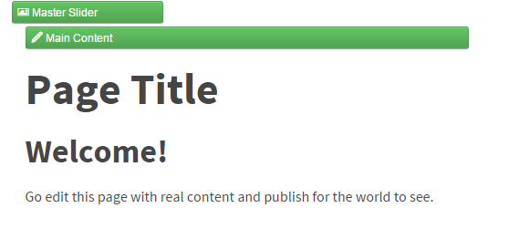
Unless you are a Web Designer, most people need a little help
With the help of our Instruction Office, we created fill-in-the-blank templates for you to use...

Slide 6
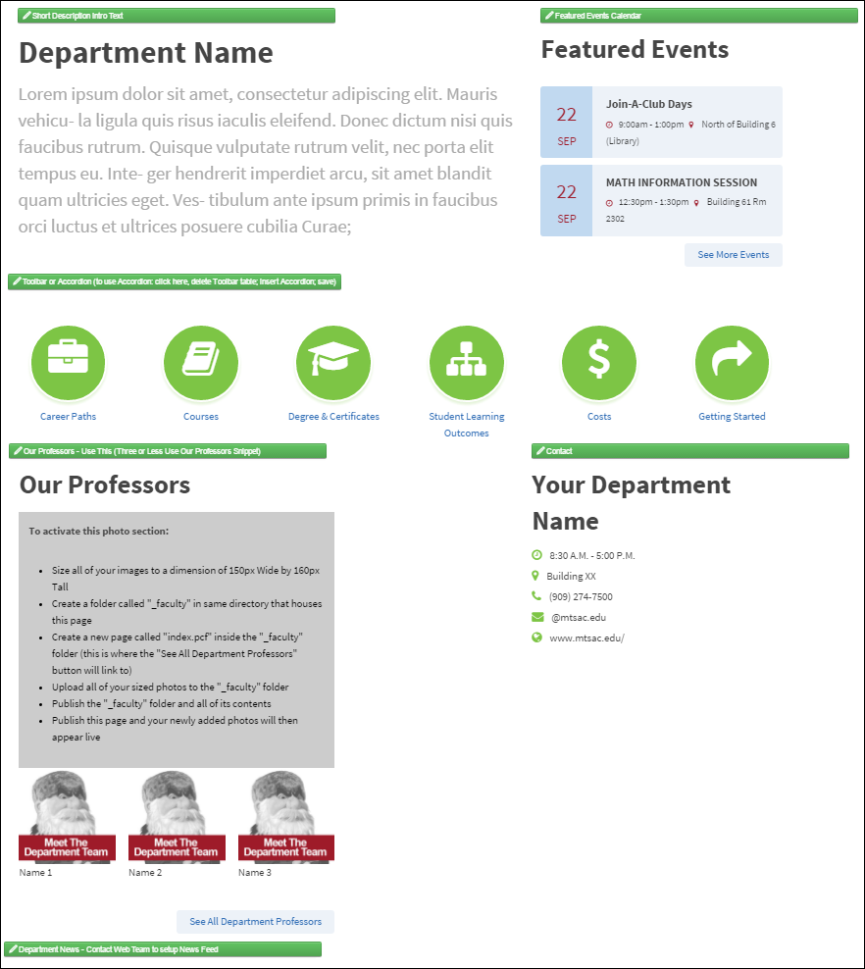
Important! Save and Publish each time you edit a new section

Slide 7
Transformation Errors are Expected
To Remove Error: Revert to a previous version
If Transformation Errors persist, call the Web Team

Slide 8
Revert to Remove Transformation Errors
Check Out the Page
Click Versions
Save and Publish
If Transformation Errors persist, call the Web Team

Slide 9
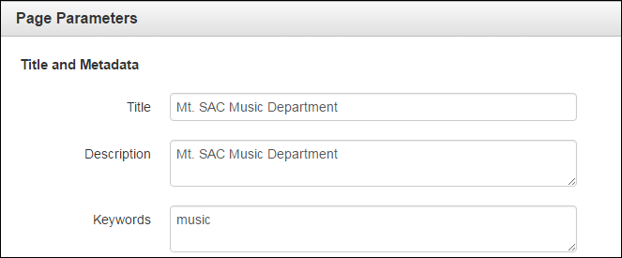
Best Practices
Help People Find Your Page
Search relies on:
Page Title
Description
Keywords

Slide 10
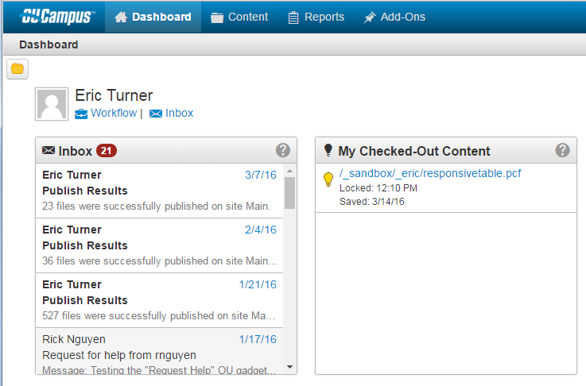
My Checked-Out Content
Bookmark this link:
http://a.cms.omniupdate.com/10/#oucampus/mtsac/Main
Notes:
My Checked out Content
Chrome Duplicate Tabs
Always Upload to Staging Not Production
Use Checkbox and Publish vs. Hover

Slide 11
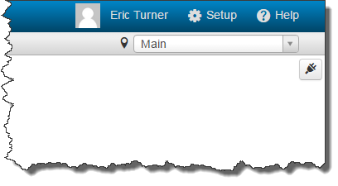
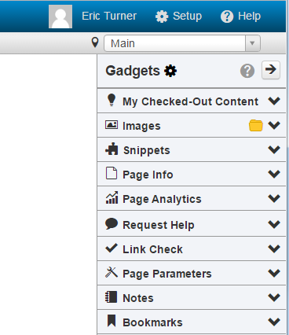
Gadgets:
My Checked Out Content
Images
Snippets
Link Check
Page Analytics
Bookmarks
How Do I Access Them?
Click the plug icon to reveal the Gadget sidebar
Click the Gear icon to configure

Slide 12
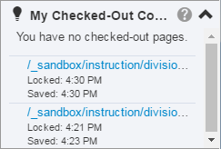
My Check-Out Content
Make sure your pages are checked in
Displays the same information as the dashboard gadget

Slide 13
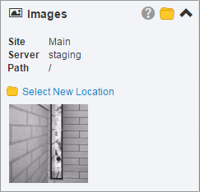
Images
Drag and Drop Previously Uploaded Images into the any Editable Region
Drag and Drop Images From the Images Gadget onto Your Local Computer

Slide 14
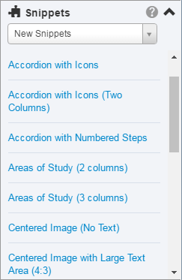
Snippets
Drag and Drop Snippets into Any Editable Region

Slide 15
Assets (Coming Soon)
Assets Gadget behaves the same as the Snippets Gadget
Drag and Drop Assets into Any Editable Region

Slide 16
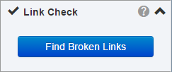
Link Check
A quick and easy way to check links on the current page
All broken links are automatically highlighted on the page
Repair them easily or send a report to someone who can

Slide 17
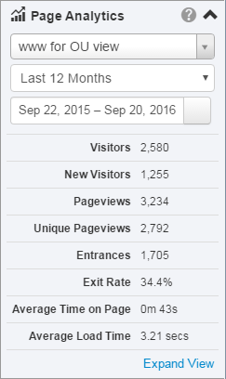
Page Analytics
Get the same page statistics as provided by Google Analytics using this gadget

Slide 18
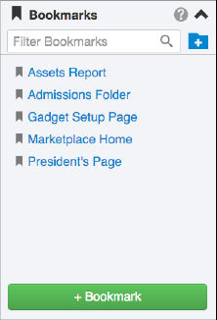
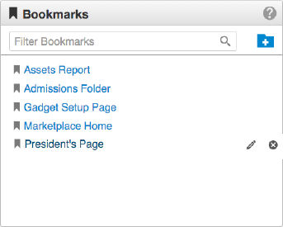
Bookmarks
Link to Pages
Organize in Folders
Search and Reorder Links

Slide 19
New Snippets
Responsive Tables
Multi-Column Layouts
Accordion
News Feeds
A to Z (Folder-Level)
www.mtsac.edu/webdesign

Slide 20
Let’s See IT…
http://www.mtsac.edu/outraining/

