Slide 1
Mt. SAC - Update application
Notes:
This video will provide you with a step by step process on how to update your application.
If you have completed a Mt. SAC application in the past and have a Mt. SAC ID, you can access your CCC Apply account to create an updated application with a new semester.
Step 1 - s

Slide 2
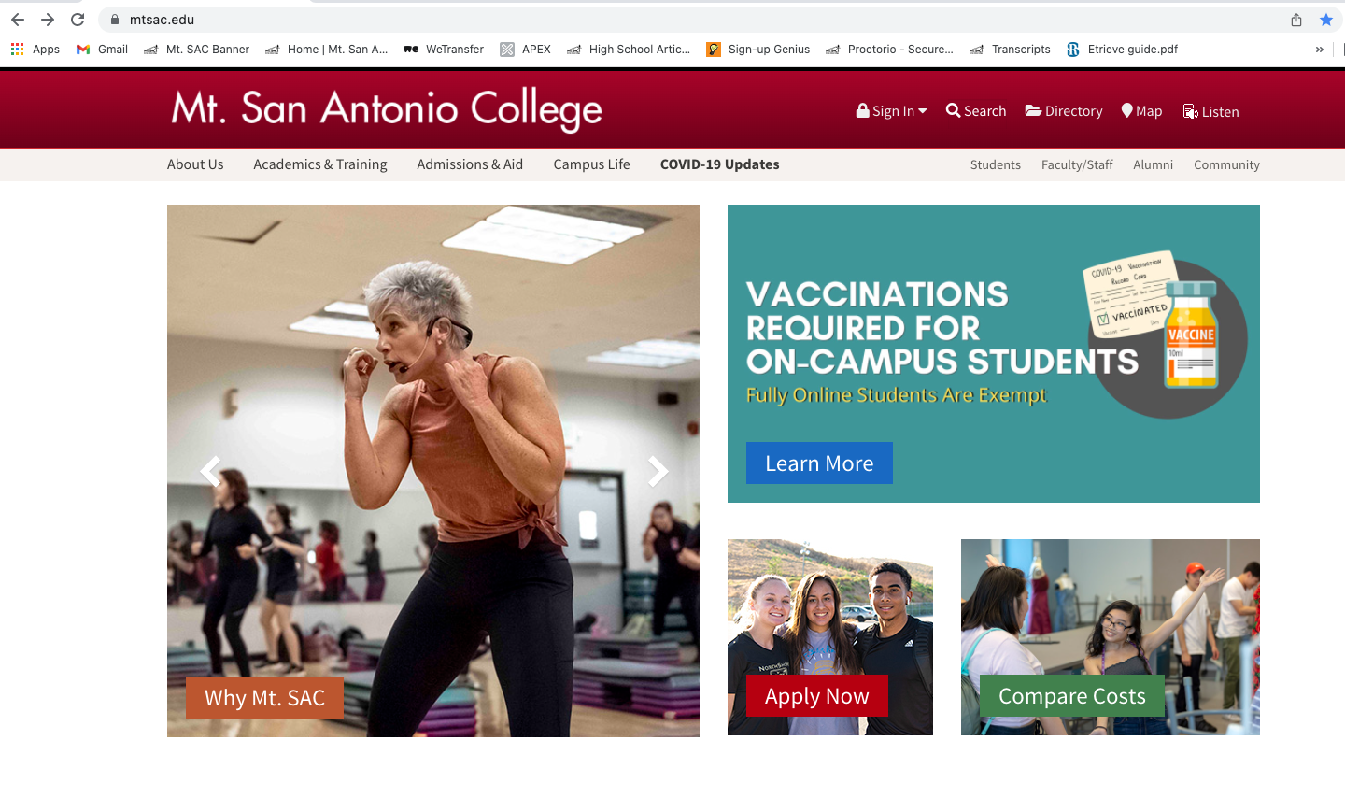
www.mtsac.edu

Slide 3
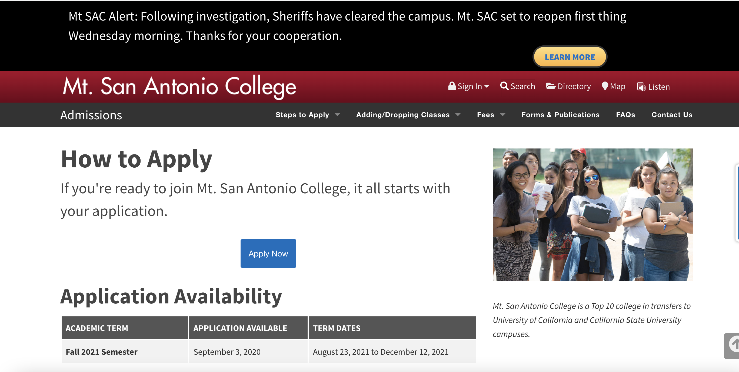

Slide 4
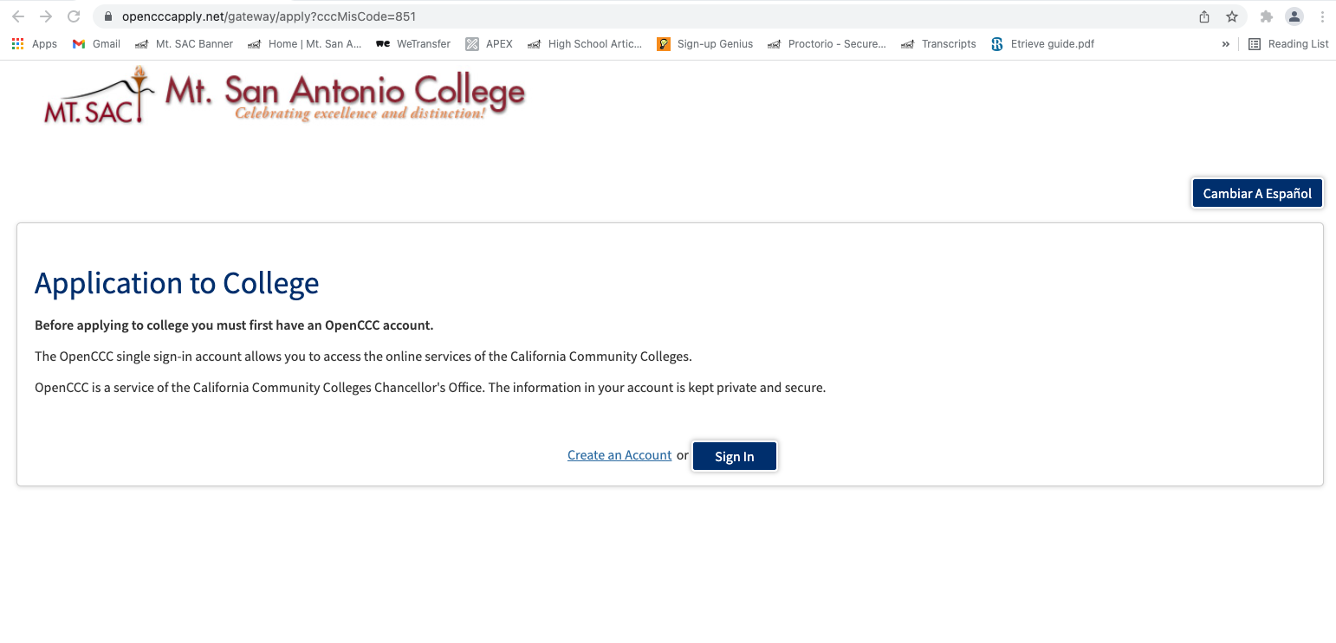
Sign in - CCC Apply Account

Slide 5
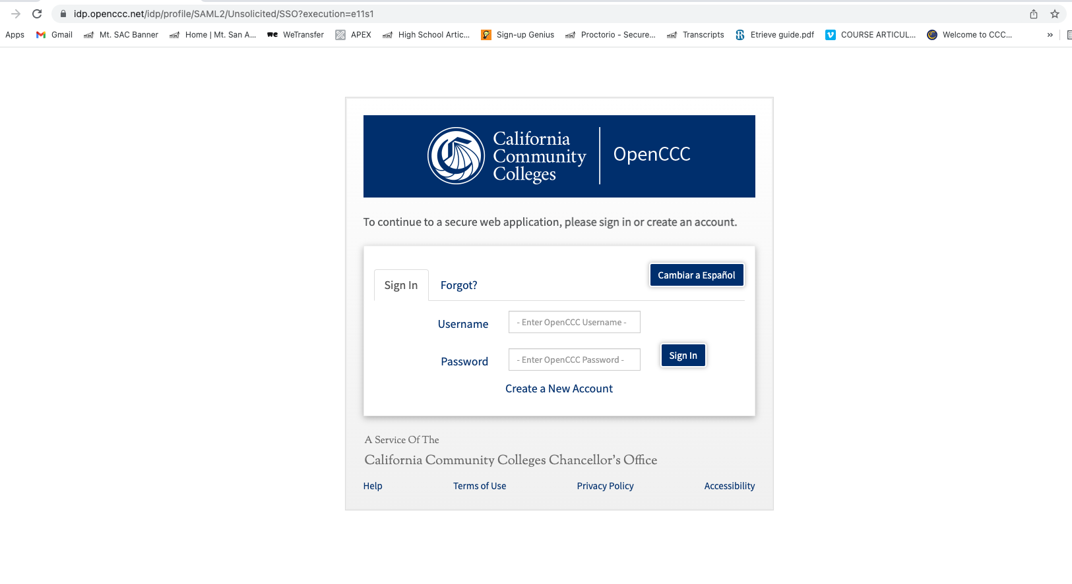
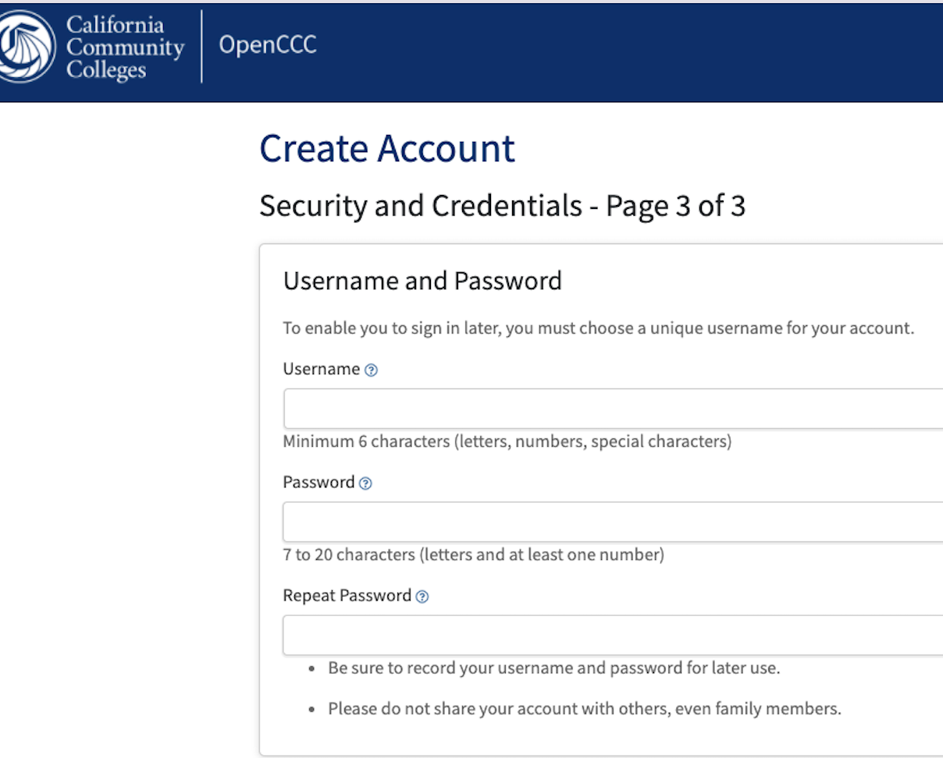
CCC Apply User name/password

Slide 6
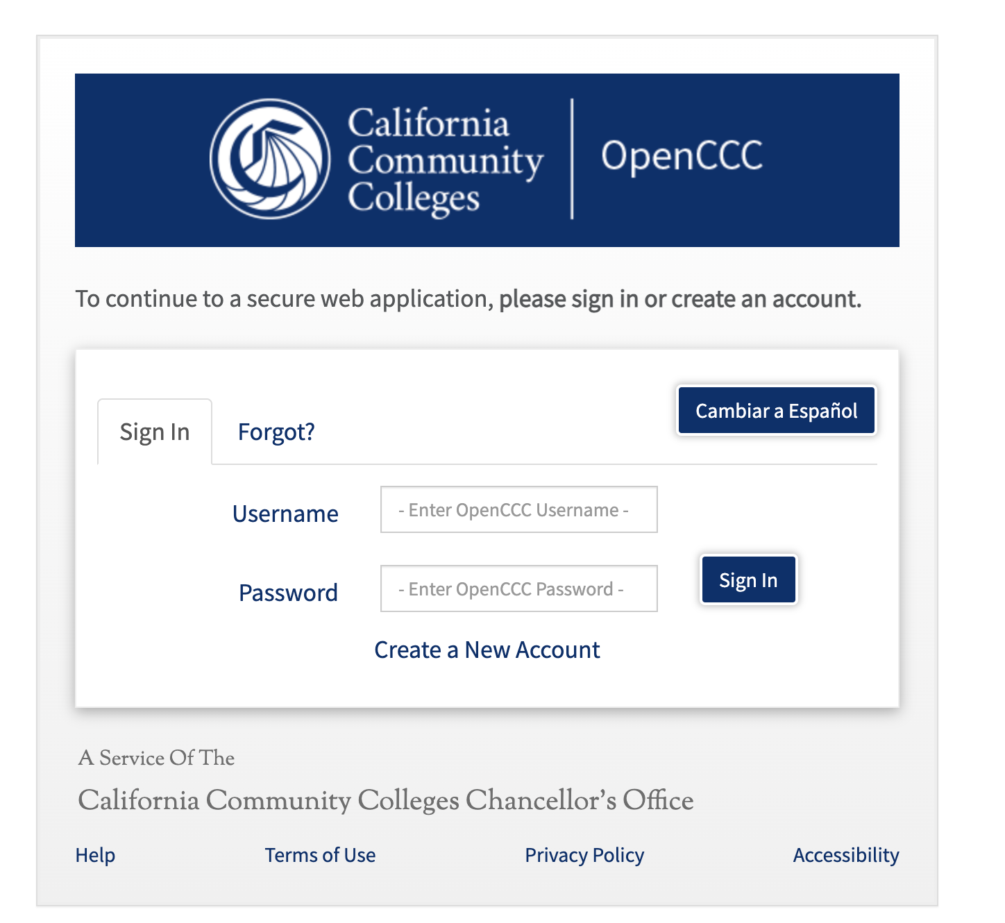
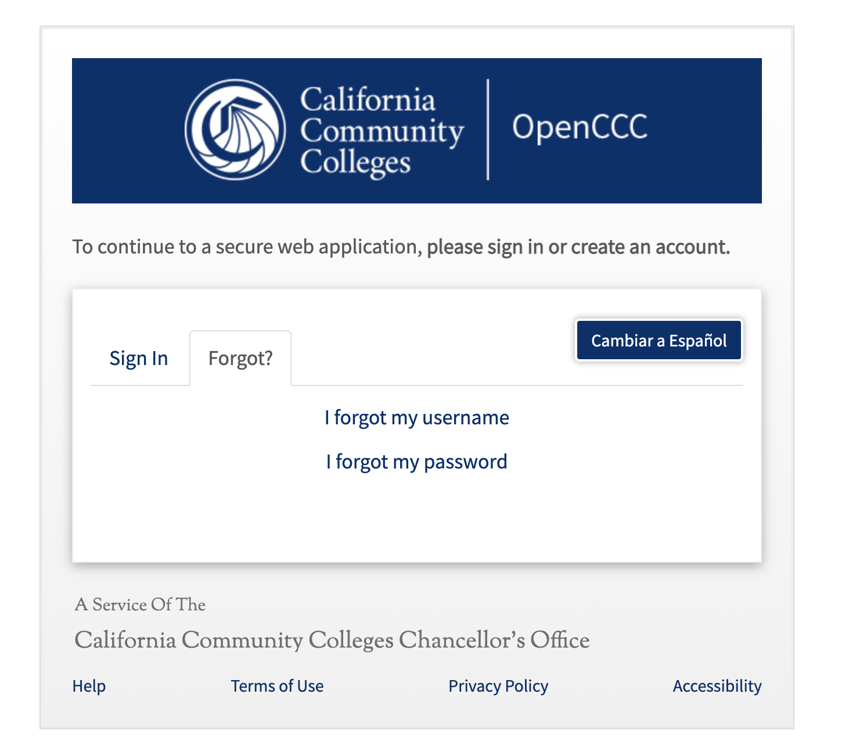
FORGOT - User name/password

Slide 7
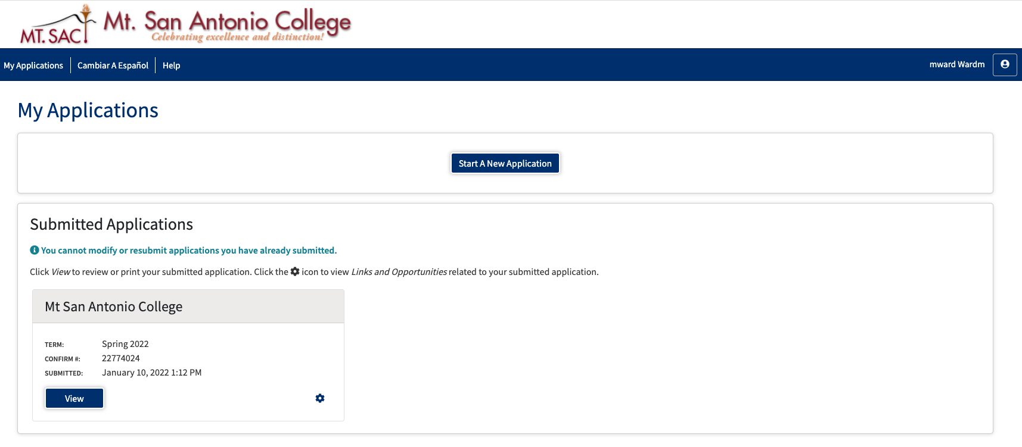
Start a new application
Notes:
Once you are logged in, you can View old applications
Create a new application for a different term.

Slide 8
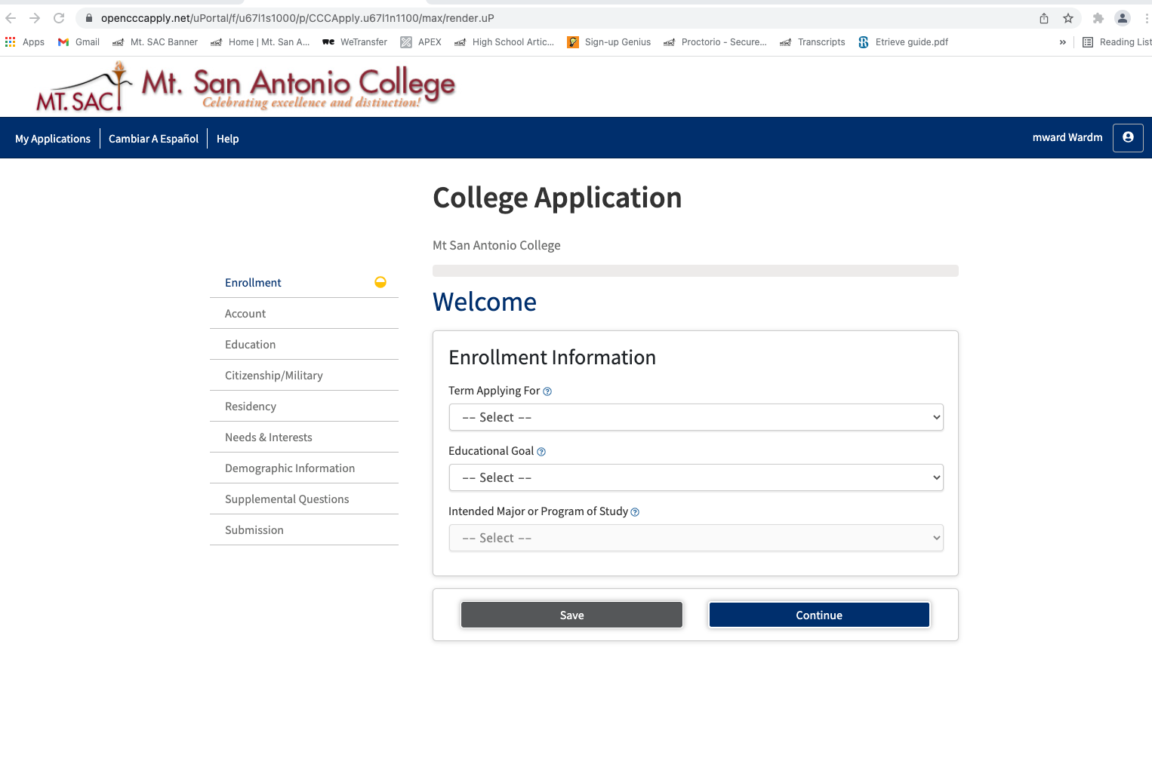
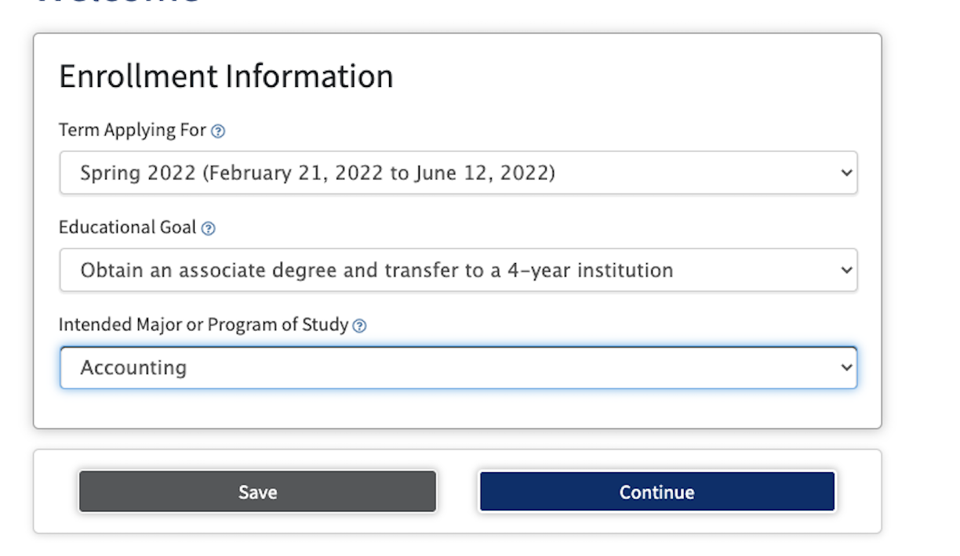

Slide 9
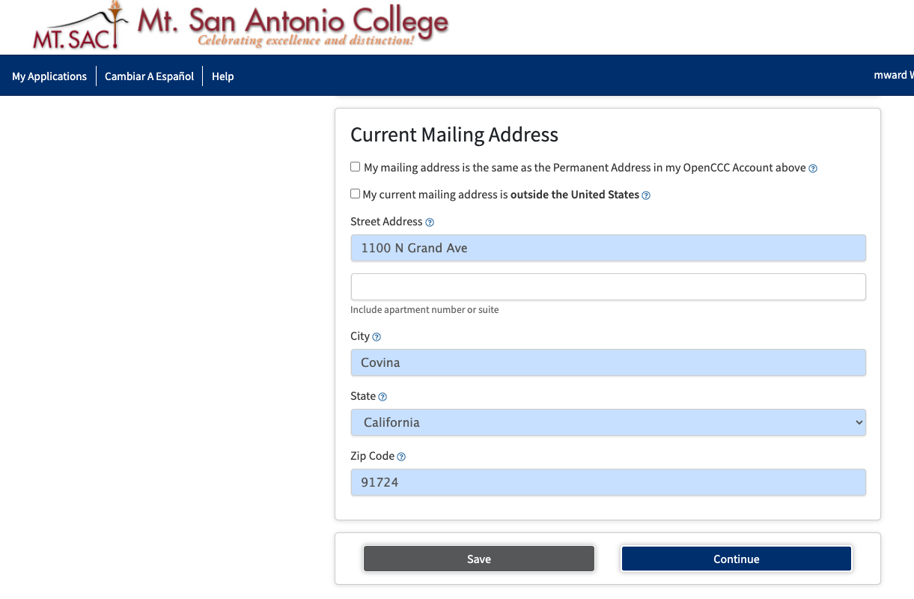

Slide 10
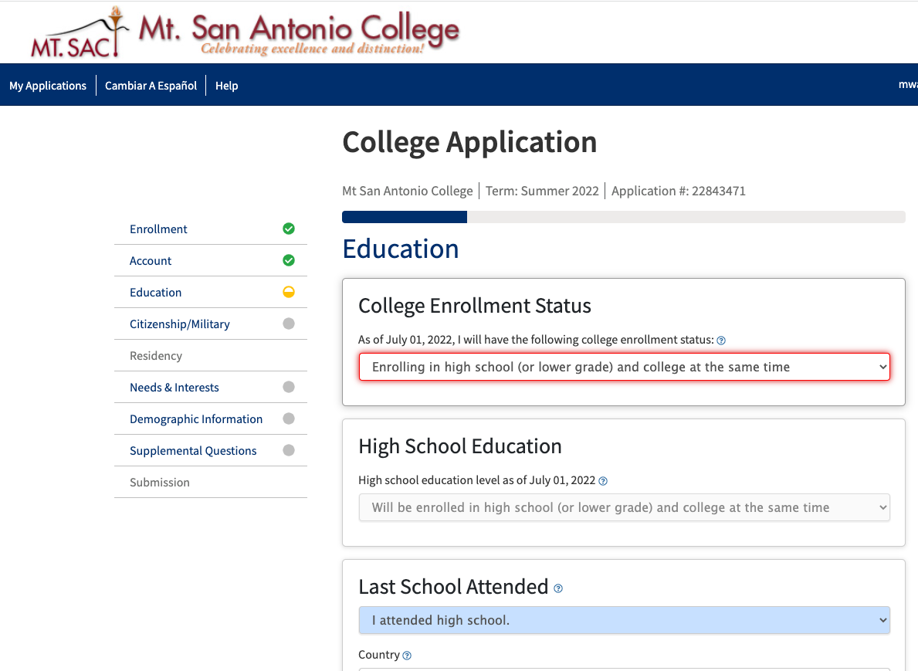

Slide 11
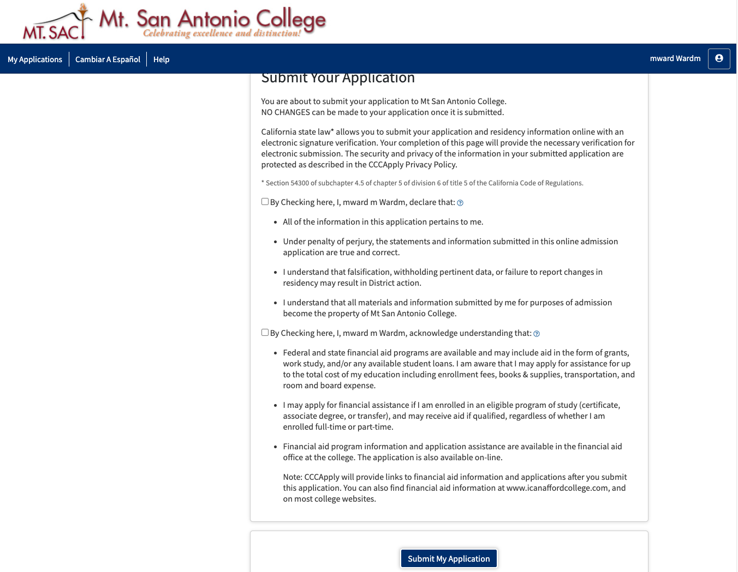

Slide 12
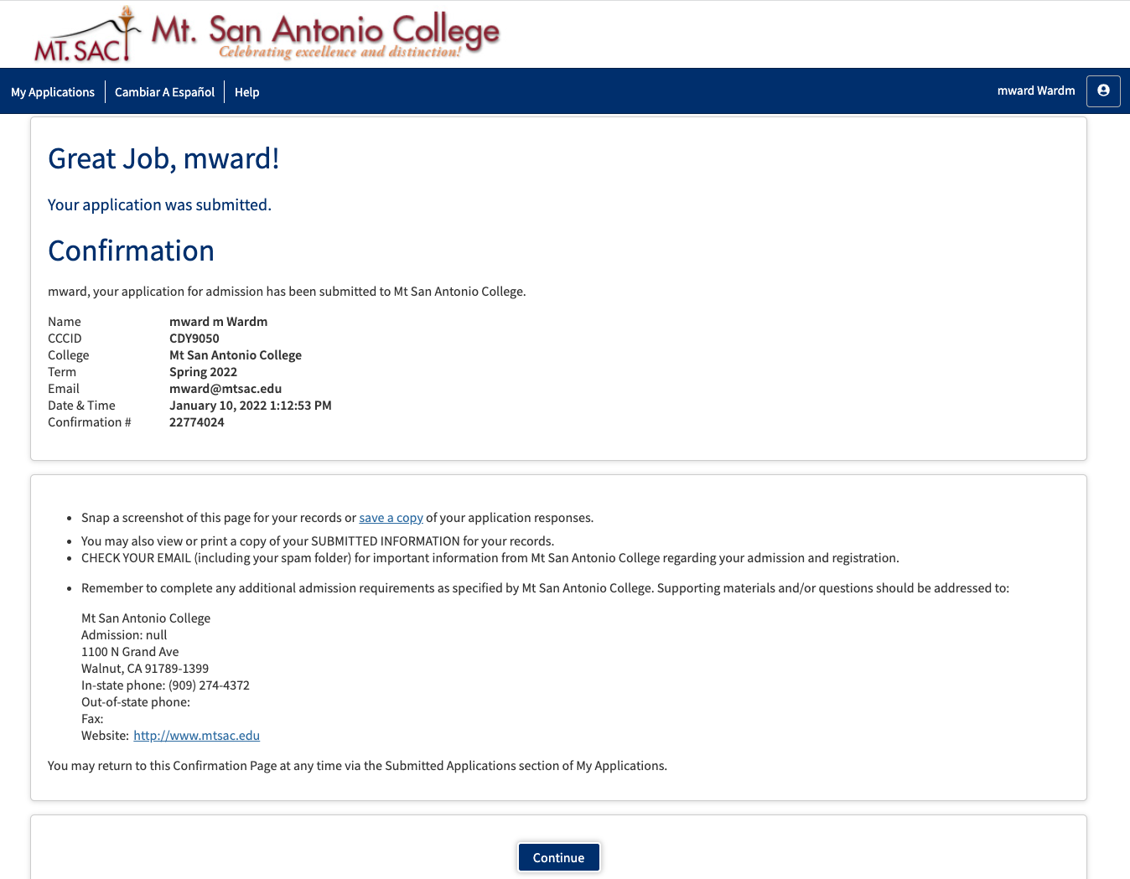
Confirmation page - PRINT

Slide 13
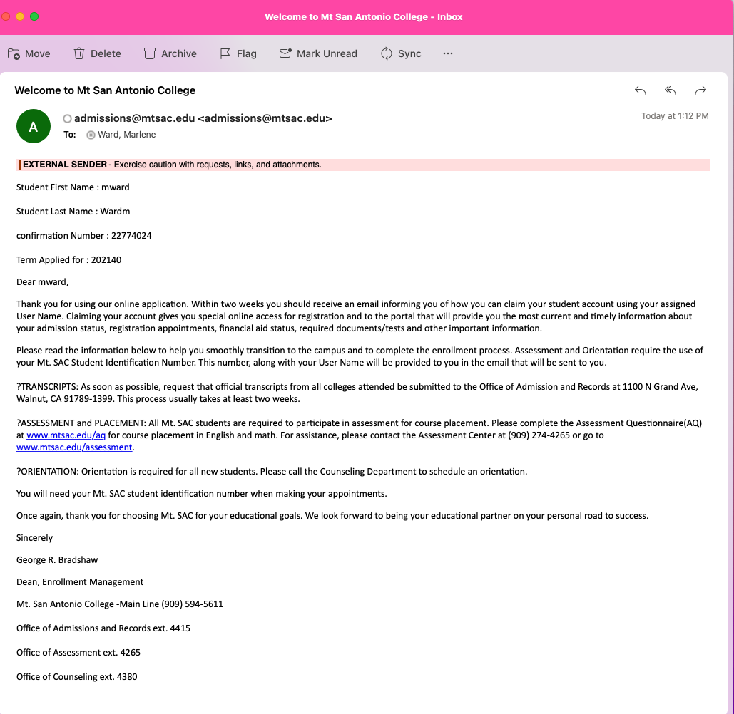
EMAIL: Confirmation of Application- print

